Slide 1
Ancient & Medieval Philosophy
Part III: Aristotle & the Later Ancients

Slide 2
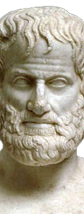
Aristotle’s Background
Background (384-322 b.c.e.)
  Athens & Macedonia
  Aristotle
    Macedonia
    Academy
    Alexander
    Lyceum founded in 322 b.c.e
This Photo by Unknown Author is licensed under CC BY-SA
Notes:
I History
A. Athens & Macedonia
1. Athens lost the Peloponnesian war to Sparta in 404 B.C.
2. The Greek city states were conquered by Philip of Macedonia in 338 B.C.
B. Aristotle
1. Born 384 B.C. in Stagira, Macedonia.
2. His father, Nichomachus, was the doctor of Amyntus II, the ruler of Macedonia.
3. Studied at the academy when he was 18 until Plato’s death in 348 B.C.
4. The academy was taken over by Plato’s nephew Speusippos.
5. Aristotle left the academy, perhaps because of anti-Macedonian sentiments, and traveled the Greek islands investigating the sea life.
6. Philip called him back to Macedonia in 342 B.C. to serve as the tutor to his son Alexander.
7. In 335 he returned to Athens to found the Lyceum, a rival school to the Academy.
a. Located near the temple of Apollo Lyceus.
8. Alexander died in 323 B.C. releasing a surge in anti-Macedonian sentiment and Aristotle’s flight from the city.
a. “lest the Athenians should sin twice against philosophy.”
9. Died in 322 B.C.
a. His will reflected his generous and affectionate nature-he provided generously for his family and servants.
b. He requested that he be buried next to his first wife, Pythias, although he did express affection for Herpyllis, his second wife.

Slide 3
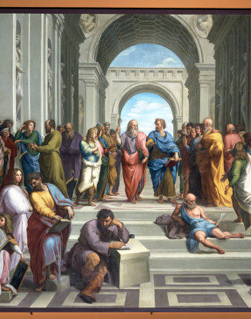
Aristotle’s Background
Background (continued)
  Plato & Aristotle
    Aristotle tried to provide more coherent solutions
    View of plato
    Plato’s mathematics-the perfect ideal
      Goethe: like a flame shooting up to heaven
    Aristotle’s biology
      Goethe: a systematic pyramid built on a broad base of earth
This Photo by Unknown Author is licensed under CC BY-SA
Notes:
C. Plato & Aristotle
1. Aristotle attempted to provide more coherent and better solutions to the problems addressed by Plato.
2. He was clearly fond of Plato and praised him as a person “whom bad men have not even the right to praise.”
3. He did not hesitate to follow where reason lead him, even if it went against the teachings of Plato.
a. “It would perhaps be thought to be better, indeed to be our duty, for the sake of maintaining the truth even to destroy what touches us closely, especially as we are philosophers or lovers of wisdom; for while both are dear, piety requires us to honour truth above our friends.”-Nicomachean Ethics.
4. While Plato ‘s works are described as idealistic, inspiring, otherworldly and perfectionist, Aristotle’s are described as realistic, scientific, worldly, and pragmatic.
a. Plato’s popular works survived, but his technical lectures in the academy were not preserved.
b. Aristotle’s technical works, mostly in the form of lecture notes, were preserved while his more popular works, including
dialogues, did not.
5. Plato’s use of mathematics revealed his approach.
a. Perfect, ideal entities that can be fully understood by reason, but not by the senses.
b. In politics, Plato began with the ideal state and discussed how there would be decline if there was deviation from this ideal.
c. Socrates claimed it did not matter if the ideal could be made real, we must still focus on the ideal.
b. Goethe (18th Century poet): Plato’s philosophy is like a flame shooting up to heaven.
6. Aristotle’s use of biology revealed his approach.
a. The biologist studies specimens and creates laws and principles from these specifics.
b. Universal knowledge arises from and is applied to the world of changing particulars.
c. In politics Aristotle surveyed 157 constitutions, organized them into categories and considered which type would work best in what circumstances.
d. There is no one, ideal formula for all societies.
e. Goethe (18th Century poet): Aristotle’s philosophy is a systematic pyramid built on a broad base of earth.

Slide 4
Aristotle’s Epistemology

Slide 5
Aristotle’s Epistemology
Empirical Approach
  The Desire to Know
    “All human beings by nature desire to know.”
    “the delight we take in our senses; for even apart from their usefulness they are loved for themselves.”
  Science
    The source of knowledge is in the senses.
    One can get above the sensory particulars to scientific knowledge.
    Science is rational discourse.
    Knowledge of X: being able to say what X is and why X is what it is.
    Wisdom: knowing the ultimate causes and principles.
Notes:
I Empirical Approach
A. The Desire to Know
1. “All human beings by nature desire to know.”
2. This is shown by “the delight we take in our senses; for even apart from their usefulness they are loved for themselves.”
B. Science
1. The source of knowledge is in the senses.
2. Using the proper method, one can get above the sensory particulars to scientific knowledge.
3. Science is rational discourse.
4. Knowledge of X involves being able to say what X is and why X is what it is.
5. Wisdom involves knowing the ultimate causes and principles.

Slide 6
Aristotle’s Epistemology
Knowledge
  Begins with the study of particulars.
  Properties are in the things.
    “Musicalness cannot exist unless there is someone who is musical.”
    A doctor does not attempt to cure the form of man, but particular men.
  One who has theory but lacks experience of particulars has gaps in knowledge.
  Knowledge is more than having sensory experiences and being aware of facts.
  Science goes beyond particular facts to demonstrate how they follow from fundamental principles.
Notes:
C. Knowledge
1. Begins with the study of particulars.
2. He places the properties in the things.
a. “Musicalness cannot exist unless there is someone who is musical.”
b. A doctor does not attempt to cure the form of man, but particular men.
3. One who has theory but lacks experience of the particulars has gaps in his/her knowledge.
4. Knowledge is more than merely having sensory experiences and being aware of sets of facts.
5. Science goes beyond the particular facts to demonstrate how the particulars follow from fundamental principles.

Slide 7
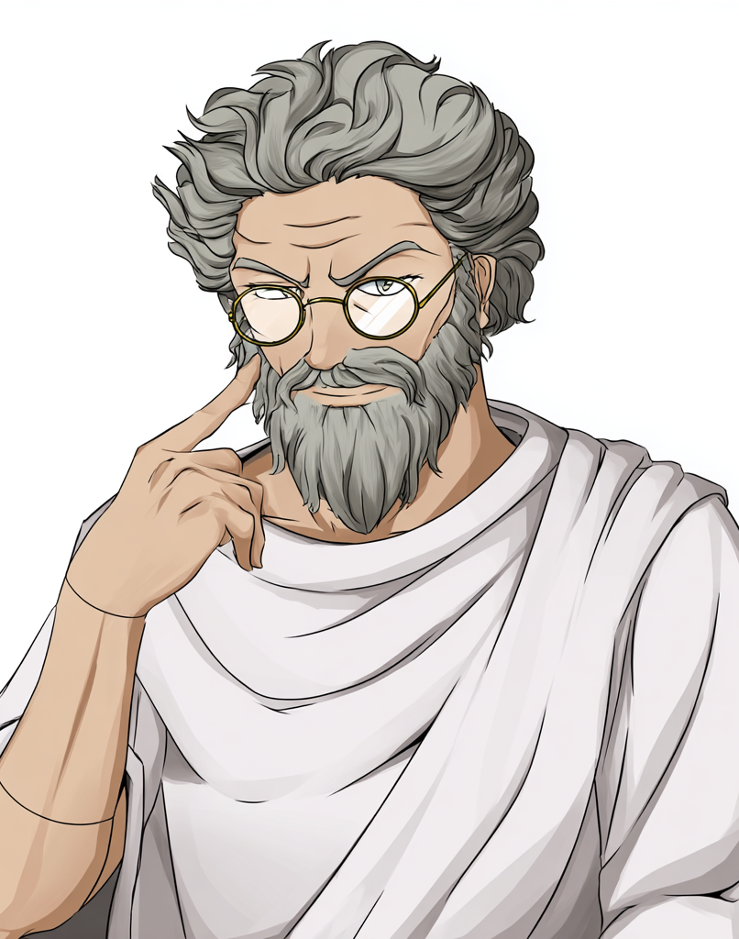
Aristotle’s Epistemology
Science
  The scientist
    Does not seek understanding of a particular X.
    Seeks a general understanding of Xs in terms of universal qualities.
  Sets out to distinguish the essence of X from the accidents of an individual.
    Essence of X: what it is to be X, without this essence a thing is not X.
    Accidents: other qualities an X might or might not possess; it can remain X with or without them.
  Goals:
    Determine how each fact fits into a system
    Grasp the causality involved.
  A scientific account explains why a particular fact could not be other than it is.
  Scientific knowledge
    Is not a mere list of facts.
    Involves knowing the principles behind the facts.
  True science: necessary truths deductively derived from self-evident axioms and definitions.
Notes:
D. Science
1. The scientist does not seek understanding of a specific particular X, she seeks a general understanding of Xs in terms of universal qualities.
2. The scientist sets out to distinguish the essence of X from the accidents an individual might possess.
a. The essence is what it is to be X-without this essence a thing is not X.
b. The accidents are other qualities that an X might or might not possess-it can remain X with or without them.
3. The goal is to determine how each fact fits into a system and to grasp the causality involved.
4. A scientific account explains why a particular fact could not be other than it is.
5. Scientific knowledge is not a mere list of facts.
6. Scientific knowledge involves knowing the principles behind the facts.
7. True science consists of necessary truths deductively derived from self-evident axioms and definitions.

Slide 8

Aristotle’s Epistemology
Language, Thought & Reality
  Language thought & reality have the same structure
  Knowledge matches the structure of the world
    Otherwise knowledge would be impossible
  Reasoning
    Going from one bit of info about the world to another.
  Speaking about the world requires similarity between language and reality
  Language “divides the beast of reality along its joints.”
  Language must be similar to thought since one can speak of thoughts.
Notes:
II Language, Thought and Reality
A. Same Structure
1. Language, thought and reality share the same structure.
2. We possess knowledge that matches the structure of the world.
a. We could not have knowledge of nature unless there was a similarity between the mind and nature.
3. Reasoning in thought is not merely going from one mental object to another-it is going from one bit of information about the world to another one.
4. We could not speak about the world without similarity between language and the world.
5. Language “divides the beast of reality along its joints.”
6. Knowledge includes the ability to talk intelligently about the world.
7. Language must be similar to thought; otherwise one could to speak of their thoughts.

Slide 9
Aristotle categories
The categories
  Goal: find the structure of language, thought and the world.
  Revelation of categories.
Notes:
III The Categories
A. Categories
1. The goal is to find the structure of language, thought and the world.
2. How we speak and understand things will reveal the categories of thought and language and also of reality-the structures are the same.

Slide 10
Aristotle the ten categories
Substance
  Example: A rock
Quantity
  Example: 40k
Quality
  Example: Purple
Relation
  Example: Taller
Place
  Example: In the library
Time
  Example: Yesterday
Position
  Example: Fallen
State
  Example: Clothed
Action
  Example: Walking
Passivity
  Example: Being taunted
Notes:
B. The Ten Categories
1. Substance
a. Examples: a man, a rock, a stingray.
2. Quantity
a. Examples: 30 feet, 200 pounds, 6 miles.
3. Quality
a. Examples: foolish, purple, happy.
4. Relation
a. Examples: Smaller, taller, half.
5. Place
a. Examples: In the library, under water, by the statue.
6. Time
a. Examples: Now, yesterday, today.
7. Position
a. Examples: Sitting, fallen, upright.
8. State
a. Examples: Naked, clothed, flowering.
9. Action
a. Examples: Shrinking, growing, walking.
10. Passivity
a. Examples: Being frozen, being burned, being taunted.

Slide 11

Aristotle substance
Substance
  An individual thing
  “They are the entities which underlie everything else…and everything else is either predicated of them or present in them.”
  Subject which is predicated to the other categories
  Can exist apart from specific properties
  Properties cannot exist apart from substances
Notes:
C. Substance
1. An individual thing.
2. “They are the entities which underlie everything else…and everything else is either predicated of them or present in them.”
-Categories
3. A substance is a subject to which is predicated the other categories.
4. Substances can exist apart from specific properties, but properties cannot exist apart from a substance.

Slide 12
Aristotle’s Logic
Science and Logic
  To go beyond being a list, science requires reasoning.
  Effective reasoning requires a procedure that reliably yields truth.
  Aristotle is credited with the development of logic.
    Until the 19th century few modifications were made to it.
    Parts of his logic persist.
Notes:
A. Science and Logic
1. To go beyond being a mere list of facts, science requires the application of reasoning.
2. Effective reasoning requires a procedure that reliably yields truth.
3. Aristotle is credited with the development of logic.
a. He did such an extraordinary job that until the 19th century few modifications were made to it.
b. Parts of his system of logic persist to this day.

Slide 13
Aristotle’s Logic
Categorical Logic
Four Types of Sentences
All S are P
No S are P
Some S are P
Some S are not P
Notes:
B. Categorical Logic
1. Four Types of Sentences
a. All S are P
b. No S are P
c. Some S are P
d. Some S are not P

Slide 14
Aristotle’s Logic
Argument
Premises: evidence or reasons.
Conclusion: the claim supported by the premises.
Syllogism: an argument with two premises and one conclusion.
Example
All Men are Mortal
Socrates is a man.
Socrates is mortal.
Notes:
2. Argument
a. Premises: evidence or reasons.
c. Conclusion: the claim supported by the premises.
3. Syllogism: an argument with two premises and one conclusion.
4. Example
a. All Men are Mortal
b. Socrates is a man.
c. Socrates is mortal.

Slide 15
Aristotle’s Logic
Valid: an argument is valid when the conclusion necessarily follows from the premises.
Invalid: an argument is invalid when it could have all true premises and a false conclusion at the same time.
Aristotle determined that validity
  Is a structural feature of arguments
  Is distinct from the content of an argument.
  A valid argument could contain all false premises.
  An invalid argument could contain all true claims.
Distinction between form and content was also applied in his metaphysics as a distinction between form and matter.
Notes:
5. Valid: an argument is valid when the conclusion necessarily follows from the premises.
6. Invalid: an argument is invalid when it could have all true premises and a false conclusion at the same time.
7. Aristotle determined that validity is a structural feature of arguments that is distinct from the content of an argument.
a. A valid argument could contain all false premises, while an invalid argument could contain all true claims.
8. This distinction between form an content was also applied in his metaphysics as a distinction between form and matter.

Slide 16

Aristotle’s First Principles
Regress
  It is not possible to prove everything deductively.
  If everything had to be proven deductively, an infinite regress would arise.
  Deductive proofs require first principles-premises that do not require any support.
What first principles are not
  Arbitrary (there would no basis for necessary knowledge)
  Innate (Absurd to be unaware of knowledge)
Notes:
V First Principles
A. Regress
1. It is not possible to prove everything deductively.
2. If everything had to be proven deductively, an infinite regress would arise.
3. Deductive proofs require first principles-premises that do not require any support.
B. What the first principles are not.
1. Arbitrary: this would provide no basis for scientific and necessary knowledge.
2. Innate: it would be absurd to think people have such knowledge from birth without being aware of it.

Slide 17
Aristotle’s
First Principles
Induction
  Reveals the universal and necessary features in the changing world of particulars.
  Like experiences strengthen like traces.
  Knowledge of the universal qualities.
  The mind extracts universals from particulars until the categories are reached.
  Induction + Intuition yields first principles.
Notes:
C. Induction
1. Reveals the universal and necessary features in the changing world of particulars.
2. Sense experience leaves traces in the memory and like experiences strengthen like traces.
3. From this process knowledge of the universal qualities begin to emerge.
a. “Like a rout in battle stopped by first one man making a stand and then another, until the original formation has been
restored.” –Posterior Analytics
4. The mind extracts the universals from the particulars and does so with ever increasing levels of generality, until the
categories are reached.
5. Induction provides us with such generalizations, but requires the addition of intuition to yield first principles.

Slide 18
Aristotle’s First Principles
Intuition
  World has a rational order
  Experience
  Intellectual intuition takes us beyond particulars to universal and necessary truths.
  Universals are not based on the particulars.
  Aristotle replaces Plato's recollection with recognition.
  Two types of principles
    Science
    logic
Notes:
D. Intuition
1. The world has a rational order.
2. Experience does not prove this order but does acquaint us with the order.
3. Through an intellectual intuition we go beyond the particulars to the universal and necessary truths that serve as the
foundations of knowledge.
4. The universals are not based on the particulars, but experience with the particulars inspires the intuition that goes beyond induction.
5. In place of Plato’s recollection, Aristotle offers recognition-the mind recognizes the universals within experience.
6. Two types of principles are revealed: those of the sciences and those of logic.

Slide 19
Aristotle’s First principles
First principles of the sciences
  Fundamental principles and definitions of the sciences.
  Math, medicine, physics, ethics and the other sciences.
First principles of logic
  Fundamental to all reasoning, regardless of the subject.
  Law of non-contradiction: A cannot both be B and not B.
  The law of excluded middle: A must be either B or not B.
  The law of identity: A is A.
  These principles describe the laws of thought, language and reality.
Notes:
E. First Principles of the Sciences
1. Fundamental principles and definitions of the sciences.
2. Math, medicine, physics, ethics and the other sciences.
F. First Principles of Logic
1. Fundamental to all reasoning, regardless of the subject.
2. Law of non-contradiction: A cannot both be B and not B.
3. The law of excluded middle: A must be either B or not B.
4. The law of identity: A is A.
5. These principles describe the laws of thought, language and reality.

Slide 20

Aristotle’s Metaphysics
Metaphysics
  First philosophy
  “After physics”
This Photo by Unknown Author is licensed under CC BY-SA-NC
Notes:
I Introduction
A. Metaphysics
1. Aristotle called metaphysics “first philosophy.”
2. An editor of Aristotle’s works did not know what to call a collection of works that came after Physics, so he called them “metaphysics” (“after physics”).

Slide 21
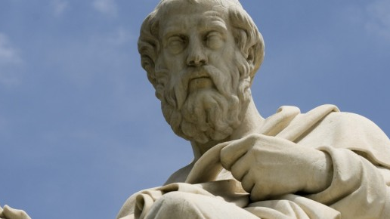
Aristotle’ Criticism of Plato’s Forms
Plato’s view
  Forms are perfect, unchanging and eternal.
  Particulars are imperfect, changing and mortal.
  Forms exist apart from the world of particulars
Criticism: Explanatory Power and Complexity
  1. The Forms lack explanatory power-they do not explain the natural world.
  2. Adding a realm of forms doubles the realms that are in need of explanation.
  3. Rather than creating a unity, postulation of the forms adds additional multiplicity.
This Photo by Unknown Author is licensed under CC BY-SA-NC
Notes:
II Criticism of Plato’s Forms
A. Plato’s View
1. The Forms are perfect, unchanging and eternal.
2. The world of particulars is a world of imperfection, change, and mortality.
3. The Forms exist apart from the world of particulars.
B. Explanatory Power and Complexity
1. The Forms lack explanatory power-they do not explain the natural world.
2. Adding a realm of forms doubles the realms that are in need of explanation.
3. Rather than creating a unity, postulation of the forms adds additional multiplicity.

Slide 22

Aristotle Criticism of Plato’s Forms
Change and Movement
  1. The Forms do not appear to contribute to the particulars.
  2. The Forms do not cause movement or change in the particulars.
  3. If the Forms are the basis of all explanation, then “the whole study of nature has been annihilated.”
Notes:
C. Change and Movement
1. The Forms do not appear to contribute to the particulars.
2. The Forms do not cause movement or change in the particulars.
3. If the Forms are the basis of all explanation, then “the whole study of nature has been annihilated.”

Slide 23
Aristotle’s
Criticism of Plato’s Forms
Substance
Being separate from the particulars, the Forms cannot be their essence or substance.
Participation
Participation is a mystery.
Talk of participation “is to use empty words and poetical metaphors.”
The Third Man Argument
Notes:
D. Substance
1. Being separate from the particulars, the Forms cannot be their essence or substance.
E. Participation
1. Participation is a mystery.
2. Talk of participation “is to use empty words and poetical metaphors.”
F. The Third Man
1. Aristotle uses the Third Man argument.

Slide 24
Aristotle’s Criticism of Plato’s Forms
Conclusion
  Aristotle rejects Plato’s Forms.
  “The Forms we can dispense with, for they are mere sound without sense; and even if there are such things, they are not relevant to our discussion.”
  Accepts universal, objective forms that make up the essences of particulars.
    These forms make knowledge possible.
    The world’s order can only be explained in terms of the forms.
Notes:
G. Conclusion
1. Aristotle rejects the Forms.
2. “The Forms we can dispense with, for they are mere sound without sense; and even if there are such things, they are not relevant to our discussion.”
3. He still accepts that there are universal, objective forms that make up the essences of particulars.
4. These forms make knowledge possible.
5. The order of the world can only be explained in terms of the forms.

Slide 25
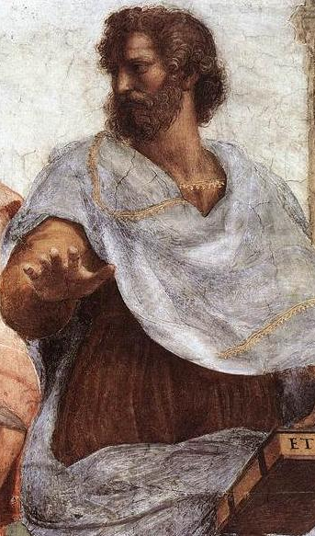
Aristotle: Substance
Forms brought to earth
  Plato: transcendent universals (outside)
  Aristotle: immanent universals (within)
  Forms must be constituents of things to be causes and explanations.
  Reality is a collection of substances
Whatness
  The properties a substance possesses, what makes a thing what it is in terms of types.
  Whatness is not what individuates
This Photo by Unknown Author is licensed under CC BY-SA
Notes:
III Substance
A. Forms Brought to Earth
1. Plato accepts transcendent universals-Forms that exist outside the realm of particulars.
2. Aristotle accepts immanent universals-forms that exist within the realm of particulars.
3. The forms can only be causes and explanations if they are a constituent of things.
4. Reality is a collection of substances-substance is the fundamental ontological category.
B. Whatness
1. Whatness: The properties a substance possesses-what makes a thing what it is in terms of types.
2. These are universal properties that many things might possess.
3. The whatness does not capture what is unique about the thing.
4. The whatness is not what individuates a thing-it does not make it distinct from all other things of the same type.

Slide 26
Aristotle: Substance
Thisness
  Individuates the thing
  Makes it distinct from all others of the same type
Notes:
C. Thisness
1. The thisness is what individuates the thing.
2. It is what makes it distinct from all other things of the same type.

Slide 27
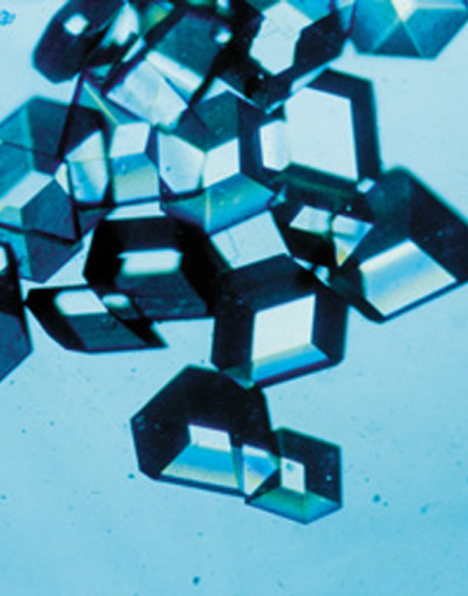
Aristotle: Substance
Form and Matter
  Whatness: form
  Thisness: matter
This Photo by Unknown Author is licensed under CC BY-SA
Notes:
IV Form and Matter
A. Form and Matter
1. The whatness of a thing is its form.
2. The thisness of a thing is its matter.

Slide 28
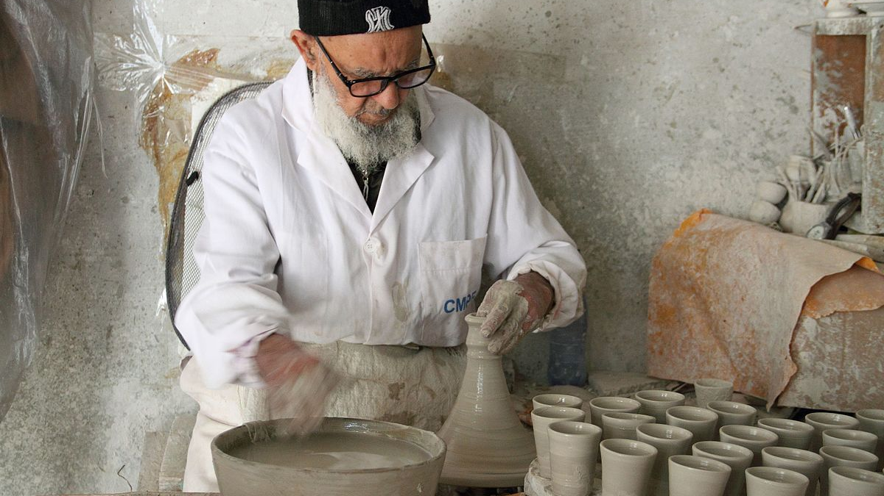
Aristotle: Substance
Function & form
  Form is based on function
  Form is the essence of a thing,the set of properties that make it what it is.
Matter
  Basis of individuation
  Actualized possibilities
  Many forms
  Need not be a physical object in the usual sense
This Photo by Unknown Author is licensed under CC BY-SA
Notes:
B. Function & Form
1. An object has the form it does because of a particular function or purpose.
2. The form is the essence of a thing.
3. The essence is the set of properties that make it what it is.
4. Not all forms can be fully characterized in terms of physical characteristics.
C. Matter
1. The basis of individuation.
2. It is a collection of possibilities from which a specific thing can be actualized.
3. Matter can take many forms.
4. The matter of a thing need not be a physical object in the usual sense.

Slide 29

Aristotle: Substance
Form & Matter
  A particular consists of form and matter.
  Form and matter are not two parts in the sense that something is a physical part.
  Forms do not exist apart from matter and matter does not exist without form.
This Photo by Unknown Author is licensed under CC BY-SA
Notes:
D. Form & Matter
1. A particular consists of form and matter.
2. Form and matter are not two parts in the sense that something is a physical part.
3. Forms do not exist apart from matter and matter does not exist without form.

Slide 30

Aristotle: Potentiality & Actuality
Change
  Form and matter do not complete the world’s explanation
  Change occurs
The acorn
  An acorn has a specific form and matter.
  Understanding the form and matter of the acorn does not complete one’s understanding of the acorn.
  Understanding the acorn also requires understanding its potential to become an oak tree.
Notes:
V Potentiality and Actuality
A. Change
1. Form and matter do not exhaust the explanation of the world.
2. Change occurs.
B. The Acorn
1. An acorn has a specific form and matter.
2. Understanding the form and matter of the acorn does not complete one’s understanding of the acorn.
3. Understanding the acorn also requires understanding its potential to become an oak tree.

Slide 31
Aristotle: Potentiality & Actuality
Potentiality & Actuality
  Change: going from potentiality to actuality.
  Potentiality is associated with matter.
    The matter of the acorn is not the tree, but is potentially the tree.
  Actuality is associated with form.
    The actual oak tree arises from the acorn guided by the form.
  Change involves a change of form, but the nature of a thing includes its capacity to change (potential).
Notes:
C. Potentiality & Actuality
1. Change involves going from potentiality to actuality.
2. Potentiality is associated with matter.
a. The matter the acorn is not the tree, but is potentially the tree.
3. Actuality is associated with form.
a. The actual oak tree arises from the acorn guided by the form.
4. Change involves a change of form, but the nature of a thing includes its capacity to change (potential).

Slide 32
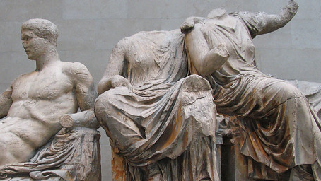
Aristotle: Change
Understanding change
  Understanding Causes
  “Cause” also includes explanations.
Four causes
  Material Cause: the matter that composes the thing.
    a. Example: The stone that makes up a statue.
  Efficient Cause: The origin of the process that produced the thing.
    a. The cause that actualizes the thing’s potential.
    b. Example: The parents of a child.
This Photo by Unknown Author is licensed under CC BY-SA-NC
Notes:
VI Change
A. Understanding Change
1. Requires understanding the various causes.
2. Aristotle uses “cause” in a broad sense that also includes what is now considered an explanation.
B. Four Causes
1. Material Cause: the matter that composes the thing.
a. Example: The stone that makes up a statue.
2. Efficient Cause: The origin of the process that produced the thing.
a. The cause that actualizes the thing’s potential.
b. Example: The parents of a child.

Slide 33
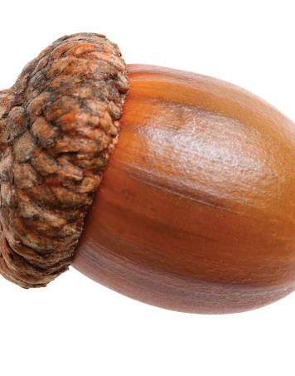
Aristotle: Change
Formal Cause: The essence of the thing.
  The form that is actualized which makes the thing what it is.
  Example: The form of a human causes the baby to become a human adult and not a squirrel.
Final Cause: The end, purpose or function of the thing.
  Natural objects have purposes, ends and functions.
  Example: The final cause of the acorn is becoming a tree that will create more acorns.
This Photo by Unknown Author is licensed under CC BY-NC
Notes:
3. Formal Cause: The essence of the thing.
a. The form that is actualized which makes the thing what it is.
b. Example: The form of a human causes the baby to become a human adult and not a squirrel.
4. Final Cause: The end, purpose or function of the thing.
a. Natural objects have purposes, ends and functions.
b. Example: The final cause of the acorn is becoming a tree that will create more acorns.

Slide 34
Aristotle: Teleology
Teleology
  From “telos” which means “end” or “goal.”
  Nature is a collection of processes that aim at fulfilling various ends.
  not an assumption that the natural beings are consciously aiming towards the ends.
  The essence of each substance includes the impetuous to achieve its end(s).
  Entelechy: The final stage of a process.
Notes:
VII Teleology
A. Teleology
1. From “telos” which means “end” or “goal.”
2. Nature is regarded as a collection of processes that aim at fulfilling various ends.
3. There is not an assumption that the natural beings are consciously aiming towards the ends.
4. The essence of each substance includes the impetuous to achieve its end(s).
5. Entelechy: The final stage of a process.

Slide 35
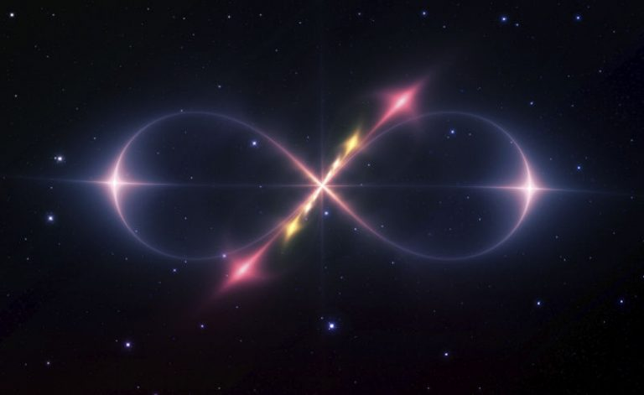
Aristotle: The Unmoved Mover
A world of ends.
  The activity of the things in the world aim towards ends and the actualization of potentials.
  Matter is a collection of potentials and needs to be actualized by something else.
  Objects have the potential to move,but will not move until the motion is actualized by something else.
The Eternal Universe
  No temporally first cause
  Assumed an eternal universe that has always been in motion.
  He shared the Greek view that it was absurd to believe the universe had a beginning in which it arose from nothing.
  There must be a source of motion for everything.
  This source of motion cannot be in motion since it would require a mover to set it in motion, leading to an infinite regress.
This Photo by Unknown Author is licensed under CC BY-SA-NC
Notes:
VIII The Unmoved Mover
A. A world of ends.
1. The activity of the things in the world aim towards ends and the actualization of potentials.
2. Matter is merely a collection of potentials and needs to be actualized by something else.
3. Objects have the potential to move, but will not move until the motion is actualized by something else.
B. The Eternal Universe
1. He did not accept a temporally first cause-he assumed an eternal universe that has always been in motion.
a. He shared the common Greek view that it was absurd to believe the universe had a beginning in which it arose from nothing.
2. There must be a source of motion for everything.
3. This source of motion cannot itself be in motion since it would require a mover to set it in motion, thus leading to an infinite regress.

Slide 36
Aristotle: The Unmoved Mover
The unmoved mover is not God
  Not a transcendent, anthropomorphic, personal God
  If it could care, it could be moved
The unmoved mover is unmoving
  Not in motion, so not an efficient cause
  It is a final cause and the basis of teleology
  All things desire to be like the unmoved mover
  Does not reciprocate this desire; it is unmoved
Notes:
C. The Unmoved Mover is not God.
1. The unmoved mover is not a transcendent, anthropomorphic, personal God.
2. If it could care then it would be affected (moved) by other things and would not be the unmoved mover.
D. The Unmoved Mover is Unmoving
1. It is not in motion and hence is not an efficient cause.
2. It is a final cause and the basis of the teleology of the world.
3. In seeking to be complete (fully actualized) all things desire to be like the unmoved mover.
4. Different things seek different types of actualization.
5. The unmoved mover does not reciprocate this desire-it is unmoved.

Slide 37
Aristotle the unmoved mover
Aristotle: The Unmoved Mover
The Unmoved Mover has the Highest Degree of Reality
  All other things have unrealized potential.
  What is purely actual need not change since it has no potential left.
  Being of the highest reality it must be engaged in the highest activity, which is thought.
  The rationality of human beings makes them the highest natural creatures.
  By analogy, the unmoved mover must be thinking in the highest rational manner.
  The unmoved mover cannot be thinking about particulars.
    This would place change and division within it.
  The object of the unmoved mover’s thoughts must be unchanging and undivided.
  “Therefore it must be of itself that the divine thought thinks (since it is the most excellent of all things), and its thinking is thinking on thinking.” -Metaphysics
  Influence on stoics, neoplatonists, and medieval thinkers especially Thomas Aquinas.
Notes:
E. The Unmoved Mover has the Highest Degree of Reality
1. All other things have unrealized potential.
2. What is purely actual need not change since it has no potential left.
3. Being of the highest reality it must be engaged in the highest activity, which is thought.
4. The rationality of human beings makes them the highest natural creatures.
5. By analogy, the unmoved mover must be thinking in the highest rational manner.
6. The unmoved mover cannot be thinking about particulars-this would place change and division within it.
7. The object of the unmoved mover’s thoughts must be unchanging and undivided.
8. “Therefore it must be of itself that the divine thought thinks (since it is the most excellent of all things), and its thinking is thinking on thinking.” -Metaphysics
9. This view had considerable influence on latter thinkers, especially the stoics, neoplatonists, and medieval thinkers especially Thomas Aquinas.

Slide 38
Aristotle's Moral Theory

Slide 39
Aristotle’s Ethics
Nicomachean Ethics
  Named after his father and son.
  Does not claim to offer an entirely new moral theory.
  Absurd to think no one had ever discovered what it is to be good.
  A commonsense, intuitive approach to ethics.
Notes:
A. Nicomachean Ethics
1. Named after both Aristotle’s father and son.
2. He does not claim to offer an entirely new moral theory-it would be absurd to think no one had ever previously discovered what it is to be good.
3. His works have a commonsense approach to ethics that tends to match most peoples’ intuitions.

Slide 40
Aristotle’s Ethics
Nature of Ethics
  A body of objective knowledge.
  A science of conduct whose aim is to guide us to human excellence.
  A matter of knowing and practicing principles.
  A person can be mistaken about morality.
  Ethics is not an exact science.
  When ethical principles are applied in specific situations, ambiguities and other difficulties arise.
  Ethics is analogous to navigation and medicine
    Exact and specific rules are not possible.
Notes:
B. Nature of Ethics
1. Ethics is a body of objective knowledge.
2. It is a science of conduct whose aim is to guide us to human excellence.
3. Morality is a matter of knowing and practicing principles.
4. A person can be mistaken in regards to morality.
5. Ethics is not an exact science.
6. When ethical principles are applied in specific situations, ambiguities and other difficulties arise.
7. Ethics is analogous to navigation and medicine in that exact and specific rules are not possible.

Slide 41
Aristotle’s Ethics
Intellectual Virtue & Moral Virtue
  Intellectual virtue: excellence of intelligence.
  Moral virtue: excellence of character.
  Both are required to lead the good life and to be happy.
Notes:
C. Intellectual Virtue & Moral Virtue
1. Intellectual virtue: excellence of intelligence.
2. Moral virtue: excellence of character.
3. Both are required to lead the good life and to be happy.

Slide 42
Aristotle’s Ethics
Intellectual Virtue
  Philosophic wisdom: a theoretical understanding achieved by grasping the unchanging structure of reality.
  Practical wisdom: the rational understanding of how to conduct one’s life.
  The inquiry is to become good and not just to know what virtue is.
    Otherwise the inquiry would be useless.
  More is needed beyond intellectual virtue, namely the ability to moderate one’s emotions and desires.
  Part of being virtuous is acting from knowledge.
Notes:
D. Intellectual Virtue
1. Philosophic wisdom: a theoretical understanding achieved by grasping the unchanging structure of reality.
2. Practical wisdom: the rational understanding of how to conduct one’s life.
3. However, the inquiry is to become good and not just to know what virtue is-otherwise the inquiry would be useless.
4. More is needed beyond intellectual virtue, namely the ability to moderate one’s emotions and desires.
5. But, one part of being virtuous is acting from knowledge.

Slide 43

Aristotle’s Virtue Theory
The Supreme Good
  End
    Rational activity
    Good: that at which all things aim
    Activities
  Regress-Reductio Argument
    We do not choose everything for the sake of something else
    This would involve an infinite progression,
    Making the aim pointless and ineffectual
    The end must be the Good-the supreme good.
  Knowledge of the Good
    Target
Notes:
Aristotle’s Virtue Theory
I The Supreme Good
A. End
1. Every rational activity, art and action aims at some end or good.
2. Good is that at which all things aim.
3. There are many actions, arts and sciences, so their ends are many.
a. Medical science’s end is health.
b. Military science’s end is victory.
c. Economic science’s end is wealth.
4. Our activities have some end which we want for its own sake, and for the sake of which we want all the other ends
B. Regress-Reductio Argument
1. We do not choose everything for the sake of something else
2. This would involve an infinite progression,
3. Making the aim pointless and ineffectual
4. The end must be the Good-the supreme good.
C. Knowledge of the Good
1. Knowledge of the Good is of great importance to us for the conduct of our lives.
2. We are more likely to achieve our aim if we have a target.

Slide 44
Aristotle’s Virtue Theory
Happiness & Lives
  Happiness
    Highest of all practical goods
  The Three Main Types of Life
    The life of pleasure
    The political
    The contemplative
Notes:
II Happiness & Lives
A. Happiness
1. The highest of all practical goods to people is happiness-living or doing well.
2. Opinions differ about happiness.
3. The many see it as obvious and familiar like pleasure or money or eminence.
a. When ill it is health,
b. When poor it is money.
4. Some claim that over and above these particular goods there is another good in itself and the cause the goodness in all others.
B. The three main types of life:
1. The life of pleasure.
2. The political.
3. The contemplative.

Slide 45
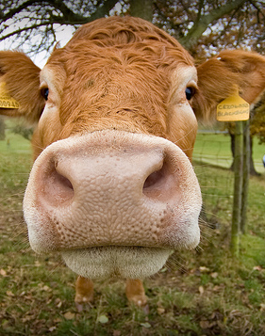
Aristotle’s Virtue Theory
Life of Pleasure
  Life of Pleasure
    Masses
    Bovine existence
    Sardanapalus
  Pleasure is not Happiness
    To mistake pleasure for happiness is to prefer a “life suitable for beasts” instead of what is appropriate to humans.
    To take pleasure/amusement to be happiness would be a mistake.
      Happiness is the end, so that we chose all other things for its sake.
      To exert oneself and work for the sake of amusement/pleasure “seems silly and childish.”
    While pleasure is not happiness, it is part of happiness.
This Photo by Unknown Author is licensed under CC BY-SA
Notes:
III Life of Pleasure
A The Life of Pleasure
1. The masses and most vulgar believe the Good or happiness is pleasure.
2. They ask for nothing better than the life of enjoyment.
3. The utter servility of the masses is from their preference for a bovine existence.
4. Their view is considered because many powerful people share the tastes of Sardanapalus.
B. Pleasure is not Happiness
1. To mistake pleasure for happiness is to prefer a “life suitable for beasts” instead of what is appropriate to humans.
2. To take pleasure/amusement to be happiness would be a mistake.
a. Happiness is the end, so that we chose all other things for its sake.
b. To exert oneself and work for the sake of amusement/pleasure “seems silly and childish.”
3. While pleasure is not happiness, it is part of happiness.

Slide 46
Aristotle’s virtue theory
Life of Honor
  The Life of Honor
    Goal of the political life
  Honor is not the Good
    Too superficial.
    Honor depends more on those who confer it than on the receiver.
    The Good is something proper to its possessor and not easily taken from him.
    People seek honor to convince themselves of their own goodness, so goodness is superior to honor.
  Goodness/Justice rather than honor?
    Deficient as an end
    Compatible with suffering and misfortune
      Paradox (criticism of Plato)
Notes:
IV Life of Honor
A. The Life of Honor
1. Cultured people identify the Good with honor, because it is the goal of political life.
B. Honor is not the Good
1. This is too superficial.
2. Honor depends more on those who confer it than on the receiver.
3. The Good is something proper to its possessor and not easily taken from him.
4. People seek honor to convince themselves of their own goodness, so goodness is superior to honor.
C. Goodness/justice rather than honor?
1. One might suppose that goodness/justice rather than honor is the end pursued in public life.
2. Good ness is deficient as an end.
3. The possession of goodness is compatible with being asleep and a life of inactivity.
4. It is also compatible with the most atrocious suffering and misfortune
a. None would call such a life happy-unless he was defending a paradox.

Slide 47

Aristotle’s Virtue Theory
What is the Good for Man?
  Wealth & The Good
    Wealth is only a means
  Inadequate
    Own account
    Attacks
  What is the good for man?
    The ultimate end or of human life: something that is completely satisfying
    Happiness
This Photo by Unknown Author is licensed under CC BY-SA-NC
Notes:
V What is the Good for Man?
A. Wealth and the Good
1. Wealth is not the good that is sought because it serves only as a means.
B. Inadequate
1. The earlier suggestions are more likely ends than wealth, because they are appreciated on their own account.
2. But they are inadequate, and many attacks on them have been published.
C. What is the Good for man?
1. It must be the ultimate end or object of human life: something that is in itself completely satisfying.
2. Happiness fits this description.

Slide 48
Aristotle’s Virtue Theory
The Good
  Second Argument for the Good
    The good appears to vary with the action, art, or sciences.
    The good of each one is that for the sake of which everything else is done.
    In every action and pursuit it is the end, since it is for the sake of this that everything else is done.
    If there is one thing that is the end of all actions, it will be the practical good-or goods, if more than one
    Thus, the argument has reached the same conclusion as before.
Notes:
VI The Good
A. Second argument for The Good
1. The good appears to vary with the action, art, or sciences.
2. The good of each one is that for the sake of which everything else is done.
a. Medicine-health.
b. Strategy-victory;
c. Architecture-building
3. In every action and pursuit it is the end, since it is for the sake of this that everything else is done.
4. If there is one thing that is the end of all actions, it will be the practical good-or goods, if more than one.
5. Thus the argument has reached the same conclusion as before.

Slide 49
Aristotle’s Virtue Theory
The Good
  The Final End
    There are more ends than one.
    Some are chosen as means to something else, so not all of them are final ends
    The supreme good is something final.
    If there is one final end, it is the good we seek.
    If there is more than one, it will be the most final.
    An object pursued for its own sake is more final than one pursued because of something else.
    What is always choseable for its own sake and never because of another is final without qualification.
Notes:
B. The Final End
1. There are more ends than one.
2. Some are chosen as means to something else, so not all of them are final ends
3. The supreme good is something final.
4. If there is one final end, it is the good we seek.
5. If there is more than one, it will be the most final.
6. An object pursued for its own sake is more final than one pursued because of something else.
7. What is always chose able for its own sake and never because of another is final without qualification.

Slide 50
Aristotle’s Virtue Theory
The Good
  Choice Argument for happiness as the final end
    Happiness is such an end-we choose it for itself and never for any other reason.
    Honor, pleasure, intelligence and other good qualities are chosen partly for themselves and for the sake of happiness.
    No one chooses happiness for the sake of the good qualities or for any other reason.
  Self Sufficiency Argument for happiness as the final end
    The perfect good is self-sufficient.
    Self sufficient is not what is sufficient for a solitary life.
      Social being
      Limit to avoid infinity
    A self-sufficient thing is one which by itself makes life desirable and in no way deficient.
    Happiness is such a thing.
Notes:
C. Choice Argument for Happiness as the Final End
1. Happiness is such an end-we choose it for itself and never for any other reason.
2. Honor, pleasure, intelligence and other good qualities are chosen partly for themselves and for the sake of happiness.
3. No one chooses happiness for the sake of the good qualities or for any other reason.
D. Self Sufficiency Argument for Happiness as the Final End
1. The perfect good is self-sufficient.
2. Self sufficient is not what is sufficient for a solitary life.
a. Man is by nature a social being, so it includes parents, wife, children, friends and fellow-citizens.
a. A limit must be set: if it is extended to grandparents, grandchildren and friends of friends it will proceed to infinity.
3. A self-sufficient thing is one which by itself makes life desirable and in no way deficient.
4. Happiness is such a thing.

Slide 51
Aristotle’s Virtue Theory
The Good
  Most Desirable Argument for Happiness
    It is the most desirable of all things, not seen as one among many.
    If it was one among many, happiness would be made more desirable by the addition of even the least good.
    So, happiness is perfect and self-sufficient, being the end to which our actions are directed.
Notes:
E. Most Desirable Argument for Happiness
1. It is the most desirable of all things, not seen as one among many.
2. If it was one among many, happiness would be made more desirable by the addition of even the least good.
a. Because addition makes the sum of goods greater.
b. The greater of two goods is always more desirable.
3. So, happiness is perfect and self-sufficient, being the end to which our actions are directed.

Slide 52
Aristotle’s Virtue Theory
The Function of Man
  Argument for function
    Happiness is a virtuous activity of the soul.
    Taking happiness as the supreme good is a platitude, so an account is required.
    This can be achieved by understanding man’s function.
    The goodness and proficiency of an artist-or any class having a specific function is in the performance of that function.
    The same will be true of man, if man has a function.
      Analogy 1: Is it likely that joiners and shoemakers have certain functions and man has been left by nature a functionless being?
      Analogy 2: As the eye and hand and foot and other members have a function, a human being has a function over and above these particular functions.
Notes:
VI The Function of Man
A. Argument for Function
1. Happiness is a virtuous activity of the soul.
2. Taking happiness as the supreme good is a platitude, so an account is required.
3. This can be achieved by understanding man’s function.
4. The goodness and proficiency of an artist-or any class having a specific function is in the performance of that function.
5. The same will be true of man, if man has a function.
6. Analogy 1: Is it likely that joiners and shoemakers have certain functions and man has been left by nature a functionless being?
7. Analogy 2: As the eye and hand and foot and other members have a function, a human being has a function over and above these particular functions.

Slide 53
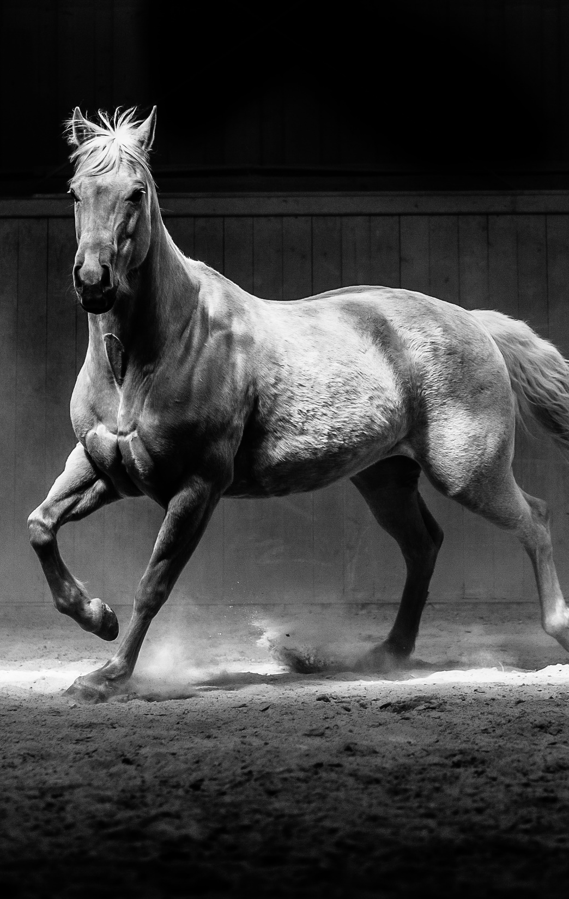
Aristotle’s Virtue Theory
The Function of Man
  Life is not Man’s Function
    Life is shared by plants.
    We are looking for man's proper function.
    So, we must exclude from our definition the life consisting in nutrition and growth.
    Sentient life is shared by horses, cattle and other animals.
    So, thus must be excluded as well.
  The Function is found in the rational part
    There remains a practical life of the rational part.
    This has two aspects:
    a. One amenable to reason.
    b. Another possessing it and initiating thought.
    The life determined by activity is the life of man because it is the stricter sense.
Notes:
B. Life is not Man’s function.
1. Life is shared by plants.
2. We are looking for man's proper function.
3. So, we must exclude from our definition the life consisting in nutrition and growth.
4. Sentient life is shared by horses, cattle and other animals.
5. So, thus must be excluded as well.
C. The Function is found in the Rational Part
1. There remains a practical life of the rational part.
2. This has two aspects:
a. One amenable to reason.
b. Another possessing it and initiating thought.
3. The life determined by activity is the life of man because it is the stricter sense.

Slide 54
Aristotle’s Virtue Theory
The Function of Man
  Function & Good
    The function of man is an activity of the soul in accord with or implying a rational principle.
    The function of an individual and of a good individual is the same.
    If the function of man is an activity of the soul, implying a rational principle.
    If the function of a good man is to perform these well and rightly.
    If every function is performed well when performed in accord with its proper excellence.
    Then the good for man is an activity of soul in accordance with virtue.
      If there is more that one kind of virtue, in accordance with the best and most perfect kind.
      Further qualification: in a complete lifetime - one day or a brief space of time cannot make a man blessed and happy
Notes:
D. Function and Good
1. The function of man is an activity of the soul in accord with or implying a rational principle.
2. The function of an individual and of a good individual is the same.
a. Example: The function of the harpist is to play the harp, but that of the good harpist is to play it well.
3. If the function of man is an activity of the soul, implying a rational principle.
4. If the function of a good man is to perform these well and rightly.
5. If every function is performed well when performed in accord with its proper excellence.
6. Then the good for man is an activity of soul in accordance with virtue.
a. If there is more that one kind of virtue, in accordance with the best and most perfect kind.
7. Further qualification: in a complete lifetime - one day or a brief space of time cannot make a man blessed and happy.

Slide 55
Aristotle’s Virtue Theory
How is Happiness Acquired?
  How?
    Learnt?
    Acquired by habit?
    Divine dispensation?
    Chance?
  Divine Dispensation
    If anything is a gift of the gods, it is happiness.
    Of all human possessions it is the best.
    This point falls under another branch of study.
Notes:
VII How is happiness acquired
A. How is happiness acquired?
1. Can it be learnt?
2. Can it be acquired by habitation or cultivated in some other way?
3. Does it come by a divine dispensation.
3. Does it come by chance?
B. Divine Dispensation
1. If anything is a gift of the gods, it is happiness.
2. Of all human possessions it is the best.
3. This point falls under another branch of study.

Slide 56

Aristotle’s Virtue Theory
How is Happiness Acquired?
  Study & Training
    Most divine
    End of goodness is the best
    Widely shared
  Teleological Argument Against Chance
    It is better to win happiness by study than by chance,
    It is natural for nature's effects to be the finest possible,
    Similarly for the effects of art and of any other cause, especially those of the best kind.
    That the most important and finest thing of all should be left to chance would be a gross disharmony
This Photo by Unknown Author is licensed under CC BY-SA-NC
Notes:
C. Study & Training
1. If happiness is not a divine gift, but acquired by moral goodness and study or training, it is one of our most divine possessions;
2. The end of goodness is the best: something divine and blissful.
3. Happiness will be widely shared as it can be acquired via study or application, by anyone who is not handicapped by an incapacity for goodness.
D. Teleological Argument against Chance
1. It is better to win happiness by study than by chance,
2. It is natural for nature's effects to be the finest possible,
3. Similarly for the effects of art and of any other cause, especially those of the best kind.
4. That the most important and finest thing of all should be left to chance would be a gross disharmony.

Slide 57
Aristotle’s Virtue Theory
How is Happiness Acquired?
  Happiness
    Virtuous activity of the soul
    All other goods
  Political Science & Virtue
    End of political science
    Imbue citizens
Notes:
E. Happiness
1. Happiness is a kind of virtuous activity of soul.
2. All other goods are necessary pre-conditions of happiness or contribute to it and serve as its instruments.
F. Political Science and Virtue
1. The end of political science is the highest good.
2. The chief concern of this science is to imbue the citizens with virtue and the readiness to do fine deeds.

Slide 58

Aristotle’s Virtue Theory
Excellence & Virtue
  Excellence
    Enables its possessor to function
    Renders good
      Eye
      Horse
  Virtue
    Moral virtue
    Excess, deficiency and mean
This Photo by Unknown Author is licensed under CC BY
Notes:
VIII Excellence & Virtue
A. Excellence
1. Any excellence enables its possessor to function, so this is true of human excellence, virtue.
2. Any excellence renders what it is the excellence of good, and makes it perform its function well
3. Examples
a. The excellence of the eye makes both the eye and its function good
b. The excellence of a horse makes him a fine horse.
4. Human excellence is the disposition that makes one good and causes him to perform his function well.
B. Virtue
1. By virtue is meant moral virtue since it is concerned with feelings and actions.
2. These involve excess, deficiency and a mean.
3. It is possible to feel fear, confidence, desire, anger, pity, and pleasure and pain too much or too little, and both are wrong.

Slide 59
Aristotle’s Virtue Theory
Excellence & Virtue
  The Mark of At the right times
    On the right grounds
    Towards the right people
    For the right motive
    In the right way
    To an intermediate, the best, degree
    Virtue: to have feelings
  Actions
    Excess, deficiency, mean
  The mean
    Excess & deficiency are failings
    Mean
    Virtue is a mean condition
Notes:
C. The Mark of Virtue is to have these feelings
1. At the right times
2. On the right grounds
3. Towards the right people
4. For the right motive
5. In the right way
6. To an intermediate, the best, degree.
D. Actions
1. There are excess, deficiency and a mean in the case of actions.
2. It is in the field of actions and feelings that virtue operates.
E. The Mean
1. Excess and deficiency are failings.
2. The mean is praised and recognized as a success
3. Virtue is a mean condition, as much as it aims at hitting the mean.

Slide 60
Aristotle’s Virtue Theory
The Doctrine of the Mean Applied
  Particulars
  More Particulars
Notes:
IX The doctrine of the mean applied to particular virtues
A. Particulars
1. In Fear and Confidence the mean is Courage.
b. One with excessive confidence is rash.
d. One who has an excess of fear and a deficiency of confidence is a coward.
2. In pleasure and pain, the mean is temperance and the excess is licentiousness.
3. In giving/receiving money he mean is Liberality.
a. The excess and deficiency are Prodigality and Illiberality;
1. The prodigal spends too much and gets too little.
2. The illiberal man gets too much and spends too little.
B. More Particulars
1. Money
a. Mean: Magnificence
b. Excess :Tastelessness and Vulgarity,
c. Deficiency: Pettiness.
2. Honor & Dishonor
a. Mean: Magnanimity,
b. Excess: Vanity,
c. Deficiency: Pusillanimity.
3.Ambition
a. Excess: ambitious
b. Deficient: unambitious.
4. Anger
a. The intermediate man is Patient and the mean Patience;
b. The excessive one is Irascible and his vice Irascibility,
c. The deficient one is Spiritless and has a Lack of Spirit.
5. Truth
a. Mean: Truthfulness;
b. Excess: boastfulness.
c. Deficiency: Irony.
6. Social Pleasentness
a. Mean: Wit.
b. Excess: Buffoonery.
c. Deficiency: Boorishness.
7. Pleasentness
a. Mean: Friendliness;
b. Excess without motive: Obsequious.
c. Excess with a motive of self-interest: Flatterer.
d. Deficient and unpleasant in all circumstances: Cantankerous and ill-tempered.
8. Modesty is not a virtue, but the modest are praised.
a. Deficient: A Shy man who is overawed at anything.
b. Excess: A shameless man feels too little or no shame.
c. Mean: Modest.
3. Righteous Indignation is a mean between Envy and Spite.

Slide 61
Aristotle’s Virtue Theory
Virtues & Vices
Domain | Deficiency (Vice) | Mean (Virtue) | Excess (Vice)
Fear & Confidence | Cowardice (too much fear) | Courage | Rashness (too much confidence)
Pleasure & Pain | – | Temperance | Licentiousness
Money (general) | Illiberality (gets too much, spends little) | Liberality | Prodigality (spends too much, gets too little)
Money (large spending) | Pettiness | Magnificence | Tastelessness / Vulgarity
Honor & Dishonor | Pusillanimity | Magnanimity | Vanity
Ambition | Unambitious | – | Ambitious
Anger | Spiritless / Lack of Spirit | Patience | Irascibility
Truth | Irony | Truthfulness | Boastfulness
Social Pleasantness | Boorishness | Wit | Buffoonery
Pleasantness (general) | Cantankerous / Ill-tempered | Friendliness | Obsequious (no motive) / Flatterer (self-interest)
Modesty | Shyness (overawed) | Modesty (praised, not virtue) | Shamelessness (too little/no shame)
Moral Emotion | Spite | Righteous Indignation | Envy
Notes:
IX The doctrine of the mean applied to particular virtues
A. Particulars
1. In Fear and Confidence the mean is Courage.
b. One with excessive confidence is rash.
d. One who has an excess of fear and a deficiency of confidence is a coward.
2. In pleasure and pain, the mean is temperance and the excess is licentiousness.
3. In giving/receiving money he mean is Liberality.
a. The excess and deficiency are Prodigality and Illiberality;
1. The prodigal spends too much and gets too little.
2. The illiberal man gets too much and spends too little.
B. More Particulars
1. Money
a. Mean: Magnificence
b. Excess :Tastelessness and Vulgarity,
c. Deficiency: Pettiness.
2. Honor & Dishonor
a. Mean: Magnanimity,
b. Excess: Vanity,
c. Deficiency: Pusillanimity.
3.Ambition
a. Excess: ambitious
b. Deficient: unambitious.
4. Anger
a. The intermediate man is Patient and the mean Patience;
b. The excessive one is Irascible and his vice Irascibility,
c. The deficient one is Spiritless and has a Lack of Spirit.
5. Truth
a. Mean: Truthfulness;
b. Excess: boastfulness.
c. Deficiency: Irony.
6. Social Pleasentness
a. Mean: Wit.
b. Excess: Buffoonery.
c. Deficiency: Boorishness.
7. Pleasentness
a. Mean: Friendliness;
b. Excess without motive: Obsequious.
c. Excess with a motive of self-interest: Flatterer.
d. Deficient and unpleasant in all circumstances: Cantankerous and ill-tempered.
8. Modesty is not a virtue, but the modest are praised.
a. Deficient: A Shy man who is overawed at anything.
b. Excess: A shameless man feels too little or no shame.
c. Mean: Modest.
3. Righteous Indignation is a mean between Envy and Spite.

Slide 62
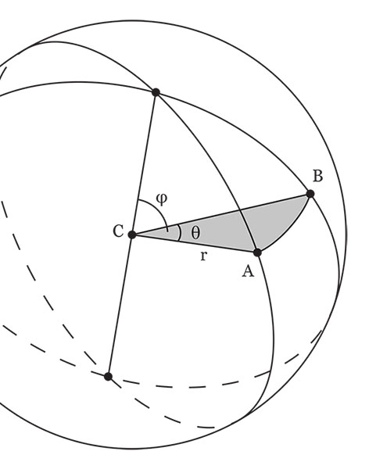
Aristotle’s Virtue Theory
Summing up and three practical rules for good conduct.
Virtue
  A mean between two vices, one of excess and the other of deficiency,
  Aims at hitting the mean point in feelings and actions.
It is difficult to be good.
  Difficult to find the midpoint.
  Analogy: Only one who knows can find the centre of a circle.
  Easy to get angry or to give and spend money;
  To feel or act towards the right person to the right extent at the right time for the right reason in the right way is not easy and not everyone that can do it.
  To Do these things well is a rare, laudable and fine achievement.
This Photo by Unknown Author is licensed under CC BY-SA
Notes:
X Summing up and three practical rules for good conduct.
A. Virtue
1. Moral virtue is a mean.
2. It is a mean between two vices, one of excess and the other of deficiency,
3. It aims at hitting the mean point in feelings and actions.
B. It is difficult to be good.
1. It is difficult to find the midpoint.
2. Analogy: Only one who knows can find the centre of a circle.
3. It is easy to get angry or to give and spend money;
4. To feel or act towards the right person to the right extent at the right time for the right reason in the right way is not easy and not everyone that can do it.
5. Hence to do these things well is a rare, laudable and fine achievement.

Slide 63
Aristotle’s Virtue Theory
Summing Up & Three Rules
  Practical Rule #1: Keeping away from the contrary extreme
    Rule: Keep away from that extreme which is more contrary to the mean,
      As Calypso advises: Far from this surf and surge keep thou thy ship.
    One extreme is always more erroneous than the other;
    Choose the next best course and the lesser evil.
  Practical Rule #2: Likely errors
    Rule: We must notice errors into which we are liable to fall and drag ourselves in the contrary direction
    We all have different natural tendencies.
    We find ours from the pleasure and pain they give us.
    We shall arrive at the mean by pressing well away from our failing.
      Like one straightening a warped piece of wood.
Notes:
C. Practical Rule 1
1. Rule: Keep away from that extreme which is more contrary to the mean,
a. As Calypso advises: Far from this surf and surge keep thou thy ship.
2. One extreme is always more erroneous than the other;
3. As it is difficult to hit the mean, we must chose the next best course and the lesser evil.
D. Practical Rule 2
1. Rule: We must notice errors into which we are liable to fall and drag ourselves in the contrary direction;
2. We all have different natural tendencies.
3. We find ours from the pleasure and pain they give us.
4. We shall arrive at the mean by pressing well away from our failing.
a. Like one straightening a warped piece of wood.

Slide 64
Aristotle’s Virtue Theory
  Practical Rule #3: Pleasure
    Rule: One must guard especially against pleasure and pleasant things, because we are not impartial judges of pleasure
    Helen of Troy
Notes:
E. Practical Rule 3
1. Rule: One must guard especially against pleasure and pleasant things, because we are not impartial judges of pleasure.
2. We should adopt the same attitude towards it as the Trojan elders did towards Helen, and repeat their pronouncement.
3. If this eliminates the attraction, we will be less likely to go wrong.

Slide 65
Aristotle’s Virtue Theory
  Hitting the Mean
    By following these rules we shall have the best chance of hitting the mean.
    It is not easy to determine what is the right way to be angry, with whom, on what grounds, and for how long.
    Those showing deficiency are sometimes praised as patient
    Sometimes those who display temper are praised as manly.
    One who deviates only a little from the right degree, in excess or deficiency, is not censured.
    Only the one who goes too far is censured, because he is noticeable.
Notes:
F. Hitting the Mean
1. By following these rules we shall have the best chance of hitting the mean.
2. This difficult, especially in particular cases.
a. It is not easy to determine what is the right way to be angry, with whom, on what grounds, and for how long.
b. Those showing deficiency are sometimes praised as patient and sometimes those who display temper are praised as manly.
3. One who deviates only a little from the right degree, in excess or deficiency, is not censured.
4. Only the one who goes too far is censured, because he is noticeable.

Slide 66
Aristotle’s Virtue Theory
  Rule
    It is not easy to define by rule for how long, and how much, a man may go wrong before he incurs blame.
    No easier than to define any other object of perception.
    Questions of degree occur in particular cases, and the decision lies with our perception.
    In conduct the mean is to be commended.
    One should incline sometimes towards excess and sometimes towards deficiency
    In this way we shall most easily hit upon the mean-the right course.
Notes:
G. Rule
1. It is not easy to define by rule for how long, and how much, a man may go wrong before he incurs blame.
2. This is no easier than to define any other object of perception.
3. Such questions of degree occur in particular cases, and the decision lies with our perception.
4. In all our conduct it is the mean that is to be commended.
5. One should incline sometimes towards excess and sometimes towards deficiency
6. In this way we shall most easily hit upon the mean-the right course.

Slide 67

Aristotle: Moral Education
The Origin & Nature of Virtue
  Human Nature
    Moral virtues are developed neither by nor contrary to nature
    Natural to receive virtue
    Full development of virtues is due to habit.
  Natural Faculties
    We acquire the potentialities and later actualize them
    Senses
  Acquiring Virtues
    Acquired by exercising
    Learn by doing
    Examples
Notes:
Habit and Virtue
-Aristotle
I The origin and nature of virtue.
A. Human Nature
1. Moral virtues are developed neither by nor contrary to nature.
2. It is natural to receive virtue.
3. Full development of virtues is due to habit.
B. Natural Faculties
1. We acquire the potentialities and later actualize them.
2. We have senses before use and not from use.
C. Acquiring Virtues
1. Virtues are acquired by exercising them, as with arts.
2. Anything we have to learn we learn by doing.
3. People become builders by building and instrumentalists by playing instruments.
4. People become just by performing just acts, temperate by performing temperate ones, brave by performing brave ones.

Slide 68

Aristotle: Moral Education
The Origin & Nature of Virtue
  City States
    Habit
    Intent of legislators
    Good vs. bad constitutions
  Learning Crafts
    Causes
    Need to teach
  Learning Virtues
    Analogy
    Like activities produce like dispositions
    Habits formed at earliest age
Notes:
D. City States
1. That virtues are acquired by habit is supported by what happens in city states.
2. Legislators make citizens good by habituation.
3. This is the intention of every legislator.
4. Failing it, they fail their object.
5. This distinguishes a good constitution and a bad one.
E. Learning Crafts
1. The causes that bring out an excellence are the same that destroy it
a. By playing the harp people become good or bad harpists.
2. The same applies to builders and other craftsmen.
3. Otherwise there would be no need to teach: they would be born good or bad.
F. Learning Virtues is the Same as learning crafts.
1. How we behave in dealing with others makes us just or unjust.
2. How we behave when in danger makes us brave or cowardly.
3. Like activities produce like dispositions.
4. The habits formed from the earliest age make all the difference in the world.

Slide 69
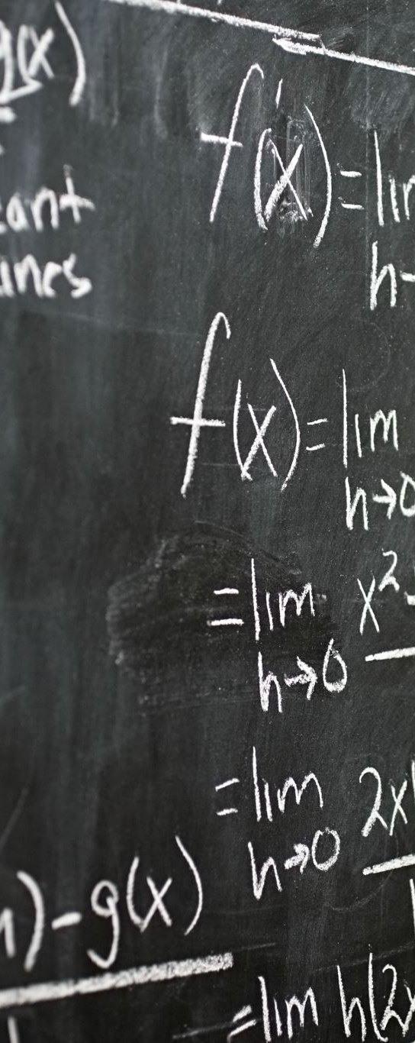
Aristotle: Moral Education
General Rules
  General Rules
    Practical sciences depend on circumstances
    Only general rules can be given
  Ethics is not theoretical
    We are studying not to know goodness, but how to become good men
    Otherwise, it would be useless
  Right Principle
    That we should act according to right principle is assumed as a basis for discussion
Notes:
II General Rules
A. General Rules
1. In a practical science so much depends on particular circumstances that only general rules can be given.
B. Ethics is not theoretical
1. This branch of philosophy unlike others is not theoretical.
2. We are studying not to know goodness, but how to become good men.
3. Otherwise it would be useless.
C. Right Principle
1. That we should act according to right principle is assumed as a basis for discussion.

Slide 70
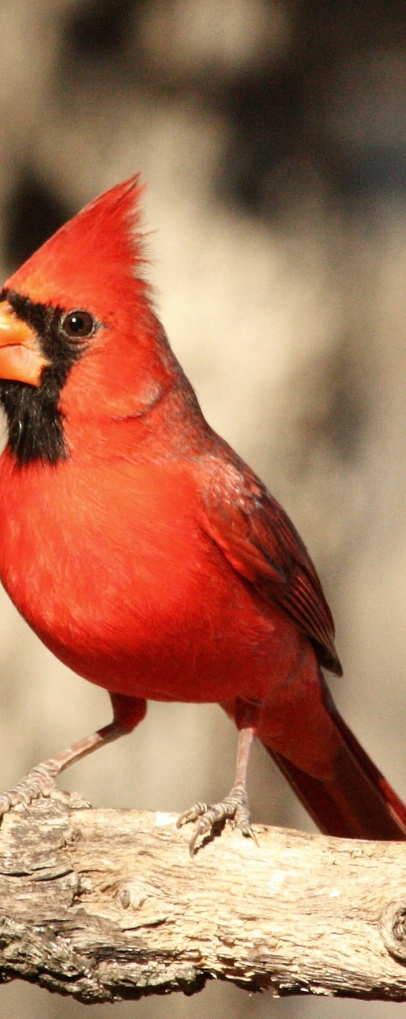
Aristotle: Moral Education
General Rules
  Outline
    Any account of conduct must be stated in outline and not in precise detail
    Health analogy
    Its application to particular problems allows no precision
    They do not fall under any art or professional tradition
    The agents must think out for themselves what the circumstances demand
    Medicine and navigation analogy
  Cardinal Rule
    Right conduct is incompatible with excess or deficiency in feelings and actions
Notes:
C. Right Principle
1. That we should act according to right principle is assumed as a basis for discussion.
D. Outline
1. Any account of conduct must be stated in outline and not in precise detail.
2. Questions of conduct and expedience are as little fixed as what is healthful.
3. Its application to particular problems allows no precision.
4. They do not fall under any art or professional tradition.
5. The agents must at every step to think out for themselves what the circumstances demand.
6. Just as in medicine and navigation.
E. Cardinal rule
1. Right conduct is incompatible with excess or deficiency in feelings and actions.

Slide 71

Aristotle: Moral Education
General Rules
  Analogy to health: destroying
    Moral qualities are destroyed by deficiency and excess, like health
    Excessive and insufficient exercise destroy one’s strength
    Eating and drinking too much or too little destroy health.
    The right quantity produces, increases, and preserves health.
  Virtue: Excess & Deficiency
    What is true for health is true for the virtues
    One who fears everything becomes a coward
    One who is afraid of nothing becomes foolhardy
    One who indulges in every pleasure without restraint becomes licentious
    Temperance and courage are destroyed by excess and deficiency and preserved by the mean.
Notes:
F. Analogy to health-Destroying
1. Moral qualities are destroyed by deficiency and excess, like health.
2. Excessive and insufficient exercise destroy one’s strength
3. Eating and drinking too much or too little destroy health.
4. The right quantity produces, increases, and preserves health.
G. Virtue: Excess & Deficiency
1. What is true for health is true for the virtues.
2. One who fears everything becomes a coward.
3. One who is afraid of nothing becomes foolhardy.
4. One who indulges in every pleasure without restraint becomes licentious.
5. Temperance and courage are destroyed by excess and deficiency and preserved by the mean.

Slide 72

Aristotle: Moral Education
General Rules
  Fostering of Virtues
    Virtues are exercised in the same kinds of action as gave rise to them
    Virtues are fostered by the same actions that destroy them
    The activities that flow from them consist in the same sort of actions
  Health Analogy: fostering
    Physical strength results from plenty of nourishment and severe training
    The strong best carry out this program
  Fostering Virtues
    Analogous to fostering health.
    Examples
Notes:
F. Fostering of Virtues
1. Virtues are exercised in the same kinds of action as gave rise to them.
2. Virtues are fostered by the same actions that destroy them.
3. The activities that flow from them consist in the same sort of actions.
G. Health Analogy-Fostering
1. Physical strength results from plenty of nourishment and severe training.
2. The strong best carry out this program.
H. Fostering Virtues
1. Analogous to fostering health.
2. By refraining from pleasures we become temperate.
3. The temperate are most able to abstain from pleasures.
4. By facing alarming situations we become brave.
5. The brave are most able to face alarming situations.

Slide 73
Aristotle: Moral Education
Pleasure & Pain
  Index of Moral Progress
    Index of moral progress.
    Good conduct lies in a proper attitude towards pleasure and pain.
    The pleasure or pain that accompanies acts is a signs of their dispositions
  Moral Goodness
    It is with pleasures and pains that moral goodness is concerned.
    Pleasure induces to behave badly.
    Pain induces us to shrink from fine actions.
    Plato: true education is being trained from infancy to feel joy and grief at the right things.
    Three factors for choice: the fine, the advantageous, the pleasant.
    Three factors for avoidance: the base, the harmful, the painful.
Notes:
III Pleasure & Pain
A. Index of Moral Progress
1. The pleasure or pain of actions serves as an index of moral progress.
2. Good conduct lies in a proper attitude towards pleasure and pain.
3. The pleasure or pain that accompanies acts is a signs of their dispositions.
4. Example: bodily pleasures.
a. One who enjoys abstaining is temperate.
b. One who finds abstaining irksome is licentious.
5. Example: facing danger.
a. The brace do so gladly or without distress.
b. The coward feels distressed.
B. Moral Goodness
1. It is with pleasures and pains that moral goodness is concerned.
2. Pleasure induces to behave badly.
3. Pain induces us to shrink from fine actions.
4. Plato: true education is being trained from infancy to feel joy and grief at the right things.
5. Every feeling and action is accompanied by pleasure or pain, so virtue is concerned with both.
6. People become bad because of pleasures and pain by shunning or seeking the wrong ones or at the wrong times, or in the wrong way.
7. Three factors for choice: the fine, the advantageous, the pleasant.
8. Three factors for avoidance: the base, the harmful, the painful.

Slide 74
Aristotle: Moral Education
Pleasure & Pain
  Standards of Regulating Actions
    Heraclitus
    Harder course
  Concern
    Concern on morality and political science
Notes:
C. Standards of Regulating Actions
1. Pleasure and pain are the standards used to regulate our actions.
2. Feeling pleasure and pain rightly or wrongly effects conduct, so our whole inquiry must be concerned with these sensations.
3. Heraclitus: it is hard to fight the emotions and even harder to fight pleasure.
4. The harder course is always the concern of art and virtue because success is better in the face of difficulty.
D. Concern
1. The concern of morality and political science must be with pleasures and pains.
2. One who treats them rightly will be good and one who treats them wrongly will be bad.

Slide 75

Aristotle: Moral Education
An Objection & Replies
  Objection
    How can we say that people must perform virtuous actions to become virtuous?
    If they do what is virtuous, they are already virtuous.
    Analogy: if people use words correctly or play music correctly, they are already literate or musical.
  First Reply-Arts
    This is not true even in the arts.
    Words
    Literate if he does a literate act in a literate way-in virtue of his own literacy.
Notes:
IV An Objection & Replies
A. Objection
1. How can we say that people must perform virtuous actions to become virtuous?
2. If they do what is virtuous, they are already virtuous.
3. This is analogous to: if people use words correctly or play music correctly, they are already literate or musical.
B. First Reply-Arts
1. This is not true even in the arts.
2. One can put a few words together correctly by accident or at another’s prompting.
3. One will only be literate if he does a literate act in a literate way-in virtue of his own literacy.

Slide 76
Aristotle: Moral Education
An Objection & Replies
  Reply-Distinguishing
    Works of art have merit in themselves
    Virtuous acts are not done in a virtuous way because they have a certain quality.
    They are only virtuous if the agent also acts in a certain state: he
      Knows what he is doing.
      Chooses to do it and chooses it for its own sake.
      Does it from a fixed and permanent disposition.
    These, knowledge excepted, are not necessary qualifications for the arts.
    For acquiring virtues, knowledge is of little or no force.
    For acquiring virtue, the others are of supreme importance since repeated performance of virtuous acts make us virtuous.
Notes:
C. Reply- Distinguishing Incidentally Virtuous acts From True Virtuous Acts
1. Works of art have merit in themselves; so it is enough to produce them with a certain quality.
2. Virtuous acts are not done in a just or temperate way merely because they have a certain quality.
3. They are only virtuous if the agent also acts in a certain state: he
a. Knows what he is doing.
b. Chooses to do it and chooses it for its own sake.
c. Does it from a fixed and permanent disposition.
4. These, knowledge excepted, are not necessary qualifications for the arts.
5. For acquiring virtues, knowledge is of little or no force.
6. For acquiring virtue, the others are of supreme importance since repeated performance of virtuous acts make us virtuous.

Slide 77
Aristotle: Moral Education
An Objection & Replies
  Reply-Distinguishing & Acquiring
    Acts are called just and temperate when they are such as a just or temperate man would do.
    What makes the agent just or temperate is acting as a just and temperate man does.
    A man becomes virtuous by virtuous acts.
    There is no likelihood of a man becoming good by not doing them.
  Medicine Analogy
    Most have recourse to their principle, imagining they are philosophical
    They are like invalids who listen to a doctor but do not carry out his instructions.
    As bodies of invalids don’t benefit from such treatment, their souls will get none from philosophy.
Notes:
D. Reply-Distinguishing & Acquiring
1. Acts are called just and temperate when they are such as a just or temperate man would do.
2. What makes the agent just or temperate is not acting but acting as a just and temperate man does.
3. A man becomes virtuous by virtuous acts.
4. There is no likelihood of a man becoming good by not doing them.
E. Medicine Analogy
1. Most have recourse to their principle, imagining they are philosophical, and so will become serious-minded.
2. They are like invalids who listen to a doctor but do not carry out his instructions.
3. Just as bodies of invalids don’t benefit from such treatment, their souls will get none from philosophy.

Slide 78

Aristotle: Moral Education
Practice
  Putting it into Practice
    The end is not theoretical knowledge, but putting knowledge into practice.
    It is not enough to know about goodness.
    Must endeavor to possess and use goodness or adopt any means to become good.
  Discourses on Morality
    Discourses
    Discourse on morality can
      Encourage the young who are liberal-minded.
      Render a generous and idealistic character susceptible of virtue.
    Discourses on morality cannot impel the masses towards human perfection.
Notes:
V Practice
A. Putting it into Practice
1. In the case of conduct the end is not theoretical knowledge, but putting knowledge into practice.
2. It is not enough to know about goodness.
3. We must endeavor to possess and use goodness or adopt any means to become good.
B. Discourses on Morality
1. If discourse were enough to make people moral, then such discourses would be what is needed.
2. Discourse on morality can
a. Encourage the young who are liberal-minded.
b. Render a generous and idealistic character susceptible of virtue.
3. Discourses on morality cannot impel the masses towards human perfection.

Slide 79
Aristotle: Moral Education
Practice
  The Many & Discourse
    It is the nature of the many to:
      Be ruled by fear rather than by shame.
      To refrain from evil not because of disgrace but because of punishments.
    Living under the sway of their feelings, the many
      Pursue their pleasures and the means of obtaining them.
      Shun the pains opposite their pleasures.
      Have no conception of what is fine and pleasurable, because they have never tasted it.
    The many cannot be reformed by discourse because dislodging by arguments long embedded habit is difficult if not impossible.
  All Means
Notes:
C. The Many & Discourse
1. It is the nature of the many to:
a. Be ruled by fear rather than by shame.
b. To refrain from evil not because of disgrace but because of punishments.
2. Living under the sway of their feelings, the many
a. Pursue their pleasures and the means of obtaining them.
b. Shun the pains opposite their pleasures.
c. Have no conception of what is fine and truly pleasurable, because they have never tasted it.
3. The many cannot be reformed by discourse because dislodging by arguments long embedded habit is difficult if not impossible.
D. All Means
1. We should be content if the combination of all the means to make us good enables us to attain some portion of goodness.

Slide 80

Aristotle: Moral Education
Practice
  Nature & Instruction
    Goodness can only be induced in a suitably receptive character
    Nature or habit or instruction
    The bounty of nature is beyond our control
    Discussion and instruction are not effective in all cases.
  Analogy to Land
    Land
    Feeling yields to force, not argument.
Notes:
E. Nature & Instruction
1. Goodness can only be induced in a suitably receptive character.
2. Some claim it is by nature or habit or instruction that some people become good.
3. The bounty of nature is beyond our control and is bestowed by divine dispensation upon the fortunate.
4. Discussion and instruction are not effective in all cases.
F. Analogy to land
1. Land has to be prepared before planting.
2. The mind of the pupil has to be prepared in its habits if it is to enjoy and dislike the right things.
3. One who lives by feelings would not listen to an argument to dissuade him or understand it.
4. When a man is in that state it is not possible to persuade him out of it.
5. In general, feeling yields to force, not argument.
6. We must have a character to work on that has an affinity to virtue-appreciates what is noble and objects to what is base.

Slide 81
Aristotle: Moral Education
Education in Goodness
  Education of the Youth
    Obtaining a right training for goodness from an early age is hard, unless one has been brought up under the right laws.
    A temperate and hardy way of life is not pleasant, especially when young.
    Therefore, upbringing and occupations should be regulated by law, because they will cease to be irksome when they have become habitual.
Notes:
VI Education in goodness is best undertaken by the state.
A. First Argument-Education of the Youth
1. Obtaining a right training for goodness from an early age is hard, unless one has been brought up under the right laws.
2. This is because a temperate and hardy way of life is not pleasant to most people, especially when young.
3. Therefore, upbringing and occupations should be regulated by law, because they will cease to be irksome when they have become habitual.

Slide 82
Aristotle: Moral Education
Education in Goodness
  Regulation of Life
    It is not enough to have received the right upbringing and supervision in youth.
    Must keep observing their regimen and accustoming themselves to it
    Laws will be needed to regulate these activities and to cover the whole of life.
    Most are readier to submit to compulsion and punishment than to arguments and fine ideals.
    Some think that Legislators should
      Encourage people to goodness and appeal to their finer feelings
      Inflict chastisement and penalties on any who disobey through deficiency of character and to deport the incorrigible.
    A good man, whose life is related to a fine ideal, will listen to reason.
    The bad man, whose object is pleasure, must be controlled by pain, like a beast
      The pains inflicted should be those most contrary to the favored pleasures.
Notes:
B. Second Argument-Regulation of Life
1. It is not enough to have received the right upbringing and supervision in youth.
2. They must keep observing their regimen and accustoming themselves to it even after they are grown up.
3. Laws will be needed to regulate these activities and to cover the whole of life.
4. For most people are readier to submit to compulsion and punishment than to arguments and fine ideals.
5. Some think that Legislators should
a. Encourage people to goodness and appeal to their finer feelings, in the hope that their habits will respond.
b. Also inflict chastisement and penalties on any who disobey through deficiency of character and to deport the incorrigible. 6. A good man, whose life is related to a fine ideal, will listen to reason.
7. The bad man, whose object is pleasure, must be controlled by pain, like a beast of burden.
a. The pains inflicted should be those most contrary to the favored pleasures.

Slide 83
Aristotle: Moral Education
Education in Goodness
  Guidance
    To be a good man one must have been brought up in the right way and trained in the right habits and must spend the rest of his life in reputable occupations, doing no wrong either with or against one’s will.
    Living under the guidance of a right system that has effective force.
    The orders a father or an individual gives have no forceful or compulsive power in general, unless he is a king.
    Law, being the pronouncement of a kind of practical wisdom or intelligence, does have the power of compulsion.
    Although people resent it when their impulses are opposed by human agents, the law causes no irritation by enjoining decent behavior.
Notes:
D. Third Argument-Guidance
1. To be a good man one must have been brought up in the right way and trained in the right habits and must spend the rest of his life in reputable occupations, doing no wrong either with or against one’s will.
2. This can be achieved by living under the guidance of some intelligence or right system that has effective force.
3. The orders that a father or an individual gives have no forceful or compulsive power in general, unless he is a king.
4. Law, being the pronouncement of a kind of practical wisdom or intelligence, does have the power of compulsion.
5. Although people resent it when their impulses are opposed by human agents, even if they are in the right, the law causes no irritation by enjoining decent behavior.

Slide 84
Aristotle: Moral Education
Education in Goodness
  Parents-Second Choice
    If neglected by the state, it can be supplied by the parent; it calls for knowledge of legislative science.
    Best solution: introduce a proper system of public supervision of these matters.
    If neglected by the state, it would be right for to help children and friends on the way to goodness, and that he should have the power or at least the choice of doing this.
    Producing a right disposition in a person is not a task for anybody: if anyone can do it, it is the man with knowledge.
      Analogy to practical professions.
Notes:
E. Parents-Second Choice
1. If neglected by the state, it can be supplied by the parent; but it calls for some knowledge of legislative science.
2. The best solution would be to introduce a proper system of public supervision of these matters.
3. If neglected by the state, it would be right for each individual to help his children and friends on the way to goodness, and that he should have the power or at least the choice of doing this.
4. Producing a right disposition in a person is not a task for anybody: if anyone can do it, it is the man with knowledge.
a. Just as in the case of medicine and all other professions that call for application and practical understanding.

Slide 85
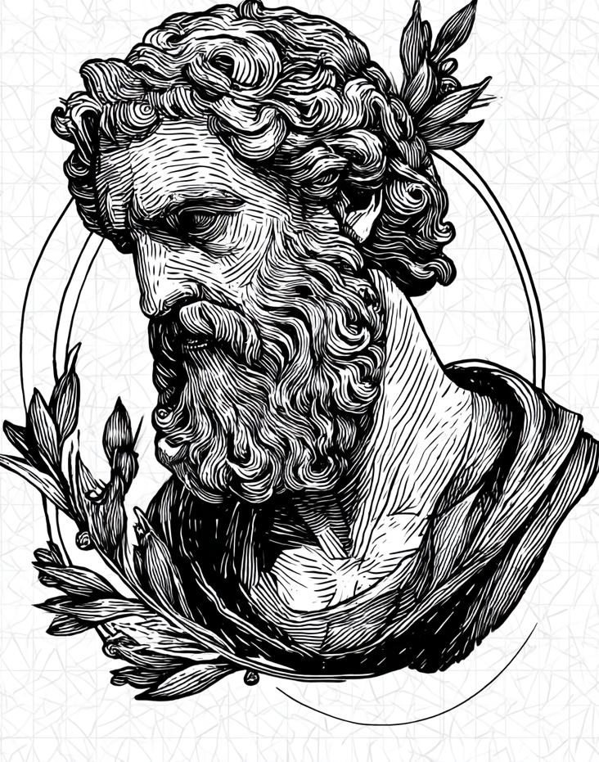
The Latter Ancients
Hellenistic & Roman Philosophy

Slide 86
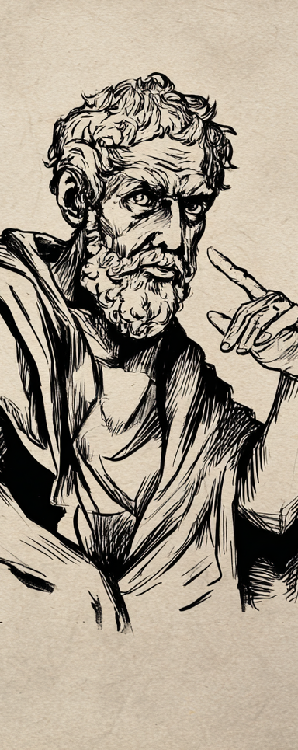
Hellenistic & Roman Philosophy
Hellenic & Hellenistic
The End of the Hellenic
  Death of Alexander the Great (323 B.C.)
  Death of and Aristotle (322 B.C.)
  Hellenic: characterized by Greek civilization being relatively self-contained.
Hellenistic (“quasi-Greek”)
  Blending of Greek culture with other cultures, primarily Egypt and the Near East.
Romans
  2nd and 1st centuries B.C. the Romans expanded and conquered the Hellenistic states.
  The Romans absorbed the Hellenistic culture and passed it on in the Western world.
  Western Roman period ended around the middle of the 6th century AD
  Eastern Roman empire endured about another 1,000 years until the fall of Constantinople.
Notes:
I Hellenic, Hellenistic, and Roman Periods
A. Hellenic & Hellenistic
1. The deaths of Alexander the Great (323 B.C.) and Aristotle (322 B.C.) are taken to mark the end of the Hellenic period and the start of the Hellenistic period.
2. The Hellenic was characterized by Greek civilization being relatively self-contained.
3. The Hellenistic (“quasi-Greek”) was characterized by the blending of Greek culture with other cultures, primarily those of Egypt and the Near East.
B. Roman
1. Begin in the 2nd ^{t} and 1st centuries B.C. as the Romans expanded and conquered the Hellenistic states.
2. The Romans absorbed the Hellenistic culture and passed it on in the Western world.
3. The Western Roman period eventually ended around the middle of the 6th century AD, although the Eastern Roman empire endured about another 1,000 years until the fall of Constantinople.

Slide 87
Hellenistic & Roman Philosophy:
Social Context
Political Changes
  Constant wars between Greek city-states exhausted them
  Greek city-states fell to military empires, ultimately being conquered by Rome.
  History was beyond human control.
  Hellenic: participation in one’s city-state offered opportunities for fulfillment, leading to a sense of civic duty among many Greeks.
  Under foreign empires, most Greeks gave grudging compliance to foreign laws.
Social Problems
  The social problems that motivated Socrates remained.
  Lack of integrating values
  Old institutions had failed
  The old religions declined
  The Greek gods seemed impotent
  The fates seemed to rule the day.
Notes:
II Social Context
A. Political Changes
1. The constant wars between the Greek city-states exhausted their physical and spiritual resources.
2. The Greek city-states fell under the rule of military empires, ultimately being conquered by Rome.
3. These events seemed to show that history was beyond human control.
4. In the Hellenic period participation in one’s city-state offered opportunities for fulfillment, leading to a sense of civic duty among many Greeks.
5. Under the rule of foreign empires, most Greeks merely gave grudging compliance to the foreign laws.
B. Social Problems
1. The social problems that motivated Socrates still remained.
2. There was a lack of integrating values that could produce social cohesion.
3. Old institutions had failed, the old religions declined, the Greek gods seemed impotent, and the fates seemed to rule the day.

Slide 88
Hellenistic & Roman Philosophy:
Effects on Philosophy
Approaches
  Philosophers tended to adopt individualistic, practical approaches to philosophy.
  Focus on solutions to the problems of this life: ethics and practical matters.
    What is most worthwhile in life?
    What is left to strive for?
    What does one need to know to shape their life?
  Goal: develop a philosophy offering peace and escape from the dismal nature of the times.
  Theoretical knowledge only valued to the extent that it enabled one to make life better.
    Most thinkers scavenged the work of predecessors.
Notes:
A. Approaches
1. Philosophers tended to adopt individualistic, practical approaches to philosophy.
2. The main focus was offering solutions to the problems of this life: ethics and practical matters.
a. What is most worthwhile in life?
b. What is left to strive for?
c. What does one need to know to shape his life?
3. The goal was to develop a philosophy offering peace and escape from the dismal nature of the times.
4. Theoretical knowledge was only valued to the extent that it enabled one to make his/her life better.
a. Hence, most thinkers tended to scavenge the work of their predecessors.

Slide 89
Hellenistic & Roman Philosophy:
Seven Schools of Thought
Academics
  Plato’s Academy.
  Drifted far from Plato’s views.
  Taken over by the Skeptics.
Peripatetics
  Aristotle’s school.
  Concerned with empirical observation and science.
  Lacked some of Aristotle’s integrating approach.
Cynicism
Epicureanism
Stoicism
Skepticism
Neoplatonism
Notes:
1. Academics
a. Carried on Plato’s Academy.
b. The Academy drifted far from Plato’s views.
c. Was taken over by the Skeptics at one point.
2. Peripatetics
a. Carried on Aristotle’s school.
b. Mainly concerned with empirical observation and science.
c. Lacked some of Aristotle’s integrating approach.
3. Cynicism.
4. Epicureanism.
5. Stoicism.
6. Skepticism.
7. Neoplatonism.

Slide 90

Cynicism
Founded by Antisthenes (445-365 B.C.).
  Student of the Sophist Gorgias.
  Student of Socrates
  Considered himself the true heir of Socrates.
“Cynic” means “canine.”
  Diogenes’ self-given nickname “the dog.”
  Possibly an insult by the opponents of the Cynics.
  Might be from the Cynosarges, where Antisthenes taught.
Notes:
I Introduction
A. Background
1. Founded by Antisthenes (approximately 445-365 B.C.).
a. Once a student of the Sophist Gorgias.
b. Became a student of Socrates and considered himself to be the true heir of Socrates.
2. “Cynic” means “canine.”
a. The name might come from Diogenes’ self-given nickname “the dog.”
b. It might have been used as an insult by the opponents of the Cynics.
c. Or it might be from the Cynosarges, where Antisthenes taught.

Slide 91
Cynicism’s Views
Stance
  More an approach to life, a stance, than a developed philosophy.
Opposition to Convention
  Like Sophists, their emphasis was on the opposition of nature and convention.
  Endorsed doing what was natural and in repudiating social conventions.
  Social conventions are artificial and tyrannical.
Ethical View
  Happiness stems from virtue
  Virtue is acquired by achieving freedom from earthly possessions and pleasures.
  Antisthenes said he would rather fall victim to madness than to desire.
  Value only one’s natural mental and spiritual possessions because everything else is without value.
  External and physical possessions, such as wealth, freedom and honor are valueless.
  External things like poverty, shame, loss of liberty, sickness and death are not evil.
Notes:
Views
A. Stance
1. Cynicism tended to be more of an approach to life, a stance, than a developed philosophy.
B. Opposition to Convention
1. Like the Sophists, their main emphasis was on the opposition of nature and convention.
2. They endorsed doing what was natural and in repudiating social conventions.
3. Social conventions were regarded as artificial and tyrannical.
C. Ethical View
1. Happiness stems from virtue and virtue is acquired by achieving freedom from all earthly possessions and pleasures.
2. Antisthenes said he would rather fall victim to madness than to desire.
3. The key is to value only one’s natural mental and spiritual possessions because everything else is without value.
4. External and physical possessions, such as wealth, freedom and honor are valueless.
5. External things like poverty, shame, loss of liberty, sickness and death are not evil.

Slide 92
Cynicism’s Views
Religion
  There is one God.
  God is best served by virtue.
  Organized religion and its external, worldly trappings were condemned as human constructions.
Behavior
  Attempted to undermine conventional values of society, which they saw as artificial and corrupt.
  They took care of their “biological needs” in public.
  Insulting in manner
  Squalid in appearance, wearing tattered ponchos and leather pouches.
  Traveled, preaching about the follies of humanity.
Notes:
D. Religion
1. There is one God.
2. God is best served by the practice of virtue.
3. Organized religion and all its external, worldly trappings were condemned as human constructions.
E. Behavior
1. The Cynics spared no effort in their attempts to undermine the conventional values of society, which they saw as artificial and corrupt.
2. They took care of their biological needs in public.
3. They were insulting in manner and squalid in appearance, wearing tattered ponchos and leather pouches.
4. They traveled from place to place, preaching about the follies of humanity.

Slide 93
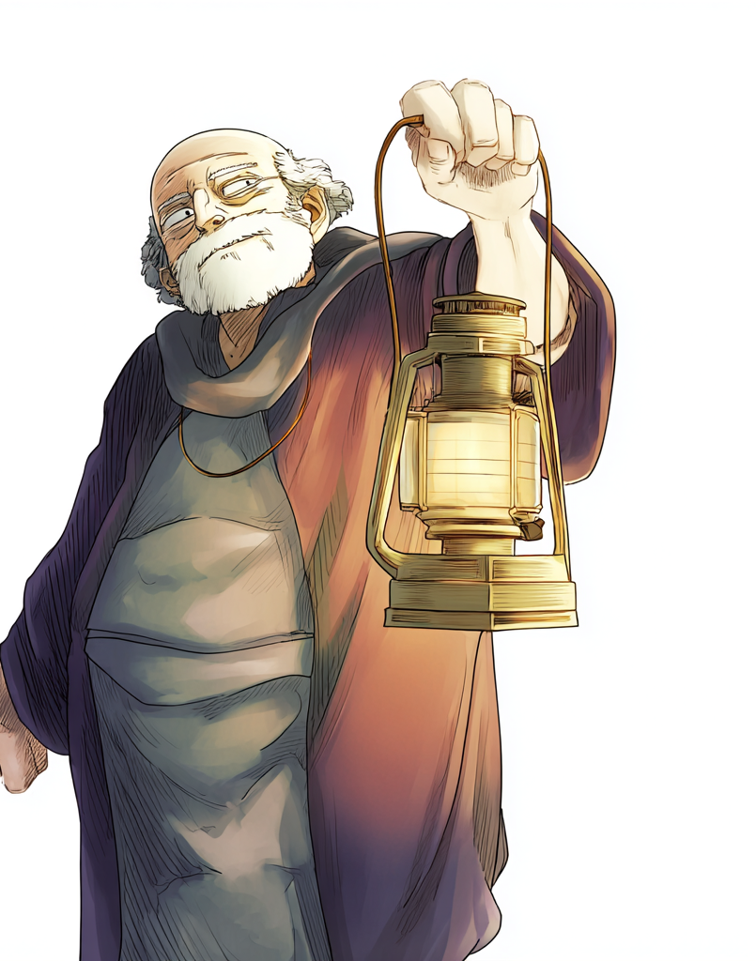
Diogenes the Cynic
Diogenes of Sinope (412-323 B.C)
  Nicknamed himself “the dog.”
  Admired animals because they stuck to the bare necessities.
  Went about with a lantern at midday, looking for an honest man.
  When Alexander the Great entered Corinth, he was moved by Diogenes’condition and asked if he could do anything for him.
  Diogenes is said to have replied, “Stand out of my light.”
His follower Crates brought to the Stoics
  Concern with virtue.
  Lack of concern about worldly matters.
  Freedom from the narrow limits of a culture.
Notes:
F. Diogenes of Sinope
1. 412-323 B.C
2. Nicknamed himself “the dog.”
3. Admired animals because they stuck to the bare necessities.
4. Diogenes is said to have gone about with a lantern at midday, looking for an honest man.
5. It is said that when Alexander the Great entered Corinth, he was moved by Diogenes’ condition and asked if he could do anything for him.
a. Diogenes is said to have replied, “Stand out of my light.”
6. His follower Crates brought the Cynics concern with virtue, lack of concern about worldly matters and their freedom from the narrow limits of a culture to the Stoics.

Slide 94
Epicureanism
Epicurus (341-270 B.C.)
  Taught at The Garden
    A school in a garden on the outskirts of Athens.
  Open to all and included men, women, children, slaves, warriors, prostitutes, and prominent Athenians.
  Known for his affection.
  Loved by his followers who held a monthly feast and a yearly birthday party.
  His philosophy was spread throughout the Greek world by his followers.
    Used catechisms (doctrinal manuals with Q&A)
  300+ scrolls of his writings, only three letters and some fragments surviving.
Notes:
I Epicurus
A. Background
1. 341-270 B.C.
2. He taught at The Garden, a school located in a garden on the outskirts of Athens.
3. His school was open to all and included men, women, children, slaves, warriors, prostitutes, and prominent Athenians.
4. He was known for his affection.
5. He was so loved by his followers that they, as per his will, held a monthly feast and a yearly birthday party.
6. Many people found the philosophy attractive and it was spread throughout the Greek world with great vigor by his followers.
7. His works were spread by catechism.
8. It is believed that there were 300+ scrolls of his writings, only three letters and some fragments have lasted to the present day.

Slide 95
Epicurean Metaphysics
Purpose of Philosophy
  To heal the soul and bring about a happy existence.
  Theoretical speculation that did not serve practical needs was looked down on.
  A philosophical argument is empty unless it heals human disease.
    As medicine is without benefit if it does not heal the diseases of the body,
    philosophy is without benefit if it does not cure the disease of the soul.
  The disease of the soul is psychological turmoil.
  Turmoil is created by false beliefs about what is true and valuable.
Notes:
II Epicurean Metaphysics
A. Purpose of Philosophy
1. The point of philosophy is to heal the soul and bring about a happy existence.
2. Theoretical speculation that did not serve practical needs was looked down on.
3. He claimed that a philosophical argument is empty unless it heals human disease.
4. As medicine is without benefit if it does not heal the diseases of the body, philosophy is without benefit if it does not cure the disease of the soul.
5. The disease of the soul is psychological turmoil.
6. This turmoil is created by false beliefs about what is true and valuable.

Slide 96

Epicurean Metaphysics
Metaphysics
  Metaphysics is to serve as an antidote.
  Reality: an infinite number of atoms moving in an infinite void.
  Atoms have various sizes and shapes.
  Since atoms are matter, they must have weight.
  Their natural movement is downward in the void.
  The atoms randomly swerve which causes them to collide and form objects.
  Humans are collections of moving atoms.
  The soul is a material entity made up of fine atoms in the body.
  Since atoms can spontaneously go off their paths, not everything is determined or predictable.
  They took this as enabling free will.
Notes:
B. Metaphysics
1. Metaphysics is to serve as an antidote.
2. Reality is composed of an infinite number of atoms moving in an infinite void.
3. The atoms have various sizes and shapes.
4. Since atoms are matter, they must have weight.
5. Their natural movement is downward in the void.
6. The atoms randomly swerve which causes them to collide and form objects.
7. Humans are collections of moving atoms.
8. The soul is a material entity made up of fine atoms in the body.
9. Since atoms can spontaneously go off their paths, not everything is determined or predictable.
10. They took this as enabling free will.

Slide 97
Epicurean Ethics
Psychological Hedonism
  Materialism of Epicureanism precludes non-physical values such as the Platonic good.
  Values must be grounded on the atoms.
  Values depend on pleasure and pain from atoms interacting with the senses.
  Psychological hedonism: It is a psychological fact that pleasure motivates all human activities.
    “Pleasure is the starting point and goal of living blessedly.”
  All actions are explainable in terms of pursuing physical or psychological pleasures.
  People do things because they want to and they want to because doing so makes living more pleasant.
Notes:
A. Psychological Hedonism
1. The materialism of Epicureanism precluded the existence of any non-physical values such as the Platonic good.
2. Values must be grounded on the atoms and their behavior.
3. Specifically, values depend on the production of pleasure and pain resulting from the atoms interacting with the senses.
4. Psychological hedonism: It is a psychological fact that pleasure motivates all human activities.
a. “Pleasure is the starting point and goal of living blessedly.”
5. All actions are explainable in terms of pursuing physical or psychological pleasures.
6. He reasons that people do things because they want to and they want to because doing so makes living more pleasant.

Slide 98
Epicurean Ethics
Ethical Hedonism
  If psychological hedonism is correct, then it is plausible to base ethics upon it.
  Good is pleasure and evil is pain.
  Ethical hedonism: only pleasure is good.
  Pursuit of pleasure and avoidance of pain describes human behavior (psychological hedonism) and prescribes what is of highest value (ethical hedonism).
  Hence, the injunction to pursue good and avoid evil is an injunction to pursue pleasure and avoid pain.
  Imprudent pursuit of pleasure could be problematic.
  The good life achieves repose, tranquility or quietude.
  The goal is ataraxia, freedom from worry, attained by avoiding pain and pursuing the proper pleasures.
  Certain pleasures, such as overdrinking, promiscuity, and overeating provide momentary pleasures but lead to lasting pains.
  Mental pleasures and friendship are lasting and lead to repose, tranquility or quietude.
Notes:
B. Ethical Hedonism
1. If psychological hedonism is correct, then it is plausible to base ethics upon it.
2. Good is identified with pleasure and evil with pain.
3. Ethical hedonism: only pleasure is good.
4. The pursuit of pleasure and the avoidance of pain describes human behavior (psychological hedonism) and prescribes what is of highest value (ethical hedonism).
5. Hence, the injunction to pursue good and avoid evil amounts to an injunction to pursue pleasure and avoid pain.
6. He was aware that the imprudent pursuit of pleasure could be problematic.
7. The good life is a life that achieves repose, tranquility or quietude.
8. The goal is ataraxia, freedom from worry, which is attained by avoiding pain and pursuing the proper pleasures.
9. Certain pleasures, such as overdrinking, promiscuity, overeating and so on provide momentary pleasures but lead to lasting pains.
10. Mental pleasures and friendship are lasting and lead to repose, tranquility or quietude.

Slide 99
Epicurean Ethics
C. Types of Desire
1. From a letter to Menoeceus.
2. Groundless: not based in nature.
a. Examples: fame and luxuries.
3. Natural, but unnecessary
a. Examples: sex, delicious food and drink.
4. Natural and necessary for happiness.
a. Examples: wisdom, friendship.
5. Natural and necessary for comfort.
a. Examples: clothing
6. Natural and necessary for life.
a. Examples: water, food.
Notes:
C. Types of Desire
1. From a letter to Menoeceus.
2. Groundless: not based in nature.
a. Examples: fame and luxuries.
3. Natural, but unnecessary
a. Examples: sex, delicious food and drink.
4. Natural and necessary for happiness.
a. Examples: wisdom, friendship.
5. Natural and necessary for comfort.
a. Examples: clothing
6. Natural and necessary for life.
a. Examples: water, food.

Slide 100

Epicurean Ethics
The life of the happy person consists in:
  Prudence
  Self-sufficiency
  Sober reasoning
  Honor
  Justice
  Wisdom.
  Bodily health
  Peace of mind
  Plain food
Notes:
D. The life of the happy person consists in:
1. Prudence
2. Self-sufficiency.
3. Sober reasoning.
4. Honor
5. Justice
6. Wisdom.
7. Bodily health
8. Peace of mind
9. Plain food

Slide 101
Epicurean Ethics
Pleasure
  Lived frugal and austere lives.
  Emphasis on friendship as the highest pleasure.
  Moral virtue was not a matter of excellence or an end achieved for its own sake.
  Virtue is a means to an end, that of pleasure.
  “One must honour the noble, and the virtues and things like that, if they produce pleasure. But if they do not, one must bid them goodbye.”
Notes:
E. Pleasure
1. The Epicureans lived frugal and austere lives and put a great deal of emphasis on friendship as the highest pleasure.
2. Moral virtue was not a matter of excellence or an end achieved for its own sake.
3. Virtue is a means to an end, that of pleasure.
4. “One must honour the noble, and the virtues and things like that, if they produce pleasure. But if they do not, one must bid them goodbye.”

Slide 102
Epicurean Social Thought
Individualism
  Little concern with social & political philosophy.
Views
  Civil laws are based on convention and expediency.
  Civil laws are to be obeyed on entirely pragmatic grounds.
    Doing so will result in a more peaceful life.
Warned against political involvement
  It leads to disquiet from responsibilities and the creation of enemies.
  The wise avoid politics.
  “The purest security is that which comes from a quiet life and withdrawal from the many.”
Notes:
IV Epicurean Social Thought
A. Individualism
1. The individualistic nature of Epicureanism entailed that there was little concern with social & political philosophy.
B. Views
1. Civil laws are based on convention and expediency.
2. Civil laws are to be obeyed on entirely pragmatic grounds-doing so will result in a more peaceful life.
3. He warned against political involvement for it leads to disquiet from responsibilities and the creation of enemies.
4. The wise avoid politics.
5. “The purest security is that which comes from a quiet life and withdrawal from the many.”

Slide 103
Epicurean Views of Religion & Death
The Gods
  The fear produced by myths concerning the god and the afterlife is a disease of the soul.
  The gods have physical bodies.
  The gods are immortal because their atoms are different from all other atoms.
  The gods are too aloof and too concerned with their own pleasure to interfere with this world.
  The gods spend their time in a way that is the most blessed and best supplied with all kinds of good things.
  The gods are idle and are not entangled with any serious preoccupations.
  The gods do not toil but rejoice in their wisdom and virtue.
  The gods are certain they will always experience supreme and eternal pleasures.
  We need not worry about appeasing the gods or their punishment because they are too peaceful to be capable of gratitude or anger.
  This realization allows people to live without fear of the gods.
Notes:
V Epicurean Views of Religion and Death
A. The Gods
1. The fear produced by myths concerning the god and the afterlife is a disease of the soul.
2. Given his materialism and view that immaterial substance is nonsense, he claims that the gods have physical bodies.
3. The gods are immortal because their atoms are different from all other atoms.
4. The gods are too aloof and too concerned with their own pleasure to interfere with this world.
5. The gods spend their time in a way that is the most blessed and best supplied with all kinds of good things.
6. The gods are idle and are not entangled with any serious preoccupations.
7. The gods do not toil but rejoice in their wisdom and virtue.
8. The gods are certain they will always experience supreme and eternal pleasures.
9. We need not worry about appeasing the gods or their punishment because they are too peaceful to be capable of gratitude or anger.
10. This realization allows people to live without fear of the gods.

Slide 104

Epicurean Views of Religion & Death
Death
  If we exist, then death does not.
  If death exists, then we do not.
  We will never experience death because
    Death is when the soul atoms disperse with the last breath
    Ending our ability to experience pain and pleasure.
  All good and bad lies in sense-experience.
    Death is the cessation of this experience.
  Knowing this makes mortality a matter of contentment “not by adding a limitless time to life but by removing the longing for immortality.”
Notes:
B. Death
1. If we exist, then death does not.
2. If death exists, then we do not.
3. We will never experience death because death is when the soul atoms disperse with the last breath, ending our ability to experience pain and pleasure.
4. All good and bad lies in sense-experience and death is the cessation of this experience.
5. Knowing this makes mortality a matter of contentment “not by adding a limitless time to life but by removing the longing for immortality.”

Slide 105
Epicureanism: Criticisms & Concerns
Virtue
  Epicureans lived virtuously only because virtue was valued for egoistic consequences.
  The reason to be moral is that doing so is advantageous
    It makes life more pleasant.
  One should be just to avoid consequences from the exposure of one’s injustices.
  Epicureans have no grounds for criticizing someone who takes the pleasures of being unjust to outweigh the pains.
Notes:
A. Virtue
1. Epicureans lived virtuously but only because virtue was valued only for its egoistic consequences.
2. The reason to be moral is that doing so is advantageous-it makes life more pleasant.
3. One should be just to avoid the consequences resulting from the exposure of one’s injustices.
4. The Epicureans seems to have no grounds for criticizing someone who takes the pleasures of being unjust to outweigh the pains-assuming the pleasure really did outweigh the pain.

Slide 106
Epicureanism: Criticisms & Concerns
Friendship
  “Friendship comes to be because of its utility.”
  Friendship seems chosen by self-serving opportunist as the result of calculated scheming.
  Epicurus seemed to have been better than the implications of his philosophy.
    Friendship might require sacrificing one’s life for a friend.
  “every friendship is worth choosing for its own sake.”
  His theory entails that friendship has only extrinsic value in terms of the pleasure the person gets from friendships.
Notes:
B. Friendship
1. “Friendship comes to be because of its utility.”
2. This makes it seem that friendship is chosen by self-serving opportunist as the result of calculated scheming.
3. Epicurus himself seemed to have been better than the implications of his philosophy.
a. He claimed that friendship might require sacrificing one’s life for a friend.
b. He also claimed that “every friendship is worth choosing for its own sake.”
4. His theory entails that friendship has mere extrinsic value in terms of the pleasure the person gets from his friendships.

Slide 107
Epicureanism: Criticisms & Concerns
Social Involvement
  Individualism and withdrawal of Epicureanism characterized the Hellenistic era.
  Contrast with social philosophies of Plato and Aristotle
    The importance of the political life for goodness
    The importance of improving the state.
  It is not possible to have a meaningful engagement with society beyond a circle of friends.
Successful
  It spread rapidly and far.
  Endured until the 4th century A.D.
Notes:
C. Social Involvement
1. The individualism and withdrawal inherent to Epicureanism characterized the Hellenistic era.
2. His views contrasted starkly with the social philosophies of Plato and Aristotle who regarded the importance of the political life for goodness and the importance of improving the state.
3. The Epicureans held that it was not possible to have a meaningful engagement with society beyond a circle of friends.
4. The philosophy was successful-it spread rapidly and far; it also endured until the 4th century A.D.

Slide 108
Stoicism: Background
Rivalry with Epicureanism
  Stoicism arose contemporaneously with Epicureanism.
  Stoicism was successful and rivaled Epicureanism.
  Both endured into the Christian era
    Paul spoke before both groups in Athens (Acts 17).
Notes:
Rivalry with Epicureanism
1. Stoicism arose contemporaneously with Epicureanism.
2. Stoicism was successful and rivaled Epicureanism.
3. Both endured into the Christian era-Paul spoke before both groups in Athens (Acts 17).

Slide 109
Stoicism: Background
Zeno (336-264 B.C).
  Not the Zeno who was a student of Parmenides.
  From Citium in Cyprus.
  Founded a school in Athens.
  He taught from a porch, which is stoa in Greek
    Hence the name “stoicism.”
  His teachings attracted many followers.
  He was admired and officially honored by Athens.
Notes:
B. Zeno
1. Lived 336-264 B.C.
2. Not to be confused with the Zeno who was a student of Parmenides.
3. From Citium in Cyprus.
4. Founded a school in Athens.
5. He taught from a porch, which is stoa in Greek-hence the name “stoicism.”
6. His teachings attracted many followers.
7. He was admired and officially honored by Athens.

Slide 110
Stoicism & Epicureanism
Similarities
  Both were popular while remaining philosophy.
    Presented rational arguments for their views.
  Both dealt with logic and physics, but focused on their application to applied ethics.
  Both accepted physicalism and empiricism.
  Both encouraged people to act in accord with nature.
Notes:
A. Similarities
1. Both philosophies were popular while still remaining philosophy-they presented rational arguments for their views.
2. Both dealt with logic and physics, but focused on their application to applied ethics.
3. Both accepted physicalism and empiricism.
4. Both encouraged people to act in accord with nature.

Slide 111

Stoicism & Epicureanism
Differences
  Epicureans: the material universe is one of blind chance, with a small element of free will.
  Stoics: the material universe is run by a benevolent, divine plan.
  Epicureans: Humans are pleasure seekers and pleasure is the highest good.
  Virtue has instrumental value.
  Stoics: Virtue, duty, character and self-discipline have intrinsic value.
    Based on Socrates’ view that no real harm can befall a person who is virtuous.
  Epicureans: Social philosophy is based on enlightened self-interest
    Looked down on social involvement beyond one’s circle of friends.
  Stoics: social philosophy is based on the view that we should put universal ends ahead of our own selfish interests
    Regarded humanity as a family.
Notes:
B. Differences
1. Epicureans: the material universe is one of blind chance, with a small element of free will.
2. Stoics: the material universe is run by a benevolent, divine plan.
3. Epicureans: Humans are pleasure seekers and pleasure is the highest good.
a. Virtue has instrumental value.
4. Stoics: Virtue, duty, character and self-discipline have intrinsic value.
a. Based on Socrates’ view that no real harm can befall a person who is virtuous.
5. Epicureans: Their social philosophy is based on enlightened self-interest and they looked down on social involvement beyond that of one’s circle of friends.
6. Stoics: Their social philosophy is based on the view that we should put universal ends ahead of our own selfish interests and they regarded humanity as a family.

Slide 112
Stoic Metaphysics
Materialism
  Physicalists.
  Denied the existence of chance.
  God, the human soul, the forms and forces are all material but are made of fine matter called pneuma (breath/wind).
Teleology & The Divine
  The universe is purposeful and imbued with the divine.
  The divinity is caring and just.
  Used many names for the divine: Zeus, God, Nature, Order, Universal Reason, Fate, Destiny, and Providence.
  The divinity wisely guides all things towards the most perfect, beautiful and good outcome possible.
Notes:
Materialism
Physicalists.
Denied the existence of chance.
God, the human soul, the forms and forces are all material but are made of fine matter called pneuma (breath/wind).
B. Teleology & The Divine
1. The universe was purposeful and imbued with the divine.
2. The divinity is caring and just.
3. The Stoics used many names for the divine: Zeus, God, Nature, Order, Universal Reason, Fate, Destiny, and Providence.
4. The divinity wisely guides all things towards the most perfect, beautiful and good outcome possible.

Slide 113

Stoic Metaphysics
Teleology & The Divine Continued
  The divinity is transcendent and diffused through the world, thus assuming its form.
  The divinity is the Logos (rational principle) and is immanent in the world as its creative and guiding power.
  The Logos is all permeating fiery vapor that is manifested in
    The fiery spheres of the heavens.
    The warmth and vitality of living things.
    Rational thought in the human soul.
  The world is a continuum, like a field, as opposed to the distinct atoms of the Epicureans.
  The Logos is the soul and reason of the world which is regarded as a living thing.
  Logoi: sparks of the divine that are dispersed throughout the world to guide the development of things.
Notes:
.
5. The divinity is both transcendent and diffused through the world, thus assuming its form.
6. The divinity is the Logos (rational principle) and is immanent in the world as its creative and guiding power.
7. The Logos is all permeating fiery vapor that is manifested in
a. The fiery spheres of the heavens.
b. The warmth and vitality of living things.
c. Rational thought in the human soul.
8. The world is a continuum, like a field, as opposed to the distinct atoms of the Epicureans.
9. The Logos is the soul and reason of the world which is regarded as a living thing.
10. Logoi: sparks of the divine that are dispersed throughout the world to guide the development of things.

Slide 114

Stoic Metaphysics
Necessity
  The divinity is not free
    The process of nature arises from his substance with necessity.
  There is no chance or contingency in the world.
  All events are determined
  Nothing could be anyway other than its is or was.
  The world is the product of a benevolent divinity and hence nurtures and fulfills the deepest human needs.
Notes:
C. Necessity
1. The divinity is not free-the process of nature arises from his substance with necessity.
2. There is no chance or contingency in the world.
3. All events are determined and nothing could be anyway other than its is or was.
4. This determined world is the product of a benevolent divinity and hence nurtures and fulfills the deepest human needs.

Slide 115

Stoic Metaphysics
Human Beings
  Sparks of the divine fire.
  A microcosm of the whole universe.
  Human reason mirrors the Logos and hence can have knowledge of the universe.
  Souls endure after death until the world ends and then they return to the divine along with everything else.
    Cleanthes (331-232 B.C.): All souls endure after death.
    Chrysippus (280-207 B.C.): Only virtuous souls endure after death.
Notes:
D. Human Beings
1. Humans are sparks of the divine fire.
2. Each human is a microcosm of the whole universe.
3. Human reason mirrors the Logos and hence can have knowledge of the universe.
4. Souls endure after death until the world ends and then they return to the divine along with everything else.
a. Cleanthes (331-232 B.C.): All souls endure after death.
b. Chrysippus (280-207 B.C.): Only virtuous solves endure after death.

Slide 116

Stoic Metaphysics: The Problem of Evil
Problem: If every aspect of the world is directed by a benevolent divinity, how does one explain the existence of evil?
  Some Stoics explained evil in terms of human wickedness, but this would only explain evils caused by humans and not natural evils.
Response #1: if we could see the world as a whole, then we would see that it is perfect, beautiful and good.
  Evil is a mere illusion created by our short sightedness.
Response #2: Some evils are necessary for achieving good.
  Evil is essential for virtue
  Without vice and suffering, there could be no virtues such as courage, patience, temperance, etc..
Response #3: Evil cannot affect virtuous people.
Notes:
E. The Problem of Evil
1. If every aspect of the world is directed by a benevolent divinity, how does one explain the existence of evil?
2. Some Stoics explained evil in terms of human wickedness, but this would at most explain evils caused by humans and not natural evils.
3. Response #1: if we could see the world as a whole, then we would see that it is perfect, beautiful and good.
a. Evil is a mere illusion created by our short sightedness.
4. Response #2: Some evils are necessary for achieving good.
a. Evil is essential for virtue-without vice and suffering, there could be no virtues such as courage, patience, temperance, ect.
5. Response #3: Evil cannot affect virtuous people.

Slide 117
Stoic Ethics
Life
  The highest good is a life lived in accord with reason.
  Happiness is acquired by living such a life.
  Goal: Make one’s mind a mirror of the order of the world
  S toic metaphysics connects to their moral theory.
Notes:
A. Life
1. The highest good is a life lived in accord with reason.
2. Happiness is acquired by living such a life.
3. The goal is to make one’s mind a mirror of the order of the world, thus the Stoic metaphysics connects to their moral theory.

Slide 118

Stoic Ethics
Achieving Rational Control
  Become free from passion-.
    A person controlled by their passions is not rationally determining her existence.
  Make your happiness depend only on what you can control.
    Love, fame, wealth and pleasure depend on outside factors.
    It is unwise to make them goals.
  Realize the universe is determined and cannot be changed.
  Realize you can control your attitude towards life and choose to accept that everything that occurs expresses the will of the divinity and is an essential part of the beautiful and good purpose of the divinity.
  Avoid resisting the irresistible course of necessity and simply go along with it.
  Base your happiness on the achievement of virtue and inner peace.
Notes:
B. Achieving Rational Control
1. Become free from passion- a person controlled by their passions is not rationally determining her existence.
2. Make your happiness depend only on what you can control.
a. Love, fame, wealth and pleasure depend on outside factors, thus it is unwise to make them goals.
3. Realize that the universe is determined and that it cannot be changed.
4. Realize that you can control your attitude towards life and choose to accept that everything that occurs expresses the will of the divinity and is an essential part of the beautiful and good purpose of the divinity.
5. Avoid resisting the irresistible course of necessity and simply go along with it.
6. Base your happiness on the achievement of virtue and inner peace.

Slide 119
Stoic Ethics: Advice
Zeno & Chrysippus-the dog & wagon analogy.
  A dog is tied to a wagon.
  If the dog wishes to follow, the wagon pulls and he follows so his own power and necessity are united.
  If he does not want to follow, he will be pulled along anyway.
  The same is true of humanity-if a person does not wish to follow, they will be pulled to the “fated event.”
Epictetus (50-138 A.D.): “Ask not that events should happen as you will but let your will be that events should happen as they do, and you shall have peace.”
Notes:
C. Stoic Advice
1. Zeno & Chrysippus-the dog & wagon analogy.
a. A dog is tied to a wagon.
b. If the dog wishes to follow, the wagon pulls and he follows so his own power and necessity are united.
c. If he does not want to follow, he will be pulled along anyway.
d. The same is true of humanity-if a person does not wish to follow, they will be pulled along anyway to the “fated event.”
2. Epictetus (50-138 A.D.): “Ask not that events should happen as you will, but let your will be that events should happen as they do, and you shall have peace.”

Slide 120
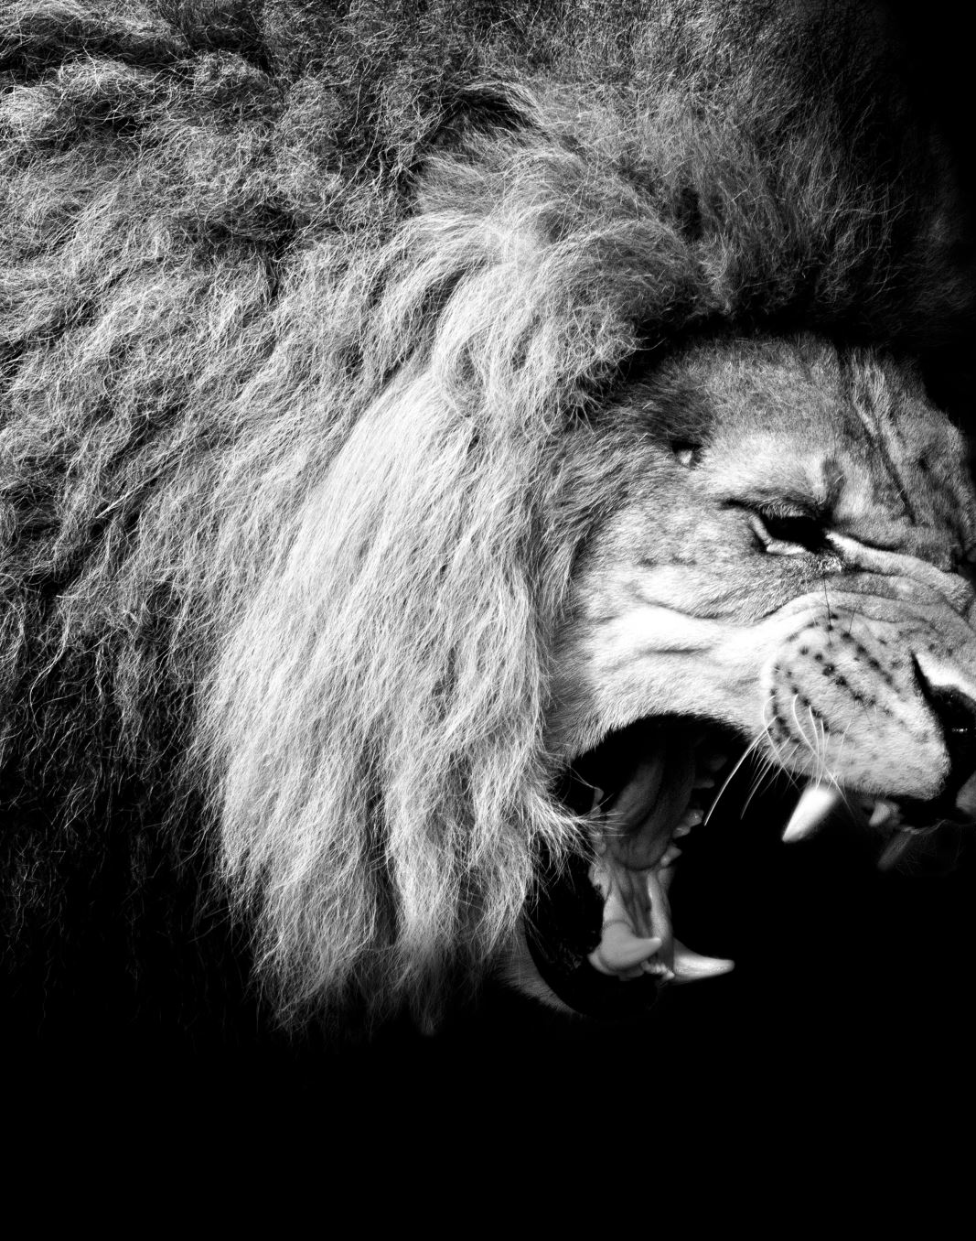
Stoic Ethics
Reason, Freedom & Emotions
  You are free if you act based on reason.
  The alternative is to be governed by desires, like animals.
  Moral evils arise from desires/passions and they need to be eliminated.
Notes:
D. Reason, Freedom & Emotions
1. You are free as long as you act on the basis of reason.
2. The alternative is to be governed by desires, like animals.
3. Moral evils arise from desires/passions and they need to be eliminated.

Slide 121

Stoic Ethics: Four Kinds of Emotions
Chrysippus: there are four general kinds of emotions and all are based on mistaken judgments.
  Pleasure: based on a present good.
  Desire: based on the anticipation of a future good.
  Grief: based on dismay about a present evil.
  Fear: based on dismay about a future evil.
As all events are inevitable and occur from necessity as part of the benevolent plan of the divinity, it is irrational to be affected by emotions.
Notes:
E. Four Kinds of Emotions
1. According to Chrysippus, there are four general kinds of emotions and all are based on mistaken judgments.
2. Pleasure: based on a present good.
3. Desire: based on the anticipation of a future good.
4. Grief: based on dismay about a present evil.
5. Fear: based on dismay about a future evil.
6. Since all events are inevitable and occur from necessity as part of the benevolent plan of the divinity, it is irrational to be affected by emotions.

Slide 122
Stoic Ethics
Apathy
  The Stoic ideal was to achieve as state of apathy.
  Apathy is freedom from passion and a refusal to be dismayed by events.
Death
  Death is not an evil nor is it to be feared.
  Death is a natural and necessary aspect of existence.
  Stoics were willing to commit suicide when they thought it appropriate.
  When Zeno injured his foot, he took it as a sign from the divine that his time was up, so he committed suicide.
Notes:
F. Apathy
1. The Stoic ideal was to achieve as state of apathy.
2. For the stoics apathy is the freedom from passion and a refusal to be dismayed by events.
G. Death
1. Death is not an evil nor is it to be feared.
2. Death is a natural and necessary aspect of existence.
3. The Stoics were willing to commit suicide when they thought it was appropriate.
a. When Zeno injured his foot, he took it as a sign from the divine that his time was up, so he committed suicide.

Slide 123
Stoic Ethics
Virtue & Vice
  Early Stoics did not accept degrees of vice and virtue: one was either perfectly virtuous or not virtuous.
  Latter Stoics allowed for degrees of vice and virtue.
The Indifferents
  Indifferent: any external thing that does not affect the virtue of happiness of the wise.
  Include: health, pleasure, beauty, wealth, disease, pain, ugliness and poverty.
Latter Stoics claimed some indifferents are “preferences” or “advantages” which are permissible as goals.
  Provided one does not make happiness depend on them.

Slide 124
Stoic Social Thought
Social Duty
  Many Stoics were not Greeks.
  This provided a more diverse perspective.
  When asked about his city, Zeno declared he was “a citizen of the cosmos.”
  Cynics’ view about rising above conventions influenced the Stoics.
  Each is part of humanity and must go beyond selfishness and self-interest.
  Grounded in their metaphysics which entails all rational beings contain a divine spark.
  The divine is the metaphorical father of humanity, making humans a family.
  Gender, wealth, ethnicity, and class had no significance.
  People have a duty to make society mirror the ordered universe, justice and benevolence of the divine.
Notes:
A. Social Duty
1. Many Stoics were not Greeks.
2. This provided a more diverse perspective.
3. When asked about his city, Zeno declared that he was “a citizen of the cosmos.”
4. It is likely that the Cynics’ view about rising above conventions influenced the Stoics.
5. Each individual is part of humanity and must go beyond selfishness and self-interest.
6. This view was grounded in their metaphysics which entailed that all rational beings contain a divine spark.
7. They took the divine to be the metaphorical father of humanity, making humans a family.
8. Given their views, gender, wealth, ethnicity, and class had no significance.
9. People had a duty to make society mirror the ordered universe, justice and benevolence of the divine.

Slide 125
Roman Stoics
The appeal of Stoicism to Romans
  The notion that people belong to one community under one standard matched Roman political goals.
  The emphasis on resignation appealed to the Romans
    Stoicism does not encourage defiance or revolution.
  Stoicism was adopted as a semi-official philosophy for a while.
Roman Stoics
  Cicero (a lawyer, 106-43 B.C. ),
  Seneca (one of Nero’s high officials, 4 B.C.- 65 A.D)
  Epictetus (one of Nero’s slaves 50-138 AD )
  Emperor Marcus Aurelius Antoninus(121-180 A.D.)
Roman Modifications to Stoicism
  Downplayed the more severe aspects and developed the practical elements.
  Emphasized the virtues of civic duty and downplayed the ideal of apathy.
Notes:
A. The appeal of Stoicism to Romans
1. The notion that people belong to one community under one standard matched Roman political goals.
2. The emphasis on resignation appealed to the Romans-Stoicism does not encourage defiance or revolution.
3. Stoicism was adopted as a semi-official philosophy for a while.
4. Roman Stoics included: Cicero (a lawyer, 106-43 B.C. ), Seneca (one of Nero’s high officials, 4 B.C.- 65 A.D), Epictetus (one of Nero’s slaves 50-138 AD ), and the Emperor Marcus Aurelius Antoninus(121-180 A.D.)).
B. Roman Modifications to Stoicism
1. They downplayed the more severe aspects and developed the practical elements.
2. To make it fit Roman needs, they emphasized the virtues of civic duty and downplayed the ideal of apathy.

Slide 126

Roman Stoics
Natural Law Theory
  Applied natural law theory to Roman law.
  Natural Law Theory: Nature is ruled by physical laws as well as moral laws.
  Natural law applies to all, regardless of time and place.
Cicero divided laws into two types:
  Laws that are local human conventions.
  A natural moral order forming a universal law that everyone is subject to in virtue of possessing divine reason.
Human laws are only correct if they correspond with natural law.
Notes:
C. Natural Law Theory
1. The Roman Stoics applied the concept of natural law theory to Roman law.
2. Natural Law Theory: Nature is ruled by physical laws as well as moral laws.
3. Natural law applies to all, regardless of time and place.
4. Cicero divided laws into two types:
a. Laws that are local human conventions.
b. A natural moral order forming a universal law that everyone is subject to in virtue of possessing divine reason.
5. Human laws are only correct if they correspond with natural law.

Slide 127
Roman Stoics
Ethics of Duty
Prior to skepticism, Greek ethical theory put little emphasis on duty.
  Emphasis was placed on one’s own self interest or pursuing the good life.
  Stoics claimed there are some things people must do because they are the right things to do.
    Marcus Aurelius: “Have I done something for the general interest? Well then I have had my reward.”
  For the Stoics, duty extended to include humanity.
    Marcus Aurelius: “But my nature is rational and social; and my city and country, so far as I am Antoninus, is Rome, but so far as I am a man, it is the world.”
Notes:
D. Ethics of Duty
1. Prior to skepticism, Greek ethical theory put little emphasis on duty.
a. Emphasis was placed upon one’s own self interest or pursuing the good life.
2. The Stoics claimed that there are some things people must do because they are the right things to do.
a. Marcus Aurelius: “Have I done something for the general interest? Well then I have had my reward.”
3. For the Stoics, duty extended to include humanity.
a. Marcus Aurelius: “But my nature is rational and social; and my city and country, so far as I am Antoninus, is Rome, but so far as I am a man, it is the world.”

Slide 128

Stoicism: Importance & Problems
Freedom and Determinism
  The Stoics focused the problem.
  Critics claimed Stoicism is incoherent.
  A deterministic universe leaves no room for any freedom.
  Human attitudes are as determined as anything else.
  Humans could not choose their attitude, thus undermining Stoicism.
Notes:
A. Freedom and Determinism
1. The Stoics focused the problem.
2. Critics claimed that Stoicism is incoherent.
3. A deterministic universe seems to leave no room for any freedom.
4. As such, human attitudes would seem to be as determined as anything else.
5. Thus, humans could not choose their attitude, thus undermining Stoicism.

Slide 129
Stoicism: Importance & Problems
Apathy
  Critics claim apathy is acquired at the expense of normal and proper human emotions.
  While Stoics claim we should do what is right, such as relieving suffering, we should feel no guilt or pity if we fail.
  Seneca claimed pity was a mental defect because “no sorrow befalls a wise man.”
  Bertrand Russell criticized Stoicism for its coldness
    It condemns not just bad passions but all of them.
Impact
  Stoicism endured as a distinct philosophy for about 500 years.
  Stoicism had a deep and lasting impact on Christianity.
    Freedom comes from a sense of detachment.
    God has a benevolent plan for the universe.
    God is the father and humanity is a family.
    Evil is the result of human choice or an illusion created by misperception.
Notes:
B. Apathy
1. Critics claim that apathy is acquired at the expense of normal and proper human emotions.
2. While Stoics claim that we should do what is right, such as relieving suffering, we should feel no guilt or pity if we fail.
3. Seneca claimed that pity was a mental defect because “no sorrow befalls a wise man.”
4. Bertrand Russell criticized Stoicism for its coldness-it condemns not just bad passions but all of them.
C. Impact
1. Stoicism endured as a distinct philosophy for about 500 years.
2. Stoicism had a deep and lasting impact on Christianity.
a. Freedom comes from a sense of detachment.
b. God has a benevolent plan for the universe.
c. God is the father and humanity is a family.
d. Evil is the result of human choice or an illusion created by misperception.

Slide 130

Skepticism
This Photo by Unknown Author is licensed under CC BY-NC
Notes:
C. Superglobal/Extreme skepticism
1. They maintain universal doubt.
2. They go beyond global skeptics by denying that we can have knowledge of mathematics or logic.
D. Methodological Skepticism
1. Some form of skepticism is adopted as a means to another end.
2. The methodological skeptic is typically trying to refute skepticism.
3. Descartes is the best-known example

Slide 131
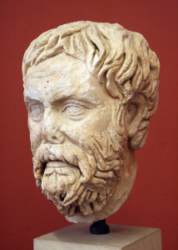
History of Skepticism
Introduction
  Skeptikos
    Error to assume that human reason is capable of yielding knowledge about reality.
    Skeptikos (inquirers)
    Lack of Foundations for beliefs
  Pyrrho of Elis (320-270 B.C.)
    Revitalization of skepticism
    1st Century B.C.
    Produced no writings
This Photo by Unknown Author is licensed under CC BY-SA
Notes:
History of Skepticism
I Introduction
A. Skeptikos
1. The skeptics claimed that it was an error to assume that human reason is capable of yielding knowledge about reality.
2. The name “skeptic” comes from the Greek “skeptikos”, meaning “inquirers.”
3. The skeptics inquired into the foundation of beliefs and claimed to have the honesty to accept that our beliefs in fact lack such foundations.
B. Pyrrho of Elis (320-270 B.C.)
1. While skepticism dates back to the Sophists, Pyrrho revitalized it.
2. By the 1st century B.C. Pyrrhonism became synonymous with Skepticism.
3. Pyrrho did not produce any writings, but other writers recorded his views.

Slide 132

History of Skepticism
  Pyrrho’s Sense Experience Argument
    Sense experience cannot provide knowledge.
    To provide knowledge the sense experiences must match their objects.
    If we can never get outside of our sensations, we can never know the experiences match the alleged objects.
This Photo by Unknown Author is licensed under CC BY-NC-ND
Notes:
C. Pyrrho’s Sense Experience argument
1. Sense experience cannot provide knowledge.
2. To provide knowledge the sense experiences must match their objects.
3. But, if we can never get outside of our sensations, we can never know that the experiences match the alleged objects.

Slide 133

History of Skepticism
This Photo by Unknown Author is licensed under CC BY-NC-ND
Notes:
Monitor Example

Slide 134

History of Skepticism
  Pyrrho’s Reason Argument
    Argumentation cannot provide knowledge.
    For each argument there is an equally good counter-argument.
    Thus, there is no rational ground for accepting one argument over another.
This Photo by Unknown Author is licensed under CC BY-SA-NC
Notes:
D. Pyrrho’s Reason Argument
1. Argumentation cannot provide knowledge.
2. For each argument there is an equally good counter-argument.
3. Thus, there is no rational ground for accepting one argument over another.

Slide 135

History of Skepticism
  Skeptic’s Position
    Given that both senses and reason fail, we cannot have knowledge.
    One can only speak in terms of experience.
    Prudent approach: suspend judgment and not make any assumptions.
    This skepticism also applies to morality.
    A wise person adopts apathy and indifference.
    People should follow existing laws & traditions.
This Photo by Unknown Author is licensed under CC BY
Notes:
E. Skeptics’ Position
1. Given that both the senses and reason fail, we cannot have knowledge.
2. One can only speak in terms of appearances.
3. The prudent approach is to suspend judgment and not make any assumptions.
4. The skepticism also applies to morality.
5. A wise person adopts apathy and indifference-do not worry about what you do not know.
6. Since we cannot know what is really good or bad, people should simply follow the existing laws and traditions.

Slide 136

History of Skepticism
Academic Skepticism
  Arcesilaus
    316-242 B.C.
    Head of Plato’s Academy
    Turned Academy towards skepticism
  Carneades
    214-129 B.C.
    Took over Academy after Arcesilaus.
    Brilliant philosopher
    Athenian Ambassador to Rome (156-155 B.C.)
    Public speeches on philosophy
    Two-Faced Method of skepticism:
      One day he gave an excellent argument in favor of justice The next day he gave an equally good argument against justice.
Notes:
II Academic Skepticism
A. Arcesilaus
1. Approximately 316-242 B.C.
2. The head of Plato’s Academy.
3. He turned the Academy towards skepticism
B. Carneades
1. 214-129 B.C.
2. Took over the Academy after Arcesilaus.
3. Considered one of the most brilliant philosophers of his time.
4. Served as the Athenian ambassador to Rome I 156-155 B.C.
5. Along with a Stoic and Aristotelian, he gave public speeches on philosophy.
6. He utilized the “two face” method of skepticism: one day he gave an excellent argument in favor of justice and the next day he gave an equally good argument against justice.

Slide 137
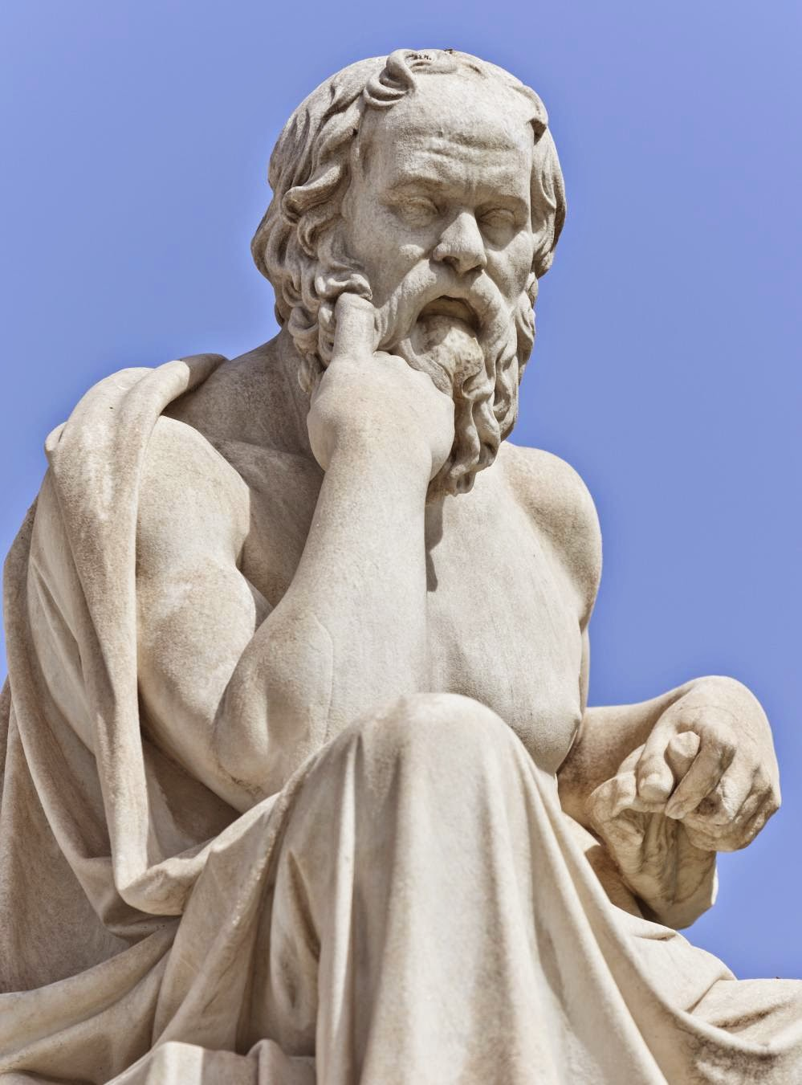
History of Skepticism
  The Academy
    Skeptics thought the Academy lost the Socratic spirit.
    Ironic charge
    Skeptics focused on
      Socrates’ claim he knew nothing.
      Socratic dialogues ended without a definite conclusion.
This Photo by Unknown Author is licensed under CC BY
Notes:
C. The Academy
1. The Skeptics thought the Academy had lost the Socratic spirit of inquiry and had settled into dogmatism.
2. This change was ironic, given Plato’s view that the Forms were object of knowledge and his attacks on the Sophists.
3. The Skeptics focused on:
a. Socrates’ claim that he knew nothing.
b. How the Socratic dialogues ended without reaching a definite conclusion.
4. The Skeptics also utilized Plato’s attacks on the senses and his claim in the Timaeus that physics is merely a “likely story.”

Slide 138

History of Skepticism
  Appearance
    Skeptics attacked the dogmatism of the Stoics and Epicureans.
    Some sense impressions seem indubitable.
    Dreams & hallucinations seem convincing but are false.
This Photo by Unknown Author is licensed under CC BY-SA
Notes:
B. Appearance
1. The Skeptics attacked the dogmatism of Stoics and Epicureans because they used the senses as a foundation of knowledge.
2. While the senses can only yield appearances, some sense impressions seemed so indubitable that one had to assent to them.
3. However, in dreams and hallucinations people experience seem convincing but are, of course, false.

Slide 139
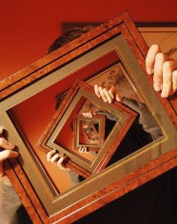
History of Skepticism
  Main Argument: No Criterion for Truth
    Any standard of truth will also need justification
    Thus requiring another standard to establish the truth of the standard.
    And so on in an infinite regress.
This Photo by Unknown Author is licensed under CC BY-SA-NC
Notes:
4. Their main argument is there can be no criterion for truth:
a. Any standard of truth will also need justification.
b. Thus requiring another standard to establish the truth of the standard.
c. And so on into an infinite regress.

Slide 140

History of Skepticism
  Claims
    Did not claim that nothing can be known.
    Claim: we appear to lack knowledge.
    Suspended judgment regarding skepticism.
  Probability
    Stoics argued that skepticism would lead to the suspension of activity.
    Carneades argued that certainty is not possible but probability is and is sufficient.
    Compromise lead to scorn from Stoics and later Pyrrhonic skeptics.
This Photo by Unknown Author is licensed under CC BY-SA-NC
Notes:
5. The Skeptics did not claim that nothing can be known-instead they claim that it we appear to lack knowledge.
6. They suspended judgment as to whether skepticism was true or not.
C. Probability
1. The Stoics argued that consistency would entail that Skepticism would lead to the suspension of all activity and not just judgment.
2. Carneades responded by arguing that while certainty is not possible, probability is and it is sufficient to allow human action.
3. This compromise earned the scorn of both the Stoics and the later Pyrrhonic skeptics.

Slide 141
History of Skepticism
Revival of Pyrrhonian Skepticism
  Purists
    The Academics were not skeptical enough.
    Rejected Carneade’s view of probability.
    Named after Pyrrho.
    Formalized skepticism.
Notes:
III Revival of Pyrrhonian Skepticism
A. Purists
1. It was believed that the Academics were simply not skeptical enough.
2. They rejected Carneade’s view of probability- they argued that distinguishing probabilities required knowledge.
3. Pyrrhonian skeptics got the name from Pyrrho.

Slide 142

History of Skepticism
  Agrippa: Five Pillars of Skepticism
    Disagreement: Not everyone will agree on an issue.
    Infinite regress
      Resolution requires reasons
      Reasons require justifications
      Justifications require justifications and so on to infinty.
Notes:
B. Agrippa: the five pillars of Skepticism
1. Disagreement: Not everyone will agree on an issue.
2. Infinite regress: Resolving an issue requires reasons, but reasons need justification and these justifications will also need justifications and so on into infinity.

Slide 143

History of Skepticism
    Relativity: Perceptions of things differ in different circumstances.
    Hypothesis: All starting points are arbitrary.
    Circular Reasoning: Any argument that avoids the other 4 pillars will be circular.
Notes:
3. Relativity: Perceptions of things differ in different circumstances.
4. Hypothesis: If someone attempts to solve the regress problem by using a self evident starting point, another person can put forth a contradictory starting point and claim that it is self evident-this makes all starting points arbitrary.
5. Circular reasoning: Any argument that someone manages to avoid the first four problems will have to assume what it is trying

Slide 144

History of Skepticism
Latter Skeptics: Two Theses
Nothing is self-evident
Nothing can be proven
Skeptic’s Goal
Personal peace
If one cannot know, there is no reason to worry.
Accept what appears to be and follow existing customs and laws.
Sextus Empiricus (3rd Century AD)
This Photo by Unknown Author is licensed under CC BY-NC-ND
Notes:
C. Latter Skeptics: Two Theses
1. Nothing is self evident.
2. Nothing can be proven.
D. Skeptics’ Goal
1. The goal is to achieve personal peace.
2. If one cannot know, there is no reason to worry whether one has the truth or not.
3. There is no need to try to distinguish truth form falsehood or good from evil.
4. One should simply accept what appears to be and simply follow existing customs and laws.
5. Sextus Empiricus, 3rd century A.D. held this view.

Slide 145

History of Skepticism
Importance of Skepticism
  Problem
    Starting points are needed for arguments.
    This implies there are reasons for believing the starting points.
  Contributions
    Made philosophers more critical.
    Philosophers had to accept or respond to the skeptics.
    St. Augustine Against the Academics
    Methodological skepticism in the Modern era.
    Skepticism used to attack reason and support faith & revelation.
    Development of science.
This Photo by Unknown Author is licensed under CC BY-SA
Notes:
IV Importance of Skepticism
A. Problem
1. It makes no sense to create arguments unless there is some information that serves as their starting points (premises).
2. This implies there are reasons to believe that the starting points (premises) are true.
B. Contributions
1. Skepticism made philosophers more critical and helped reduce dogmatism.
2. Philosophers had to either accept or respond to the Skeptical arguments.
3. One early response was given by St. Augustine in his Against the Academics.
4. Skepticism was revived in the Modern period as a weapon and as a philosophic tool.
a. Descartes used methodological skepticism to develop his epistemology.
b. Berkeley chose to accept a world of appearances to avoid skeptical problems.
5. Some religious philosophers used skepticism to attack the pretenses of reason-thus showing that faith and revelation are the only possible sources of knowledge.
a. Erasmus, Pascal, Montaigne, and Bayle.
6. Skepticism might have contributed to the development of science: if the real essences of things cannot be known, then it is best to avoid metaphysics and stick to empirical examination of the world of appearances.

Slide 146

History of Skepticism
  The Decline of Skepticism
    Did not succeed in creating peace.
    Created Confusion.
    Unsatisfactory.
    Religious philosophies & Christianity.
This Photo by Unknown Author is licensed under CC BY-SA
Notes:
C. The Decline of Skepticism
1. Skepticism never seemed to succeed in providing peace, but it did create confusion.
2. While undermining dogmatism, Skepticism failed to provide any positive alternatives.
3. Simply following existing traditions and customs did not satisfy many people.
4. People turned to various religious philosophies and latter to Christianity.

Slide 147
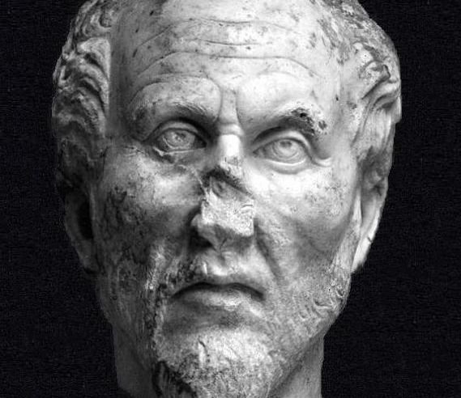
Plotinus & Neoplatonism

Slide 148
Plotinus & Neoplatonism
Background
  3rd Century A.D. was a terrible time in Roman history.
  Emperors were enthroned by the military and removed by assassination.
  The army was weakened by corruption and internal strife.
  Barbarians were at the edges of the Empire.
  War, disease, corruption, taxes, and diminished resources plagued the empire.
  People hoped for a religious salvation via an absorption into God.
  These helped fuel the rise of a religious philosophy.
Notes:
I Introduction & Background
A. Background
1. The 3rd Century A.D. was a terrible time in Roman history.
2. Emperors were enthroned by the military and removed by assassination.
3. The army was weakened by corruption and internal strife.
4. Barbarians were at the edges of the Empire.
5. War, disease, corruption, taxes, and diminished resources plagued the empire.
6. These conditions lead people to hope for a religious salvation via an absorption into God.
7. These conditions also helped fuel the rise of a religious philosophy.

Slide 149
Plotinus & Neoplatonism
The One is Incomprehensible
  Things that have the most reality are those with the most unity.
  It is transcendent, beyond all thought and being, and is also incomprehensible.
  It could only be described if properties could be attributed to it.
  If it had distinguishable properties it would have parts.
  The source of all is beyond all properties and is without plurality.
  It has no conscious activity, no thought or willing, because such activity would indicate a duality.
  Plotinus referred to it as: the One, such as God, the Good, First Existent, the Absolute, the Infinite, and the Father.
Notes:
A. The One is Incomprehensible
1. Things that have the most reality are those with the most unity.
2. It is transcendent, beyond all thought and being, and is also incomprehensible.
3. It could only be described if properties could be attributed to it.
4. If it had distinguishable properties it would have parts.
5. The source of all properties is beyond all properties and is without plurality.
6. It has no conscious activity, no thought or willing, because such activity would indicate a duality.
7. He referred to it as: the One, such as God, the Good, First Existent, the Absolute, the Infinite, and the Father.

Slide 150
Plotinus & Neoplatonism
The One as Cause
  The One does not consciously acts.
  The being of the One is so “full” it “overflows” so all things emanate from the One, while the one remains unchanged.
  Plotinus uses Plato’s metaphor of the sun
    It sheds its light without being diminished.
  Also uses the metaphor of a mirror
    Something can be reproduced in a mirror without being affected.
  The world proceeds from the One but from necessity, not conscious choice.

Slide 151
Plotinus & Neoplatonism
Intellect
  Nous
  The first emanation of the One is nous.
  Nous: Intellect, Intellectual Principle, Divine Mind, or Spirit.
  Nous is eternal and perfect.
  It cannot be divided into parts, but does have distinguishable aspects.
Aspects of Intellect
  The knower.
  The objects of knowledge.
Notes:
III Intellect
A. Nous
1. The first emanation of the One is nous.
2. Nous: Intellect, Intellectual Principle, Divine Mind, or Spirit.
3. Nous is eternal and perfect.
4. It cannot be divided into parts, but does have distinguishable aspects.
5. Its aspects are:
a. The knower.
b. The objects of knowledge.

Slide 152
Plotinus & Neoplatonism
  The Intellect intuits two objects:
    The One.
    Itself.
  In knowing itself, it knows it contains all the Platonic Forms.
  It intuits all the Forms in a single eternal and unified vision.
  Like Plato he accepts there are Forms of Universals.
  Unlike Plato, he claims that there are Forms of particulars.
  Each particular is given eternal value and status in the Nous.
Notes:
.
6. The Intellect intuits two objects:
a. The One.
b. Itself.
7. In knowing itself, it knows it contains all the Platonic Forms.
8. It intuits all the Forms in a single eternal and unified vision.
9. Like Plato he accepts there are Forms of Universals.
10. Unlike Plato, he claims that there are Forms of particulars.
11. Each particular is given eternal value and status in the Nous.

Slide 153
Plotinus & Neoplatonism
Soul
  The Soul eternally emanates from the Nous.
  The Soul is eternal and immaterial.
  Serves to mediate between the spiritual realm and that of the senses, uniting the world into one living being.
  Soul’s two aspects:
  The higher part looks to Intellect and is untouched by what is beneath it.
  The lower part descends to generate the sensible world and replicate its vision of the Forms within it.
  The Soul, like the One, does not act consciously.
  Identified with Nature and generates a world corresponding to all the possible forms of Being that are within the Nous.
Notes:
.
6. The Intellect intuits two objects:
a. The One.
b. Itself.
7. In knowing itself, it knows it contains all the Platonic Forms.
8. It intuits all the Forms in a single eternal and unified vision.
9. Like Plato he accepts there are Forms of Universals.
10. Unlike Plato, he claims that there are Forms of particulars.
11. Each particular is given eternal value and status in the Nous.

Slide 154

Plotinus & Neoplatonism
Human Souls
  Aspects of the Soul.
  Are like the light from the sun shining into houses: each house seems to have its own light, but it is all a manifestation of one light.
  Like the Soul, human souls have two aspects:
    Higher aspect: belongs to the realm of the Intellect.
    Lower aspect: involved with the body.
  Souls exist prior to bodies and are incarnated by descending from the spiritual realm.
  Souls are reincarnated after death but do not retain memories.
Notes:
C. Human Souls
1. Human souls are aspects of the Soul.
2. Human souls are like the light from the sun that shines into houses: each house seems to have its own light, but it is all a manifestation of one light source.
3. Like the Soul, human souls have two aspects:
a. Higher aspect-belongs to the realm of the Intellect.
b. Lower aspect-involved with the body.
4. Souls exist prior to the bodies and they are incarnated by descending from the spiritual realm.
5. Souls are reincarnated after death although they do not retain their memories.

Slide 155
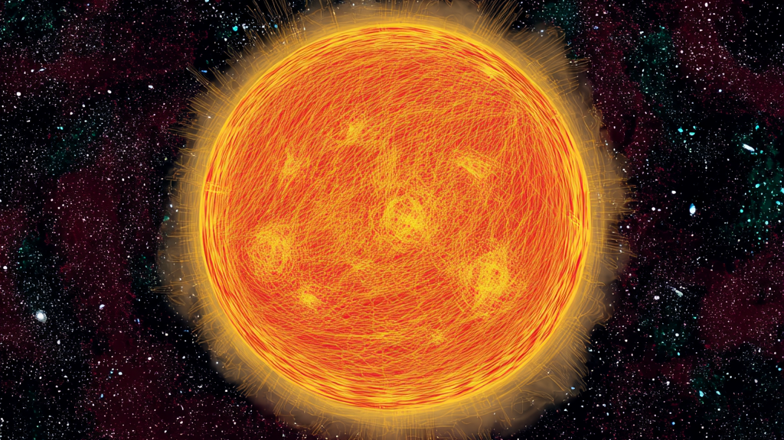
Plotinus & Neoplatonism: Physical World
Matter
  The Soul always desires to exercise its powers.
  The final emanation of the Soul is the material world.
  This emanation is not a creation that occurs at a point in time.
  The emanation of matter is necessary and eternal.
The Sun Analogy
  This emanation is not an additional reality
    Matter is a non-being.
  As the sun’s rays get further away they get dimmer until total darkness is reached.
  The Soul emanates reality and goodness.
  As darkness is the privation of light, matter is a privation of goodness and reality.
  Any goodness or intelligibility of material objects is due to dim reflections of the intelligible world.
  Matter corrupts all it contacts so while the Soul illuminates matter, the matter “darkens and weakens” the illumination.
Notes:
IV Physical World
A. Matter
1. The Soul always desires to exercise its powers.
2. The final emanation of the Soul is the material world.
3. This emanation is not a creation that occurs at a point in time-the emanation of matter is necessary and eternal.
B. The Sun Analogy
1. This emanation is not an additional reality-matter is a non-being.
2. As the sun’s rays get further away they get increasingly dimmer until total darkness is reached.
3. The Soul emanates reality and goodness and, as darkness is the privation of light, matter is a privation of goodness and reality.
4. Any goodness or intelligibility of material objects is due to dim reflections of the intelligible world.
5. Matter corrupts all that it contacts so that while the Soul illuminates matter, the matter “darkens and weakens” the illumination.

Slide 156
Plotinus & Neoplatonism:The Problem of Evil
Matter & Evil
  Matter is the source of evil.
  Plotinus suggests matter might have been a mistake.
Degrees Argument
  Since the material world is the last emanation in the series of necessary emanations, it shares in their goodness.
  These emanation creates all possible degrees of being, producing the most diverse and richest world.
Notes:
A. Matter & Evil
1. Matter is the source of evil.
2. Plotinus suggests that matter might have been a mistake.
B. Degrees
1. Since the material world is the last emanation in the series of necessary emanations, it shares in their goodness.
2. These emanation creates all possible degrees of being, thus producing the most diverse and richest world.

Slide 157
Plotinus & Neoplatonism:The Problem of Evil
Necessary Imperfection Argument
  Anything less than God falls short of perfection by necessity.
  Any world will have imperfections.
  The world has as much goodness as is possible in matter.
Big Picture
  The world is like a picture or a play.
  Each part has a role to play in the whole.
  The role of each part can be overlooked if one focuses on one part.
  The worst parts of the world can be used by God, although the reasons for their existence cannot be known.
  Even the evil of humans serves to give others a greater appreciation of virtue.
Notes:
C. Necessary Imperfection
1. Anything less than God falls short of perfection by necessity.
2. Thus, any world will have imperfections.
3. The world has as much goodness as is possible in matter.
D. Big Picture
1. The world is like a picture or a play.
2. Each part has a role to play in the whole.
3. The role of each part can be overlooked if one focuses on one part.
4. The worst parts of the world can be used by God, although the reasons for their existence cannot be known.
5. Even the evil of humans serves to give others a greater appreciation of virtue.

Slide 158
Plotinus & Neoplatonism: The Way of Ascent
The Descent of Man
  The descent of the soul into the body is a fall into the lower and inferior part of the world.
  The fall is caused by human audacity and desire to be autonomous.
  The more people focus on their bodies, senses, and individuality, the more trapped and alienated they become.
  The soul naturally “flies” in the spiritual realm, but it becomes distracted, thus falling to earth and losing its “wings.”
  There is still hope since the soul remains part of the higher realm.
  Evil is not a real thing that drags the soul down.
  Evil is the willingness of humans that turns them away from God.
  Perfect souls that always turn to the Intellect contain no evil.
  Souls that are blinded by passion and seduced by matter are drawn down to the darkness and privation of evil.
Notes:
VI The Way of Ascent
A. The Descent of Man
1. The descent of the soul into the body is a fall into the lower and inferior part of the world.
2. The fall is caused by human audacity and desire to be autonomous.
3. The more people focus on their bodies, senses, and individuality, the more trapped and alienated they become.
4. The soul naturally “flies” in the spiritual realm, but it becomes distracted, thus falling to earth and losing its “wings.”
5. There is still hope since the soul remains part of the higher realm.
6. Evil is not a real thing that drags the soul down.
7. Evil is the willingness of humans that turns them away from God.
8. Perfect souls that always turn to the Intellect contain no evil.
9. Souls that are blinded by passion and seduced by matter are drawn down to the darkness and privation of evil.

Slide 159

Plotinus & Neoplatonism: The Way of Ascent
The Descent of Man
  The descent of the soul into the body is a fall into the lower and inferior part of the world.
  The fall is caused by human audacity and desire to be autonomous.
  The more people focus on their bodies, senses, and individuality, the more trapped and alienated they become.
  The soul naturally “flies” in the spiritual realm, but it becomes distracted, thus falling to earth and losing its “wings.”
  There is still hope since the soul remains part of the higher realm.
  Evil is not a real thing that drags the soul down.
  Evil is the willingness of humans that turns them away from God.
  Perfect souls that always turn to the Intellect contain no evil.
  Souls that are blinded by passion and seduced by matter are drawn down to the darkness and privation of evil.
Notes:
VI The Way of Ascent
A. The Descent of Man
1. The descent of the soul into the body is a fall into the lower and inferior part of the world.
2. The fall is caused by human audacity and desire to be autonomous.
3. The more people focus on their bodies, senses, and individuality, the more trapped and alienated they become.
4. The soul naturally “flies” in the spiritual realm, but it becomes distracted, thus falling to earth and losing its “wings.”
5. There is still hope since the soul remains part of the higher realm.
6. Evil is not a real thing that drags the soul down.
7. Evil is the willingness of humans that turns them away from God.
8. Perfect souls that always turn to the Intellect contain no evil.
9. Souls that are blinded by passion and seduced by matter are drawn down to the darkness and privation of evil.

Slide 160
Plotinus & Neoplatonism: The Way of Ascent
Salvation
  Freedom and peace can be found by remaining aloof from the body and focusing on the soul.
  The first stages is purification through intellectual and moral discipline.
    Learning to see the forms in the particulars would help this process.
Statue analogy
  If you do not see yourself as beautiful, then like someone working on a statue, you must cut away the excess, straighten the crooked, replace the dark with brightness.
  “Never stop ‘working on your statue’ till the divine glory of virtue shines out on you.”
Second stage: participate in philosophical dialectic, thus gaining understanding of the intelligible world.
The final stage is a mystical and ecstatic union with God.
  This stage is beyond language and thought.
The final stage can be achieved for limited moments in life, but the body is always a hindrance to this.
  Porphyry claimed that Plotinus achieved this state four times during six years.
  This final stage can be made permanent.
  The goal, as in Plotinus’ last words is to “try to bring back the god in you to the divine in the All.”
Notes:
B. Salvation
1. Freedom and peace can be found by remaining aloof from the body and focusing on the soul.
2. The first stages is purification through intellectual and moral discipline.
a. Learning to see the forms in the particulars would help this process.
3. The statue analogy: If you do not see yourself as beautiful, then like someone working on a statue, you must cut away the excess, straighten the crooked, replace the dark with brightness.
a. “Never stop ‘working on your statue’ till the divine glory of virtue shines out on you.”
4. The second stage is to participate in the philosophical dialectic, thus gaining understanding of the intelligible world.
5. The final stage is a mystical and ecstatic union with God.
a. This stage is beyond language and thought.
6. The final stage can be achieved for limited moments in life, but the body is always a hindrance to this.
a. Porphyry claimed that Plotinus achieved this state four times during six years.
7. This final stage can be made permanent.
8. The goal, as put in Plotinus’ last words is to “try to bring back the god in you to the divine in the All.”

Slide 161
Plotinus & Neoplatonism: Impact
Endurance
  The movement continued for over 350 years after the death of Plotinus.
  Porphyry (232-305 A.D.) took over the school in Rome.
  Schools existed in Syria, Asia Minor, Athens, and Alexander.
  In the 4th century Plutarch introduced Neoplatonism to the Academy and his successor Proclus carried on the tradition.
Christianity
  Plotinus said little about Christianity, aside from criticizing the Gnostics.
  Porphyry and his successors were anti-Christian.
  Many Christians found Neoplatonism attractive.
Origen
  185-254 A.D.
  A Church theologian.
  Taught by Plotinus’s teacher Ammonius.
  Arranged the three persons of the Holy Trinity in a hierarchy.
  Claimed that via sin, pre-existent human souls descended into bodies.
Notes:
A. Endurance
1. The movement continued for over 350 years after the death of Plotinus.
2. Porphyry (232-305 A.D.) took over the school in Rome.
3. Schools existed in Syria, Asia Minor, Athens, and Alexander.
4. In the 4th century Plutarch introduced Neoplatonism to the Academy and his successor Proclus carried on the tradition.
B. Christianity
1. Plotinus said little about Christianity, aside from criticizing the Gnostics.
2. Porphyry and his successors were anti-Christian.
3. Many Christians found Neoplatonism attractive.
C. Origen
1. 185-254 A.D.
2. A Church theologian.
3. Taught by Plotinus’s teacher Ammonius.
4. Arranged the three persons of the Holy Trinity in a hierarchy.
5. Claimed that via sin, pre-existent human souls descended into bodies.

Slide 162
Plotinus & Neoplatonism: Impact
Other Christian Thinkers
  St. Augustine based his Christian philosophy on Plotinus’s interpretation of Plato.
  Augustine claimed that with a few changes the Platonic philosophers would be Christians.
  Boethius (480-525 A.D.D), a Roman Christian influenced by Neoplatonism translated one of Porphyry’s books on Aristotle into Latin.
  Around 500 A.D. a work appeared supposedly written by Dionysus, one of the Apostle Paul’s converts.
    The work was actually written by a Neoplatonist.
    Not known to be a forgery, Medieval thinkers used it and Neoplatonic themes were introduced into
  Christianity and mysticism was enhanced.
  In 529 AD the Christian Emperor Justinian closed all the pagan schools of philosophy in Athens.
  Neoplatonism’s influence remained in Christianity, thus keeping Greek philosophy alive in the West.
Notes:
D. Other Christian Thinkers
1. St. Augustine based his Christian philosophy on Plotinus’s interpretation of Plato.
2. Augustine claimed that with a few changes the Platonic philosophers would be Christians.
3. Boethius (480-525 A.D.D), a Roman Christian influenced by Neoplatonism translated one of Porphyry’s books on Aristotle into Latin.
4. Around 500 A.D. a work appeared supposedly written by Dionysus, one of the Apostle Paul’s converts.
a. The work was actually written by a Neoplatonist.
b. Because it was not known to be a forgery, Medieval thinkers used it and thus Neoplatonic themes were introduced into
Christianity and mysticism was enhanced.
5. In 529 AD the Christian Emperor Justinian closed all the pagan schools of philosophy in Athens.
6. Neoplatonism’s influence remained in Christianity, thus keeping Greek philosophy alive in the West.

Slide 163

The Rise of Christian Thought

Slide 164
Early Christianity: Greek and Christian Thought
Greek Religion & Philosophy
  The Greeks were mostly polytheists.
  The Greek gods were limited, typically subject to the Fates, and had restricted domains.
  Plato’s Demiurge used the Forms to guide its shaping of uncreated matter.
  Aristotle’s Prime Mover was impersonal and immanent.
  The Greek thinkers tended to aim for truth.
  Many Greek thinkers accepted the Logos
    A principle of reason and order in the universe.
Notes:
I Greek and Christian Thought
A. Greek Religion & Philosophy
1. The Greeks were mostly polytheists.
2. The Greek gods were limited, typically subject to the Fates, and had restricted domains.
3. Plato’s Demiurge used the Forms to guide its shaping of uncreated matter.
4. Aristotle’s Prime Mover was impersonal and immanent.
5. The Greek thinkers tended to aim for truth.
6. Many Greek thinkers accepted the Logos-a principle of reason and order in the universe.

Slide 165
Early Christianity: Greek and Christian Thought
Christianity
  Judaism and Christianity are monotheistic religions.
  God is an all powerful and transcendent being.
  God created the world and rules it completely.
  God is a personal god who loves His creation.
  Christianity is a revealed religion.
    God revealed himself via the prophets, Jesus and scripture.
  In the Gospel of John, God is the Logos and Jesus is the Logos in human form.
  Human history and life are to be understood in religious terms.
Notes:
B. Christianity
1. Judaism and Christianity are monotheistic religions.
2. God is an all powerful and transcendent being.
3. God created the world and rules it completely.
4. God is a personal god who loves His creation.
5. Christianity is a revealed religion.
a. God revealed himself via the prophets, Jesus and scripture.
6. In the Gospel of John, God is the Logos and Jesus is the Logos in human form.
7. Human history and life are to be understood in religious terms.

Slide 166
Early Christianity: Little Time for Philosophy
Second Coming
  Early Christians faced four concerns that left little time for philosophical speculation.
  It was believed that Jesus would return during the lifetime of the Apostles.
  Hence, there was little time and little reason to engage in philosophy.
Persecution
  Early Christians had to deal with persecution from the Romans.
  In the Roman Empire, religion was a concern of the state:
    Success of the state rested on the citizens paying proper homage to the gods.
  Christians refused to pay homage to the Roman gods and proclaimed Christ as ruler of the earth.
  This was regarded as treason, a capital offense.
  Persecution varied among emperors, ending in the reign of Constantine (305-337).
Notes:
II Christianity & Philosophy: Little Time for Philosophy
A. Second Coming
1. Early Christians faced four concerns that left little time for philosophical speculation.
2. It was believed that Jesus would return in the second coming during the lifetime of the Apostles.
3. Hence, there was little time and little reason to engage in philosophy.
B. Persecution
1. Early Christians had to deal with persecution from the Romans.
2. In the Roman Empire, religion was a concern of the state: the success of the state was seen as resting on the citizens paying proper homage to the gods.
3. The Christians refused to pay homage to the Roman gods and had proclaimed Christ as ruler of the earth.
4. This was regarded as treason, a capital offense.
5. The persecution varied among emperors, and ended in the reign of Constantine (305-337).

Slide 167
Early Christianity: Little Time for Philosophy
Evangelism
  The goal of Christianity was saving souls rather than presenting philosophical theory.
Heretics
  Many variations of Christianity existed
  Each claimed to be the authentic version.
  Some heresies were Christianized versions of Greek religious philosophies.
  Other heresies were alternative interpretations of the Christian theology.
Notes:
C. Evangelism
1. The goal of Christianity was to save souls rather than to present a philosophical theory.
D. Heretics
1. Many variations of Christianity existed, each of which claimed to be the authentic version.
2. Some of these heresies were Christianized versions of Greek religious philosophies.
3. Other heresies were alternative interpretations of the Christian theology.

Slide 168
Early Christianity: Rise of Philosophic Concerns
Delayed Return
  As time passed it became evident the second coming was not immanent.
  Christians attempted to Christianize their culture by broadening out from the Jewish background.
  They attempted to reconcile Christianity with Greek tradition and thought.
  Christianity spread to the Roman upper classes; some trained in Greek philosophy.
  Christian thinkers began using Greek philosophical categories to show Christianity is intellectually respectable.
Apologetics
  “Apologetics” derived from Athenian law
  An apology is making a reply or defending one’s position.
  Christians used philosophic methods to defend Christianity in the face of Greek culture and philosophy.
  Christians used philosophic methods to counter the heresies, many of which were Christianized variants of Greek religious philosophy.
  Refuting the heretics required argumentation and clarification of Christian doctrines.
Notes:
A. Delayed Return
1. As time passed it became evident that the second coming was not immanent.
2. The Christians began to attempt to Christianize their culture by broadening out from the Jewish background.
3. The Christians began attempting to reconcile Christianity with Greek tradition and thought.
4. Christianity spread to the Roman upper classes, some of whom had been trained in Greek philosophy.
5. Hence, Christian thinkers began to use Greek philosophical categories and attempted to show that Christianity is intellectually respectable.
B. Apologetics
1. “Apologetics” was derived from Athenian law where an apology is making a reply or defending one’s position.
2. Christians used philosophic methods to defend Christianity in the face of Greek culture and philosophy.
3. Christians also used philosophic methods to counter the heresies, many of which were Christianized variants of Greek religious philosophy.
4. Refuting the heretics required argumentation and clarification of Christian doctrines.

Slide 169
The Problem of Faith and Reason
Greeks
  The Greeks had no conflict between faith and reason.
  Greek religion was not a revealed faith
    Religious ideas were passed on by poets and tradition.
  Greek philosophers relied on philosophical reason and tended to either reject or downplay the religious traditions.
Jewish Tradition
  The Jewish tradition lacked the conflict between faith and reason.
  Jewish tradition emphasized the faithfulness of God to His people, thus making philosophical reasoning seem needless.
Cause of The Problem
  The problem arises because there are two sources of information: faith/revelation and reason.
  As Greek ways of thought began to supplant Jewish influences, Christians had to address various concerns.
  They had to respond to external philosophical attacks.
  They had to resolve internal controversies.
  They had to address the Greek concern with a systematic approach to reality.
Notes:
A. Greeks
1. The Greeks had no real conflict between faith and reason.
2. Greek religion was not a revealed faith-religious ideas were passed on by poets and tradition.
3. Greek philosophers relied on philosophical reason and tended to either reject or downplay the religious traditions.
B. Jewish Tradition
1. The Jewish tradition lacked the conflict between faith and reason.
2. Jewish tradition emphasized the faithfulness of God to His people, thus making philosophical reasoning seem needless.
C. Cause of The Problem
1. The problem arises because there are two sources of information: faith/revelation and reason.
2. As Greek ways of thought began to supplant Jewish influences, Christians had to address various concerns.
3. They had to respond to external philosophical attacks.
4. They had to resolve internal controversies.
5. They had to address the Greek concern with a systematic approach to reality.

Slide 170
The Problem of Faith and Reason
Questions
  Is Christian belief rational?
  What is the relation between faith and reason?
  In cases where faith and reason conflict, what should be done?
Points of Disagreement
  Christian thinkers rejected many of the views of the Greek philosophers.
  For Plato, the highest goal was to achieve knowledge of the Good, as opposed to achieving salvation.
  Plato accepted reincarnation, as opposed to the Christian notion of a permanent afterlife.
  The Epicureans advocated the life of pleasure and claimed the soul ceased to exist at death.
Points of Agreement
  Plato claimed that the soul was immortal and that the transcendent is of greater concern than the material world.
  Aristotle presented arguments that could be employed to argue for the existence of God.
  Aristotle argued that the universe had a purpose.
  The Stoics argued for an orderly and meaningful world that was aimed at fulfilling a divine purpose.
Notes:
D. Questions
1. Is Christian belief rational?
2. What is the relation between faith and reason?
3. In cases where faith and reason conflict, what should be done?
E. Points of Disagreement
1. Christian thinkers rejected many of the views of the Greek philosophers.
2. For Plato, the highest goal was to achieve knowledge of the Good, as opposed to achieving salvation.
3. Plato accepted reincarnation, as opposed to the Christian notion of a permanent afterlife.
4. The Epicureans advocated the life of pleasure and claimed the soul ceased to exist at death.
F. Points of Agreement
1. Plato claimed that the soul was immortal and that the transcendent is of greater concern than the material world.
2. Aristotle presented arguments that could be employed to argue for the existence of God.
3. Aristotle argued that the universe had a purpose.
4. The Stoics argued for a orderly and meaningful world that was aimed at fulfilling a divine purpose.

Slide 171

The Problem of Faith and Reason
Biblical Tradition: Anti-Philosophy
  Paul’s first letter to the Corinthians
    The wisdom of the world is foolishness in God’s eyes
    Christ’s gospel seems foolish in the eyes of pagans.
  Paul: “Make sure no one traps you and deprives you of your freedom by some secondhand, empty, rational philosophy based on the principles of this world instead of on Christ.”
Biblical Tradition: Pro-Philosophy
  Paul told Stoics and Epicureans that all three groups worshipped the same God
    But Christianity provided fuller information.
  Paul quoted Stoics to support his theology.
  Paul claimed that although the Greeks had not received a revelation,
    They had knowledge of God via His creation and
    The moral laws were “engraved on their hearts.”
  The Book of Proverbs praises wisdom.
  The prologue to the Gospel of John mentions the Divine Logos.
This Photo by Unknown Author is licensed under CC BY-SA
Notes:
G. Biblical Tradition: Anti-Philosophy
1. Paul’s first letter to the Corinthians declares that the wisdom of the world is foolishness in God’s eyes and that Christ’s gospel seems foolish in the eyes of pagans.
2. Paul: “Make sure no one traps you and deprives you of your freedom by some secondhand, empty, rational philosophy based on the principles of this world instead of on Christ.”
H. Biblical Tradition: Pro-Philosophy
1. Paul told the Stoics and Epicureans that all three groups worshipped the same God-Christianity provided fuller information.
2. Paul quoted Stoics to support his theology.
3. Paul claimed that although the Greeks had not received a revelation, they had knowledge of God via his creation and the moral laws were “engraved on their hearts.”
4. The Book of Proverbs praises wisdom.
5. The prologue to the Gospel of John mentions the Divine Logos.

Slide 172
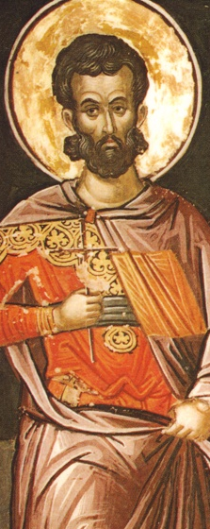
Early Christian Thinkers
Justin Martyr
Background
  Born to pagan parents in Samara around 100.
  Traveled the Middle East and Italy in search of truth.
  Tried Stoicism, Aristotelianism, Pythagoreanism, Platonism and then Christianity.
  Died as a martyr in Rome around 165.
Harmony of Christianity and Greek Philosophy
  He spoke highly of the best of philosophy and philosophers.
  He claimed the Christian gospel and the best in pagan philosophy point to the same truth.
  Notes many similarities between Plato and Christianity
    Souls have a special affinity to God.
    We are morally responsible for our actions.
    There will be a time of reckoning for our actions.
Notes:
A. Background
1. Born to pagan parents in Samara around 100.
2. Traveled the Middle East and Italy in search of truth.
3. Tried Stoicism, Aristotelianism, Pythagoreanism, Platonism and then Christianity.
4. Died as a martyr in Rome around 165.
B. Harmony of Christianity and Greek Philosophy
1. He spoke highly of the best of philosophy and philosophers.
2. He claimed that the Christian gospel and the best in pagan philosophy point to the same truth.
3. He notes many similarities between Plato and Christianity
a. Souls have a special affinity to God.
b. We are morally responsible for our actions.
c. There will be a time of reckoning for our actions.

Slide 173
Early Christian Thinkers
Justin Martyr
  Claimed that the Platonic Good is God.
  Based on spurious historical data, Justin believed that Socrates and Plato knew about the Pentateuch (first 5 books of the bible).
  Based on John’s Gospel, he claimed that the Logos (Christ) enlightens all of humanity, allowing people to discover parts of God’s truth without the bible.
  People possess seeds of divine reason-Spermatic Logos.
  Claims Socrates and Plato were Christians before Christ and they followed this divine reason.
  The Old Testament and the works of Greek philosophy prepared the way for Christianity.
  There is no need to choose between reason and faith because all truth is God’s revealed truth, regardless of the source.
Notes:
4. He claimed that the Platonic Good was, in fact, God.
5. Based on spurious historical data, Justin believed that Socrates and Plato knew about the Pentateuch (first 5 books of the bible).
6. Based on John’s Gospel, he claimed that the Logos (Christ) enlightens all of humanity, allowing people to discover parts of God’s truth without the bible.
7. People possess seeds of divine reason-Spermatic Logos.
8. He claims Socrates and Plato were Christians before Christ and they followed this divine reason.
9. The Old Testament and the works of Greek philosophy prepared the way for Christianity.
10. There is no need to choose between reason and faith because all truth is God’s revealed truth, regardless of the source.

Slide 174
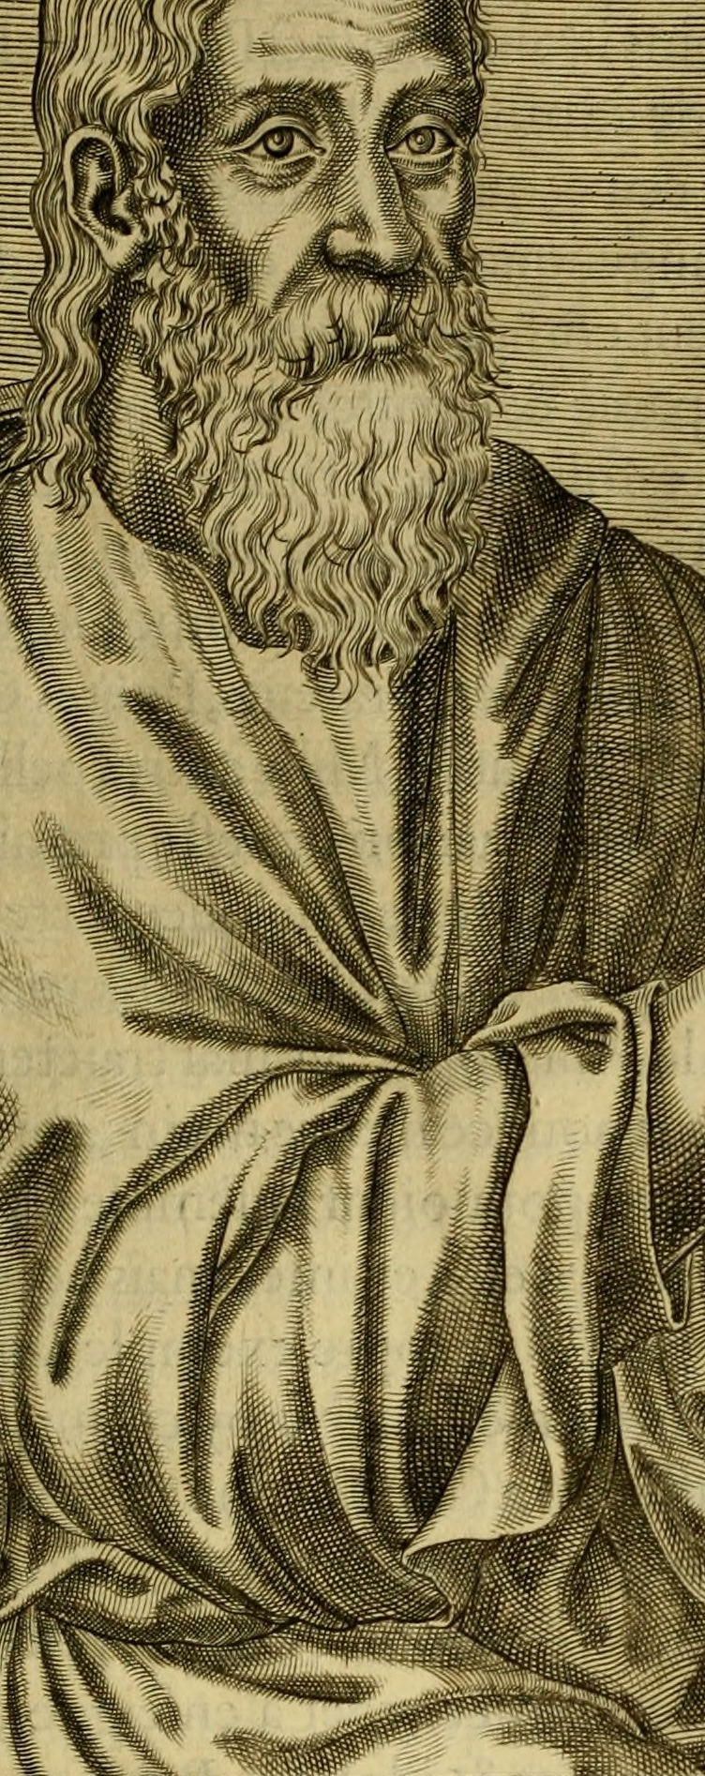
Early Christian Thinkers
Clement of Alexander
Background
  Born to pagan parents around 150.
  Became a Christian under the influence of Pantaneus, a former Stoic.
The Stromata
  A book in which he argues for Christians to respect Greek thought.
  Based on Psalms 29:3, “The Lord is on many waters.”
  Claims all truth is one and wisdom comes from God.
  Claims Old Testament law was given to the Jews and philosophy to the Greeks;
    Both were used to prepare hearts and minds for Jesus.
  Philosophy is not a product of vice since it makes people virtuous
    Hence it is a product of God whose work it is to do good.

Slide 175
Early Christian Thinkers
Clement of Alexander
Philosophy as a Tool
  Philosophy can be a helpful tool for understanding scripture.
  Paul attacked “empty, rational philosophy” based on “principles of the world” rather than Christ.
  Contends Paul was not attacking all philosophy, but only those specified.
Negative Views of Philosophy
  Claims Greeks took many ethical and theological ideas from the Hebrews.
  Claims Greek philosophy only yielded fragments of the truth and can trap us in irrelevant disputes.
  Claims revelation provides a much fuller truth.
Notes:
C. Philosophy as a Tool
1. Philosophy can be a helpful tool for understanding scripture.
2. He notes that Paul attacked “empty, rational philosophy” based on “principles of the world” rather than Christ.
3. Clement contends that Paul was not attacking all philosophy, but only those specified.
D. Negative Views of Philosophy
1. He claims that the Greeks took many ethical and theological ideas from the Hebrews.
2. He claims Greek philosophy only yielded fragments of the truth and can trap us in irrelevant disputes.
3. He claims that revelation provides a much fuller truth.

Slide 176
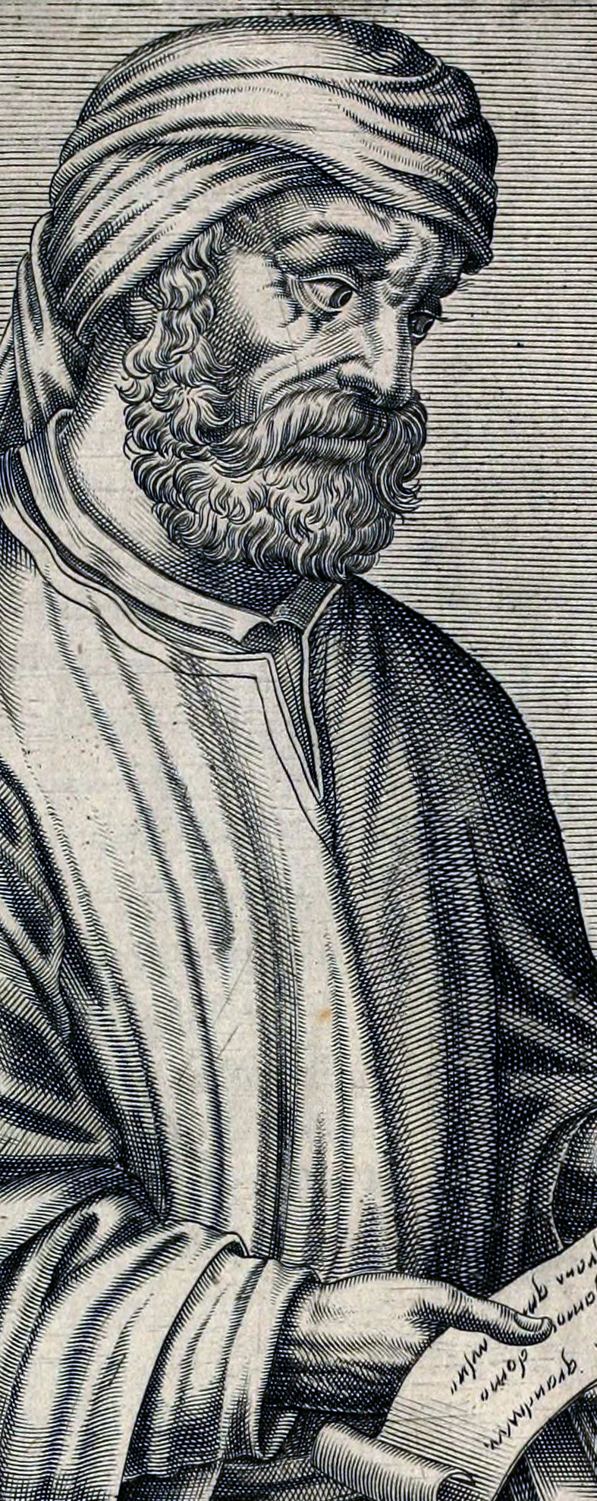
Early Christian Thinkers
Tertullian
Background
  Born around 160 to pagan parents in Carthage, North Africa.
  A trial lawyer in Rome, he converted in 193.
  His last known work appeared in 220.
Notes:
A. Background
1. Born around 160 to pagan parents in Carthage, North Africa.
2. A trial lawyer in Rome, he converted in 193.
3. His last known work appeared in 220.

Slide 177
Early Christian Thinkers
Tertullian
View of Philosophy
  Philosophers agree with Christians that the Logos created the universe.
  While philosophers became proud of their reason, they did no realize they reached the truth via dumb luck
    Much as a lost ship blunders into a safe port during a stormy night.
  Christ says “seek and ye shall find” but also states that once the truth has been found “nothing else is to be believed and therefore nothing else is to be sought.”
  He believes that heresies tend to arise out of philosophy.
  Claims that as Athens and Jerusalem are separated by hundreds of miles, pagan philosophy and Christianity are spiritually separated and can never meet.
  His attempt to keep Christianity and philosophy separate failed.
Notes:
B. View of Philosophy
1. Philosophers agree with Christians that the Logos created the universe.
2. While philosophers became proud of their reason, they did no realize that they reached the truth via dumb luck, much as a lost ship blunders into a safe port during a stormy night.
3. He notes that Christ says “seek and ye shall find” but also states that once the truth has been found “nothing else is to be believed and therefore nothing else is to be sought.”
4. He believes that heresies tend to arise out of philosophy.
5. He claims that as Athens and Jerusalem are separated by hundreds of miles, pagan philosophy and Christianity are spiritually separated and can never meet.
6. His attempt to keep Christianity and philosophy separate failed.

Slide 178

Early Heresies: Heresies & Orthodoxy
Philosophic Issue
  Early Christians faced the challenge of expressing the theology of the Hebraic tradition in terms acceptable to the Greek philosophical tradition.
  This led to more rigorous definitions of the key concepts.
  “Heresy” was Greek for “choice” or “opinion” but it came to mean “incorrect opinion.”
  Due to the existence of numerous religious philosophies, the Church had to determine what was orthodox (right belief) and what was heresy.
Notes:
A. Philosophic Issue
1. The early Christians faced the challenge of expressing the theology of the Hebraic tradition in terms acceptable to those of the Greek philosophical tradition.
2. This lead to more rigorous definitions of the key concepts.
3. Heresy was Greek for “choice” or “opinion” but it came to mean “incorrect opinion.”
4. Due to the existence of numerous religious philosophies, the Church had to determine what was orthodox (right belief) and what was heresy.

Slide 179
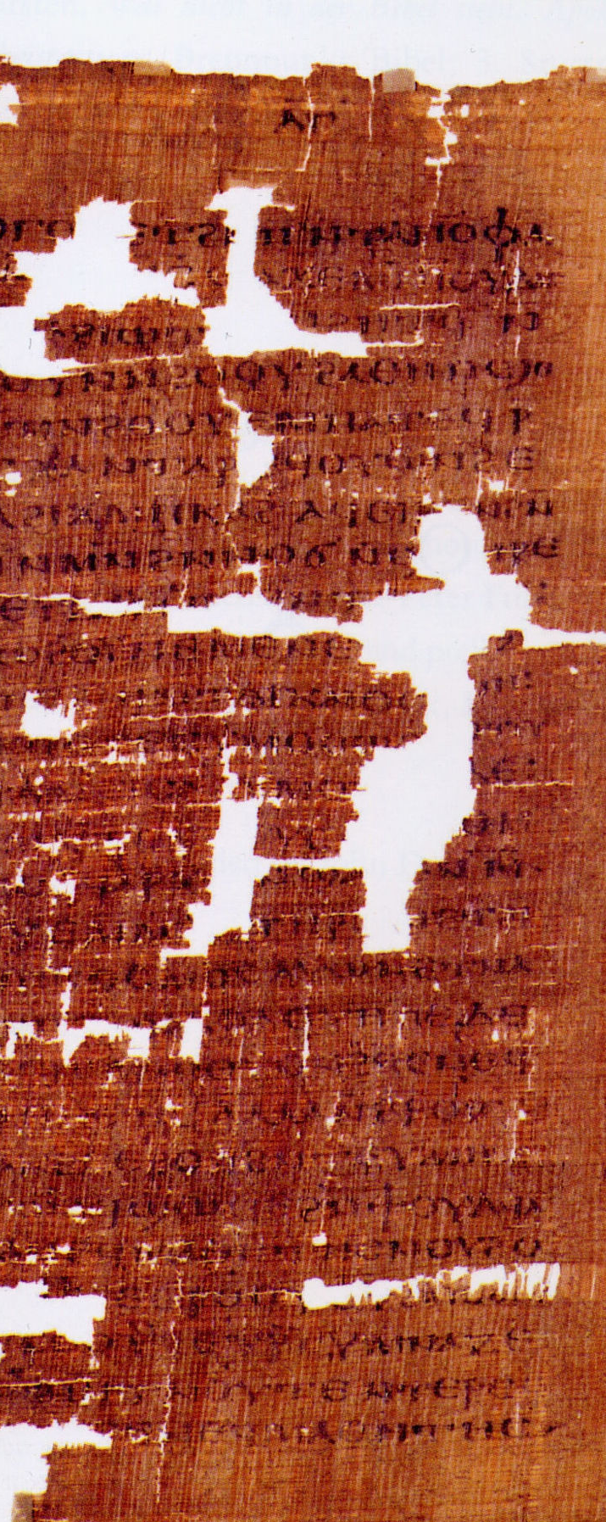
Early Heresies: Gnosticism
Introduction
  Consisted of about a dozen sects in the 2nd century, some of which predated Christianity.
  Substituted knowledge (gnosis) for faith.
  Saw themselves as superior because they had unique access to a secret body of esoteric knowledge.
  This knowledge was a mix of
    Babylonian astrology
    Egyptian cults
    Persian religion
    Neo-Pythagoreanism
    Neoplatonism
    Stoicism
    Judaism
    Christian doctrines.
Notes:
A. Introduction
1. Consisted of about a dozen sects in the 2nd century, some of which predated Christianity.
2. They substituted knowledge (gnosis) for faith.
3. They saw themselves as superior because they had unique access to a secret body of esoteric knowledge.
4. This knowledge was a mix of Babylonian astrology, Egyptian cults, Persian religion, Neo-Pythagoreanism, Neoplatonism, Stoicism, Judaism and Christian doctrines.

Slide 180
Early Heresies: Gnosticism
Views
  Numerous deities, angles, archangels and other spiritual beings emanated from the one supreme God.
  Accepted dualism between spirit and matter.
  The God of the Old Testament, the Demiurge, was an evil God who rose to oppose the God of Light.
  The Demiurge created the world of matter, a kingdom of evil and darkness.
  The Demiurge created humanity to capture portions of the good divine spirit within physical prisons.
Notes:
B. Views
1. Numerous deities, angles, archangels and other spiritual beings emanated from the one supreme God.
2. They accepted a dualism between spirit and matter.
3. The God of the Old Testament, the Demiurge, was an evil God who rose to oppose the God of Light.
4. The Demiurge created the world of matter, a kingdom of evil and darkness.
5. The Demiurge created humanity in an attempt to capture portions of the good divine spirit within physical prisons.

Slide 181
Early Heresies: Gnosticism
Christ
  Christ was one of the highest spirits.
  Thwarted the demiurge by entering a human body or perhaps by appearing to be human.
  Only the elite who could comprehend the secret doctrines could escape the material world and return to the kingdom of Light.
  Most Gnostics preached asceticism due to their perception that the material world was evil.
  Some sects were libertines because they believed
    The body and spirit were so separated that nothing of the body could affect the spirit
    Or slaking their physical desires would destroy their hold over people.
Notes:
C. Christ
1. Christ was one of the highest spirits.
2. He thwarted the demiurge by entering a human body or perhaps by appearing to be human.
3. On the elite who could comprehend the secret doctrines could escape the material world and return to the kingdom of Light.
4. Most Gnostics preached asceticism due to their perception that the material world was evil.
5. Some sects were libertines because they either believed the body and spirit were so separated that nothing of the body could affect the spirit while or that slaking their physical desires would destroy their hold over people.

Slide 182
Early Heresies: Gnosticism
Importance/Influence on Christianity
  Shows the confusing mixture of philosophy and mystery religions.
  Appealing because it used elements from the philosophies and religions of its time.
  Promoted a spiritual-physical dualism and asceticism that influenced Christianity.
  Caused Christian thinkers to become suspicious of philosophy and helped fuel the anti-intellectual aspects of Christianity.
  The problems it caused led Christian thinkers to work towards clarifying key Christian concepts.
Notes:
C. Christ
1. Christ was one of the highest spirits.
2. He thwarted the demiurge by entering a human body or perhaps by appearing to be human.
3. On the elite who could comprehend the secret doctrines could escape the material world and return to the kingdom of Light.
4. Most Gnostics preached asceticism due to their perception that the material world was evil.
5. Some sects were libertines because they either believed the body and spirit were so separated that nothing of the body could affect the spirit while or that slaking their physical desires would destroy their hold over people.
D. Importance/Influence on Christianity
1. Shows the confusing mixture of philosophy and mystery religions at this time.
2. The movement was appealing because it used elements from the philosophies and religions of its time.
3. It promoted a spiritual-physical dualism and asceticism that influenced Christianity.
4. It caused Christian thinkers to become suspicious of philosophy and helped fuel the anti-intellectual aspects of Christianity.
5. The problems it caused lead Christian thinkers to work towards clarifying key Christian concepts.

Slide 183
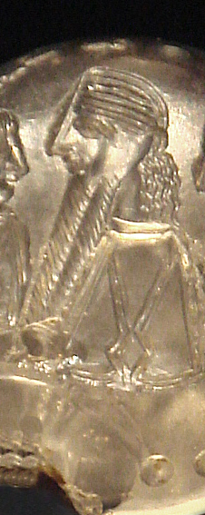
Early Heresies: The Manichean Heresy
Background
  Founded in the 3rd century by Mani, an Iranian prophet.
  A very popular religion.
  St. Augustine was a Manichean for 13 years before becoming a Christian.
Views
  The God of Light and God of Darkness are eternal rivals.
  The equal but opposite forces of good and evil struggle for dominance.
  The problem of evil is avoided since the God of Light is limited in power and opposed.
  Matter is evil and was created by the God of Darkness to trap human souls.
  Salvation is achieved by rising above the realm of matter by means of asceticism.
  Attempted to create a synthesis of all known religions:
    Buddha, Zoroaster, Jesus and Mani were all prophets for their times and places.
Notes:
A. Background
1. Founded in the 3rd century by Mani, an Iranian prophet.
2. A very popular religion.
3. Augustine was a Manichean for 13 years before becoming a Christian.
B. Views
1. The God of Light and God of Darkness are eternal rivals.
2. The equal but opposite forces of good and evil struggle for dominance.
3. The problem of evil is avoided since the God of Light is limited in power and opposed.
4. Matter is evil and was created by the God of Darkness to trap human souls.
5. Salvation is achieved by rising above the realm of matter by means of asceticism.
6. They attempted to create a synthesis of all known religions: Buddha, Zoroaster, Jesus and Mani were all prophets for their
Times and places.

Slide 184
Early Heresies: The Manichean Heresy
Importance/Influence on Christianity
  Shows the confusing mixture of philosophy and mystery religions of this time.
  Appealing because it used elements from the philosophies and religions of its time.
  It promoted a spiritual-physical dualism and asceticism that influenced Christianity.
  It caused Christian thinkers to become suspicious of philosophy and helped fuel the anti-intellectual aspects of Christianity.
  The problems it caused lead Christian thinkers to work towards clarifying key Christian concepts.
Notes:
C. Importance/Influence on Christianity
1. Shows the confusing mixture of philosophy and mystery religions at this time.
2. The movement was appealing because it used elements from the philosophies and religions of its time.
3. It promoted a spiritual-physical dualism and asceticism that influenced Christianity.
4. It caused Christian thinkers to become suspicious of philosophy and helped fuel the anti-intellectual aspects of Christianity.
5. The problems it caused lead Christian thinkers to work towards clarifying key Christian concepts.

Slide 185

Early Heresies: The Arian Heresy
Problem
  4th century crisis.
  Christians: there is one God but three divine persons: the Father, Son and Holy Spirit.
  The problem: how can there be one God and three divine persons?
Answers
  The three are different manifestations of the same being.
    This entails that God the Father died on the cross.
  The three are related to the divine substance as three humans partake of the essence of human nature.
  This implies polytheism and contradicts the tradition that there is only one God.
  Some denied that Jesus was divine while others denied that he was human.
  A myriad of other positions were considered.
Notes:
A. Problem
1. 4th century crisis.
2. Christians held there is one God but also spoke of three divine persons: the Father, Son (Jesus/Logos) and the Holy Spirit.
3. The problem: how can there be one God and three divine persons?
B. Answers
1. The three are different manifestations of the same being.
a. This entails that God the Father died on the cross.
2. The three beings are related to the divine substance as three humans partake of the essence of human nature.
a. This implies a version of polytheism and hence contradicts the tradition that there is only one God.
3. Some denied that Jesus was divine while others denied that he was human.
4. A myriad of other positions were considered.

Slide 186
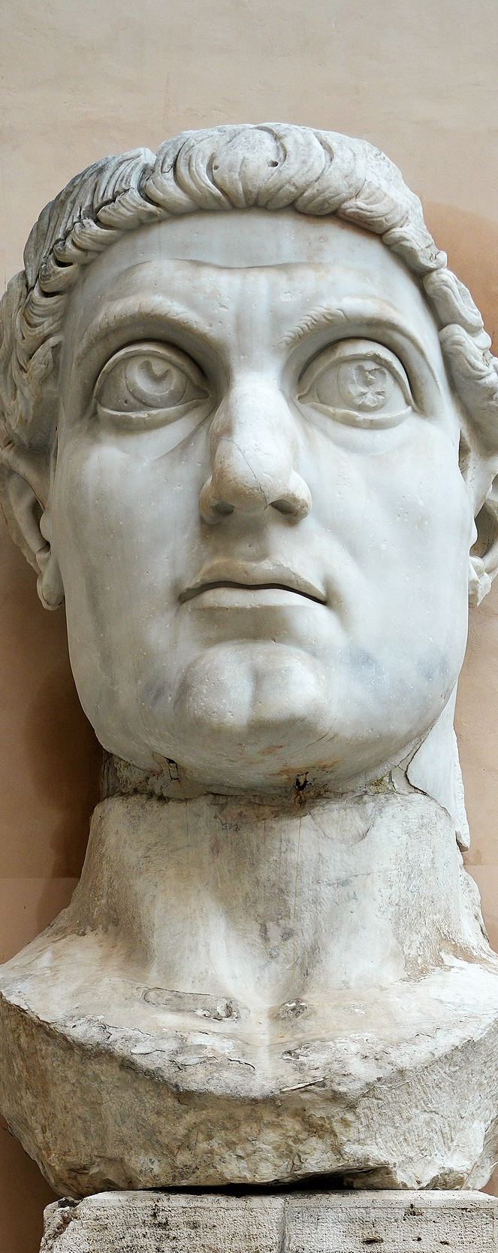
Early Heresies: The Arian Heresy
Athanasius
  Became the Bishop of Alexandria.
  Claimed God was manifested in three persons who shared the same divine substance.
  The Son is the same substance as the Father.
Arius
  A cleric in Alexandria.
  Claimed the Son was created by the Father and the two were not the same being,
Council of Nicea
  Called by Emperor Constantine in 325 to settle the dispute between Athanasius and Arius to end civil disorder.
  Athanasius carried the majority and the Arians were denounced as heretics.
  The proceedings became the Nicene Creed.
Notes:
C. Athanasius
1. Became the Bishop of Alexandria.
2. Claimed that God was manifested in three persons who shared the same divine substance.
3. The Son is the same substance as the Father.
D. Arius
1. A cleric in Alexandria.
2. Claimed the Son was created by the Father and the two were not the same being,
E. Council of Nicea
1. Called by Emperor Constantine in 325 to settle the dispute between Athanasius and Arius so as to end civil disorder.
2. Athanasius carried the majority and the Arians were denounced as heretics.
3. The proceedings became the Nicene Creed.

Slide 187
Early Heresies: The Arian Heresy
The Battle Continued
  The dispute endured.
  The radical Arians claimed the Son’s essence is unlike (anomoios, in Greek) the Father’s.
  The Nicene formula stated the two were the same being (homoousios).
  The moderate Arians and those accepting the Nicene Creed compromised and agreed the Son and Father are of similar substance (homoiousios).
  They believed purity of the faith, divine truth and salvation were at stake in this dispute.
  The dispute led to several more councils.
Philosophical Significance
  The term “substance” is used as a philosophical term and is not used in this manner in the bible.
  Greek metaphysical concepts played a significant role in the development of Christianity.
  Example: similarity between the participation of particulars in the Forms and the participation of Jesus in the Divinity of the Father.
Notes:
F. The Battle Continued
1. The dispute endured for quite some time.
2. The radical Arians claimed that the Son’s essence is unlike (anomoios, in Greek) the Father’s.
3. The Nicene formula stated that the two were the same being (homoousios).
4. Eventually the moderate Arians and those accepting the Nicene Creed compromised and agreed that the Son and Father are of similar substance (homoiousios).
5. The thinkers involved believed that the purity of the faith, divine truth and salvation were at stake in this dispute.
6. The dispute lead to several more councils.
G. Philosophical Significance
1. The term “substance” is used a philosophical term and is not used in this manner in the bible.
2. Greek metaphysical concepts played a significant role in the development of Christianity.
3. Another example is the similarity between the participation of particulars in the Forms and the participation of Jesus in the Divinity of the Father.

Slide 188
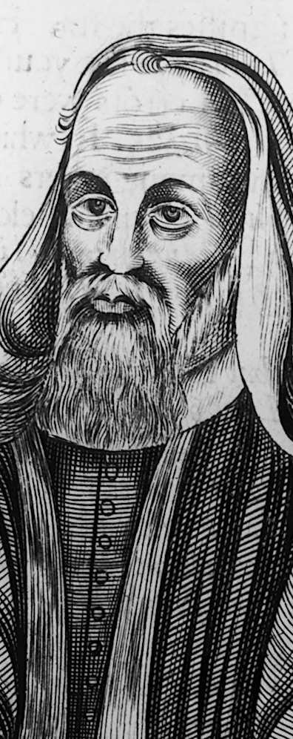
Early Heresies: The Pelagian Heresy
Background
  Started by the British monk Pelagius in 5th century Rome.
  He was concerned about the doctrine of original sin.
Doctrine of Original Sin
  When Adam disobeyed God, sin entered into the human race.
  All of Adams descendants inherited the sinful nature.
  Christ has come to save us from our helpless bondage to sin.
  God only saves those He wills to be saved, all others remain victims of their sinful nature.
Notes:
A. Background
1. Started by the British monk Pelagius in 5th century Rome.
2. He was concerned about the doctrine of original sin.
B. The Doctrine of Original Sin
1. When Adam disobeyed God, sin entered into the human race.
2. All of Adams descendents inherited the sinful nature.
3. Christ has come to save us from our helpless bondage to sin.
4. God only saves those he wills to be saved, all others remain victims of their sinful nature.

Slide 189
Early Heresies: The Pelagian Heresy
Pelagius
  The doctrine of original sin leads to moral apathy.
  If one is born sinful and cannot resist sin,
    There is no reason to try
    People are not morally accountable.
  He claimed we have moral freedom
    Can resist sin
    Can make correct moral choice without external help.
  Adam set a bad example for humanity.
  God sent Jesus as an example to help us decide to choose good.
  With or without Jesus the capacity for moral freedom remains the same.
Notes:
C. Pelagius
1. The doctrine of original sin leads to moral apathy.
2. If one is born sinful and cannot resist sin, there is no reason to try and people are not morally accountable.
3. He claimed we have moral freedom and can resist sin and make correct moral choice without external help.
4. Adam set a bad example for humanity.
5. God sent Jesus as an example to help us decide to choose good.
6. With or without Jesus the capacity for moral freedom remains the same.

Slide 190
Early Heresies: The Pelagian Heresy
Heresy
  Pelagianism was condemned as heresy because
    It put emphasis on human moral autonomy
    Made divine grace and the death of Jesus vastly less important.
Significance
  Augustine disagreed with Pelagius, which shaped his theology and that of Christianity.
  Focused the problem of reconciling God’s sovereignty with human freedom.
  Raised the problem of balancing the determining factors on human behavior with moral responsibility.
Notes:
D. Heresy
1 Pelagianism was condemned as heresy because it put emphasis on human moral autonomy and made divine grace and the death of Jesus vastly less important.
E. Significance
1.Augustine disagreed with Pelagius, which shaped his theology and that of Christianity.
2. Focused the problem of reconciling God’s sovereignty with human freedom.
3. Once again raised the problem of balancing the determining factors on human behavior with moral responsibility.

Slide 191
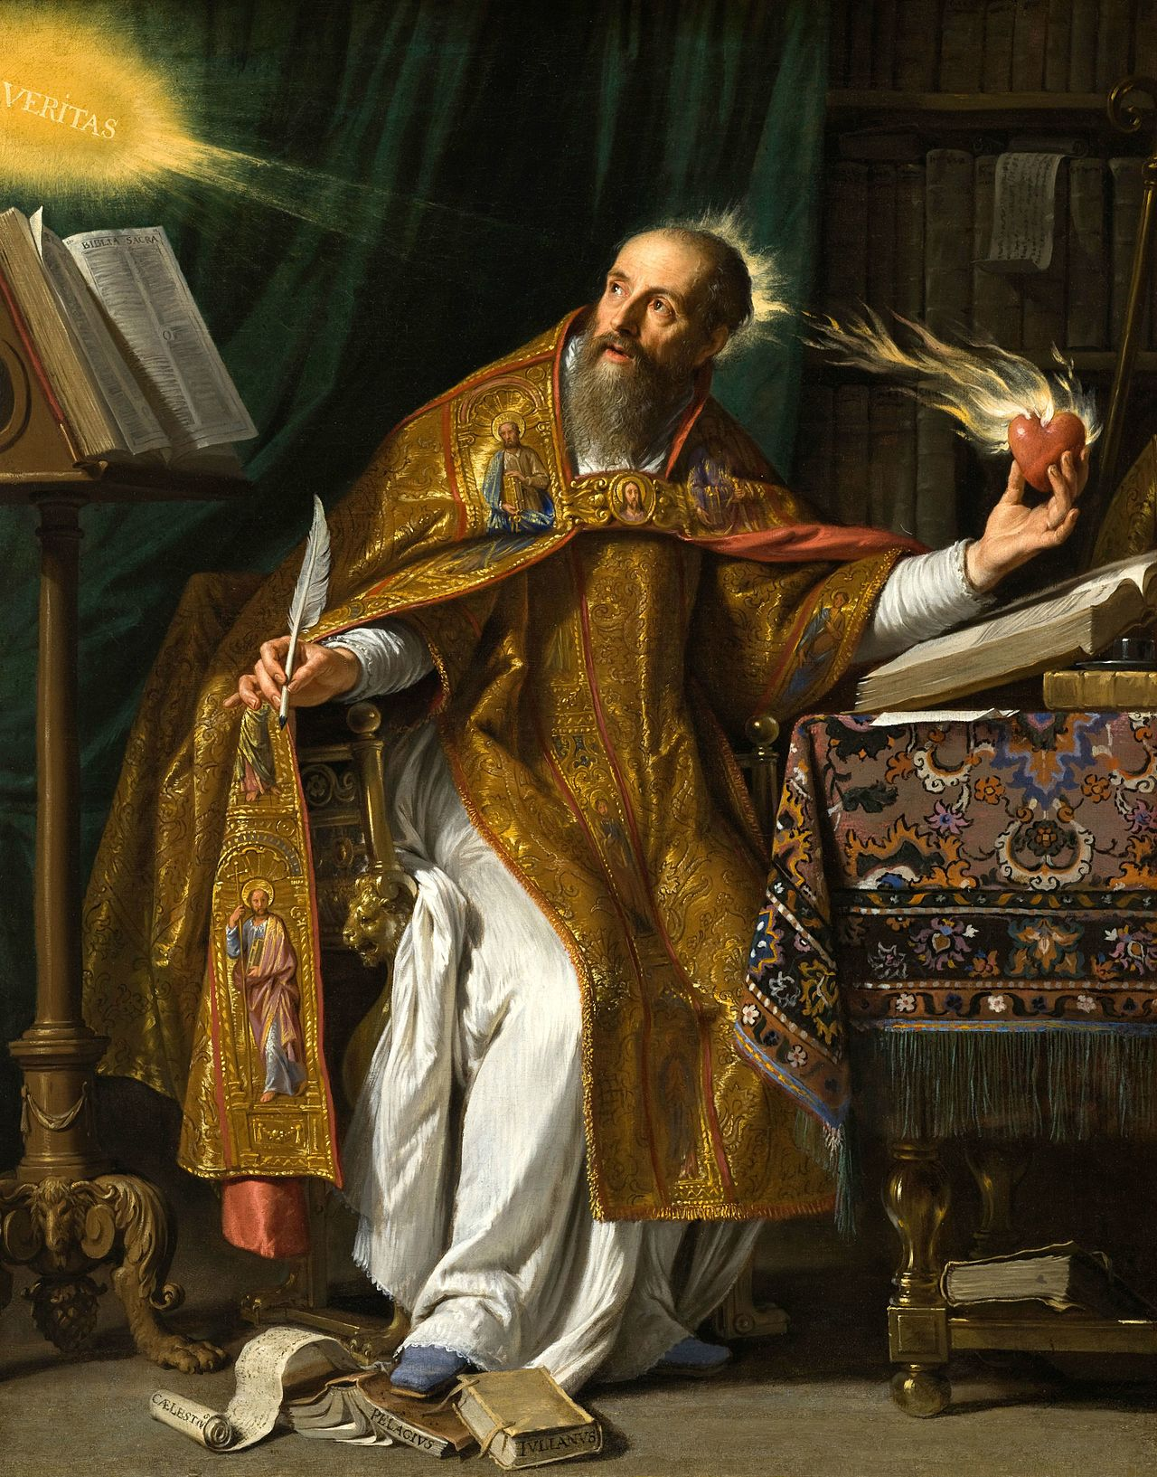
St. Augustine

Slide 192
St. Augustine: Background
Pre-Christian Background
  Born in 354 in North Africa to Patricius and Saint Monica.
  Went to Carthage in 370 to study rhetoric.
  Lived with a mistress and had an illegitimate son.
  Impressed by their answer to the problem of evil and that he could blame his passions and desires on an external cause, he became a Manichean.
  Was a successful teacher of rhetoric and won a prize for his poetry.
  His nine years with the Manicheans ended when Faustus, the master teacher of the Manicheans, turned out to be a pompous simpleton.
  After adopting skepticism, he went to Rome to further his career and find better students.
  In 384 he went to Milan to be a professor of rhetoric.
  In Milan, he was befriended by St Ambrose, the bishop of the city, at the request of Monica.
  He struggled against his lusts, but was unable to resist them, taking another mistress.
    “Grant me chastity and continence, but not yet.”
Notes:
A. Pre-Christian Background
1. Born in 354 in North Africa to Patricius and Saint Monica.
2. Went to Carthage in 370 to study rhetoric.
3. He lived with a mistress and had an illegitimate son.
4. Impressed by their answer to the problem of evil and the fact that he could blame his passions and desires on an external cause, he became a Manichean.
5. He was a successful teacher of rhetoric and won a prize for his poetry.
6. His nine years with the Manicheans ended when Faustus, the master teacher of the Manicheans, turned out to be a pompous simpleton.
7. After adopting skepticism, he went to Rome to further his career and find better students.
8. In 384 he went to Milan to be a professor of rhetoric.
9. In Milan, he was befriended by St Ambrose, the bishop of the city at the request of Monica.
10. He struggled against his lusts, but was unable to resist them, taking another mistress.
a. “Grant me chastity and continence, but not yet.”

Slide 193
St. Augustine: Background
Christian Background
  Read Neoplatonism and it gave him a glimpse of peace.
  The writings of the Apostle Paul showed him the way.
  Moved by the conversion of Victorinus, a translator of the Neoplatonists and Aristotle’s logic.
  In 386 his turmoil leads him to convert: an inner voice said, “let it be now.”
  He struggled against his passions.
  In misery, he read a passage from St. Paul, yielded to God and felt peace.
  He was baptized by St. Ambrose on Easter Sunday in 387.
  He left the profession of rhetoric and devoted his energy to the Church.
  Returned home and in 396 he became the Bishop of Hippo.
  He died in 430 as the Empire was falling and the barbarians were at the gates.

Slide 194
St. Augustine: Philosophy
Platonic & Neoplatonic
  Platonists came the closest to Christianity.
  Platonists had “unlawful possession” of God’s truth
    Christians should take it back.
Limits
  He only wanted to know the God and the soul, nothing more.
  Not interested in purely intellectual problems.
  Philosophy is either a means to God or an obstacle in the way of God.
Notes:
A. Platonic & Neoplatonic
1. He claims the Platonists came the closest to Christianity.
2. He claimed the Platonists had “unlawful possession” of God’s truth, so the Christians should willing to take it back from them.
B. Limits
1. He claimed that he only wanted to know the God and the soul, nothing more.
2. He was not interested in purely intellectual problems.
3. Philosophy is either a means to God or an obstacle in the way of God.

Slide 195
St. Augustine: Philosophy
Philosophy & Religion
  Early writings, ending with Confessions (400), reflected optimism about natural reason and focused on problems it could address.
  Focused on refuting the Manicheans and skeptical philosophies.
  Later writings, such as City of God (426), have more of a scriptural base and put reason in subordination to faith.
    Many works aimed at addressing Christian heresies.
  No aspect of reality could be understood apart from the religious perspective.
Did not distinguish
  Between natural reason and revelation
  Between philosophy and theology
  Between humans and natural beings and humans as spiritual beings.
  In cases not covered by scripture, Augustine accepts Plato’s answers.
  In cases covered by the Bible, it is the final word.
Notes:
C. Philosophy & Religion
1. His early writings, ending with Confessions (400), reflected optimism about natural reason and focused on problems it could address.
a. These works focused mainly on refuting the Manicheans and skeptical philosophies.
2. His later writings, such as City of God (426), tend to be more of a scriptural base and put reason in subordination to faith.
a. Many of these works aimed at addressing Christian heresies.
3. He claimed that no aspect of reality could be understood apart from the religious perspective.
4. He did not distinguish between natural reason and revelation, between philosophy and theology, or between humans and natural beings and humans as spiritual beings.
5. In cases not covered by scripture, Augustine accepts Plato’s answers.
6. In cases covered by the Bible, it is the final word.

Slide 196
St. Augustine:Philosophy
Primacy of the Will & Love
  Everything in the universe is a result of God’s free and sovereign will.
  For humans, everything is explained in terms of the will.
  The human intellect follows the will.
  The will is free and determined by nothing.
  The will is moved by what it chooses to love and is drawn in that direction.

Slide 197
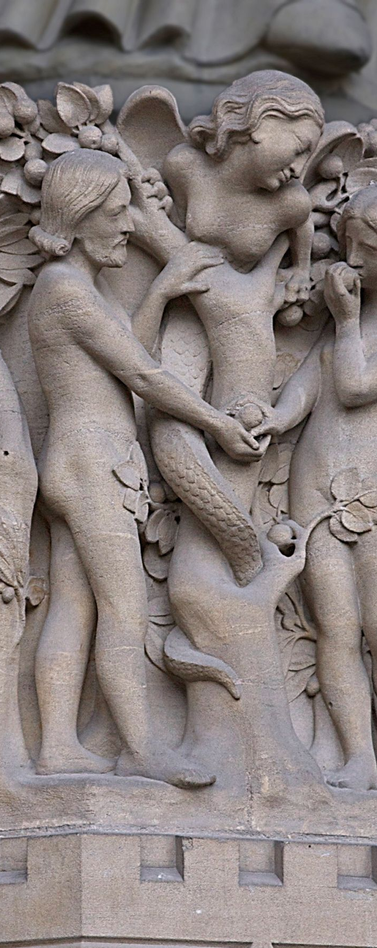
St. Augustine: Philosophy
Sin
  Humans inherited the original sin and re-enact it.
  All aspects of human life are infected by sin.
Sin
  Bends our will away from God
  Leads us to self-love and love of a corrupt and ephemeral world.
  Sin affects ethics, epistemology, and human history.
  A tension in his work is the conflict between sin and free will.
Notes:
E. Sin
1. Humans inherited the original sin and re-enact it.
2. All aspects of human life are infected by sin.
3. Sin bends our will away from God and leads us to self-love and love of a corrupt and ephemeral world.
4. Sin affects ethics, epistemology, and human history.
5. A major tension in his work is the conflict between sin and free will.

Slide 198
St. Augustine: Epistemology
Goals
  Knowledges is not an end in itself.
  Not interested in knowledge as a means of developing science and other ways of influencing the physical world.
  Epistemology’s goal is to weed out false views that interfere with the soul’s journey to God.
  Truth is key to a happy life and brings one closer to God.
Notes:
Goals
Knowledges is not an end in itself.
Not interested in knowledge as a means of developing science and other ways of influencing the physical world.
Epistemology’s goal is to weed out false views that interfere with the soul’s journey to God.
Truth is key to a happy life and brings one closer to God.

Slide 199
St. Augustine: Epistemology
The Search for Certainty
Certainty
  Only certain, absolute, eternal truth serves as an adequate foundation for life.
Against the Skeptics
  Reply to skeptics of the new Platonic Academy, such as Carneades.
  Skeptics claimed
    Nothing can be known
    Judgment should be suspended.
    Suspending judgment and pursuing truth would make one happy and wise.
  Augustine claimed
    Cannot be wise without knowing the truth
    An unending pursuit would not lead to happiness.
Attacking the Skeptics
  Find a proposition whose truth is certain.
  Skeptics make truth claims
  Skeptics claim to know that Skepticism is correct.
Notes:
A. Certainty
1. Only certain, absolute, eternal truth could serve as an adequate foundation for life.
B. Against the Skeptics
1. A reply to the skeptics of the new Platonic Academy, such as Carneades.
2. The skeptics claimed that nothing can be known and judgment should be suspended.
3. The skeptics claimed that suspending judgment and pursuing truth would make one happy and wise.
4. Augustine claimed that one cannot be wise without knowing the truth and that such unending pursuit would not lead to happiness.
C. Attacking the Skeptics
1. Augustine set out to find a proposition whose truth is certain.
2. He claims that Skeptics make truth claims and that Skeptics claim to know that Skepticism is correct.

Slide 200
St. Augustine: Epistemology
The Search for Certainty
Argument that skepticism is self-refuting.
  Skeptics claim we cannot know anything to be true.
  To deny we cannot know the truth requires a definition of “truth.”
  The definition is either true or false.
  If the definition is true, then the Skeptics know some truths
    They refute their own claim.
  If the definition is false, then it is useless in a defense of Skepticism.
    Their claim is meaningless.
Logical Propositions
  Certain logical propositions are known to be true.
  Without logic it would be impossible to present the Skeptical position.
  We can know mathematical truths with certainty.
Notes:
D. Argument that skepticism is self-refuting.
1. The Skeptics claim we cannot know anything to be true.
2. To deny we cannot know the truth requires a definition of “truth.”
3. The definition is either true or false.
4. If the definition is true, then the Skeptics know some truths-thus they refute their own claim.
5. If the definition is false, then it is useless in a defense of Skepticism-their claim is meaningless.
E. Logical Propositions
1. Augustine claims that certain logical propositions are known to be true.
2. Without logic it would be impossible to even present the Skeptical position.
3. He asserts that we can know mathematical truths with certainty.

Slide 201
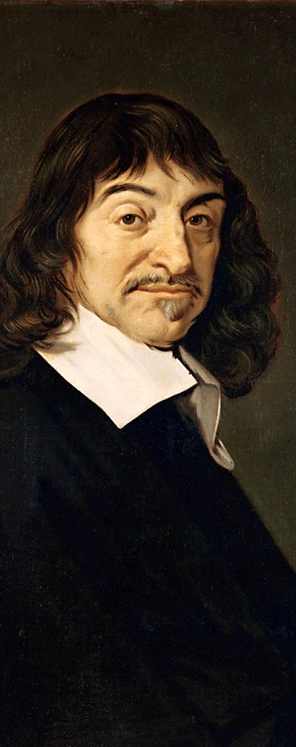
St. Augustine: Epistemology
The Search for Certainty
Senses
  The Skeptics argued that sense experience is not reliable.
  Claims that what the senses report is always true, if we do not go beyond the experience.
  Claims reason needs to interpret sense experience before we can make inferences about what lies beyond them.
Self Conscious
  We can be certain about the content of our own minds.
    We know that we are.
  If he is mistaken, then he exists, if one does not exist, one cannot be mistaken.
  As he knows that he is, he claims that he knows that he knows.
  He knows that he loves, thus he knows at least three things.
  This refutes the skeptical claim.
  Descartes
Notes:
F. Senses
1. The Skeptics argued that sense experience is not reliable.
2. He claims that what the senses report is always true, provided that we do not go beyond the experience.
3. He claims that reason needs to interpret the sense experience before we can make inferences about what lies beyond them.
G. Self Conscious
1. We can be certain about the content of our own minds-we know that we are.
2. If he is mistaken, then he exists-if one does not exist, one cannot be mistaken.
3. As he knows that he is, he claims that he knows that he knows.
4. He also adds that he knows that he loves, thus he knows at least three things.
5. This refutes the skeptical claim.
6. This same sort of argument was later given by Descartes.

Slide 202
St. Augustine: Epistemology
Platonism
Senses
  He values the senses more than Plato does.
  The senses and their objects were created by God.
  The senses have a role to play in practical life.
  The senses cannot
    Yield perfect, eternal truth
    Cannot give knowledge by themselves
Notes:
II Platonism
A. Senses
1. He values the senses more than Plato does.
2. The senses and their objects were created by God.
3. The senses have a role to play in practical life.
4. The senses cannot yield perfect, eternal truth and cannot give knowledge by themselves.

Slide 203
St. Augustine: Epistemology
Platonism
Inward Truths
  The mind must judge sense experiences by utilizing eternal reasons within the mind.
  That truth resides within the soul is based on:
    Platonism
    The claim the soul is made in God’s image.
  Are
    Immaterial
    Independent of sound, space and time.
Notes:
B. Inward Truths
1. The mind must judge the sense experiences by utilizing the eternal reasons that are within the mind.
2. His view that the truth resides within the soul is based on Platonism and the claim that the soul is made in the image of God.
3. These truths are immaterial and independent of sound, space and time.

Slide 204

St. Augustine: Epistemology
Platonism
  Uses mathematics to argue for a higher level of reality beyond the physical world.
  Physical realities are:
    Particular
    Temporal
    Changing
    Discovered via experience.
  Mathematical laws and numbers are:
    Eternal
    Unchanging
    Discovered via the intellect.
  So, there must be two kinds of reality.
Moral truths are
  Objective
  Among the higher truths
  Apprehended via an “intellectual sight.”
Notes:
B. Inward Truths
1. The mind must judge the sense experiences by utilizing the eternal reasons that are within the mind.
2. His view that the truth resides within the soul is based on Platonism and the claim that the soul is made in the image of God.
3. These truths are immaterial and independent of sound, space and time.
4. He uses mathematics to argue for a higher level of reality beyond the physical world.
a. Physical realities are particular, temporal, changing, and discovered via experience.
b. Mathematical laws and numbers are eternal, unchanging and discovered via the intellect.
c. So, there must be two kinds of reality.
5. Moral truths are objective and among the higher truths and are apprehended via an “intellectual sight.”

Slide 205

St. Augustine: Epistemology
Divine Illumination
Acquisition of Eternal Truths
  Uses Plato’s analogy between physical perception of the external world and interior vision of the mind.
  Rejects Plato’s doctrine of recollection on theological grounds.
  Rejects that we can know the truths via natural reason.
  Intelligible realities/eternal truths/forms/divine ideas are discovered via divine light.
  Uses the Platonic metaphor that the divine light is like the sun.
  The human mind is dependent on God’s light to see the truth
    This is not a mystical, religious experience.
  Metaphor of remembering to describe this discovery
    “cognition” is from “cogito” which can mean “I recollect.”
    The illumination might not be noticed.
    The mind becomes aware of, collects and assembles knowledge that was scattered, concealed and neglected.
Notes:
A. Acquisition of Eternal Truths
1. He makes use of Plato’s analogy between physical perception of the external world and the interior vision of the mind.
2. He rejects the Platonic doctrine of recollection on theological grounds.
3. He also rejects the view that we can know the truths via our own natural reason.
4. The intelligible realities/eternal truths/forms/divine ideas are discovered via divine light.
5. He uses the Platonic metaphor that the divine light is like the sun.
6. The human mind is dependent on God’s light to see the truth, although this is not a mystical, religious experience.
7. He uses the metaphor of remembering to describe this discovery, noting that “cognition” is from “cogito” which can mean “I recollect.”
a. The illumination might not be noticed.
b. The mind becomes aware of, collects and assembles knowledge that was scattered, concealed and neglected.

Slide 206
St. Augustine: Epistemology
Divine Illumination
Memoria
  Non-sensory contents of the mind.
  Includes memories and everything present to the mind.
  Knowledge of
    The self
    Ethical truths
    Values
    God
  Looking inward, one sees a glimpse of an infinite realm of truths.
  “I myself cannot grasp the totality of what I am.”
  Inward journey reveals the transcendent realm and sets one on a trip beyond the physical world and self, then to what is eternal and God.
Notes:
B. Memoria
1. The nonsensory contents of the mind.
2. Includes actual memories as well as everything present to the mind.
a. Knowledge of the self, ethical truths, values and God.
3. Looking inward, one sees a glimpse of an infinite realm of truths.
a. “I myself cannot grasp the totality of what I am.”
4. The inward journey reveals the transcendent realm and sets one on a trip beyond the physical world and self, then to
What is eternal and God.

Slide 207
St. Augustine: Epistemology
Divine Illumination
Faith and Reason
  Reason requires faith to work properly.
  Faith and reason are not alternative means to the truth, if they were:
    There would be no need for faith.
    This would assume the self-sufficiency of reason, which he denies.
    This would assume reason is neutral, but he takes reason as affected by emotions, values and faith.
  Makes a strong connection between morality and reason.
    Example: an immoral person will not accept a proof of God’s existence.
  The divine light illuminates everyone, but how much each perceives depends on their heart.
  Based on experience, he claims knowledge of the good does not make one good but being good enables one to have knowledge of the good.
  Understanding follows faith.
Notes:
C. Faith and Reason
1. Reason requires faith to work properly.
2. Faith and reason are not alternative means to the truth, if they were:
a. There would be no need for faith.
b. This would assume the self-sufficiency of reason, which Augustine denies.
c. This would assume that reason is neutral, but Augustine takes reason to be affected by emotions, values and faith.
3. He makes a strong connection between morality and reason.
a. One will not accept, for example, a proof of God’s existence if one is immoral.
4. Although the divine light illuminates everyone, how much each person perceives depends on his or her heart.
5. Based on his experiences, he claims that knowledge of the good does not make one good but that being good enables one to have knowledge of the good.
6. He claims that understanding follows faith.

Slide 208

St. Augustine: Metaphysics
Existence of God
Intent of Proofs
  Helping people find what they seek rather than convert atheists.
  Begins with faith in God, then proceeds on to reason.
  Does not believe that the finite can ever prove the infinite.
Design Argument
  The order, changes and movement in the universe and the beauty of the form of the visible things show the world was created by God.
  Sense experience is too uncertain and the physical world too changing and unlike God to provide a foundation for belief.
Notes:
A. Intent of Proofs
1. His proofs seem to aim at helping people find what they seek rather than attempts to convert the atheists.
2. He begins with faith in God, then proceeds on to reason.
3. He does not believe that the finite can ever prove the infinite.
B. Design Argument
1. The order, changes and movement in the universe and the beauty of the form of the visible things show that the world was created and that this creator is God.
2. But, sense experience is too uncertain and the physical world too changing and unlike God to provide an effective foundation for belief.

Slide 209
St. Augustine: Metaphysics
Existence of God
Person Argument
  God is closer to humans than to the created world.
  The spiritual being, made in God’s image, brings us closer to God than the physical world.
  The quest for God leads “from the exterior to the interior, and from the interior to the superior.”
Argument from On Free Choice of the Will
  Argues for the existence of objective and universal eternal truths of reason.
  If there is an eternal and necessary truth higher than and independent of the mind, then it must be God because these are God’s attributes.
  He assumes Plato’s Good is God and uses Plato’s arguments for the impersonal Good as the characteristics of God.
Notes:
C. Person Argument
1.God is closer to humans than to the created world.
2. The spiritual being, made in God’s image, brings us closer to God than does the physical world.
3. He claims that the quest for God leads “from the exterior to the interior, and from the interior to the superior.”
D. Argument from On Free Choice of the Will
1. He argues for the existence of objective and universal eternal truths of reason.
2. If there is an eternal and necessary truth that is higher than and independent of the mind, then it must be God because these are God’s attributes.
3. Augustine seems to assume that Plato’s Good is God and tags onto Plato’s arguments for the impersonal Good the characteristics of God.

Slide 210
St. Augustine: Metaphysics
Creation
Ex Nihilo Creation
  The world was brought into being from nothing.
  In accord with the Biblical account of creation.
  Heaven and earth must have been created as they show change and variation.
  He assumes anything that changes must be created and anything unchanging is eternal.
  So, the world is not eternal.
  The world is not part of God
    This would bring a part of God into the realm of change and destruction.
  Following Plato, he accepts a perfect being cannot change: this would be to a less perfect being.
Notes:
A. Ex Nihilo Creation
1. The world was brought into being from nothing.
2. This is in accord with the Biblical account of creation.
3. Heaven and earth must have been created because they show change and variation.
4. He assumes that anything that changes must be created and anything unchanging is eternal.
5. So, the world is not eternal.
6. The world is not part of God for this would bring a part of God into the realm of change and destruction.
7. Following Plato, he accepts that a perfect being cannot change for the only change would be to a less perfect being.

Slide 211
St. Augustine: Metaphysics
Creation
Creation was a Free Act
  God is sovereign so the world did not flow from Him out of necessity.
  Like Plato’s Demiurge, God created the world to share His goodness.
The World is based on Forms
  The world of particulars is based on the eternal forms.
    Bases his account on Plato
    A chapter of Confessions is devoted to making Genesis fit Platonism.
  Unlike for Plato,
    The forms do not exist as independent beings, they reside in God’s mind.
    The creator does not impose forms on pre-existing matter, matter is created.
Notes:
B. Creation was a Free Act
1. God is sovereign so the world did not flow from Him out of necessity.
2. Like Plato’s Demiurge, God created the world to share His goodness.
C. The World is based on Forms
1. The world of particulars is based on the eternal forms.
2. He bases his account on Plato and an entire chapter of Confessions is devoted to making Genesis fit Platonism.
3. Unlike Plato, Augustine does not take the forms to exist as independent beings and instead takes them to reside in God’s mind.
4. Unlike Plato, Augustine does not take the creator to impose forms on pre-existing matter and instead claims that the matter would need to be created.

Slide 212
St. Augustine: Metaphysics
Creation
Rational Seeds
  God placed rational seeds/seminal reasons (rationes seminales) in the world from which future created beings will emerge.
  To resolve the apparent contradiction between the claim God “created all things together” and different beings were created on different days during the six days of creation.
  God created everything simultaneously, but God created some things fully developed and others as undeveloped seeds.
  These seeds developed and will develop into a diversity of creatures.
  Natural forces and the action of created beings have no causal role to play.
  Any “new” species were created as part of the original creation.
Notes:
D. Rational Seeds
1. God placed rational seeds/seminal reasons (rationes seminales) in the world from which future created beings will emerge.
2. This is presented to resolve the apparent contradiction between the claim God “created all things together” and that different beings were created on different days during the six days of creation.
3. He claims that God created everything simultaneously, but God created some things fully developed and others as undeveloped seeds.
4. These seeds developed and will develop into a diversity of creatures.
5. Thus, natural forces and the action of created beings have no causal role to play.
6. Any “new” species that appear were actually created as part of the original creation.

Slide 213

St. Augustine: Metaphysics
Creation
Time
  Manicheans raised the question of what God was doing before creation.
  Reply: “He was preparing hell for those who pry into mysteries.”
  The question assumes time was progressing prior to creation.
  If God was waiting and then decided to create, this entails change in God.
  God did not create the world in time, He created the world and time together.
  He takes time as change, putting it in the category of things that have a beginning.
  Time is a relational being-without creation, there would be no change and hence no time.
  Since God is eternal, there is no before or after for Him.

Slide 214
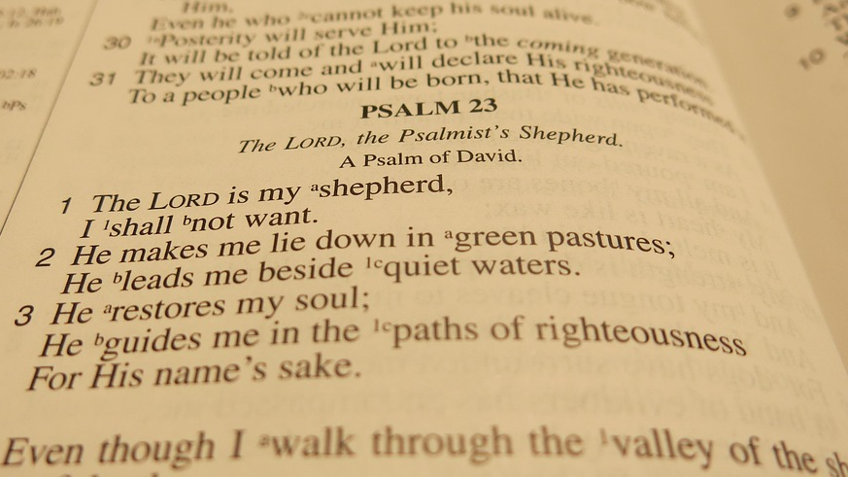
St. Augustine: Metaphysics
Foreknowledge and Free Will
Time
  God created time and does not exist within it.
  Time is how created beings experience the world.
Psalm Analogy
  He can have a psalm in his mind and all at once.
  As it is recited, some words become past and he is aware of the words to be spoken.
  By analogy, God knows all of time as one eternal moment.
Notes:
A. Time
1. God created time and does not exist within it.
2. Time is how created beings experience the world.
B. Psalm Analogy
1. He notes he can have a psalm in his mind and all at once.
2. As it is recited, some words become past and he is aware of the words to be spoken.
3. By analogy, God knows all of time as one eternal moment.

Slide 215

St. Augustine: Metaphysics
Foreknowledge and Free Will
Freedom
  If God is aware of all time, how can free will exist?
  God knows what will happen before it happens.
  “We act by choice in all those things we feel and know that we cannot act otherwise than willingly.”
Foreordained
  Since God is sovereign His will cannot be hindered by the will of any created creature.
  He applies this to his own life, claiming that all events were orchestrated by God.
  God “works in the hearts” of people to incline their wills as He wills
    “To good deeds according to His mercy or to evil after their own deserts.”
  Freedom and God’s sovereignty are compatible.
  Example: God commands faith and works but also gives them as a gift so we know we do them and God makes us do so.
Notes:
C. Freedom
1. If God is aware of all time, how can free will exist?
2. He claims that God knows what will happen before it happens.
3. He also claims that “we act by choice in all those things we feel and know that we cannot act otherwise than willingly.”
D. Foreordained
1. He claims that since God is sovereign his will cannot be hindered by the will of any created creature.
2. Augustine applies this to his own life, claiming that all events were orchestrated by God.
3. He claims that God “works in the hearts” of people to incline their wills as He wills, “to good deeds according to His mercy or to evil after their own deserts.”
4. He claims that freedom and God’s sovereignty are compatible.
5. As an example, he claims that God commands faith and works but also gives them as a gift so we know we do them and that God makes us do so.

Slide 216

St. Augustine: Metaphysics
The Problem of Evil
The Problem of Evil
  The problem is reconciling the apparent existence of evil with God’s qualities.
  As a Manichean, he accepted the God of Light was opposed by an equal God of Evil.
    He rejected this when he became a Christian.
  Since God created the world, all that exists must be good.
  Evil must be a defect or corruption of what was created.
  Unlike Neoplatonists who saw matter as evil, he assumes the created world is good.
Notes:
A. The Problem of Evil
1. The problem is reconciling the apparent existence of evil with God’s qualities.
2. When he was a Manichean, Augustine accepted their view that the God of Light was opposed by an equal God of Evil.
a. He rejected this when he became a Christian.
3. Since God created the world, all that exists must be good.
4. Evil must be a defect or corruption of what was created.
5. Unlike the Neoplatonists who tended to regard matter as evil, Augustine assumes that the created world is good.

Slide 217
St. Augustine: Metaphysics
The Problem of Evil
First Reply
  What we regard as evil merely appears to be evil to us.
  Such evil things and events are a means to achieve goodness.
  Example: problems in life teach us to desire the afterlife rather than coveting things on earth.
Second Reply
  Evil is a privation.
  As shadow is an absence of light, evil is an absence of perfect goodness.
  Since no created thing can match God’s perfection, they are all imperfect.
  If God eliminated all evil/imperfection, they nothing would be left other than Him.
  Despite its imperfections, the created world is beautiful
  Our limited perception causes us to fail to see the entire pattern, leading us to think evil and ugliness exist.
Notes:
B. First Reply
1. What we regard as evil merely appears to be evil to us.
2. Such evil things and events are, in fact, means to achieve goodness.
3. For example, problems in this life teach us to desire the afterlife rather than coveting things on earth.
C. Second Reply
1. Evil is a privation.
2. As shadow is an absence of light, evil is an absence of perfect goodness.
3. Since no created thing can match God’s perfection, they are all imperfect.
4. If God eliminated all evil/imperfection, they nothing would be left other than Him.
5. Despite its imperfections, the created world is beautiful-it is our limited perception that causes us to fail to see the entire pattern, thus leading us to think evil and ugliness exist.

Slide 218
St. Augustine: Metaphysics
The Problem of Evil
Third Reply
  All apparent natural evils, like pain, merely seem to be evil.
  Only moral evil is close to ‘real’ evil.
  Moral evil arises from the human will and is a privation
    Only a defective will turns from God.
  Only Adam had true free will: he could choose to sin or not sin.
  Since Adam chose to sin, all his descendants must sin-
    We cannot do otherwise.
  When God gives His grace, the will can turn to God
    We gain grace by turning to God.
  God grants grace to some and not others.
Notes:
D. Third Reply
1. All apparent natural evils, like pain, merely seem to be evil.
2. Only moral evil is close to ‘real’ evil.
3. Moral evil arises from the human will and is a privation-only a defective will turns from God.
4. Only Adam had true free will-he could chose to sin or not sin.
5. Since Adam chose to sin, all his descendents must sin-we cannot do otherwise.
6. When God gives His grace, the will can turn to God-we do gain grace by turning to God.
7. God grants grace to some and not others.
8. Grace is not merit based for if it were, then
a. God would owe us grace.
b. This would lead to pride, the cause of original sin.
c. Grace would not be a freely bestowed gift.
9. To the claim that this is unjust, Augustine offers the debt analogy.
a. If he is owed money by several people, but cancels the debt of some, the others have no ground to claim it is unjust.
b. This is because they still owe him the money.
c. The canceling of debt is a gift, not something the debtor can claim as something she deserves.

Slide 219
St. Augustine: Metaphysics
The Problem of Evil
  Grace is not merit based for if it were, then
    God would owe us grace.
  This would lead to pride, the cause of original sin.
  Grace would not be a freely bestowed gift.
  To the claim that this is unjust, he offers the debt analogy.
    If he is owed money by several people, but cancels the debt of some, the others have no ground to claim it is unjust.
    This is because they still owe him the money.
  Canceling of debt is a gift, not something a debtor can claim as something deserved
Notes:
8. Grace is not merit based for if it were, then
a. God would owe us grace.
b. This would lead to pride, the cause of original sin.
c. Grace would not be a freely bestowed gift.
9. To the claim that this is unjust, Augustine offers the debt analogy.
a. If he is owed money by several people, but cancels the debt of some, the others have no ground to claim it is unjust.
b. This is because they still owe him the money.
c. The canceling of debt is a gift, not something the debtor can claim as something she deserves.

Slide 220
St. Augustine: Metaphysics
The Problem of Evil
Free Will & Sin
  If we must sin, the will is not free.
  He claims that since the source of our actions is our character, we are free.
  We are free in that we are not physically impeded or limited by logical necessity.
  When we act, we follow what we love.
  It is simply a fact that without God’s grace our love is corrupted.
Notes:
E. Free Will & Sin
1. If we must sin, it seems the will is not free.
2. Augustine claims that since the source of our actions is our character, we are free.
3. We are free in the sense that we are not physically impeded or limited by logical necessity.
4. When we act, we follow what we love.
5. It is simply a fact that without God’s grace our love is corrupted.

Slide 221
St. Augustine: Philosophy of History
Greek Philosophy of History
  He presents the first philosophy of history aimed at revealing the pattern and purpose behind events.
  Plato and other Greek thinkers ignored the changing events of history in favor of eternal truths.
  Greek materialists tended to regard the universe as ruled by random forces.
  Typical Greek view: events follow endless cycle of the seasons
    Emergence
    Creation
    Decline.
  He regarded this view as mistaken.
Biblical View of History
  History is meaningful and linear: history has a beginning, a middle and an end.
  God and the created beings have a role to play in history.
Notes:
. Greek Philosophy of History
1. Augustine presents the first philosophy of history that aims at revealing the pattern and purpose behind events.
2. Plato and other Greek thinkers ignored the fleeting and changing events of history in favor of eternal truths.
3. Greek materialists tended to regard the universe as ruled by random forces.
4. The typical Greek view was that events tend to follow the endless cycle of the seasons-emergence, creation, decline.
5. Augustine regarded this view as mistaken.
B. Biblical View of History
1. History is both meaningful and linear: history has a beginning, a middle and an end.
2. God and the created beings have a role to play in history.

Slide 222
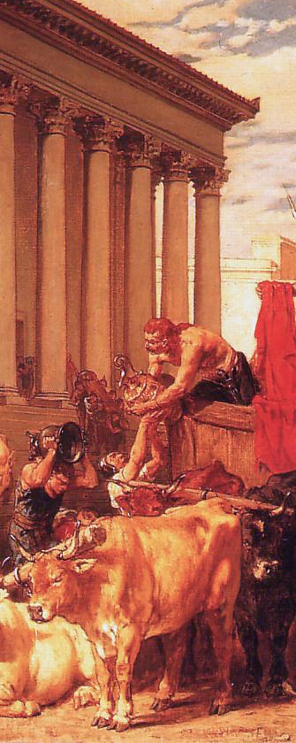
St. Augustine: Philosophy of History
The Sack of Rome
  In 410 the Goths looted Rome for three days.
  Roman pagans blamed the Christians.
    In 382 Christians had removed the statue of the Goddess of Victory from the senate building.
    Emperor Theodosius made the worship of pagan gods a crime punishable by death.
    Thus, Rome had been stripped of its divine protection by the Christians.
  Aquinas replied with the City of God in order to defend Christianity.
    Written from 413-426.
    Consisted of 22 books and about 1,000 pages.

Slide 223

St. Augustine: Philosophy of History
  He contends that the strength of Rome was derived from its virtues
    God honored them by granting success.
    Their best ideals were the same as those of Christianity.
  The Romans fell into depravity and evil and thus the city weakened.
    Augustine spends 11 volumes cataloging the sins of Rome.
  The second half discusses history
  He asserts the driving force behind history is inherently moral in nature.
    The main elements are God’s plan and human moral choices.

Slide 224
St. Augustine: Philosophy of History
The Two Cities
Two Cities
  History is a conflict between the City of the World and the City of God.
  The cities represent two opposed spiritual systems that have existed since Adam sinned.
  Each state serves the interests of one or the other of these Cities.
  Like Plato, he holds individuals and societies have the same moral structure.
    Both are to be understood in terms of their loves.
  Each person is a citizen of one city or the other, decided by what the individual loves.

Slide 225
St. Augustine: Philosophy of History
The Two Cities
The State
  Unlike Plato, Aristotle and other Greek thinkers, he saw the state as a necessary evil created to limit human sin and the tendency towards lawlessness.
  The only truly good society is that of the faithful.
  Since people live in particular states, they owe their state loyalty unless it prevents the worship of God.
  Society provides a temporal and flawed peace.
  True peace can only be achieved in heaven, the soul’s true city.
  States reflect the corrupt nature of humanity
  People should live by the laws of God and influence the secular state with God’s principles.
  The church is superior to the state.
Notes:
B. The State
1. Unlike Plato, Aristotle and other Greek thinkers, Augustine regarded the state as a necessary evil that was created to limit human sin and the tendency towards lawlessness.
2. The only truly good society is that of the faithful.
3. Since people live in particular states, they owe their state loyalty unless it prevents the worship of God.
4. Society provides a temporal and flawed peace and true peace can only be achieved in heaven, the soul’s true city.
5. States reflect the corrupt nature of humanity, so people should live by the laws of God and try to influence the secular state with God’s principles.
6. The church is superior to the state.

Slide 226
St. Augustine: Philosophy of History
View of History
Control
  God has complete control over history.
  “God alone has the power to grant kingdoms and empires.”
  Good and evil states, good and evil rulers, all gain their power from God.
  God decides the length and outcome of war.
    If He decides to afflict mankind, the war lasts longer.
    if He decides to console mankind, the war is of shorter duration.
  God does not act randomly or fortuitously
    “He is God, not Fortune.”
  He provides the hidden order of history that is known to Him.
  He is not bound to this order
    He is the one that orders it.
Notes:
A. Control
1. God has complete control over history.
2. “God alone has the power to grant kingdoms and empires.”
3. Good states and evil states, good rulers and evil rulers, all gain their power from God.
4. God decides the length and outcome of war.
a. If He decides to afflict mankind, the war lasts longer.
b. if He decides to console mankind, the war is of shorter duration.
5. God does not act randomly or fortuitously-“He is God, not Fortune.”
6. He provides the hidden order of history that is known to Him.
7. He is not bound to this order-He is the one that orders it.

Slide 227
St. Augustine: Philosophy of History
View of History
Morality
  History is not driven by economics or politics.
    They are the result of moral forces.
  The moral order is concealed from us.
    God is still in control even when it seems like evil is prospering and good is suffering.
  Suffering serves a good purpose.
    It tests and cleanses the good.
    It keeps the faithful from growing to attached to the world.
  “In general, bad men come to a bad end, and good men enjoy eventual success.
Notes:
B. Morality
1. History is not driven by economics or politics.
2. History, economics and politics are the result of moral forces.
3. The moral order is concealed from us.
a. Though we might think He is not, God is still in control even when it seems like evil is prospering and good is suffering.
4. The suffering serves a good purpose.
a. It tests and cleanses the good.
b. It keeps the faithful from growing to attached to the world.
5. He does claim that “in general, bad men come to a bad end, and good men enjoy eventual success.

Slide 228
St. Augustine: Philosophy of History
View of History
History & Free Will
  He claims that God is in control, but humans are responsible.
  People do things of their own will, but God “stirs up their spirits.”
  “For the Almighty sets in motion even in the innermost hearts of men the movement of their will.”
Order
  Things are as they are meant to be; one should approach change with great caution.
  He argued in favor of preserving peace and the social order-even in evil societies.
Notes:
C. History & Free Will
1. Given that God controls history to punish or bless as He wills, can humans make decisions that affect history?
2. He claims that God is in control, but humans are responsible.
3. He asserts that people do things of their own will, but God “stirs up their spirits.”
4. His ultimate position seems to be: “For the Almighty sets in motion even in the innermost hearts of men the movement of their will.”
D. Order
1. Things are as they are meant to be, so one should approach change with great caution.
2. Augustine argued in favor of preserving peace and the social order-even in evil societies.

Slide 229
St. Augustine: Impact
Impact
  Provides the model for Christian scholarship.
  He influenced Catholicism.
  Protestant Reformers held they were restoring the church to Augustine’s theology.
    John Calvin claimed his theology came from Augustine.
  He provided a new view of history, giving rise to attempts to explain events with an underlying causal factor.
    This approach was later taken by thinkers like Karl Marx.
  Raised many philosophical points and created methods that were later used in the Modern period.
  Example: introspection as a philosophical method
    Descartes.

Slide 230

End of Part Three

