Slide 1

Ancient & Medieval Philosophy
Part 4: Medieval Thought

Slide 2

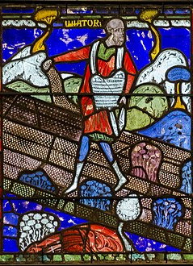
Early Middle Ages: Background
Middle Ages
1,000 years between the Classical period’s end (fall of Rome) and the Modern period (Renaissance).
Medieval: “medium” (middle) and “aevum” (age)
“Middle Ages”
  Named during the Renaissance
  Expresses that the time was a period of stagnation between the progress of the classic age and the renewed progress of the modern era.
Notes:
I Middle Ages
A. Middle Ages
1. 1,000 year period between the Classical period’s end (fall of Rome) and the Modern period (Renaissance).
2. Medieval is derived from “medium” (middle) and “aevum” (age)
3. The term “Middle Ages” was created during the Renaissance to express the view that the time was a period of stagnation between the progress of the classic age and the renewed progress of the modern era.

Slide 3
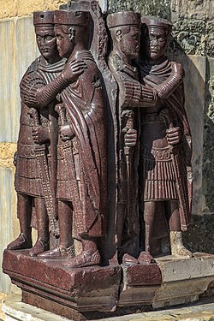
Early Middle Ages: Background
Fall of Rome
  The Empire suffered from an ever-growing bureaucracy.
    Division into western and eastern regions.
    West ruled from Rome, then Ravenna.
    East ruled from Constantinople.
  The Empire faced a shortage of troops and began recruiting non-Romans, mainly Germanic tribesmen.
    This “de-Romanized” the army.
  Gave the barbarians effective military training and knowledge of Roman tactics.
Notes:
Murray Foubister - https://www.flickr.com/photos/mfoubister/11002237996/ (1986) Gardner's Art Through the Ages, Volume I: Ancient, Medieval, and Non-European Art, Harcourt, Brace, Jovanovich, p. 242 ISBN: 978-0-15-503764-9.
Fall of Rome
1. The Empire suffered from an ever growing bureaucracy, leading to its division into western and eastern regions.
a. The west was ruled from Rome, then from Ravenna.
b. The east was ruled from Constantinople.
2. The Empire also faced a shortage of troops and began recruiting large numbers of non-Romans, mainly Germanic tribesmen.
a. This “de-Romanized” the army.
b. This also provided the barbarians with effective military training and knowledge of Roman tactics.
3. Various tribes settled within Roman lands including the Vandals, Visigoths, and Ostrogoths.
a. This further “de-Romanized” the Roman Empire and weakened Rome’s power in the provinces.
b. It also put the barbarians within easy striking distance of Rome.
4. In 410 the Goths pillaged Rome.
5. In 455 the Vandals raided Rome.
6. In 476 the Eastern Roman Empire effectively ceased to exist as a ruling authority.

Slide 4
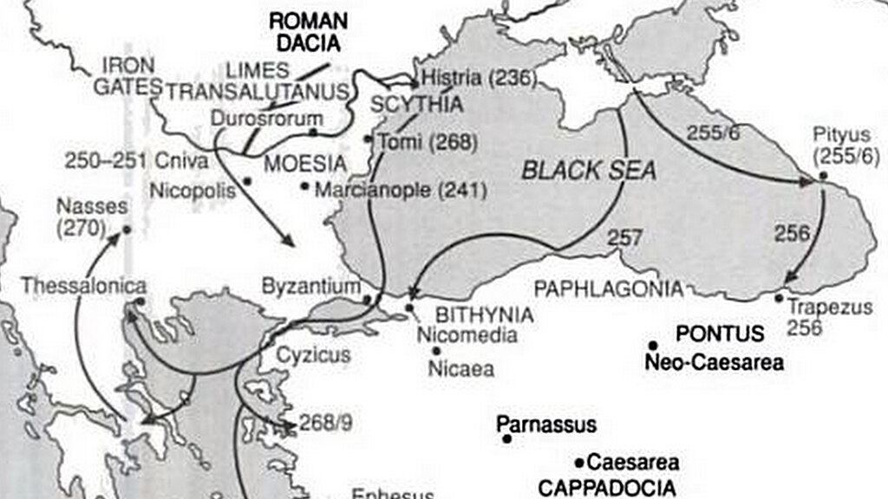
Early Middle Ages: Background
Various tribes settled within Roman lands
  Vandals
  Visigoths
  Ostrogoths.
This further “de-Romanized” the Roman Empire and weakened Rome’s power in the provinces.
  Put barbarians within easy striking distance of Rome.
  410 : Goths pillaged Rome.
  455: Vandals raided Rome.
  476: Eastern Roman Empire ceased to exist as a ruling authority.
Notes:
User:Newsleep

Slide 5

Early Middle Ages: Background
Barbarian Kingdoms
  Vandals ruled North Africa.
  Goths controlled Italy and Spain.
  Franks took over Gaul and the Rhineland, giving rise to France.
  Angles and Saxons conquered Britain, merging to form Angle-Land, which became England.
  War and political chaos were the order of the day.

Slide 6
The Early Middle Ages: Background
The Roman Catholic Church
  Maintained its existence as an institution.
  Adopted the monarchial model
    The Bishop of Rome was declared the father (“papa”) of the church, or Pope.
  The Church was the only institution strong enough to survive the fall of the Western Empire and took on many state roles:
    Tax collection.
    Looking after raising and storing of food.
    Repairing city fortifications.
    Operating courts of criminal law.
    Operating hospitals and inns.
    Providing education.

Slide 7
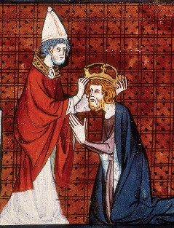
The Early Middle Ages: Background
Dark Ages
  Culture, politics and scholarship very limited compared to classical period.
Carolingian Renaissance
  Charlemagne (Charles the Great) ruled from 768 to 814.
  Began as ruler of the Franks and united Western Europe.
  Promoted arts and education.
  Started schools in the cathedrals and monasteries.
  Preserved classical Christian culture by teaching and copying and preserving texts.
  These schools endured the chaos following his death and many European universities arose from them.

Slide 8
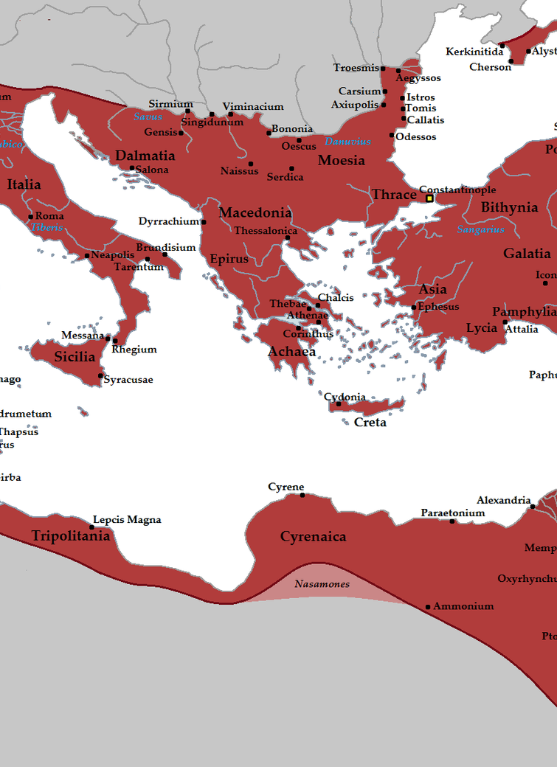
The Early Middle Ages: Background
Byzantine Empire
  Eastern Roman Empire.
  Maintained much of its political and cultural integrity throughout the middle ages.
  Two centers of learning: Athens and Alexandria.
  Pagans and Jews were often persecuted by the Christians.
Notes:
By Tataryn - Own work; The Map as History 2018, CC BY-SA 3.0, https://commons.wikimedia.org/w/index.php?curid=19926428
E. Byzantine Empire
1. The Eastern Roman Empire.
2. It was able to maintain much of its political and cultural integrity throughout the middle ages.
3. It contained two centers of learning: Athens and Alexandria.
4. In an ironic twist, the pagans and Jews were often persecuted by the Christians.

Slide 9
The Early Middle Ages: Background
Alexandria
  Had a Neoplatonic school lead by Hypatia until she was murdered by a Christian mob in 415.
  The Bishop of Alexandria, Cyril, instituted repressive policies.
  Christians eventually burned the Great Library, destroying works in science, philosophy, literature, etc.
Athens
  Plato’s Academy and other pagan schools prospered until Emperor Justinian the Great closed them in 529.
  Scholars managed to preserve some of the texts of the Greek philosophers.
The Byzantine Empire focused on theology and politics, with little contributions being made to literature, philosophy, or science.

Slide 10
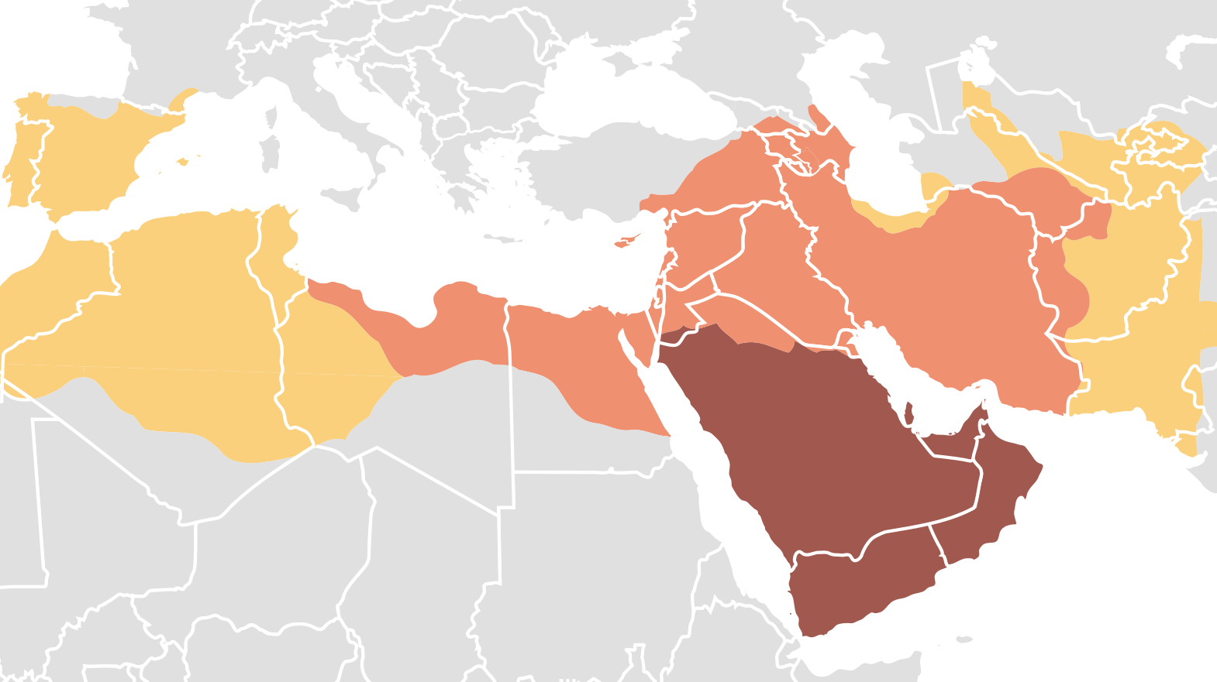
The Early Middle Ages: Background
Islamic Empire
  By the 700s Islam was a potent force.
  Muslims took control over
    Persia
    Egypt
    Africa
    Spain.
  Muslims preserved Aristotle’s texts and made significant developments in science, mathematics and philosophy.
Notes:
By DieBuche - Own work using:http://guides.library.iit.edu/content.php?pid=27903&sid=322018 (archive1, archive2) (via Image:Age_of_Caliphs.png)Image:BlankMap-World6.svgThe Times Concise Atlas of World History ed. by Geoffrey Barraclough published by Times Books Ltd. ISBN 0-7230-0274-6 pp. 40-41., Public Domain, https://commons.wikimedia.org/w/index.php?curid=10802592
Islamic Empire
1. By the 700s Islam had become a potent force.
2. Muslims took control over Persia, Syria, Egypt, Africa and Spain.
3. The Muslims preserved Aristotle’s texts and made significant developments in science, mathematics and philosophy.

Slide 11
The Early Middle Ages: Philosophy
Time Periods
  Patristic Period: 1st century A.D. to Augustine.
    From “pater” which is Latin for “father.”
    Writings of early Christian thinkers, the Fathers of the Church.
    Includes Christian thought from the context of the classical world.
  Dark Ages: 5th-10th centuries.
    War and cultural and political upheavals.
    Some bright spots:
      Charlemagne
      Boethius
      John Scotus Erigena.
  By the 9th century Europe fell far below the level of the classical civilization.
Notes:
A. Time Periods
1. Patristic Period: from the 1st century A.D. to Augustine.
a From “pater” which is Latin for “father.”
b. The writings of the early Christian thinkers, known as the Fathers of the Church.
c. Includes the Christian thought that arose within the context of the classical world.
2. Dark Ages: 5th-10th centuries.
a. Marked by war as well as cultural and political upheavals.
b. Includes some bright spots: Charlemagne, Boethius and John Scotus Erigena.
c. By the 9th century Europe had fallen far below the level of the classical civilization.

Slide 12
The Early Middle Ages: Philosophy
Formative Period: 11th-12th centuries.
  Philosophy is revitalized
    St. Anselm
    Peter Abelard.
Culmination of Medieval Philosophy: 13th century.
  Works of Aristotle rediscovered in the West.
  Saint Thomas Aquinas.
Decline of Medieval Thought: 14th century.
  John Duns Scotus
  William of Ockham.
Notes:
Formative Period: 11th-12th centuries.
Philosophy is revitalized
St. Anselm
Peter Abelard.
Culmination of Medieval Philosophy: 13th century.
Works of Aristotle rediscovered in the West.
Saint Thomas Aquinas.
Decline of Medieval Thought: 14th century.
John Duns Scotus
William of Ockham.

Slide 13
The Early Middle Ages: Philosophy
Works
  Greek works rarely translated into Latin during the Roman era because most scholars could read Greek.
  410: St. Jerome translated the bible from Greek into Latin
    Reducing Christian interest in Greek.
  Education, reading and writing declined.
Notes:
B. Works
1. Greek works were rarely translated into Latin during the Roman era because most scholars could read Greek.
2. In 410 St. Jerome translated the bible from Greek into Latin, thus lessening Christian interest in Greek.
3. Education, reading and writing declined.

Slide 14
The Early Middle Ages: Philosophy
Few works of classic philosophy available to scholars
  Plato’s Timaeus
  Parts of Aristotle’s Logic
  An introduction Aristotle's Categories by Porphyry.
  A few of Cicero’s dialogues.
  Essays by Seneca.
  Lucretius’s poetic presentation of the Epicurean’s atomism.
Notes:
4. Few works of classic philosophy were available to scholars of the Middle Ages
a. Plato’s Timaeus was available, but his other works were not.
b. Parts of Aristotle’s Logic and an introduction to his Categories by Porphyry.
c. A few of Cicero’s dialogues.
d. Essays by Seneca.
e. Lucretius’s poetic presentation of the Epicurean’s atomism.

Slide 15
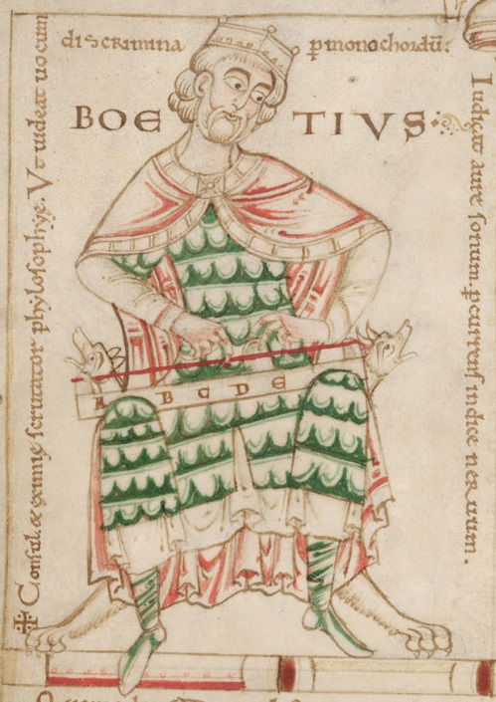
The Early Middle Ages: Boethius
Boethius (480-524/525)
  The last Roman and first Medieval scholastic.
  Raised as a Christian by a prominent Roman family.
  Educated in Athens and learned Greek language and philosophy.
  Held a high office
  Received numerous honors
  Executed for high treason.
Notes:
Boethius (480-524/525)
The last Roman and first Medieval scholastic.
Raised as a Christian by a prominent Roman family.
Educated in Athens and learned Greek language and philosophy.
Held a high office
Received numerous honors
Executed for high treason.

Slide 16
The Early Middle Ages: Boethius
Works
  Translate Plato’s and Aristotle’s works into Latin and harmonize them.
  Translated and commented on
    Aristotle’s logic
    Porphyry’s introduction to Aristotle’s Categories.
  Wrote works on logic and five theological treatises.

Slide 17
The Early Middle Ages: Boethius
The Consolation of Philosophy
  Written in poetry and pose while in prison.
  In the Stoic tradition: contemplating philosophy leads to peace.
  A dialogue between Boethius and Philosophy, presented as a nurturing woman.
  Why a just person can suffer while wicked people prosper.
  Bases his answer on the works of Plato, Aristotle, the Stoics, Plotinus, Augustine and others.
  Happiness cannot be achieved by external fortune.
  The wicked seek the false goods of honor, wealth, fame, and physical pleasure and hence will not achieve happiness.
  Happiness can only be acquired by the virtuous and it lies beyond this world.
Notes:
C. The Consolation of Philosophy
1. Written in poetry and pose while he was in prison.
2. It is in the Stoic tradition-contemplating philosophy leads to peace.
3. A dialogue between Boethius and Philosophy, presented as a nurturing woman.
4. Focuses on why a just person can suffer while wicked people prosper.
5. He bases his answer on the works of Plato, Aristotle, the Stoics, Plotinus, Augustine and others.
6. Happiness cannot be achieved by external fortune.
7. The wicked seek the false goods of honor, wealth, fame, and physical pleasure and hence will not achieve happiness.
8. Happiness can only be acquired by the virtuous and it lies beyond this world.

Slide 18
The Early Middle Ages: Boethius
Freedom and Providence in The Consolation of Philosophy
  Attempts to resolve the conflict between human freedom and God’s foreknowledge.
  We cannot have infallible knowledge of future free actions because they have yet to be decided.
  God does not exist in time
    He experiences past, present and future simultaneously.
  Future free actions are known to God, though they are free.
  God’s knowledge does not determine our actions.
Notes:
D. Freedom and Providence in The Consolation of Philosophy
1. He attempts to resolve the conflict between human freedom and God’s foreknowledge.
2. We cannot have infallible knowledge of future free actions because they have yet to be decided.
3. Unlike humans, God does not exist in time-He experiences past, present and future simultaneously.
4. Free actions that will occur in the future are thus known to God, though they are free.
5. God’s knowledge does not determine our actions.

Slide 19
The Early Middle Ages: Boethius
Influence
  His book was a favorite of Dante, Boccaccio and Chaucer.
  Added to the discussion of faith and reason a natural philosophy based on human reason.
  The work
    Made information about Aristotle available
    Illustrated how to apply philosophical categories to theology.
  Provided
    Definitions of philosophical terms
    Philosophical distinctions that proved useful to later philosophers.

Slide 20
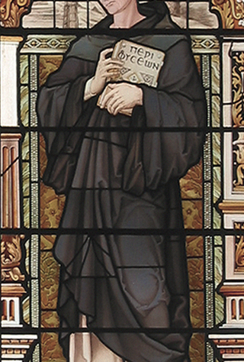
The Early Middle Ages: John Scotus Erigena
John Scotus Erigena (810-877)
  Born in Ireland and educated in a monastery.
  John Scotus means “John the Scot”
  Ireland was known as Scotia.
  ‘Erigena” means “People of Erin.”
  Ireland was relatively free from the turmoil of the 6th-8th century.
  Irish monasteries were centers of learning and preserved the Greek language.
  Served in the court of Charles the Bald, Charlemagne’s grandson.
  While drinking, the king asked Erigena what separated a Scot from a Sot
    He answered, “Only this dinner table.”
Notes:
By https://www.emma.cam.ac.uk/images/chapel/windows/thumbs/500x/eriugena.png - https://www.emma.cam.ac.uk/images/chapel/windows/thumbs/500x/eriugena.png, CC BY-SA 4.0, https://commons.wikimedia.org/w/index.php?curid=106009600
John Scotus Erigena (810-877)
A. Background
1. Born in Ireland and educated in a monastery.
2. John Scotus means “John the Scot”-during this time Ireland was known as Scotia.
3. ‘Erigena” means “People of Erin.”
4. Ireland was relatively free from the turmoil of the 6th-8th century.
5. Irish monasteries were centers of learning and preserved the Greek language.
6. He served in the court of Charles the Bald, Charlemagne’s grandson.
a. While drinking, the king asked Erigena what separated a Scot from a Sot-he answered “Only this dinner table.”

Slide 21
The Early Middle Ages: John Scotus Erigena
  Head of the Palace School in France.
  At Charles’s behest, translated writings of the church fathers from Greek into Latin.
    One work was attributed to Dionysius the Areopagite, one of St. Paul’s converts.
    The work was treated as having great authority.
    In the 17th century the work was found to be a forgery by a Neo-Platonist (“Pseudo-Dionysius”)
    It imbued Christianity with Neoplatonism.
    Erigina based much of his philosophy on it.
Notes:
7. He was the head of the Palace School in France.
8. At Charles’s behest, he translated some writing of the church fathers from Greek into Latin.
a. One work was attributed to Dionysius the Areopagite, one of St. Paul’s converts.
b. The work was treated as having great authority.
c. In the 17th century the work was found to be a forgery by a Neo-Platonist (“Pseudo-Dionysius”)
d. This work imbued Christianity with Neoplatonism.
e. Erigina based much of his philosophy on this work.

Slide 22
The Early Middle Ages: John Scotus Erigena
Goal of Philosophy
  To provide a rational interpretation of revelation.
  Quotes Augustine to support his view: “true philosophy is true religion, and conversely true religion is true philosophy.”
  Scripture should be followed but needs to be interpreted.
  Two sources for interpreting scripture: reason and the church fathers.
    Emphasis on the priority of reason.
    Claims that true faith and reason will not conflict-both come form divine wisdom.
    If they seem to conflict, then one is not genuine.
    This allowed him to interpret revelation and doctrinal traditions in the way that reason led him.
Notes:
B. Goal of Philosophy
1. To provide a rational interpretation of revelation.
2. He quotes Augustine to support his view: “true philosophy is true religion, and conversely true religion is true philosophy.”
3. Scripture should be followed in all things, although it does need to be interpreted.
4. There are two sources for interpreting scripture: reason and the church fathers.
a. He puts the emphasis on the priority of reason.
b. He claims that true faith and true reason will not conflict-both come form divine wisdom.
c. If they seem to conflict, then one or the other is not genuine.
d. This allowed him to interpret revelation and doctrinal traditions in the way that reason led him.

Slide 23
The Early Middle Ages: John Scotus Erigena
On the Division of Nature
  His major work, written around 867
  Nature has four aspects which exhaust all logical possibilities.
  What creates and is not created: God is an uncaused cause.
  What creates and what is created: the ideas in the Divine Logos are his version of the Platonic Forms.
  What is created but does not create: the created universe.
  What does not create and is not created: God taken as the final cause/end.
Notes:
C. On the Division of Nature
1. His major work, written around 867, in which he claims that nature has four aspects which exhaust all logical possibilities.
2. What creates and is not created-God is an uncaused cause.
3. What creates and what is created: the ideas in the Divine Logos are his version of the Platonic Forms.
4. What is created but does not create: the created universe.
5. What does not create and is not created: God taken as the final cause/end.

Slide 24
The Early Middle Ages: John Scotus Erigena
Pantheism and Theism in On the Division of Nature
  Blurred the distinction between pantheism and biblical theism.
    Pantheism: emphasizes the immanence of God to a degree that God is identified with the world.
    Theism: Keeps God transcendent and maintains the creator-created distinction.
  Acceptance of Neoplatonism made it all but impossible for him to maintain the orthodox absolute distinction between God and his creation.
  Given Pseudo-Dionysius’s Neoplatonism, for the world to depend on God means that either:
    The world participates in God
    Or the world flows from God.
  God is “is called the One because He is all things universally; for there is nothing in existence which does not participate in the One.”
    “The One extends itself into everything and the extension itself is everything.”
Notes:
D. Pantheism and Theism in On the Division of Nature
1. He tended to blur the distinction between pantheism and biblical theism.
a. Pantheism: emphasizes the immanence of God to a degree that God is identified with the world.
b. Theism: Keeps God transcendent and maintains the creator-created distinction.
2. His acceptance of Neoplatonism made it all but impossible for him to maintain the orthodox absolute distinction between God and his creation.
3. Given Pseudo-Dionysius’s Neoplatonism, for the world to depend on God means that either the world participates in God or that the world flows from God.
a. God is “is called the One because He is all things universally; for there is nothing in existence which does not participate in the One.”
b. “The One extends itself into everything and the extension itself is everything.”

Slide 25
The Early Middle Ages: John Scotus Erigena
Necessity in On the Division of Nature
  God’s nature and all that comes from it are necessary.
    As the infinite number series is a necessary progression from its source in 1.
    Use of numerical analogies is Neoplatonic.
    The universe is the necessary result of the divine.
  If God did not create the universe, He would be potentially its creator and hence imperfect.
  If the creation did not result from necessity, then creation would be arbitrary.
  Used the Neoplatonic metaphor that God is like a river that flows into all without changing.
Notes:
E. Necessity in On the Division of Nature
1. God’s nature and all that comes from it are necessary.
a. Just as the infinite number series is a necessary progression from its source in 1.
b. The use of numerical analogies is Neoplatonic.
2. The universe is the necessary result of the divine.
3. If God did not create the universe, He would be potentially its creator and hence imperfect.
4. If the creation did not result from necessity, then creation would be arbitrary.
5. He used the Neoplatonic metaphor that God is like a river that flows into all without changing.

Slide 26
The Early Middle Ages: John Scotus Erigena
The Problem of Evil in On the Division of Nature
  If the universe is created by God, what is the origin of evil?
  Evil is not a real being: J
    Just as darkness is the absence of light, evil is the absence of good.
    From Augustine.
  Following Augustine, he claims:
    What seems evil to us is due to our limits
    The big picture is beautiful though some parts seem ugly to us.
Notes:
F. The Problem of Evil in On the Division of Nature
1. If the universe is created by God, what is the origin of evil?
2. Evil is not a real being: Just as darkness is the absence of light, evil is the absence of good.
a. This is borrowed from Augustine.
3. Following Augustine, he claims that what seems evil to us is due to our limits and that the big picture is beautiful despite the fact that some parts seem ugly to us.

Slide 27
The Early Middle Ages: John Scotus Erigena
Unification in On the Division of Nature
  All distinctions and fragmentation will cease as these arise from a lapse from the unity of God.
  As all things flowed from God without diminishing God, all things will return without enhancing Him.
  All our longings are the result of our desire to be reunited with God.
  This matches Greek views
  At odds with the Christian views of time and creation.
  Critics said this seems to:
    Render the existence of the universe and human activity pointless.
    Contradict the Christian notion of personal immortality.
Notes:
G. Unification in On the Division of Nature
1. He claims that all distinctions and fragmentation will cease as these arise from a lapse from the unity of God.
2. As all things flowed from God without diminishing God, all things will return without enhancing Him.
3. All our longings are, in fact, the result of our desire to be reunited with God.
4. This matches the Greek tendency, but is at odds with the Christian views of time and creation.
5. Critics noted that this seems to:
a. Render the existence of the universe and human activity pointless.
b. Contradict the Christian notion of personal immortality.

Slide 28
The Early Middle Ages: John Scotus Erigena
Religious Language in On the Division of Nature
  God is beyond all categories of language and thought because to describe God is to limit God.
  How can we use language and concepts based on finite earthly experience to describe a transcendent and infinite being?
  To address this, he uses positive and negative theology.
  If we affirm X of God, we must immediately affirm not X, because our notion of X is inadequate.
    It would be improper to assume God shares anything with the finite.
  All affirmative statements about God must be metaphorical.
Notes:
H. Religious Language in On the Division of Nature
1. He claims that God is beyond all categories of language and thought because to describe God is to limit God.
2. How can we use language and concepts based on finite earthly experience to describe a transcendent and infinite being?
3. To address this, he uses positive and negative theology.
4. If we affirm X, say goodness, of God, we must immediately affirm not X, because our notion of X is inadequate-it would be improper to assume God shares anything in common with the finite.
5. All affirmative statements about God must be metaphorical.

Slide 29
The Early Middle Ages: John Scotus Erigena
  His solution
    Based on Pseudo-Dionysius
    Use superlative language such as “supergood” to avoid implying God has any qualities in common with the finite beings.
  We can use superlatives but cannot grasp their true meaning beyond knowing they are beyond the finite qualities.
  God cannot be apprehended intellectually, but only via the Neoplatonic merging with God through mystical experience.
  This influenced Christian mystics and later heretics.
Notes:
6. His solution, based on Pseudo-Dionysius, is to use superlative language such as “supergood” to avoid implying God has any
Qualities in common with the finite beings.
7. We can use the superlatives, but cannot grasp their true meaning beyond knowing they are beyond the finite qualities.
8. Hence, God cannot be apprehended intellectually, but only via the Neoplatonic merging with God through mystical experience.
9. This aspect of his work influenced Christian mystics and later heretics.

Slide 30
The Early Middle Ages: John Scotus Erigena
Influence
  He saw himself as an orthodox theologian and attempted to reconcile his work with the Church Fathers,
    One work was condemned in 855 by the Council of Valence.
    His On the Division of Nature was condemned as pantheistic heresy
    Pope Honorious ordered all copies to be burned in 1225.
  The works of Pseudo-Dionysius were seen as authoritative, yet Neo-Platonism and Christianity are at odds.
  Erigena’s works were seen as heretical, yet Neo-Platonism was the only philosophical resource available for Christian thinkers.
  Given the problems faced by Erigena, Christian thinkers
    Did not attempt to develop a systematic metaphysics
    Instead turned their attention to more limited philosophical problems.
  This continued until a new philosophical foundation became available with the works of Aristotle.
Notes:
I. Influence
1. While he regarded himself as an orthodox theologian and attempted to reconcile his work with the Church Fathers,
a. One work was condemned in 855 by the Council of Valence.
b. His On the Division of Nature was condemned as pantheistic heresy and Pope Honorious ordered all copies to be burned in 1225.
2. The works of Pseudo-Dionysius were regarded as authoritative, yet Neo-Platonism and Christianity are at odds on many points.
3. Erigena’s works were regarded as heretical, yet Neo-Platonism was the only philosophical resource available for Christian thinkers.
4. Given the problems faced by Erigena, Christian thinkers did not attempt to develop a systematic metaphysics and instead turned their attention to more limited philosophical problems.
5. This approach continued until a new philosophical foundation became available with the works of Aristotle.

Slide 31

Darkness Falls
The Darkest Ages 800-1000
  After Charlemagne’s death in 814, tribal monarchies arose and Europe was subject to invasion.
  The Vikings raided and the Saracens invaded Italy.
  The Church became corrupt and politicized.
  While Muslim culture flourished, Europe sank into new depths.
    Life expectancy was down to 30 years.
    Most people never traveled more than 10 miles from their birthplace.
  The death of Erigena marked the end of significant philosophical thought until Anselm.
Notes:
I The Darkest Ages
A. 800-1000
1. After Charlemagne’s death in 814, tribal monarchies arose and Europe was subject to invasion.
2. The Vikings raided and the Saracens invaded Italy.
3. The Church became corrupt and politicized.
4. While Muslim culture flourished, Europe sank into new depths.
a. Life expectancy was down to 30 years.
b. Most people never traveled more than 10 miles from their birthplace.
5. The death of Erigena marked the end of significant philosophical thought until Anselm.

Slide 32
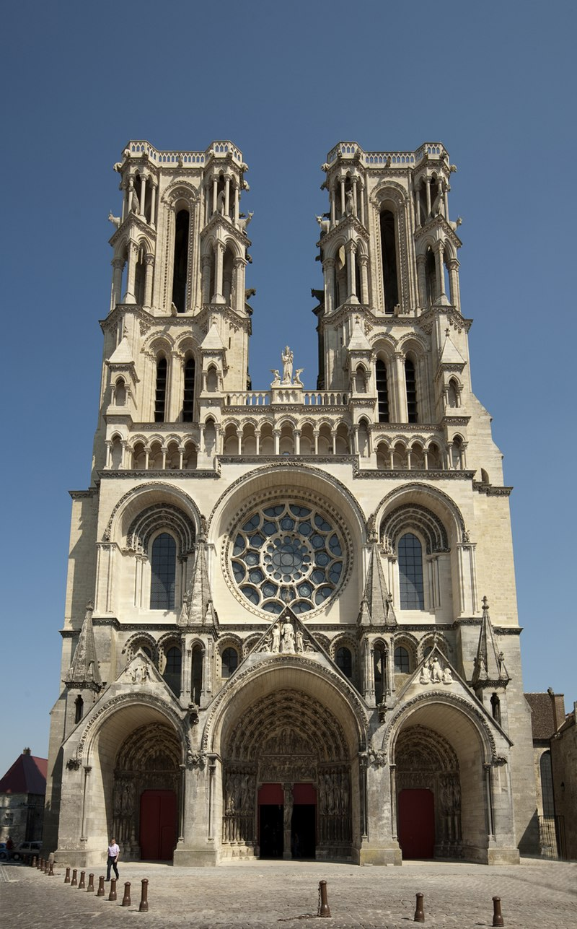
11th & 12th Century Philosophy: Background
Order
  By 1000 Europe achieved a higher degree of economic, political and social stability.
  11th-12th century: the High Middle Ages.
Gothic cathedral
  Replace earlier structures, which were low, boxy, and fort like.
  New engineering techniques allowed the production of soaring structures with open spaces and stained-glass windows.
  A metaphor for the philosophy of the time.
    As the cathedral was based on the laws of geometry and physics, Medieval Philosophy was based on Christian revelation.
    As worshippers were illuminated by the light through stained glass windows, philosophers were illuminated by reason shining through the “stain” of Platonic and Aristotelian thought.
    The tension between the sides of the arches is a metaphor for the tension between reason and faith.
Notes:
By PMRMaeyaert - Own work, CC BY-SA 3.0, https://commons.wikimedia.org/w/index.php?curid=16757905
I Background
A. Order
1. By 1000 Europe achieved a higher degree of economic, political and social stability.
2. 11th-12th century is known as the High Middle Ages.
B. Gothic cathedral
1. The cathedral replaced the earlier structures, which were low, boxy, and fort like.
2. New engineering techniques allowed the production of soaring structures with open spaces and stained-glass windows.
3. The cathedral serves as a metaphor for the philosophy of the time.
a. As the cathedral was based on the laws of geometry and physics, Medieval Philosophy was based on Christian revelation.
b. As the worshippers were illuminated by the light coming through the stained-glass windows, the philosophers were illuminated by reason shining through the “stain” of Platonic and Aristotelian thought.
c. The tension between the sides of the arches is a metaphor for the tension between reason and faith.

Slide 33
11th & 12th Century Philosophy: Background
C. Universities
  After the fall of the Roman Empire, learning was preserved in monasteries.
    Preserved documents.
    Educated priests, seen as the only people needing such education.
  In the 800s Charlemagne revived scholarship and planted the seeds for universities.
  13th century: universities flourished in Paris, Bologna, Naples, Montpellier, Oxford, Cambridge and other places.
  By 1500: over 80 universities many of which still survive.
    Many practices, such as academic robes, granting degrees and defending written theses originated in this time.
  Universities brought together scholars who preserved past ideas and advanced knowledge by analysis, debate and commentary.
  Students and faculty were expected to take and defend positions.
    Faculty who failed to answer could be fined or lose students to a rival.

Slide 34
11th & 12th Century Philosophy: Background
Greater Stability
  One faith and one Church.
    Each event seen as part of the divine plan.
    Each person had the hope of heaven.
    The church offered a comforting view of the universe with earth at its center.
  Feudalism was the sole political system.
  Manorial agriculture was the sole economic system.
  Social structure was set and included commoners, clergy and nobles.
  Philosophers had the guides of tradition and revelation.

Slide 35
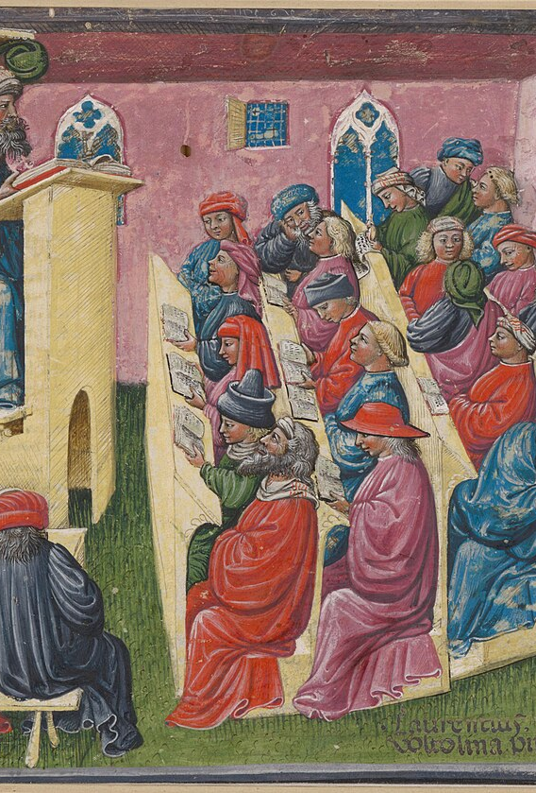
11th & 12th Century Philosophy: Scholasticism
Scholasticism
  Students and teachers in Charlemagne’s schools were called Scholastics.
  Later: the philosophical attempt to integrate faith and reason.
    Scholastics or Schoolmen.
  Scholasticism was the dominant philosophical approach of the time.
Faith & Reason
  Scholastics attempted to integrate Church doctrines and philosophy.
  Philosophy was guided by faith and faith was interpreted in terms of philosophy.
    Faith guided reason, set its agenda, and provided the foundational truths.
    Greek philosophy provided tools for clarifying, explaining and supporting the scriptural truths.
Notes:
I Scholasticism
A. Scholasticism
1. Students and teachers in Charlemagne’s schools were called Scholastics.
2. Later the term applied to the philosophical attempt to integrate faith and reason.
a. Those involved were known as Scholastics or Schoolmen.
3. Scholasticism was the dominant philosophical approach of the time.
B. Faith & Reason
1. The Scholastics attempted to integrate Church doctrines and philosophy.
2. Philosophy was guided by their faith and they interpreted their faith in terms of philosophy.
a. Faith guided reason, set its agenda, and provided the foundational truths.
b. Greek philosophy provided tools for clarifying, explaining and supporting the scriptural truths.

Slide 36
11th & 12th Century Philosophy: Scholasticism
  Peter Damian (1007-1072): theology is the “Queen of the Sciences” and philosophy her servant.
  The Church provided established doctrines forming the framework for Scholastic philosophy.
  Philosophical disagreements occurred.
  They had confidence in reason but relied on the authority of the scriptures, the Church Fathers and Boethius.
Notes:
3. Peter Damian (1007-1072): theology was the “Queen of the Sciences” and philosophy was her servant.
4. The Church provided the established doctrines which formed the framework in which Scholastic philosophy took place.
5. Philosophical disagreements occurred among the Scholastics.
6. They had confidence in the capacity of reason but always relied on the authority of the scriptures, the Church Fathers and Boethius.

Slide 37
11th & 12th Century Philosophy: Scholasticism
Methodology
  Used the dialectic, adapted from Aristotle.
  Step one: A problem is presented in the form of a question.
  Step two: Arguments for and against the various answers were presented.
  Step three: A resolution was achieved that either balanced the various answers or defended one while refuting the others.

Slide 38

The Problem of Universals
The Problem of Universals
  Introduction
    Originated with Plato & Aristotle
    Universal
      Something that can be common to many particulars
      Typically taken to be a property.
    Elements Speech & Thought
    Problem: Determining the Metaphysical nature of universals
Notes:
I The Problem of Universals
A. Introduction
1. The problem originated with Plato and Aristotle.
2. A universal is something that can be common to many particulars and is typically taken to be a property.
3. Universals seem to be elements of speech and thought.
4. The main problem is in determining the metaphysical nature of universals.

Slide 39
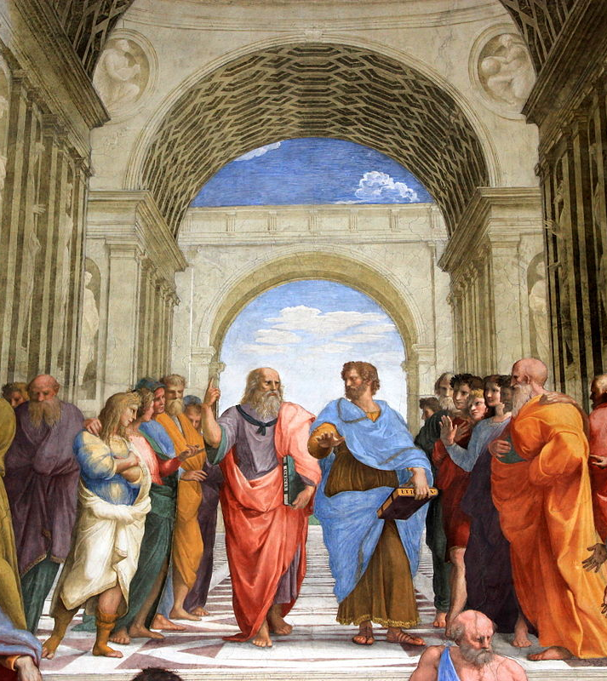
The Problem of Universals
  Scholastic Formulation of the Problem
    Based on Boethius’s translation of Porphyry’s introduction to Aristotle’s Categories.
    Question 1: Do universals exist as metaphysical entities or only in the understanding?
    Question 2: If universals exist as metaphysical entities are they material or immaterial?
    Question 3: If universals exist as metaphysical entities are they separate from sensible objects or not?
This Photo by Unknown Author is licensed under CC BY-SA
Notes:
D. Scholastic Formulation of the problem.
1. The scholastics based their approach to the problem on Boethius’ translation of Porphyry’s introduction to Aristotle’s Categories.
2. Question 1: Do universals exist as metaphysical entities or do they exist only in the understanding?
3. Question 2: If universals exist as metaphysical entities are they material or immaterial?
4. Question 3: If universals exist as metaphysical entities are they separate from sensible objects or not?
5. Porphyry refused to take a position on these issues because he regarded the problem as extremely difficult.

Slide 40
The Problem of Universals
Realism
  Defined
    Universals are real & exist in the world.
    Universals are immaterial
    Separate from sensible objects or not
      John Scotus Erigena
        Neoplatonic view that forms exist between God and the sensible world
      St. Anselm
        Accepted a Platonic view
      William of Champeux (1070-1121)
        Universals do not exist apart from individuals
        Naturally the same universal exists in different individuals
          Immanent universals.
Notes:
II Realism
A. Defined
1. Universals are real and exist in the world.
2. Universals are immaterial.
3. Realists differed on their view as to whether universals existed separate from sensible objects or not.
a. John Scotus Erigena accepted the Neoplatonic view that forms exist between God and the sensible world.
b. St. Anselm accepted a Platonic view.
c. Most, like William of Champeux (1070-1121), held that universals do not exist apart from individuals; naturally the same universal exists in different individuals-these are known as immanent universals.

Slide 41
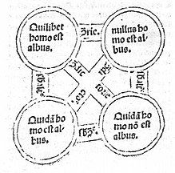
The Problem of Universals
  Epistemic Motivation
    Aristotle’s logic
      Reasoning progressed by presenting the logical relations between universals.
    If universals do not correspond to real entities, then reasoning is about mere fictions.
      We would have no knowledge
    There is correspondence between reality & logic.
This Photo by Unknown Author is licensed under CC BY-SA
Notes:
B. Epistemic Motivation
1. Basing their logic on Aristotle’s, they assumed reasoning progressed by presenting the logical relations between universals.
2. If universals do not correspond to real entities, then reasoning is about mere fictions.
3. Hence we would have no knowledge.
4. They concluded that there is a correspondence between reality and logic.

Slide 42
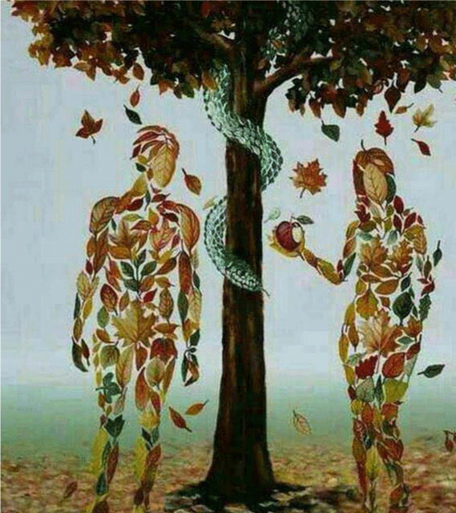
The Problem of Universals
  Scholastic Theological Motivation: Original Sin
    Original sin
    Odo of Tournai (died 1113)
      Humanity is a universal that all humans share.
      When the first humans sinned, the universal was corrupted
      Since all humans share this universal essence, all humans inherited the sin.
This Photo by Unknown Author is licensed under CC BY
Notes:
C. Scholastic Theological Motivation: Original Sin
1. Universals helped account for the concept of original sin.
2. Odo of Tournai (died 1113) claimed that humanity is a universal that all humans share.
3. When the first humans sin, the universal was corrupted.
4. Since all humans share this universal essence, all humans inherited the sin.

Slide 43
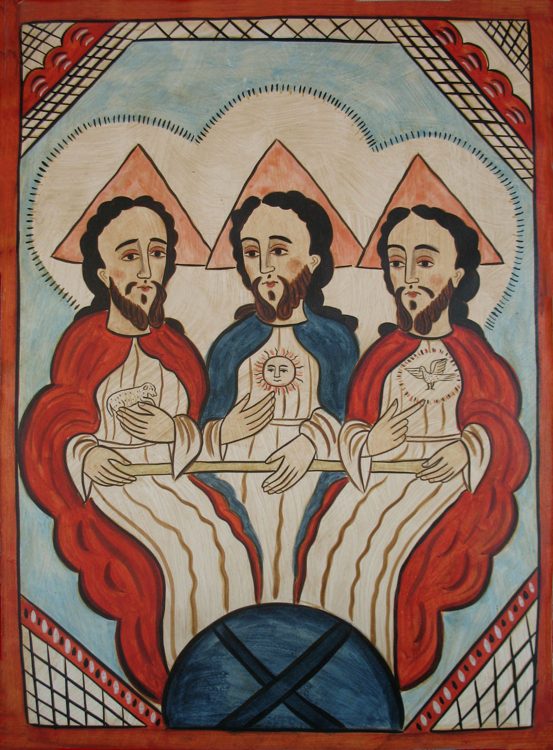
The Problem of Universals
  Scholastic Theological Motivation: Trinity
    The Trinity requires that three persons be one God.
    Divine essence as single universal solves this problem.
This Photo by Unknown Author is licensed under CC BY-NC-ND
Notes:
D. Scholastic Theological Motivation: Trinity
1. The Trinity requires that three persons be one God.
2. Taking the divine essence to be a single universal substance solves this problem.

Slide 44

The Problem of Universals
  Problem for Universals
    The Universal Human is within the universal mammal
    Logically all universals are subsumed under the most comprehensive universal: Being
    If Being is identical to God, then Pantheism is true.
    John Scotus Erigena accepted this, but most thinkers seemed ignorant of this implication
    Thinkers of this time were unaware of existing criticisms of transcendent universals.
This Photo by Unknown Author is licensed under CC BY-SA-NC
Notes:
E. Problem
1. If individual humans are humans because they participate in the universal Humanness, it follows that the universal of Humanness is within the universal Mammal.
2. Logically, all universals are subsumed within the most comprehensive universal-Being.
3. If Being is identical to God, then all things are components of God and the creator-create distinction collapses, yielding Pantheism.
4. John Scotus Erigena accepted this pantheism, but most thinkers seemed to be ignorant of this implication.
5. Because the early thinkers only had access to Plato’s Timaeus and did not have access to Aristotle’s commentaries on Plato until the 13th century, they were unaware of the existing criticisms of transcendent universals.

Slide 45

The Problem of Universals
Nominalism
  Defined
    “Nomina”: Latin for “names”
    Universals are merely names
    Only individuals have metaphysical reality.
This Photo by Unknown Author is licensed under CC BY-SA-NC
Notes:
III Nominalism
A. Defined
1. From “nomina”, Latin for “names.”
2. Universals are merely names.
3. Only individuals have metaphysical reality.

Slide 46

The Problem of Universals
  Roscelin (1050-1120)
    Teacher of logic in France
    Condemned as a heretic by the council of Soissons in 1092.
    Nothing exists outside of the mind that is not a particular.
    Universals do not have metaphysical existence.
    Universals are flatus vocis (vocal winds) used to designate groups.
    Without universals, “Trinity” is a mere name that refers to three distinct Gods.
      In the face of excommunication he abandoned this view.
This Photo by Unknown Author is licensed under CC BY-NC-ND
Notes:
B. Roscelin (approximately 1050-1120)
1. A teacher of logic in France.
2. Condemned as a heretic by the council of Soissons in 1092.
3. Nothing exists outside of the mind that is not a particular.
4. Universals do not have any metaphysical existence.
5. Universals are flatus vocis (vocal winds) used to designate groups.
6. He concluded that without universals, “Trinity” is a mere name that refers to three distinct Gods.
a. In the face of excommunication he abandoned this view.

Slide 47

The Problem of Universals
  Problems for Nominalism
    Commonsense: things in the world are ordered in natural kinds that don’t depend on our names.
    Christian theology entails an objective order
    Nominalism undercuts metaphysical foundations for the doctrine of original sin.
    Leads to a denial of the Church’s position on the Trinity.
This Photo by Unknown Author is licensed under CC BY-SA
Notes:
C. Problems
1. Commonsense seems to indicate that things in the world are ordered in natural kinds that don’t depend on our names.
2. Christian theology seems to entail an objective order in reality.
3. Nominalism seems to undercut the metaphysical foundations for the doctrine of original sin.
4. Leads to a denial of the Church’s position on the Trinity.

Slide 48
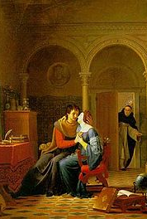
The Problem of Universals
Conceptualism
  Peter Abelard (1079-1142)
    Student of Roscelin & William of Champeaux
    Argued against realism & nominalism
  Abelard’s Attacks on Realism
    He argued that universals could have inconsistent qualities.
      Socrates and a donkey both instantiate the universal Animal.
      Socrates is rational, the donkey is irrational.
      So, Animal is both rational and irrational.
    Raised the problem of the multiple location of universals.
      How can two beings instantiate identical universals in different places at the same time?
    Raised the problem of pantheism.
This Photo by Unknown Author is licensed under CC BY-SA
Notes:
IV Conceptualism
A. Peter Abelard (1079-1142)
1. A student of Roscelin and William of Champeaux
2. Argued against realism and nominalism in support of conceptualism.
B. Abelard’s Attacks on Realism
1. He argued that universals could have inconsistent qualities.
a. Socrates and a donkey both instantiate the universal Animal.
b. Socrates is rational, the donkey is irrational.
c. So, Animal is both rational and irrational.
2. Raised the problem of the multiple location of universals.
a. How can two beings instantiate identical universals in different places at the same time.
3. Raised the problem of pantheism.

Slide 49

The Problem of Universals
  Abelard’s Attack on Nominalism
    Accepted Aristotle’s definition that a universal is what can be predicated of many things.
    Universals cannot just be words because words are physical sounds and one physical thing cannot be predicated of another.
    Abelard’s View of Universal Words
      A universal word is just a sound, but points to a universal concept.
      The concept is the word’s logical content or meaning.
      By means of these universal ideas the mind “conceives a common and confused image of many things.”
        Example: “When I hear ‘man’ a certain figure arises in my mind which is so related to individual men that it is common to all and proper to none.”
This Photo by Unknown Author is licensed under CC BY-SA
Notes:
C. Abelard’s Attack on Nominalism
1. He accepted Aristotle’s definition that a universal is what can be predicated of many things.
2. He contended that universals cannot just be words because words are physical sounds and one physical thing cannot be predicated of another.
D. Abelard’s View of Universal Words
1. A universal word is just a sound, but points to a universal concept.
2. The concept is the word’s logical content or meaning.
3. By means of these universal ideas the mind “conceives a common and confused image of many things.”
a. Example: “When I hear ‘man’ a certain figure arises in my mind which is so related to individual men that it is common to all and proper to none.”

Slide 50
The Problem of Universals
Abelard’s Moderate Nominalism
Universals as general concepts in the mind
Mental constructs that do not exist outside the mind.
Abelard’s Steps Towards Moderate Realism
Like Aristotle, claims a universal concept is acquired by abstracting what is common to individuals.
Universals have an objective basis in the things
Do not exist apart from the individuals who possess them.
Universals can be considered separately from individuals, using a distinction in reason.
An alternative to realism: it denies immanent universals but accepts objective similarities.
Notes:
E. Abelard’s Moderate Nominalism
1. Some interpret Abelard as taking universals to be only general concepts in the mind.
2. In this case, they are mental constructs that do not exist outside the mind.
F. Abelard’s Steps Towards Moderate Realism
1. Similar to Aristotle, he claims that a universal concept is acquired by abstracting what is common to individuals.
2. Thus, universals have an objective basis in the things but do not exist apart from the individuals who possess them.
3. Universals can be considered separately from individuals, using a distinction in reason.
4. This view posed an alternative to realism-it denies immanent universals but accepts objective similarities.

Slide 51

The Problem of Universals
Moderate Realism
  Originated by Abelard
  Developed by Aquinas and others.
  Universal ideas are in the mind but have a foundation in external reality.
  Universals exist ante rem (before things) in the mind of God.
  Universals exist in rem (in things) as properties that group individuals by resemblance.
  Universals are post rem (after things) as mental concepts formed by abstraction.
  The particular/individual is the basic ontological entity.
  This view was later developed in a variety of ways, such as trope theory.
This Photo by Unknown Author is licensed under CC BY-NC
Notes:
V Moderate Realism
A. Early Moderate Realism
1. Originated by Abelard and developed by Aquinas and other thinkers who had access to Aristotle’s works.
2. Universal ideas are in the mind, but have a foundation in external reality.
3. Universals exist ante rem (before things) in the mind of God.
4. Universals exist in rem (in things) as properties that group individuals by resemblance.
5. Universals are post rem (after things) as mental concepts formed by abstraction.
6. The particular/individual is the basic ontological entity.
7. This view was later developed in a variety of ways, such as trope theory.

Slide 52
Faith & Reason
Introduction
  The problem of the relationship between faith and knowledge remained.
  A variety of positions were held during this time.
Reason as predominant.
  Some had confidence in reason and let it guide their faith.
    John Scotus Erigena
    Roscelin
    Abelard
    All three had their works in theology condemned by the Church.
Notes:
A. Introduction
1. The problem of the relationship between faith and knowledge remained.
2. A variety of positions were held during this time period.
B. Reason as predominant.
1. Some had confidence in reason and let it guide their faith.
2. John Scotus Erigena, Roscelin and Abelard.
3. All three had their works in theology condemned by the Church.

Slide 53
Faith & Reason
Faith as predominant.
  The monastic reforms of 1000 led some to see reason as dangerous.
  Peter Damian (1007-1072) warned against the
    “blind foolhardiness of these pseudointellectuals who investigate nonproblems.”
    Those who presume to diminish the power of God by trusting in logic and “arguments based on the meaning of words.”
St. Bernard of Clairvaux (1091-1153)
  A mystic and reformer.
  Saw philosophy as useless and dangerous.
  Prosecuted Abelard.
  “I believe though I do not comprehend, and I hold by faith what I cannot grasp with the mind.”

Slide 54
Faith & Reason
Anselm
  Reason cannot be autonomous and must be guided by faith.
  Great confidence placed in reason.
  Thought he could prove all Christian doctrines via deduction, though he initially accepted them on faith.
  Faith must operate within the limits set by orthodoxy.
Notes:
D. Anselm’s view
1. Reason cannot be autonomous and must be guided by faith.
2. Great confidence is placed in reason.
3. Anselm believed he could prove all Christian doctrines via deduction, though he initially accepted them on faith.
4. Faith must operate within the limits set by orthodoxy.

Slide 55
Faith & Reason
Synthesis of Faith and Reason-Aquinas
  Made a clear distinction between theology and philosophy.
  The human mind could not grasp the rationality of some theological doctrines.
    These doctrines must be known via revelation and taken on faith.
  Reason is effective within its own sphere.
  Faith is not a necessity for philosophical argument.
  Faith and reason overlap to a degree.
    Some of what people take on faith can be proven by reason.
Notes:
E. Synthesis of Faith and Reason-Aquinas
1. He made a clear distinction between theology and philosophy.
2. The human mind could not grasp the rationality of some theological doctrines.
a. These doctrines must be known via revelation and taken on faith.
3. Reason is effective within its own sphere.
4. Faith is not a necessity for philosophical argument.
5. Faith and reason overlap to a degree.
a. Some of what people take on faith can be proven by reason.

Slide 56
Faith & Reason
Narrowing the Scope of Reason
  After Aquinas thinkers put less confidence in reason and narrowed its sphere.
  Siger of Brabant’s doctrine of double truth.
    Philosophy and theology could give different answers to the same question.
    Did not make an extensive attempt to resolve the differences between faith and reason.
  Duns Scotus (1266-1308) maintained balance between faith and reason.
    Did not allow for much overlap between the two spheres.
  William of Ockham separated theology and reason to protect the truths of faith.
    The existence of God can not be proven with certainty.
    Logic reveals nothing about reality but only about the forms of propositions asserted about reality.
  Separation of faith and reason was furthered by the resurgence of mysticism in the 14th century.
    Knowledge of God and religious experience were beyond the realm of reason.
Notes:
F. Narrowing the Scope of Reason
1. After Aquinas thinkers put less confidence in reason and narrowed its sphere.
2. Siger of Brabant’s doctrine of double truth.
a. Philosophy and theology could give different answers to the same question.
b. He did not make an extensive attempt to resolve the differences between faith and reason.
3. Duns Scotus (1266-1308) maintained the balance between faith and reason.
a. Did not allow for much overlap between the two spheres.
4. William of Ockham separated theology and reason to protect the truths of faith.
a. The existence of God can not be proven with certainty.
b. Logic reveals nothing about reality but only about the forms of the propositions asserted about reality.
5. The separation of faith and reason was furthered by the robust resurgence of mysticism in the 14th century.
a. Knowledge of God and religious experience were placed beyond the realm of reason.

Slide 57
Will & Intellect
Introduction
  Scholastics agreed certain human actions are good and others evil.
  They disagreed over the basis for the moral status of actions.
Notes:
A. Introduction
1. The scholastics agreed that certain human actions are good and others are evil.
2. They disagreed over the basis for the moral status of actions.

Slide 58
Will & Intellect
Intellectualism
  God’s intellect precedes His will.
  Platonic universals reside in God’s mind.
  God is aware of objectively good qualities and His will follows them in His creation.
  Actions His intellect recognizes as good are commanded by his will.
  By accepting the objectivity of goodness, this is a form of realism.
  Since humans are like God, the human intellect can recognize good
    An ethics based on reason is possible.
  This view led to a revival of natural law theory.
  Creation was preceded by the forms in God’s mind.
  The world was determined by how it matched reason, thus human reason is the best means for grasping the world’s order.
Notes:
B. Intellectualism
1. God’s intellect precedes His will.
2. The Platonic universals reside in God’s mind.
3. God is aware of the objectively good qualities and His will follows them in His creation.
4. Those actions his intellect recognizes as good are commanded by his will.
5. By accepting the objectivity of goodness, this view is a form of realism.
6. Since humans are like God, the human intellect can recognize good, thus an ethics based on reason is possible.
7. This view led to a revival of natural law theory.
8. Creation was preceded by the forms in God’s mind.
9. The world was determined by how it matched reason, thus human reason is the best means for grasping the world’s order.

Slide 59
Will & Intellect
Voluntarism
  God’s will has priority over his intellect.
  God’s sovereign will freely choose what is good and what is evil.
  The Intellectualist’s position limits God’s freedom and power as it implies his will is limited.
  Extreme voluntarists claimed God could have made anything good or evil.
  Reason is useless in moral judgments-Good must reveal what is good and bad and we must obey.
    This is known as Divine Command Theory in ethics.
  Voluntarists tended to be nominalists about morality
    “Good” and “evil” are names God gives to things and actions.
  The world is contingent
      God could have made the world in any way.
      This protects God’s sovereignty and freedom.
  This puts greater weight on revelation but makes observation more important than speculative reasoning.
    This shift helped develop the modern scientific approach.
Notes:
C. Voluntarism
1. God’s will has priority over his intellect.
2. God’s sovereign will freely choose what is good and what is evil.
3. The Intellectualist’s position limits God’s freedom and power as it implies his will is limited.
4. Extreme voluntarists claimed that God could have made anything good or evil.
5. Reason is useless in moral judgments-Good must reveal what is good and bad and we must obey.
a. This is known as Divine Command Theory in ethics.
6. Voluntarists tended to be nominalists about morality-“good” and “evil” are names God gives to things and actions.
7. The world is contingent-God could have made the world in any way.
a. This protects God’s sovereignty and freedom.
8. This puts greater weight on revelation, but also makes observation more important than speculative reasoning.
a. This shift helped develop the modern scientific approach.

Slide 60
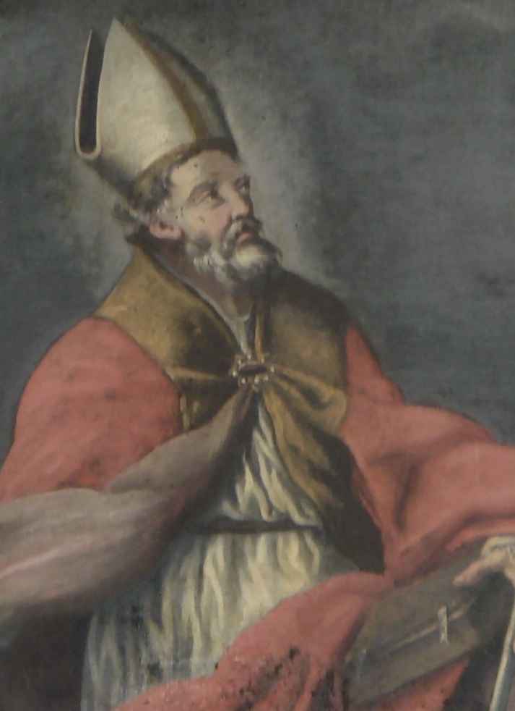
St. Anselm: Background
Background
  1033-1109
  Canonized in 1494.
  Born to an Italian noble family.
  Against his father’s wishes, he became Benedictine monk in the Norman town of Bec.
  He became an abbot
  Reluctantly became Archbishop of Canterbury for 16 years.
  Argued for the authority of the pope over the king.
  His main work is the Prosolgium
This Photo by Unknown Author is licensed under CC BY-NC-ND
Notes:
I Background
A. Background
1. 1033-1109, canonized in 1494.
2. Born to an Italian noble family.
3. Against his father’s wishes, he became Benedictine monk in the Norman town of Bec.
4. He became an abbot and then, reluctantly, the Archbishop of Canterbury for 16 years.
5. He argued for the authority of the pope over that of the king.
6. His main work is the Prosolgium
B. Goal
1. To provide conclusive, rational proofs for the Christian doctrines he had accepted initially on faith.
2. He had confidence in reason.
3. Reasoning should follow the deductive method and this would lead to all fundamental truths.
4. He believed he could provide rational arguments for the truth of the key doctrines.

Slide 61
St. Anselm: Background
Goal
  Provide conclusive, rational proofs for the Christian doctrines he had accepted initially on faith.
  Had confidence in reason.
  Reasoning should follow the deductive method, this would lead to all fundamental truths.
  Believed he could provide rational arguments for the truth of the key doctrines.
Notes:
B. Goal
1. To provide conclusive, rational proofs for the Christian doctrines he had accepted initially on faith.
2. He had confidence in reason.
3. Reasoning should follow the deductive method and this would lead to all fundamental truths.
4. He believed he could provide rational arguments for the truth of the key doctrines.

Slide 62
St. Anselm’s Ontological Argument
Anselm’s A Priori Argument for God’s Existence
  The fool understands
    “God”: a being than which nothing can be conceived (NGCBC).
    Fool says there is no God.
    The understands what he hears.
    What he understands is in his understanding.
    It is one thing for an object to be in the understanding.
    It is another to understand the object exists.
      Painter analogy
    The fool is convinced something exists in his understanding.
Notes:
Anselm’s Ontological Argument for God’s Existence
I Anselm’s A Priori Argument for God’s Existence
A. The Fool Understands
1. Definition of “God”: a being than which nothing greater can be conceived.
2. The fool has said there is no God.
3. The fool, when he hears of God, understands what he hears.
4. What he understands is in his understanding- though he does not understand it to exist.
5. It is one thing for an object to be in the understanding.
6. It is another to understand the object exists.
a. When a painter conceives of what he will paint it is in his understanding.
b. He does not understand it to exist- he has not yet painted it.
c. After it is painted it is in his understanding and he understands that it exists.
7. So, the fool is convinced something at least exists in the understanding than which nothing greater can be conceived.

Slide 63

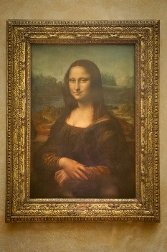
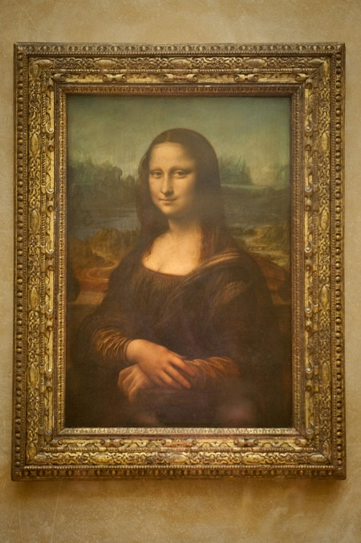

St. Anselm’s Ontological Argument
Anselm’s A Priori Argument for God’s Existence
This Photo by Unknown Author is licensed under CC BY-SA
This Photo by Unknown Author is licensed under CC BY-SA
Notes:
Anselm’s Ontological Argument for God’s Existence
I Anselm’s A Priori Argument for God’s Existence
A. The Fool Understands
1. Definition of “God”: a being than which nothing greater can be conceived.
2. The fool has said there is no God.
3. The fool, when he hears of God, understands what he hears.
4. What he understands is in his understanding- though he does not understand it to exist.
5. It is one thing for an object to be in the understanding.
6. It is another to understand the object exists.
a. When a painter conceives of what he will paint it is in his understanding.
b. He does not understand it to exist- he has not yet painted it.
c. After it is painted it is in his understanding and he understands that it exists.
7. So, the fool is convinced something at least exists in the understanding than which nothing greater can be conceived.

Slide 64

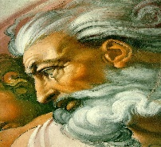
St. Anselm’s Ontological Argument
Anselm’s A Priori Argument for God’s Existence
  From Understanding to Reality
    Whatever is understood is in the understanding.
    That than which NGCBC cannot exist in the understanding alone.
    If NGCBC exists in the understanding alone, it is something GCBC.
This Photo by Unknown Author is licensed under CC BY
Notes:
B. From Understanding to Reality
1. Whatever is understood exists in the understanding.
2. That than which nothing greater can be conceived, cannot exist in the understanding alone.
3. Suppose it exists only in the understanding-it can be conceived to exist in reality; which is greater.

Slide 65
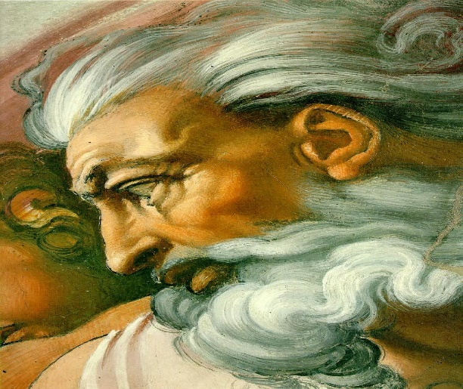
St. Anselm’s Ontological Argument
    Suppose it exists only in the understanding-it can be conceived to exist, which is greater.
    If NGCBC exists in the understanding alone it is GCBC.
    This is impossible.
    There exists NGCBC in reality & understanding.
<
Notes:
4. If that than which nothing greater can be conceived, exists in the understanding alone, it is that than which a greater can be conceived.
5. This is impossible.
6. There is no doubt that there exists a being than which nothing greater can be conceived, and it exists in the understanding and in reality.

Slide 66
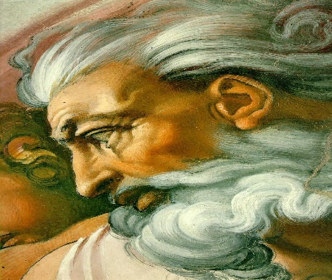
St. Anselm’s Ontological Argument
  God cannot be conceived not to exist
    NGCBC exists so truly it cannot be conceived not to exist.
    It is possible to conceive of a being that which cannot be conceived not to exist and this is greater than one that can be conceived not to exist.
    If NGCBC can be conceived not to exist, it is not NGCBC.
    This is a contradiction.
    There is so truly a NGCBC that it cannot even be conceived not to exist.
<
Notes:
C. God cannot be conceived not to exist.
1. This being exists so truly that it cannot be conceived not to exist.
2. It is possible to conceive of a being which cannot be conceived not to exist, and this is greater than one that can be conceived not to exist.
3. If that than which nothing greater can be conceived, can be conceived not to exist, it is not that than which nothing greater can be conceived.
4. This is an irreconcilable contradiction.
5. There is so truly a being than which nothing greater can be conceived to exist, that it cannot even be conceived not to exist.
6. This is God.

Slide 67

St. Anselm’s Ontological Argument
  God alone cannot be conceived not to exist
    God exists and cannot be conceived not to exist.
    If one could conceive of a being better than God, the creature would rise above its creator, which is absurd.
    Everything, except God, can be conceived not to exist.
    God alone exists more truly than all others and hence in a higher degree.
    Whatever else exists does not exist so truly so it exists to a lesser degree.
    So the fool denies God because he is a fool.
This Photo by Unknown Author is licensed under CC BY-SA
Notes:
D. God alone cannot be conceived not to exist.
1. God exists and cannot be conceived not to exist.
2. If one could conceive of a being better than God, the creature would rise above the Creator; which is absurd.
3. Everything, except God, can be conceived not to exist.
4. God alone exists more truly than all others, and hence in a higher degree.
5. Whatever else exists does not exist so truly so it exists to a lesser degrees.
6. So, the fool denies God because he is a fool.

Slide 68

Gaunilo’s Answer to the Argument of Anselm
Challenge & Doubt
  Gaunilo’s Challenge
    Suppose it is said a being which cannot be even conceived in terms of any fact, is in the understanding.
    Gaunilo accepts that this being is in his understanding.
    He will not accept that it has a real existence until a proof is given.
Notes:
I Challenge & Doubt
A. Gaunilo’s Challenge
1. Suppose it is said a being which cannot be even conceived in terms of any fact, is in the understanding.
2. Gaunilo accepts that this being is in his understanding.
3. He will not accept that it has a real existence until a proof is given.

Slide 69
Gaunilo’s Answer to the Argument of Anselm
Challenge & Doubt
  Gaunilo’s Doubt
    Anselm claims this being exists-otherwise the being which is greater than all will not be greater than all.
    Gaunilo doubts that this being is greater than any real object.
    The only existence it has is the same as when the mind, from a word heard, tries to form the image of an unknown object.
Notes:
B. Gaunilo’s Doubt
1. Anselm claims this being exists-otherwise the being which is greater than all will not be greater than all.
2. Gaunilo doubts that this being is greater than any real object.
4. The only existence it has is the same as when the mind, from a word heard, tries to form the image of an unknown object.

Slide 70
Gaunilo’s Answer to the Argument of Anselm
How is the existence of that being proved from the assumption that it is greater than all other beings?
He does not admit that this being is in his understanding even in the way which many objects whose real existence is uncertain and doubtful, are in his understanding.
It should be proved first that this being really exists.
Then, from the fact that it is greater than all, we would conclude it also subsists in itself.
Notes:
5. How is the existence of that being proved from the assumption that it is greater than all other beings?
6. He doubts Anselm’s demonstration: he does not admit that this being is in his understanding even in the way which many objects whose real existence is uncertain and doubtful, are in his understanding.
7. It should be proved first that this being really exists.
8 Then, from the fact that it is greater than all, we would conclude it also subsists in itself.

Slide 71

Gaunilo’s Answer to the Argument of Anselm
Gaunilo’s Perfect Island Argument
  The Perfect Island
    There is an island that is impossible to find, the “lost” island.
    This island has inestimable wealth and no owner or inhabitant.
    Hence it is more excellent than all other countries, which are inhabited.
    If someone claims there is such an island, Gaunilo would understand his words.
Notes:
A. The Perfect Island
1. There is an island that is impossible to find, the “lost” island.
2. This island has inestimable wealth and no owner or inhabitant.
3. Hence it is more excellent than all other countries, which are inhabited.
4. If someone claims there is such an island, Gaunilo would understand his words.

Slide 72
Gaunilo’s Answer to the Argument of Anselm
  The parity of reasoning: But suppose he said:
    You cannot doubt that this most excellent of island exists somewhere.
    You have no doubt that it is in your understanding.
    It is more excellent not to be in the understanding alone, but to exist in the understanding and in reality.
    Hence, the island must exist.
    If it does not exist, any land which really exists will be more excellent.
    Hence, the island understood to be more excellent will not be more excellent.
Notes:
The parity of reasoning: But suppose he said:
1. You cannot doubt that this most excellent of island exists somewhere.
2. You have no doubt that it is in your understanding.
3. It is more excellent not to be in the understanding alone, but to exist in the understanding and in reality.
4. Hence, the island must exist.
5. If it does not exist, any land which really exists will be more excellent.
6. Hence, the island understood to be more excellent will not be more excellent.

Slide 73
Gaunilo’s Answer to the Argument of Anselm
  Gaunilo’s Criticism of this line of reasoning.
    If someone tried to persuade him by such reasoning, he would assume the person was jesting or regard him or himself a fool.
    It ought to be shown that:
    The hypothetical excellence of this island exists as a real and indubitable fact.
    It is not an unreal object, or one whose existence is uncertain in Gaunilo’s understanding.
    He thus concludes that the method is flawed.
Notes:
C. Gaunilo’s Criticism of this line of reasoning.
1. If someone tried to persuade him by such reasoning, he would assume the person was jesting or regard him or himself a fool.
2. It ought to be shown that:
a. The hypothetical excellence of this island exists as a real and indubitable fact.
b. It is not an unreal object, or one whose existence is uncertain in Gaunilo’s understanding.

Slide 74
Gaunilo’s Answer to the Argument of Anselm
  A note of Gaunilo’s method.
    He is combining parity of reasoning with a reduction to absurdity.
    Parity of reasoning: to use reasoning that parallels the reasoning in question.
    In this case Gaunilo is using the same line of reasoning as Anselm.
    Reducing to absurdity: to prove that a claim is implausible by drawing an absurd or contradictory conclusion from it.
      In this case Gaunilo draws an absurd conclusion by using Anselm’s method.
Notes:
D. A note of Gaunilo’s method.
1. He is combining parity of reasoning with a reduction to absurdity.
2. Parity of reasoning: to use reasoning that parallels the reasoning in question.
a. In this case Gaunilo is using the same line of reasoning as Anselm.
3. Reducing to absurdity: to prove that a claim is implausible by drawing an absurd or contradictory conclusion from it.
a. In this case Gaunilo draws an absurd conclusion by using Anselm’s method.
b. He thus concludes that the method is flawed.

Slide 75
Gaunilo’s Answer to the Argument of Anselm
Parity of Reasoning
Premise 1: Argument A has form/logic L.
Premise 2: Argument B has form/logic L.
Premise 3: Argument B is flawed (or good).
Conclusion: Argument A is flawed (or good).
Analogical Argument

Slide 76

Anselm’s Reply to Gaunilo
The Island
  Anselm’s Summary of Gaunilo’s Objection
    One should suppose an island in the ocean, which surpasses all lands in its fertility.
    Because of the impossibility of discovering what does not exist is called a lost island.
    There can be no doubt that this island truly exists in reality.
    Hence one who hears it described understands what he hears.
  Anselm’s Challenge
    If any shall devise anything existing in reality or in concept alone (except that than which a greater cannot be conceived) to which he can apply Anselm’s reasoning, he will discover it.
Notes:
I The Island
A. Anselm’s Summary of Gaunilo’s Objection
1. One should suppose an island in the ocean, which surpasses all lands in its fertility.
2. Because of the impossibility of discovering what does not exist is called a lost island.
3. There can be no doubt that this island truly exists in reality.
4. Hence one who hears it described understands what he hears.
B. Anselm’s Challenge
1. If any shall devise anything existing in reality or in concept alone (except that than which a greater cannot be conceived) to which he can apply Anselm’s reasoning, he will discover it.

Slide 77
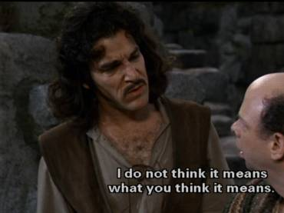
Anselm’s Reply to Gaunilo
Anselm’s Reply
  Part one: God cannot be conceived not to be.
    This being than which a greater is inconceivable cannot be conceived not to be.
    Because it exists on so assured a ground of truth.
    Otherwise it would not exist at all.
This Photo by Unknown Author is licensed under CC BY-SA
Notes:
II Anselm’s Reply
A. Part one: God cannot be conceived not to be.
1. This being than which a greater is inconceivable cannot be conceived not to be.
2. Because it exists on so assured a ground of truth.
3. Otherwise it would not exist at all.

Slide 78
Anselm’s Reply to Gaunilo
  Part Two: The dilemma
    So, if one claims he conceives this being not to exist, at the time when he conceives of this either he conceives of a being than which a greater is inconceivable or he does not conceive at all.
    If he does not conceive, he does not conceive of the nonexistence of that of which he does not conceive.
    If he conceives, he certainly conceives of a being which cannot be even conceived not to exist.
    If it could be conceived not to exist, it could be conceived to have a beginning and an end.
    This impossible.
Notes:
B. Part Two: The dilemma
1. So, if one claims he conceives this being not to exist, at the time when he conceives of this either he conceives of a being than which a greater is inconceivable or he does not conceive at all.
2. If he does not conceive, he does not conceive of the nonexistence of that of which he does not conceive.
3. If he conceives, he certainly conceives of a being which cannot be even conceived not to exist.
4. If it could be conceived not to exist, it could be conceived to have a beginning and an end.
5. This impossible.

Slide 79


Anselm’s Reply to Gaunilo
  Explanatory Analogy
    If one claims triangles do not have three sides either he conceives of a triangle or he does not.
    If he does not conceive of a triangle, he does not conceive of a triangle not having three sides.
    If he conceives of a triangle, he certainly conceives of three-sided figure.
    This impossible.

Slide 80
Anselm’s Reply to Gaunilo
  Part Three: It’s inconceivable.
    He who conceives of this being conceives of a being which cannot be even conceived not to exist.
    But he who conceives of this being does not conceive that it does not exist.
    If he does so, then he conceives what is inconceivable.
    The nonexistence of that than which a greater cannot be conceived is inconceivable.
Notes:
C. Part Three: It’s inconceivable.
1. He who conceives of this being conceives of a being which cannot be even conceived not to exist.
2. But he who conceives of this being does not conceive that it does not exist.
3. If he does so, then he conceives what is inconceivable.
4. The nonexistence of that than which a greater cannot be conceived is inconceivable.

Slide 81
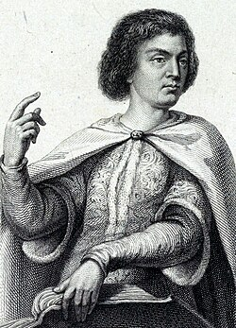
Peter Abelard: Background
1079-1142
Born near Nantes France.
Studied in the schools of Chartes and Paris.
Seen as brilliant, but disagreeable and arrogant.
  After finishing a class, he often taught a competing class on the same subject.
Had an affair with Heloise, the niece of an official at Notre Dame.
  She became pregnant and they were married in secret.
  Her family had him castrated.
  He became a monk in the abbey of St. Denis, outside Paris.
  She became a nun
  After her death in 1164 she was buried beside him.
Notes:
1. 1079-1142
2. Born near Nantes France.
3. Studied in the schools of Chartes and Paris.
4. Regarded as brilliant, but disagreeable and arrogant.
a. After finishing a class, he often taught a competing class on the same subject.
5. He had an affair with Heloise, the niece of an official at Notre Dame.
a. She became pregnant and they were married in secret.
b. Her family had him castrated.
c. He became a monk in the abbey of St. Denis, outside Paris.
d. She became a nun and after her death in 1164 she was buried beside him.

Slide 82
Peter Abelard
Books
  On the Divine Unity and the Trinity
    Condemned and burned at a council at Soissons in 1121.
  Introduction to Theology
    Lead to him being charged with heresy at a council at Sens around 1141.
  Sic et Non (Yes and No) was written in 1121-1122.
Notes:
B. Books
1. On the Divine Unity and the Trinity was condemned and burned at a council at Soissons in 1121.
2. Introduction to Theology lead to him being charged with heresy at a council at Sens around 1141.
3. Sic et Non (Yes and No) was written in 1121-1122.

Slide 83
Peter Abelard
Sic et Non
  Pioneered the technique of using the Aristotelian dialectic to clarify theological points.
    This became a standard scholastic approach used by Aquinas.
  The work presents over 150 theological questions on which the Church Fathers presenting conflicting views.
  Goal: to challenge students to exercise their minds in resolving these conflicts.
    “By doubting we come to questioning and by questioning we perceive the truth.”
  While he got in trouble for his approach, he was a person of faith and wrote that he would choose his faith over philosophy.

Slide 84
Peter Abelard: Moral Theory
Moral Theory
  He went against the dominant legalistic view of morality.
    Goodness is external conformity of an action to the law of God.
    Sin is a violation of divine law, whether the agent knew the law or not.
  “God considers not what is done, but in what spirit it is done; and the merit or praise of the agent lies not in the deed but in the intention.”
  Sin is an expression of contempt for God by willing to do what is known to be wrong.
  If one sincerely does what one thinks is right, then there may be an error but not sin.
Notes:
D. Moral Theory
1. He went against the dominant legalistic view of morality.
a. This view held that goodness is external conformity of an action to the law of God.
b. Sin is a violation of divine law, regardless of whether the agent knew the law or not.
2. He holds that God “God considers not what is done, but in what spirit it is done; and the merit or praise of the agent lies not in the deed but in the intention.”
3. He holds that Sin is an expression of contempt for God by willing to do what is known to be wrong.
4. If one sincerely does what one thinks is right, then there may be an error but not sin.

Slide 85
Peter Abelard: Moral Theory
Moral Theory
  He went against the dominant legalistic view of morality.
    Goodness is external conformity of an action to the law of God.
    Sin is a violation of divine law, whether the agent knew the law or not.
  “God considers not what is done, but in what spirit it is done; and the merit or praise of the agent lies not in the deed but in the intention.”
  Sin is an expression of contempt for God by willing to do what is known to be wrong.
  If one sincerely does what one thinks is right, then there may be an error but not sin.
Notes:
D. Moral Theory
1. He went against the dominant legalistic view of morality.
a. This view held that goodness is external conformity of an action to the law of God.
b. Sin is a violation of divine law, regardless of whether the agent knew the law or not.
2. He holds that God “God considers not what is done, but in what spirit it is done; and the merit or praise of the agent lies not in the deed but in the intention.”
3. He holds that Sin is an expression of contempt for God by willing to do what is known to be wrong.
4. If one sincerely does what one thinks is right, then there may be an error but not sin.

Slide 86
Peter Abelard: Moral Theory
  In support he cites Jesus: “Father, forgive them, for they know not what they do.”
  Does not support simple-minded and ignorant sincerity in morality.
  A good person makes a concerted effort to know what is right and to act upon that.
  A fully virtuous action is one that
    Arises from right intention
    Is objectively good because it is in accord with natural moral law or God’s specific commands.
Notes:
5. In support he cites Jesus: “Father, forgive them, for they know not what they do.”
6. He does not support simple-minded and ignorant sincerity in regards to morality.
7. A good person is one who makes a concerted effort to know what is right and to act upon that.
8. A fully virtuous action is one that arises from right intention and is objectively good because it is in accord with natural moral law or God’s specific commands.

Slide 87
Peter Abelard: Moral Theory
Pre-Voluntarism
  Implies there is no necessity to God’s moral rules.
  This explains why God commands different moralities at different times as presented in the bible.
  This freedom of choice is essential to God as the lawgiver and to humans as law followers.
  Regardless of the morality commanded by God at a particular time, people are obligated to obey.
Impact
  He developed the theory of conceptualism.
  He contributed to philosophy of mind and language.
  He contributed to Scholastic methodology.
Notes:
E. Pre-Voluntarism
1. He implies there is no necessity to God’s moral rules.
2. This explains why God commands different moralities at different times as presented in the bible.
3. This freedom of choice is essential to God as the lawgiver and also to humans as law followers.
4. Regardless of the morality commanded by God at a particular time, people are obligated to obey.
F. Impact
1. He developed the theory of conceptualism.
2. He contributed to philosophy of mind and language.
3. He contributed to Scholastic methodology.

Slide 88
Muslim Philosophers: Background
Aristotle
  Islamic and Jewish philosophers in the Arabic world had access to the works of Plato and Aristotle.
  Works of Aristotle and Plato came to Europe from the Islamic world.
  Christian philosophers were influenced by the Muslim Philosophers, mainly by their acceptance of or critical response to their works.
Notes:
I Background
A. Aristotle
1. Islamic and Jewish philosophers in the Arabic world had access to the works of Plato and Aristotle.
2. The works of Aristotle and Plato came to Europe from the Islamic world.
3. Christian philosophers were influenced by the Muslim Philosophers, mainly by their acceptance of or critical response to their works.

Slide 89
Muslim Philosophers: Background
Islamic Religion
  Islam means “submission to God’s will.”
  Monotheistic.
  Based on the revelations given to the prophet Muhammad (died 632).
  Muhammad held that
    His revelations were consistent with those of the Old and New Testaments.
    His teachings superseded earlier revelations.
  Muhammad’s revelations were recorded in the Koran.
  The followers of Islam are Muslims, which means “true believers.”
  By 732 Muslims had spread Islam from India through North Africa and into Spain.
Notes:
B. Islamic Religion
1. Islam means “submission to God’s will.”
2. Monotheistic.
3. Based on the revelations given over a period of years to the prophet Muhammad (died 632).
4. Muhammad held that his revelations were consistent with those of the Old and New Testaments, although his teachings superceded the earlier revelations.
5. Muhammad’s revelations were recorded in the Koran.
6. The followers of Islam are Muslims, which means “true believers.”
7. By 732 Muslims had spread Islam from India through North Africa and into Spain.

Slide 90
Muslim Philosophers: Background
Philosophy
  Prior to Islam, Christian and heretical sects in Mesopotamia, Persia, and Syria kept the tradition of Greek science and philosophy and preserved and translated ancient Greek texts.
  Islamic philosophy began around 800
    Muslim philosophers began translating Greek philosophy into Arabic and commenting on them.
  Task: to reconcile Aristotle with the Koran.
  Orthodoxy developed based on revealed scripture.
  Some philosophers embraced Greek philosophy and attempted to reconcile it with scriptures to make faith conform to reason.
  Others were suspicious of philosophy and the effect it might have on interpretating the faith.
  Two main groups
    An earlier eastern group in Baghdad
    A later western group in Spain.
  After Ibn Rushd, Greek philosophy was suppressed to prevent further heresy.
Notes:
C. Philosophy
1. Prior to the advent of Islam, Christian and heretical sects in Mesopotamia, Persia, and Syria kept the tradition of Greek science and philosophy and also preserved and translated ancient Greek texts.
2. Islamic philosophy began around 800 when Muslim philosophers began translating Greek philosophy into Arabic and commenting on them.
3. Their task was to reconcile Aristotle with the Koran.
4. A well-established orthodoxy developed on the basis of revealed scripture.
5. Some philosophers embraced Greek philosophy and attempted to reconcile it with scriptures so as to make faith conform to reason.
6. Other thinkers were suspicious of philosophy and the effect it might have on the interpretation of the faith.
7. The two main groups were an earlier eastern group in Baghdad and a later western group in Spain.
8. After Ibn Rushd, Greek philosophy was suppressed to prevent further heresy.

Slide 91
Muslim Philosophers: Background
Neoplatonism
  Neoplatonism influenced Islamic philosophy
  Often due to mistakes in the attribution of authorship.
  Some of Plotinus’ Enneads were translated as “Aristotle’s Theology.”
  The Book of Causes by the Athenian Neo-Platonist Proclus was attributed to Aristotle.
  Strong Neo-Platonist leaning in the interpretations of Aristotle.
Notes:
D. Neoplatonism
1. Neoplatonism influenced Islamic philosophy, often as the result of mistakes in the attribution of authorship.
2. Some of Plotinus’ Enneads were translated as “Aristotle’s Theology.”
3.The Book of Causes by the Athenian Neo-Platonist Proclus was attributed to Aristotle.
4. There was a strong Neo-Platonist leaning in the interpretations of Aristotle.

Slide 92
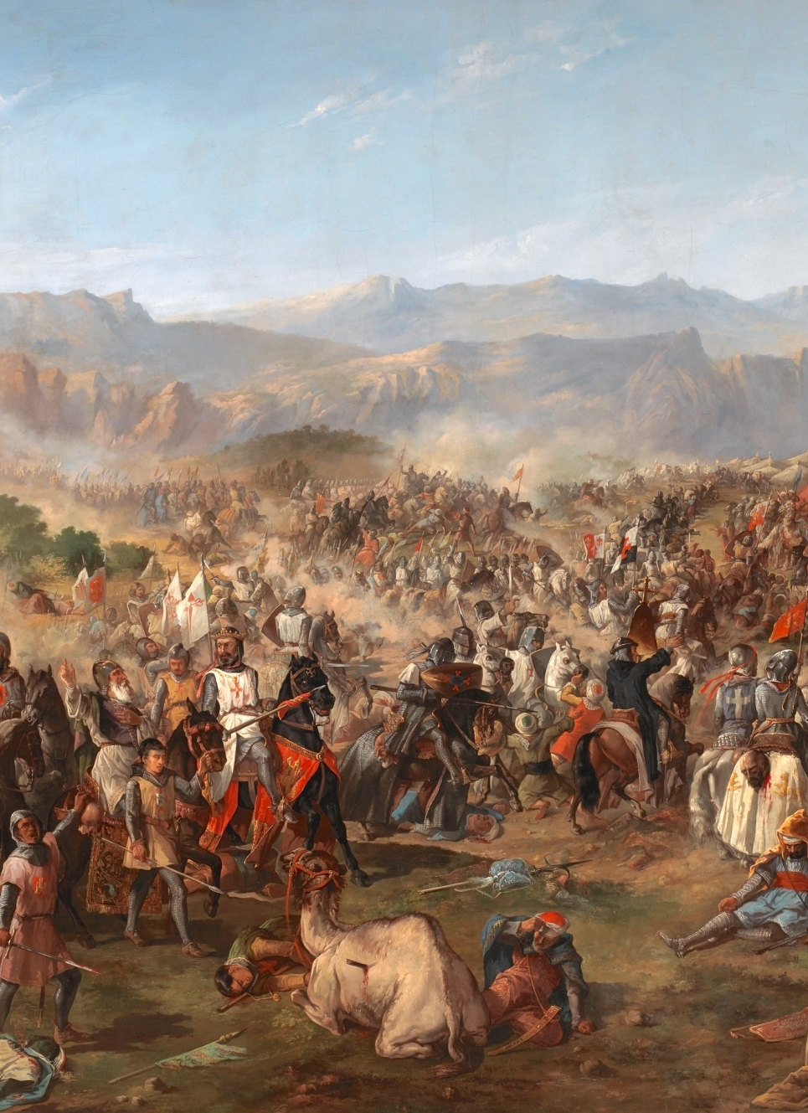
Muslim Philosophers: Background
Defeat in the West
  1212 :Christian forces defeated a Muslim army at Las Navas de Tolsa, breaking their hold on Spain.
  By the end of the century, the Christians held all of Spain except Genada, which was Muslim until 1492.
Notes:
E. Defeat in the West
1. In 1212 Christian forced defeated a Muslim army at Las Navas de Tolsa, breaking their hold on Spain.
2. By the end of the century, the Christians held all of Spain except Genada, which was Muslim until 1492.

Slide 93
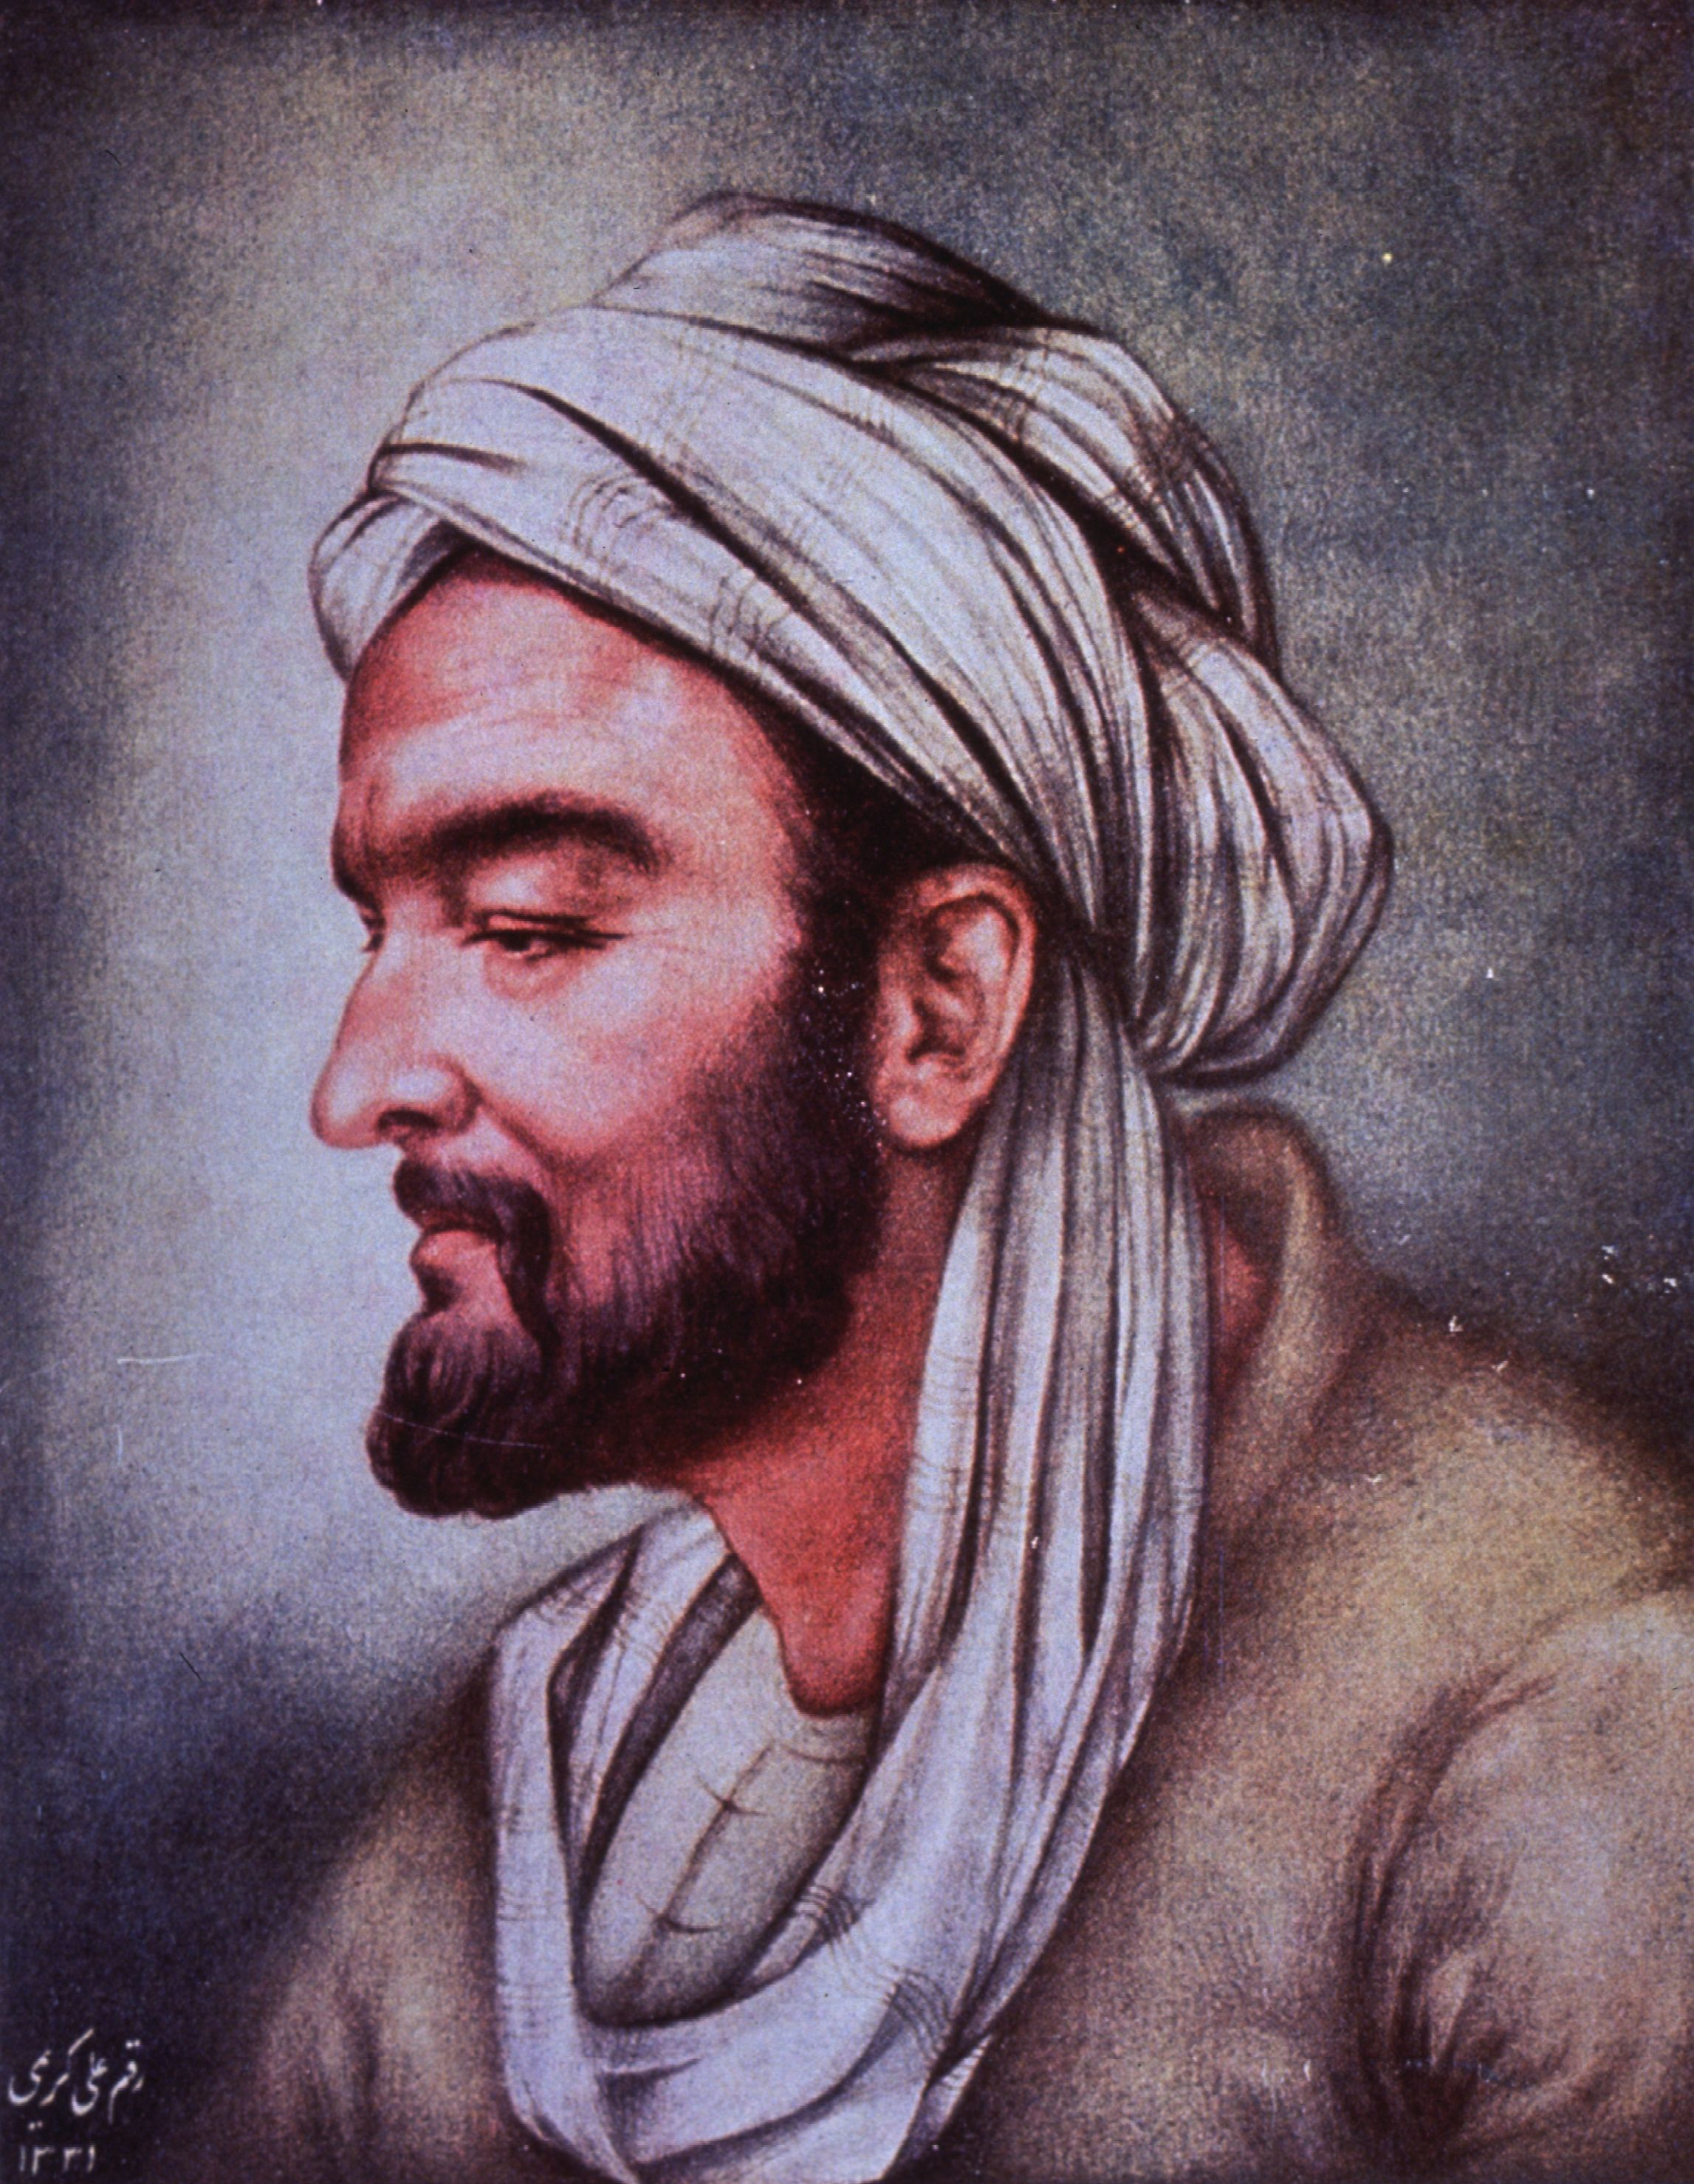
Muslim Philosophers:
Ibn Sina/Avicenna
Ibn Sina/Avicenna (980-1037)
  Born in Persia.
  A child prodigy
    Learned all the disciplines and great works in his youth .
    At 16 he became a physician.
  He worked as a physician and high government official.
  Wrote 160 books on numerous topics.
  Memorized Aristotle’s Metaphysics by reading it 40 times but did not understand it until he read Al-Farabi.
    Founder of the Muslim Aristotelian tradition
    Died in 950
  His philosophy is based on Neo-Platonism and Al-Farabi.
Notes:
II Ibn Sina/Avicenna (980-1037)
A. Background
1. Born in Persia.
2. A child prodigy-he learned all the disciplines and great works in his youth and at 16 he became a physician.
3. He worked as a physician and high government official.
4. He wrote 160 books on numerous topics.
5. Ibsn Sina said he memorized Aristotle’s Metaphysics by reading it 40 times, but did not understand it until he read Al-Farabi.
a. Founder of the Muslim Aristotelian tradition who died 950).
6. His philosophy is based on Neo-Platonism and Al-Farabi.

Slide 94
Muslim Philosophers:
Ibn Sina/Avicenna
B. Proof of God
1. He argues that God’s essence necessarily entails His existence.
2. This is not true of any other being-their essence does not necessitate their existence.
3. If all other beings are merely possible beings and not necessary, then their existence had to be caused by an existing being.
4. This series of causes involves dependent beings and as such cannot go on to infinity.
5. So, there must be a necessary being that caused the merely possible to become actual.
6. This is God.
Notes:
B. Proof of God
1. He argues that God’s essence necessarily entails His existence.
2. This is not true of any other being-their essence does not necessitate their existence.
3. If all other beings are merely possible beings and not necessary, then their existence had to be caused by an existing being.
4. This series of causes involves dependent beings and as such cannot go on to infinity.
5. So, there must be a necessary being that caused the merely possible to become actual.
6. This is God.

Slide 95
Muslim Philosophers:
Ibn Sina/Avicenna
Necessary & Eternal
  Since God is necessary and without beginning, his qualities are necessary and without beginning.
  Includes the quality of being the creator.
  Neo-Platonic: the world emanates from God due to rational necessity.
  God is not free in his creation because being the creator is a necessary quality of his being.
  If God’s qualities are eternal, then His role creator must also be eternal.
  So, the world must be eternal, although it is ontologically dependent on and emanates from God.
  No created being exists necessarily in itself
    Each is a necessary component of a world that could not be otherwise.
  All created beings are participants in a necessary chain of causes.
Notes:
C. Necessary & Eternal
1. Since God is necessary and without beginning, his qualities are also necessary and without beginning.
2. This includes the quality of being the creator.
3. Along Neo-Platonic lines, he contends that the world emanates from God due to rational necessity.
4. Thus, God is not free in his creation because being the creator is a necessary quality of his being.
5. It also follows that if God’s qualities are eternal then His role as the creator must also be eternal.
6. So, the world must be eternal, although it is ontologically dependent on and emanates from God.
7. No created being exists necessarily in itself, but each is a necessary component of a world that could not be otherwise.
8. All created beings are participants in a necessary chain of causes.

Slide 96
Muslim Philosophers:
Ibn Sina/Avicenna
Impact
  His works were translated into Latin in the 12th century.
  His proof of God’s existence influenced Jewish and Christian thinkers.
    Especially Maimonides and St. Thomas Aquinas.
  His logical rigor impressed western thinkers.
Notes:
D. Impact
1. His works were translated into Latin in the 12th century.
2. His proof of God’s existence influenced Jewish and Christian thinkers, especially Maimonides and St. Thomas Aquinas.
3. His logical rigor impressed many western thinkers.

Slide 97
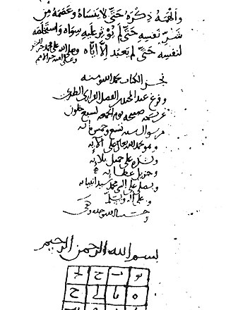
Muslim Philosophers:
Al-Ghazali
Background
  1058-1111
  Persian philosophy
  Worried Greek philosophy would corrupt Islamic faith.
Deliverance from Error
  Autobiography.
  All philosophical movements are tainted by unbelief.
Notes:
III Al-Ghazali (1058-1111)
A. Background
1. Persian philosophy.
2. He was worried that Greek philosophy would corrupt Islamic faith.
B. Deliverance from Error
1. His autobiography.
2. He contended that all philosophical; movements are tainted by unbelief.

Slide 98
Muslim Philosophers:
Al-Ghazali
The Destruction of the Philosophers/The Incoherence of the Philosophers
  Argue against Ibn Sina and others by claiming they contradict each other and the Koran.
  Arguments were logical in character but based in strict fundamentalism.
  Logic
    A useful tool, provided one did not become arrogant.
    Cannot be used to prove anything in metaphysics.
    Attempts to do so lead to unbelief.
  Argued philosophical texts should be kept away from the public:
    “just as the poor swimmer must be kept from the slippery banks, so must mankind be kept from reading these books.”
Notes:
C. The Destruction of the Philosophers/The Incoherence of the Philosophers
1. He argues against Ibn Sina and others by claiming that contradict each other, each other and the Koran.
2. His arguments were logical in character but based in strict fundamentalism.
3. Logic
a. Is a useful tool, provided one did not become arrogant.
b. Cannot be used to prove anything in metaphysics and attempts to do so lead to unbelief.
4. He argued that philosophical texts should be kept away from the public: “just as the poor swimmer must be kept from the slippery banks, so must mankind be kept from reading these books.”

Slide 99
Muslim Philosophers:
Al-Ghazali
Causality & Miracles
  Disagreed with Ibn Sina’s view that the causal chain necessarily emanates from God.
  His view precludes miracles.
  Miracle: God causes an event outside the normal course of causality.
  As the causal system is necessary, it is impossible for God to cause a miracle.
  Orthodox Muslim theology includes miracles, thus Al Ghazi needed to address this causal view.
Notes:
D. Causality & Miracles
1. He disagreed with Ibn Sina’s view that the causal chain necessarily emanates from God.
2. Ibn Sina’s view precludes miracles.
3. A miracle is when God causes an event that is outside the normal course of causality.
4. Given that the causal system as a whole is necessary, it is impossible for God to cause a miracle.
5. Orthodox Muslim theology includes miracles, thus Al Ghazi needed to address this causal view.

Slide 100
Muslim Philosophers:
Al-Ghazali
Causal Theory
  Neither logic nor experience can discover a necessary connection between cause and effect.
  Cotton and Fire example
    Touching a flame to a piece of cotton which ignites.
    It would go against our expectations and past experiences to assert the fire touched the cotton it did not burn.
    This would not violate the laws of logic: that the cotton not burn is a logical possibility.
    Regardless of the number of observed instances of cotton igniting, we could only observe that the two events have happened at the same time.
    We could never observe any necessity between the events such that one must always follow the other.
Notes:
E. Causal Theory
1. Neither logic nor experience can discover a necessary connection between cause and effect.
2. Cotton and Fire example
a. He used an example of touching a flame to a piece of cotton which ignites.
b. It would go against our expectations and past experiences to assert the fire touched the cotton it did not burn.
c. But this would not violate the laws of logic-that the cotton not burn is a logical possibility.
d. Regardless of the number of observed instances of cotton igniting, we could only observe that the two events have happened at the same time.
e. We could never observe any necessity between the events such that one must always follow the other.

Slide 101
Muslim Philosophers:
Al-Ghazali
  God is the only cause.
  The alleged laws of nature are not causes but descriptions of the way God usually operates.
  God can cause any event to follow from any other event.
  Hence, miraculous deviation from the normal course of events is logically possible for God.
Notes:
3. God is the only cause.
4. The alleged laws of nature are not causes but descriptions of the way God usually operates.
5. God can cause any event to follow from any other event.
6. Hence, miraculous deviation from the normal course of events is logically possible for God.

Slide 102
Muslim Philosophers:
Al-Ghazali
Similarities
  Nicolas Malebranche (1638-1715) used a similar line of reasoning to support his theism.
  David Hume (1711-1776) used a similar line of reasoning to support skepticism.
Notes:
F. Similarities
1. Nicolas Malebranche (1638-1715) used a similar line of reasoning to support his theism.
2. David Hume (1711-1776) used a similar line of reasoning to support skepticism.

Slide 103
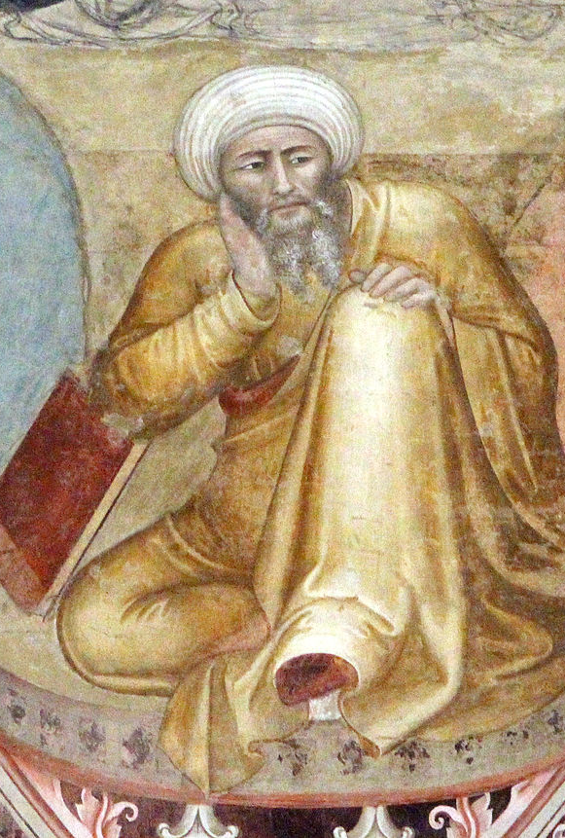
Muslim Philosophers:
Ibn Rushd/Averroes
Background
  1126-1198
  Lived in Cordova, Spain.
  Born into a family of well-known judges.
  A judge, physician, astronomer, and philosopher.
  Known for his three sets of comments of Aristotle.
  Known to Medieval Christian philosophers as “the Commentator.”
  He fell out of favor with the traditionalists and his books were burned in Islamic Spain.
Notes:
IV Ibn Rushd/Averroes (1126-1198)
A. Background
1. Lived in Cordova, Spain.
2. Born into a family of well known judges.
3. He was a judge, physician, astronomer, and philosopher.
4. Known for his three sets of comments of Aristotle.
5. Known to Medieval Christian philosophers as “the Commentator.”
6. He fell out of favor with the traditionalists and his books were burned in Islamic Spain.

Slide 104
Muslim Philosophers:
Ibn Rushd/Averroes
The Destruction of the Destruction
  A point-by-point refutation of Al-Ghazali’s The Destruction of Philosophers
  Contends Aristotle represents the culmination of the human mind and that his philosophy is consistent with the Koran.
  Koran asserts the world is God’s work and thus studying the world provides a way to prove God’s existence.
  Aristotle’s logic, physics and metaphysics provide tools for proving God’s existence.
  Uses Aristotle’s Unmoved Mover as an example.
Notes:
B. The Destruction of the Destruction
1. A point-by-point refutation of Al-Ghazali’s The Destruction of Philosophers
2. He contends that Aristotle represents the culmination of the human mind and that his philosophy is consistent with the Koran.
3. The Koran asserts that the world is God’s work and thus studying the world provides a way to prove God’s existence.
4. Aristotle’s logic, physics and metaphysics provide tools for proving God’s existence.
a. He uses Aristotle’s Unmoved Mover as an example.

Slide 105
Muslim Philosophers:
Ibn Rushd/Averroes
Double Truth Theory
  Developed to reconcile philosophy & theology.
  Koran was written for the masses who lack intellectual prowess.
  Written in an allegorical style to appeal to the imagination and emotions of the uneducated.
  The philosopher must go beneath the surface meaning to find the true meaning.
  Though philosophy might seem to conflict with religious tradition, this is an apparent conflict.
  Truth cannot conflict with truth, so the best philosophy is consistent with the Koran’s hidden meaning.
  Truth can be expressed in different levels and in different ways: figuratively in religion and literally in philosophy.
  This makes theology subordinate to philosophy since philosophers decide
    How to interpret revelation
    How to make it consistent with philosophy.
Notes:
C. Double Truth Theory
1. Developed to reconcile philosophy & theology.
2. The Koran was written for the masses who lack intellectual prowess.
a. It is thus written in an allegorical style to appeal to the imagination and emotions of the uneducated.
b. The philosopher must go beneath the surface meaning to find the true meaning.
3. Though philosophy might seem to conflict with religious tradition, this is only an apparent conflict.
4. Truth cannot conflict with truth, so the best philosophy is consistent with the Koran’s hidden meaning.
5. Truth can be expressed in different levels and in different ways: figuratively in religion and literally in philosophy.
6. This view seems to make theology subordinate to philosophy-philosophers decide how to interpret revelation and how to make it consistent with philosophy.

Slide 106
Muslim Philosophers:
Ibn Rushd/Averroes
Latin Averroists
  Badly misinterpreted by many 13th century Christian thinkers, most famously the “Latin Averroists.”
  Some thought his view was a claim could be true in philosophy while its contradiction could be true in religion.
  The “Latin Averroists”
    Faculty at the University of Paris.
    Headed by Siger of Brabant (about 1240-1284).
  To accept Aristotelian doctrines that seemed contrary to church doctrines they put philosophy and religion into distinct fields without attempting to relate them.
Notes:
D. Latin Averroists
1. He was badly misinterpreted by many 13th century Christian thinkers, most famously the “Latin Averroists.”
2. Some thought that his view was that a claim could be literally true in philosophy while its contradiction could be literally true in religion.
3. The “Latin Averroists”
a. Faculty at the University of Paris.
b. Headed by Siger of Brabant (about 1240-1284).
c. In order to accept Aristotelian doctrines that seemed contrary to church doctrines they put philosophy and religion into distinct fields without attempting to relate them.

Slide 107
Muslim Philosophers:
Ibn Rushd/Averroes
Impact
  By 1250 Latin translations of his commentaries of Aristotle began having a significant impact on Christian thinkers.
  His interpretations lead to purging many Neo-Platonic distortions of earlier commentators.
    This earned him great respect.
  Heretical elements in his work (determinism, the eternal world, and rejection of personal immortality) made thinkers suspicious of attempts to merge Aristotle and Christian thought.
  Aquinas attempted to show that Aristotle’s thought did not lead to Ibn Rushd’s heresies.
  Some saw Aquinas as tainted with Averroism.
Notes:
E. Impact
1. By 1250 Latin translations of his commentaries of Aristotle began having a significant impact on Christian thinkers.
2. His interpretations lead to the purging of many Neo-Platonic distortions inflicted by earlier commentators.
a. This earned him great respect.
3. The heretical elements in his work (determinism, the eternal world, and rejection of personal immortality) made thinkers suspicious of attempts to merge Aristotle and Christian thought.
4. Aquinas attempted to show that Aristotle’s thought did not lead to Ibn Rushd’s heresies.
a. Some regarded Aquinas as tainted with Averroism.

Slide 108
Jewish Philosophers:
Background
Background
  Jewish thinkers had access to the works of Aristotle and Plato.
  Their work on Aristotle became available to Christian thinkers.
  Aimed at reconciling philosophical conclusions with an orthodox interpretation of Judaism.
  Attempted to build a philosophical system based on the Old Testament and the Talmud (commentary on the first five books of the bible).
  Persecution isolated the European Jewish community.
    This aided conservative religious leaders who wanted to purge scientific and secular influences.
  For centuries Judaism, like Islam, permitted mysticism as the only alternative to revelation as a source of knowledge.
  After 1200 only Christian thinkers could use Aristotle in developing systematic philosophies.
Notes:
A. Background
1. Jewish thinkers had access to the works of Aristotle and Plato.
2. Their work on Aristotle was made available to Christian thinkers.
3. They aimed at reconciling philosophical conclusions with an orthodox interpretation of Judaism.
4. They attempted to build a philosophical system based on the Old Testament and the Talmud (commentary on the first five books of the bible).
5. Persecution isolated the European Jewish community.
6. This aided their conservative religious leaders who wanted to purge the scientific and secular influences.
7. For centuries Judaism, like Islam, permitted mysticism as the only alternative to revelation as a source of knowledge.
8. After 1200 only the Christian thinkers could make use of Aristotle in developing systematic philosophies.

Slide 109
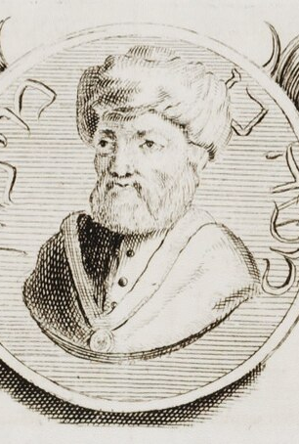
Jewish Philosophers:
Moses Maimonides
Background
  1135-1204
  Born in Cordova, Spain
  Accepted the harmony of faith and reason.
Guide for the Perplexed
  Written for those who have studied philosophy but are confused about how to reconcile it with their faith.
  If there is an apparent conflict between scripture and an airtight philosophical proof, then the scriptures should be interpreted allegorically.
  Aristotle had achieved the pinnacle in human knowledge.
  A real conflict exists between Aristotle’s claim that the world is eternal and the theological doctrine that the world has a beginning.
  Aristotle’s arguments were not airtight and could be rejected.
  Labeled a heretic
    His theological writings were taken as authoritative
    His philosophical works were condemned and then ignored by Jewish scholars until the 1800s.
Notes:
II Moses Maimonides (1135-1204)
A. Background
1. Born in Cordova, Spain
2. Accepted the harmony of faith and reason.
B. Guide for the Perplexed
1. Written for those who have studied philosophy but are confused about how to reconcile it with their faith.
2. In cases of any apparent conflict between scripture and an airtight philosophical proof, then the scriptures should be interpreted allegorically.
3. Aristotle had achieved the pinnacle in human knowledge.
4. A real conflict exists between Aristotle’s claim that the world is eternal and the theological doctrine that the world has a beginning.
5. He asserted that Aristotle’s arguments were not airtight and hence could be rejected.
6. He was labeled a heretic and while his theological writings were taken as authoritative his philosophical works were condemned and then ignored by Jewish scholars until the 1800s.

Slide 110
The Return of Aristotle
Rediscovery 12th century
  Greek writings on mathematics, astronomy, medicine and philosophy became available, including Aristotle.
  Greek Arabic and Jewish commentaries were translated into Latin.
  1210-1225: most of Aristotle’s surviving works were translated into Latin from Arabic.
Aristotle and the Church
  The Church was suspicious of pantheistic elements added by Arabic thinkers.
  The Church rejected
    The necessity & eternity of the world
    The blurring between the creator and creation.
  1215: University of Paris forbade the study of Aristotle’s Physics and Metaphysics.
    Many scholars ignored this.
Notes:
I Rediscovery
A. 12th century
1. Greek writings on mathematics, astronomy, medicine and philosophy became available, including the works of Aristotle.
2. Greek Arabic and Jewish commentaries were translated into Latin.
3. Between 1210-1225 almost all of Aristotle’s surviving works were translated into Latin from Arabic.
B. Aristotle and the Church
1. The Church was suspicious mainly because of the pantheistic elements added by Arabic thinkers.
2. The Church rejected the necessity & eternity of the world as well as the blurring between the creator and creation.
3. In 1215 the University of Paris forbade the study of Aristotle’s Physics and Metaphysics.
a. Many scholars ignored this.

Slide 111
The Return of Aristotle
Later Translations
  Scholars translated Aristotle’s work from the original Greek, removing pantheistic distortions.
  1254: Physics and Metaphysics were part of the curriculum of the University of Paris.
  Scholars began using Aristotle’s terminology such as essence & existence, necessity & contingency, and his theory of abstraction.
  What should the Christian world do with the non-Christian philosophical systems that arose from Greece, Islam, and Judaism?
Notes:
C. Later Translations
1. Scholars eventually translated Aristotle’s work from the original Greek, thus removing the pantheistic distortions.
2. In 1254 the Physics and Metaphysics were part of the curriculum of the University of Paris.
3. Scholars began to use Aristotle’s terminology such as essence & existence, necessity & contingency, and used his theory of abstraction.
4. The stage was set for the next problem: what should the Christian world do with these non-Christian philosophical systems that arose from Greece, Islam, and Judaism?

Slide 112
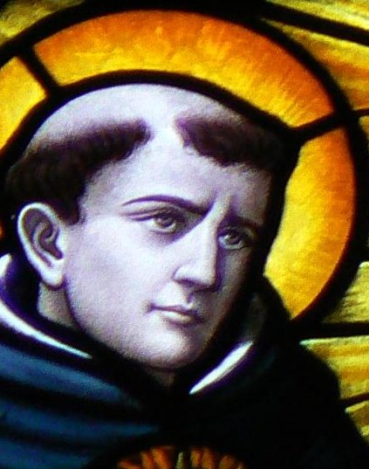
St. Thomas Aquinas:
Background
Background (1224-1274)
  Early Life
    Son of the count of Aquino
    Imprisoned in a tower
    At 14 he enrolled in University of Naples and joined the Dominican Order in 1244.
      Humble and poor preachers and scholars.
    Influenced by the Dominican theologian Albert the Great
    Appointed by the Pope as a theological adviser for communications with the Eastern Orthodox Church
    A few months before he died, he had a mystic experience that caused him to stop writing.
      “I can write no more, I have seen things which make all my writings like straw.”
    Died in 1274 in-route to the Council of Lyons
    Canonized in 1323
    1879 Pope Leo XIII recommended his philosophy as a model for Catholic thought.
This Photo by Unknown Author is licensed under CC BY-SA
Notes:
Background
I Background
A. Early Life
1. Born in 1224 or 1225 into a noble Italian family.
a. His father was the Count of Aquino.
2. His family hoped he would reach a position of ecclesiastical authority that would have political influence and wealth.
3. At 14 he enrolled in University of Naples and joined the Dominican Order in 1244.
a. The Dominicans were humble and poor preachers and scholars.
b. His family was displeased by his joining the order, so his brother kidnapped him and held him in a tower for a year.
4. After his release, he studied philosophy and theology at Paris.
5. There he was influenced by the Dominican theologian Albert the Great (Albrecht Gross).
6. Lectured and wrote in Italy and Paris.
7. Traveled often for the Church and Dominicans.
8. Appointed by the Pope as a theological adviser for communications with the Eastern Orthodox Church.
9. A few months before he died, he had a mystic experience that caused him to stop writing.
a. “I can write no more, I have seen things which make all my writings like straw.”
10. He died in 1274 en-route to the Council of Lyons.
11. Canonized in 1323 and in 1879 Pope Leo XIII recommended his philosophy as a model for Catholic thought.
B. The Ox
1. He was large and rotund, but gentle.
2. He was nicknamed “the dumb ox” because he was quiet in class and did not engage in the active discussions.
3. Cow Story
a. Other monks told him a cow was flying and he went to look, causing them to laugh and ask him if he thought cows could fly.
b. He replied that he would rather believe that a cow could fly than that another monk would lie.
C. Works
1. He wrote about 25 volumes and supposedly kept four secretaries busy transcribing different works.
a. Devotional works, sermons, lectures, and philosophy.
b. Commentaries on Aristotle, Boethius, and Pseudo-Dionysius.
2. The Summa Theologica is his major work and is longer than Aristotle’s works.

Slide 113
St. Thomas Aquinas:
Background
  The Ox
    He was large and rotund, but gentle.
    He was nicknamed “the dumb ox” because he was quiet in class and did not engage in the active discussions.
    The flying Cow
  Works
    25 Volumes
      Devotional works, sermons, lectures, and philosophy.
      Commentaries on Aristotle, Boethius, and Pseudo-Dionysius.
      The Summa Theologica is his major work and is longer than Aristotle’s works.
This Photo by Unknown Author is licensed under CC BY-SA
Notes:
Background
I Background
A. Early Life
1. Born in 1224 or 1225 into a noble Italian family.
a. His father was the Count of Aquino.
2. His family hoped he would reach a position of ecclesiastical authority that would have political influence and wealth.
3. At 14 he enrolled in University of Naples and joined the Dominican Order in 1244.
a. The Dominicans were humble and poor preachers and scholars.
b. His family was displeased by his joining the order, so his brother kidnapped him and held him in a tower for a year.
4. After his release, he studied philosophy and theology at Paris.
5. There he was influenced by the Dominican theologian Albert the Great (Albrecht Gross).
6. Lectured and wrote in Italy and Paris.
7. Traveled often for the Church and Dominicans.
8. Appointed by the Pope as a theological adviser for communications with the Eastern Orthodox Church.
9. A few months before he died, he had a mystic experience that caused him to stop writing.
a. “I can write no more, I have seen things which make all my writings like straw.”
10. He died in 1274 en-route to the Council of Lyons.
11. Canonized in 1323 and in 1879 Pope Leo XIII recommended his philosophy as a model for Catholic thought.
B. The Ox
1. He was large and rotund, but gentle.
2. He was nicknamed “the dumb ox” because he was quiet in class and did not engage in the active discussions.
3. Cow Story
a. Other monks told him a cow was flying and he went to look, causing them to laugh and ask him if he thought cows could fly.
b. He replied that he would rather believe that a cow could fly than that another monk would lie.
C. Works
1. He wrote about 25 volumes and supposedly kept four secretaries busy transcribing different works.
a. Devotional works, sermons, lectures, and philosophy.
b. Commentaries on Aristotle, Boethius, and Pseudo-Dionysius.
2. The Summa Theologica is his major work and is longer than Aristotle’s works.

Slide 114
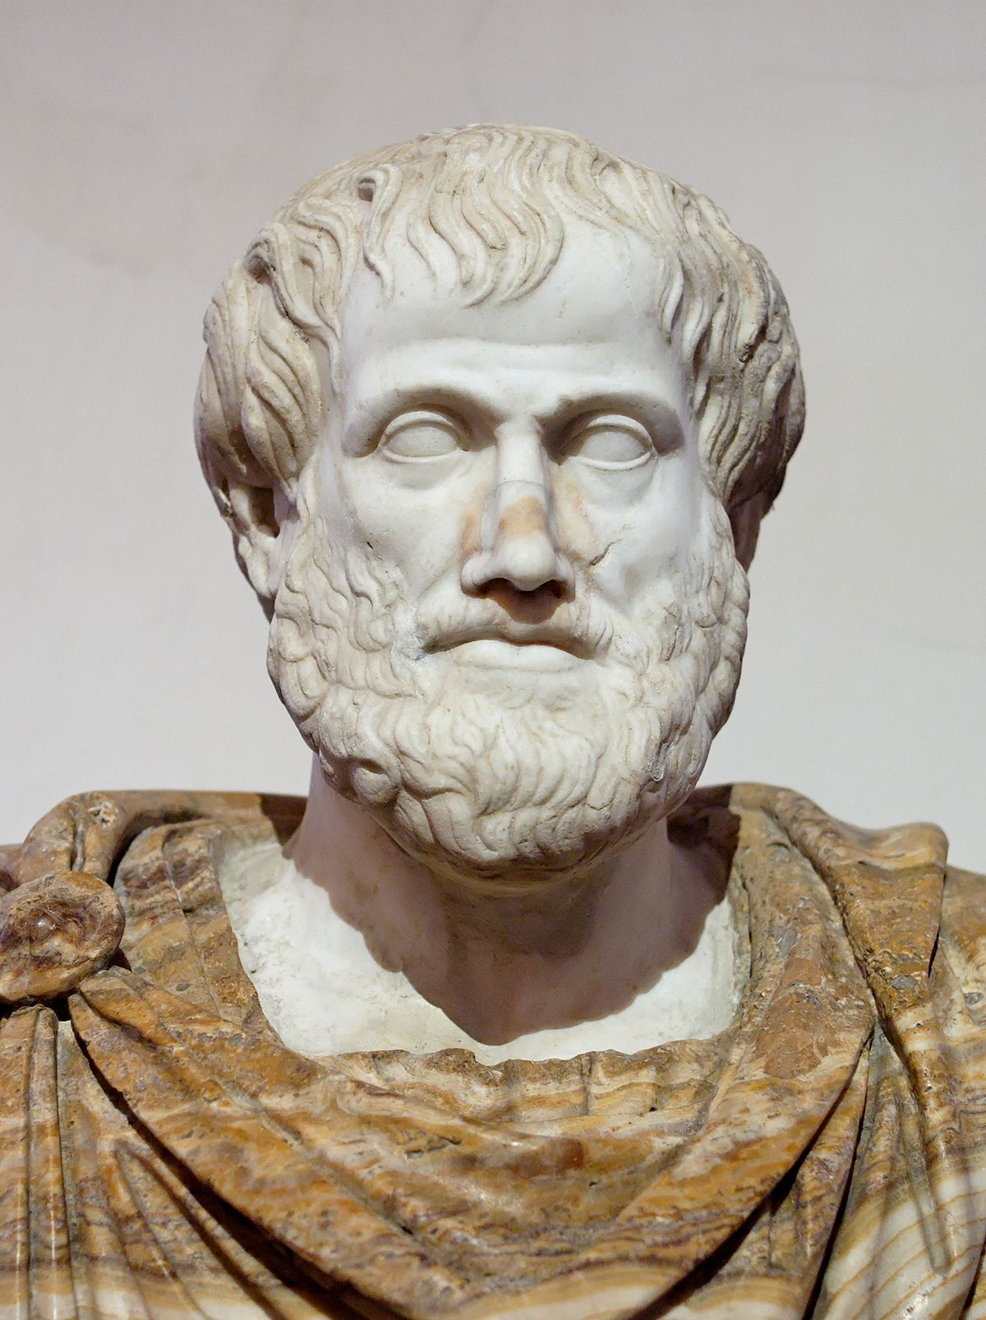
St. Thomas Aquinas: Background
Aristotle & Aquinas
  Complete Works
    12th-13th Century: the complete works of Aristotle became available in Europe.
    Aristotle’s works presented a systematic and developed philosophy.
  Conflict
    Aristotle: the world is eternal and uncreated.
    Apparently did not accept personal immortality.
    Christian thinkers influenced by Ibn Rushd’s commentaries tended to alter their theology to match their philosophy, which worried church authorities.
    Neo-Platonism was the dominant philosophy for Christians for a long time, making Aristotle’s empirical and naturalistic tendencies threatening.
This Photo by Unknown Author is licensed under CC BY-SA
Notes:
II Aristotle & Aquinas
A. Complete Works
1. 12th-13th century the complete surviving works of Aristotle became available in Europe.
2. Aristotle’s works presented a systematic and developed philosophy.
B. Conflict
1. Aristotle claimed that the world was eternal and uncreated.
2. He apparently did not accept the notion of personal immortality.
3. Christian thinkers influenced by Ibn Rushd’s commentaries on Aristotle tended to alter their theology to match their philosophy, which worried the church authorities.
4. Neo-Platonism had been the dominant philosophy for Christians for a long time, making Aristotle’s empirical and naturalistic tendencies seem threatening.

Slide 115
St. Thomas Aquinas:
Background
  Aquinas’ View
    Aristotle’s view could be adopted without heresy.
    Regarded Aristotle as a rich intellectual behavior.
    “The Philosopher.”
    Aquinas was willing to criticize Aristotle, seeing him as pagan lacking divine revelation.
  Shift from Plato to Aristotle
    Platonic notions of the eternal & other worldliness out of sync with changes of the 13th century.
    The challenge was to retain the transcendent nature of God and the afterlife while reconciling this with the concern with the here and now.
    Aquinas thought utilizing Aristotle enabled reconciliation that was theologically correct and philosophically rigorous.
This Photo by Unknown Author is licensed under CC BY-SA
Notes:
C. Aquinas’s View
1. He held that one could adopt Aristotle’s views without falling into heresy.
2. He regarded Aristotle’s works as a rich intellectual resource.
3. He refereed to Aristotle as “The Philosopher.”
4. Aquinas was quite willing to be critical of Aristotle and regarded him as pagan lacking divine revelation when it came to distinct matters of Christian faith.
D. The Shift from Plato to Aristotle
1. The Platonic notions of the eternal and the otherworldliness seemed out of sync with the changes of the 13th century.
2. The challenge was to retain the transcendent nature of God and the afterlife while reconciling this with the concern with the here and now.
3. Aquinas thought that utilizing Aristotle would enable a reconciliation that was theologically correct and philosophically rigorous.

Slide 116
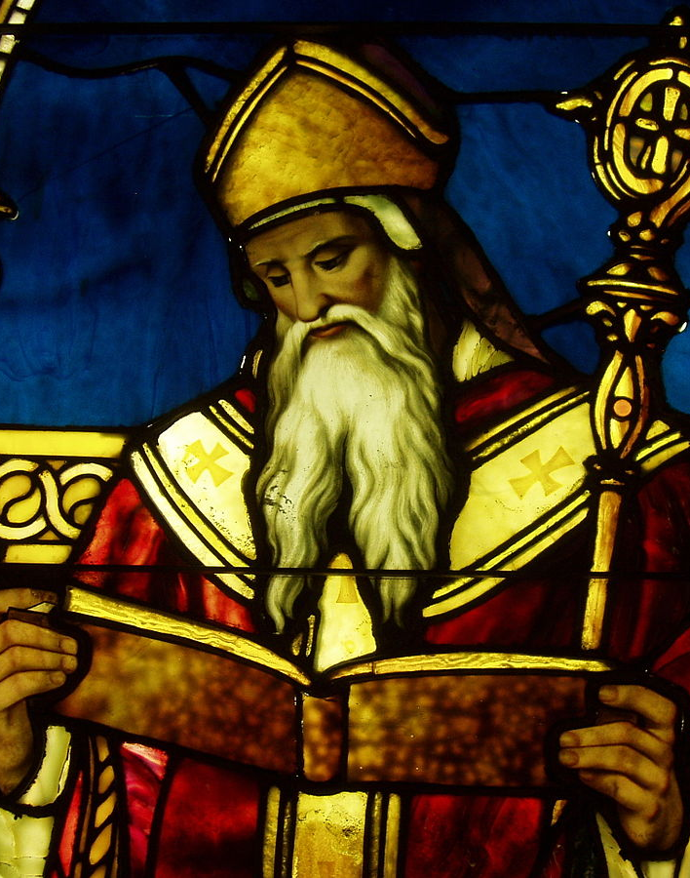
St. Thomas Aquinas: Background
Faith & Reason
  Reconciliation: Augustine
    Task: reconcile two sources of knowledge.
    Augustine: sin has damaged reason.
    The mind must be repaired by grace before reason can function properly.
    Faith is necessary condition for philosophical understanding.
    Philosophy is subservient to religion.
This Photo by Unknown Author is licensed under CC BY-SA
Notes:
III Faith & Reason
A. Reconciliation: Augustine
1. One task was to reconcile the two sources of knowledge.
2. Augustine held that sin has damaged reason.
3. The mind must be repaired by grace before reason can function properly.
4. So, faith is necessary condition for philosophical understanding and philosophy is subservient to religion.

Slide 117
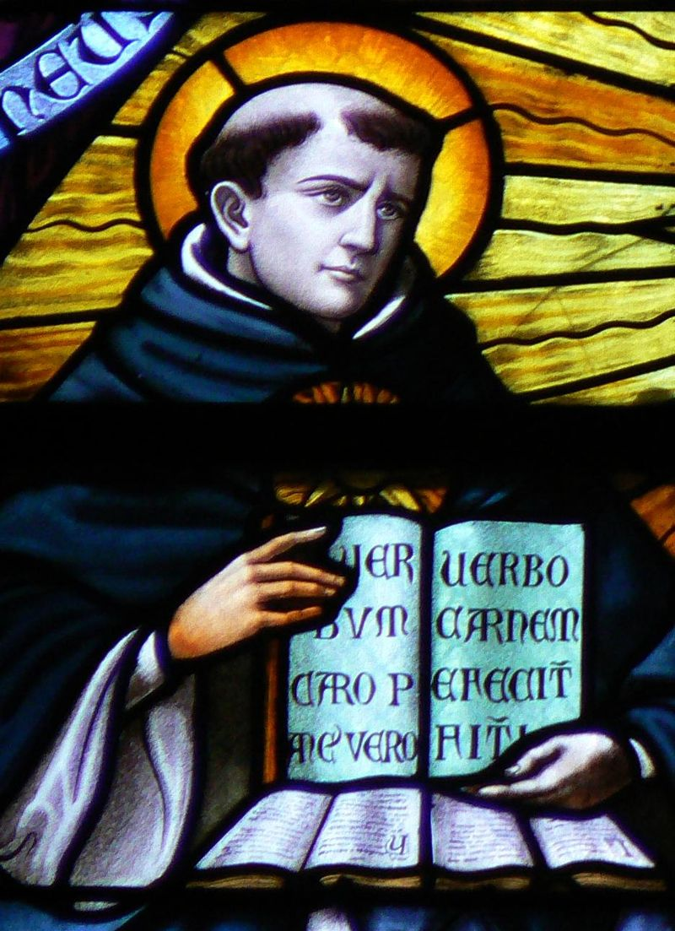
St. Thomas Aquinas: Background
  Reconciliation: Aquinas
    Sin did not cripple our rational capabilities but affected our moral life.
    Reason can be an autonomous source of knowledge.
    Distinguishes philosophy from theology, giving each its due.
    Two sources of knowledge:
      Theology yields knowledge via faith and revelation.
      Philosophy yields knowledge via human reason and experience.
    Theology begins with God and proceeds towards knowledge of the natural world.
    Philosophy begins with empirical evidence of the natural world and proceeds, via reason, to God.
    There are three types of truth and two kinds of theology.
Notes:
B. Reconciliation: Aquinas
1. Sin did not cripple our rational capabilities, but did affect our moral life.
2. Reason can be an autonomous source of knowledge.
3. He clearly distinguishes philosophy from theology while giving each its due.
4. There are two sources of knowledge:
a. Theology yields knowledge via faith and revelation.
b. Philosophy yields knowledge via human reason and experience.
5. Theology begins with God and proceeds towards knowledge of the natural world.
6. Philosophy begins with empirical evidence of the natural world and proceeds, via reason, to God.
7. For Aquinas there are three types of truth and two kinds of theology.

Slide 118
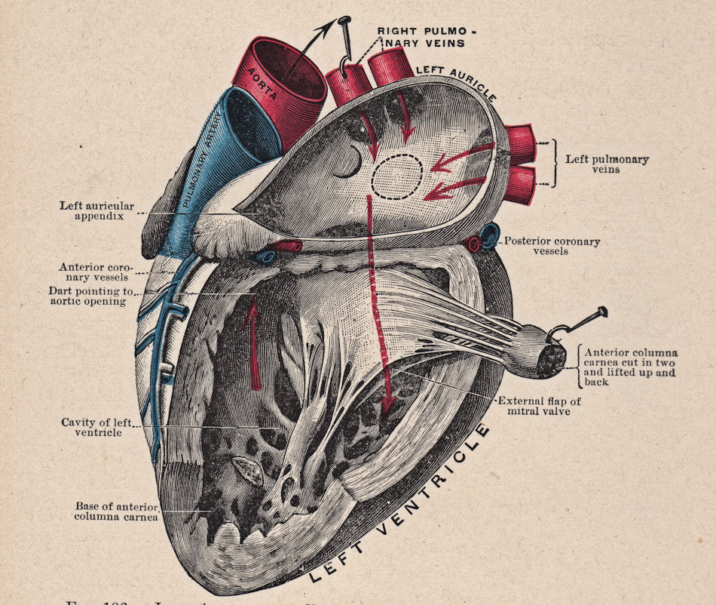
St. Thomas Aquinas:
Background
  Truth: Christian teachings that a matter of faith
    Known via revelation
    Beyond reason, not contrary to reason
    Objections and problems
    Cannot be proven/disproven by reason
    Examples: trinity, incarnation, original sin, etc.
  Truth: Empirical Knowledge & Self-Evident Philosophical Principles
    Not known via revelation
    Examples: Aristotle’s logic, biological functions of heart
This Photo by Unknown Author is licensed under CC BY-SA-NC
Notes:
C. Truth: Christian teachings that are matters of faith.
1. Known via revelation.
2. Beyond the realm of reason, yet not contrary to reason.
3. Objections and problems raised against them can be countered by reason.
4. Cannot be proven nor disproven by reason.
5. Examples: Trinity, Incarnation, original sin, the creation of the world in time, the sacraments, and the last judgment.
D. Truth: Empirical knowledge and self-evident philosophical principles.
1. These scientific and philosophical truths cannot be known via revelation.
2. Example: Aristotle’s laws of logic, the biological function of the heart.

Slide 119
St. Thomas Aquinas: Background
Truth: Overlap of philosophy & theology
Known via revelation or reason
Examples: God’s existence & qualities, existence of the soul, immortality, natural moral law
Two Type of Theology
Revealed supernatural theology
Natural theology: philosophical discipline aimed at establishing theological truths using reason and empirical evidence.
Notes:
E. Truth: Overlap of philosophy and theology.
1. These truths can be known via revelation or reason.
2. Examples: God’s existence, God’s essential qualities, the existence of the soul, immortality, and natural moral law.
F. Two types of theology
1. Revealed supernatural theology.
2. Natural theology: a philosophical discipline aimed at establishing theological truths by the use of reason and empirical evidence.
3. Where the two overlap, there can be no conflict since they both reveal truths originating in God.
4. Human interpretations and judgments of either can come into conflict.
a. True theology only conflicts with false philosophy.
b. True philosophy only conflicts with false theology.

Slide 120
St. Thomas Aquinas: Background
  Where the two theologies overlap, there can be no conflict since they both reveal truths originating in God.
  Human interpretations and judgments of either can come into conflict.
    True theology only conflicts with false philosophy.
    True philosophy only conflicts with false theology.
Notes:
. Where the two overlap, there can be no conflict since they both reveal truths originating in God.
4. Human interpretations and judgments of either can come into conflict.
a. True theology only conflicts with false philosophy.
b. True philosophy only conflicts with false theology.

Slide 121
St. Thomas Aquinas: Background
Method
  Main work: the Summa Theologica
  Utilizes the dialectic method developed by Abelard.
  Method involves five steps.
  Attempted to exhaustively and definitively address major issues.
    The Greek ancients, the Church Fathers, theologians, as well as Muslim and Jewish philosophers.
  A “cathedral of reason” that uses Aristotelian logic to lead the reader to God.
Notes:
Method
A. Introduction
1. His main work is the Summa Theologica
2. He utilizes the dialectic method developed by Abelard.
3. His method involves five steps.
a. He applies this method to issue after issue.
4. He attempted to exhaustively and definitively address the major issues.
a. He addresses a wide range of thinkers including the Greek ancients, the Church Fathers, theologians, as well as Muslim and Jewish philosophers.
5. His work is often described metaphorically as a “cathedral of reason” that uses Aristotelian logic to lead the reader to God.

Slide 122
St. Thomas Aquinas: Background
Five Steps
  Step #1: Statement of the issue.
  Step #2: A strong and fair presentation of objections:
    Standard positions he regards as incorrect but for which a supporting authority can be cited.
  Step #3: “On the contrary…”: Answers are provided that
    He regards as correct
    Are backed by authorities such as scripture or a noted theologian.
  Step #4: “I answer that…”: He develops and defends his own position.
  Step #5: A presentation of detailed replies to the initial objections.
Notes:
B. Five Steps
1. Statement of the issue.
2. A strong and fair presentation of objections: standard positions he regards as incorrect but for which a supporting authority can be cited.
3. “On the contrary…”: Answers are provided that he regards as correct and that are backed by authorities such as scripture or a noted theologian.
4. “I answer that…”: He develops and defends his own position.
5. A presentation of detailed replies to the initial objections.

Slide 123

St. Thomas Aquinas: Epistemology & Metaphysics
Aristotle’s Influence
  Citing Aristotle, he claims the mind is blank state prior to experience.
  Rejects innate knowledge
    Even that of God.
  The senses provide reason with content.
  The operation of the intellect originates in what the senses apprehend but
    “The intellect knows many things which the senses cannot perceive.”
Notes:
Aquinas’s Epistemology & Metaphysics
I Epistemology
A. Aristotle’s Influence
1. Citing Aristotle, he claims that mind is blank state prior to experience.
2. He is regarded as rejecting innate knowledge-even that of God.
3. The senses provide reason with content.
4. The operation of the intellect originates in the senses in what the senses apprehend, but “the intellect knows many things which the senses cannot perceive.”

Slide 124

St. Thomas Aquinas:
Epistemology & Metaphysics
The Intellect
  Passive and active.
  Passive operation: it receives “raw data” from sensory experience.
  Because God created the objects of experience, they are intelligible and contain universals.
  The active aspect of the intellect processes the particular sensory experience and recognizes the universals.
    The senses give the intellect X things and it abstracts the universal X from the particular X things.
  The mind is initially without content, but by nature it has the potential to receive the universals/forms.
  This is a natural process that does not require divine illumination.
  Contrasts with Augustine’s view.
This Photo by Unknown Author is licensed under CC BY-SA-NC
Notes:
B. The Intellect
1. Is passive and active.
2. In its passive operation it receives “raw data” from sensory experience.
3. Because God created the objects of experience they are intelligible and contain universals.
4. The active aspect of the intellect processes the particular sensory experience and recognizes the universals.
a. The senses give the intellect X things and it abstracts the universal X from the particular X things.
5. The mind is initially without content, but by nature it has the potential to receive the universals/forms.
6. This is a natural process that does not require divine illumination.
a. This is in contrast with Augustine’s view.

Slide 125
St. Thomas Aquinas:
Epistemology & Metaphysics
Moderate Realism
  Rejected the independent existence of universals apart from particulars.
  His ontology included only particulars which “contain” universals.
  Universals are not mere mental entities.
  When the mind abstracts universals from particulars it is abstracting from real qualities in the world and not creating arbitrary categories.
Universals
  Exist eternally as ideas in God’s mind.
  When God created the world, universals existed as the form of individual substances.
  By abstraction, universals come to exist in the minds of rational beings.
Notes:
C. Moderate Realism
1. He did not accept the independent existence of universals apart from particulars.
2. His ontology included only particulars which “contain” universals.
3. Universals are not mere mental entities.
4. When the mind abstracts the universals from particulars it is abstracting from real qualities that are present in the world and not merely creating arbitrary categories.
D. Universals
1. Exist eternally as ideas in God’s mind.
2. When God created the world, universals existed as the form of individual substances.
3. By abstraction, the universals come to exist in the minds of rational beings.

Slide 126
St. Thomas Aquinas:
Epistemology & Metaphysics
Knowledge
Derived from the senses:
  All concepts of philosophy
  All that is known of God
  All knowledge of values.
  All knowledge is inferential and indirect.
Notes:
C. Moderate Realism
1. He did not accept the independent existence of universals apart from particulars.
2. His ontology included only particulars which “contain” universals.
3. Universals are not mere mental entities.
4. When the mind abstracts the universals from particulars it is abstracting from real qualities that are present in the world and not merely creating arbitrary categories.
D. Universals
1. Exist eternally as ideas in God’s mind.
2. When God created the world, universals existed as the form of individual substances.
3. By abstraction, the universals come to exist in the minds of rational beings.

Slide 127
St. Thomas Aquinas:
Epistemology & Metaphysics
Individuals
  Like Aristotle, he holds that the natural world consists of individual substances.
  Each particular X has a substantial form:
    The universal component of the particular which is shared by all Xs.
  Each particular is also composed of matter.
The problem of continuity through change.
  The problem: Since one thing can change into another, what accounts for the continuity?
  If there is continuity, there must be a fundamental type of matter persisting through substantial changes.
  If X changes to Y, there must be something that was potentially X and Y.
    “prime matter.”
  Prime matter
    Lacks form
    Has no qualities of its own beyond being pure potentiality-the potential to take on any form.
  Prime matter is a bare particular.
Notes:
A. Individuals
1. Like Aristotle, he holds that the natural world consists of individual substances.
2. Each particular X has a substantial form: the universal component of the particular which is shared by all Xs.
3. Each particular is also composed of matter.
B. The problem of continuity through change.
1. The problem: Since one thing can change into another, what accounts for the continuity?
2. If there is continuity, there must be a fundamental type of matter that persists through substantial changes.
3. If X changes to Y, there must be something that was potentially X and Y.
4. He calls this “prime matter.”
5. Prime matter lacks form and has no qualities of its own beyond being pure potentiality-the potential to take on any form.
6. In current philosophic terminology, prime matter is generally regarded as being a bare particular.

Slide 128
St. Thomas Aquinas:
Epistemology & Metaphysics
The problem of individuation
  The problem: how can two Xs that have identical qualities be two, distinct Xs?
  Prime matter solves this problem: two Xs with the same qualities are different because they consist of different matter.
  Prime matter will never be encountered without a form and forms will never be encountered apart from matter.
Notes:
C. The problem of individuation
1. The problem: how can two Xs that have identical qualities be two, distinct Xs?
2. Prime matter solves this problem as well: two Xs with the same qualities are different because they consist of different matter.
3. Prime matter will never be encountered without a form and forms will never be encountered apart from matter.

Slide 129

St. Thomas Aquinas:
Metaphysics
Hierarchy
  Actuality and Potentiality
  Prime matter is pure potential
    it can take on any form.
  Forms are actuality
    Make matter into particular things.
  God is perfect
    He is pure actuality
    Imperfection: having unactualized potential that is not actualized.
  God cannot change
  The created universe is dynamic because all created beings are between pure potentiality and complete actuality.
  Each created being has a natural tendency towards fulfilling its potential, imitating God.
This Photo by Unknown Author is licensed under CC BY-NC
Notes:
III Metaphysics: Hierarchy
A. Actuality and Potentiality
1. Prime matter is pure potential-it can take on any form.
2. Forms are actuality-they make matter into particular sorts of things.
3. God is perfect and hence He is pure actuality-imperfection is having potential that is not actualized.
4. God cannot change, but the created universe is dynamic because all created beings are between pure potentiality and complete actuality.
5. Each created being has a natural tendency towards fulfilling its potential, thus imitating God.

Slide 130
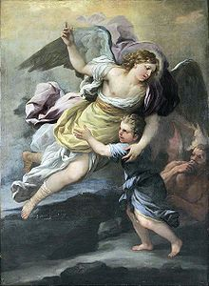
St. Thomas Aquinas:
Metaphysics
The Great Chain of Being
  The universe is a hierarchy ranging from the lowest inorganic substances to God.
  The variety exists because God created the universe to express his fullness.
  Proves the existence of angels
    Like God in being purely spiritual
    Like humans in having unrealized potentiality.
  This world is orderly and intelligible, and hence can be known.
  This world has a purpose because each created being aims at fulfilling its essence.
  Objective value judgments are grounded by this hierarchy
    Beings are greater or lesser depending on their proximity to God.
  Thus, humans have greater worth than animals.
This Photo by Unknown Author is licensed under CC BY-SA
Notes:
B. The Great Chain of Being
1. The universe is a hierarchy ranging from the lowest inorganic substances to God.
2. The variety exists because God created the universe to express his fullness.
3. He uses this to prove the existence of angels-they are like God in being purely spiritual, but like humans in having unrealized potentiality.
4. This world is orderly and intelligible, and hence can be known.
5. This world has a purpose because each created being aims at fulfilling its essence.
6. Objective value judgments are grounded by this hierarchy: beings are greater or lesser depending on their proximity to God.
7. Thus, humans have greater worth than animals.

Slide 131

St. Thomas Aquinas:
Metaphysics
Metaphysics: Existence and Essence
  Essence is what makes a thing what it is.
  Essence is distinct from the fact that something exists, at least in the case of created beings.
God
  God’s essence entails that He exists.
  God is a being such that no greater being can be conceived.
  His nature is such that He exists necessarily.
  Aquinas rejects this argument because although we understand “God” we do not directly grasp His essence.
  If we could, we would know his essence contains existence.
  Since we lack this knowledge, we cannot argue from His essence to his existence.
  Given his epistemology, arguments for God’s existence must begin with empirical experience.
This Photo by Unknown Author is licensed under CC BY-NC-ND
Notes:
IV Metaphysics: Existence and Essence
A. Essence & Existence
1. Essence is what makes a thing what it is.
2. Essence is distinct from the fact that something exists, at least in the case of created beings.
B. God
1. God’s essence entails that He exists.
2. God is a being such that no greater being can be conceived.
3. His nature is such that He exists necessarily.
4. Aquinas rejects this argument because although we understand “God” we do not directly grasp His essence.
5. If we could, we would know his essence contains existence.
6. Since we lack this knowledge, we cannot argue from His essence to his existence.
7. Given his epistemology, arguments for God’s existence must begin with empirical experience.

Slide 132
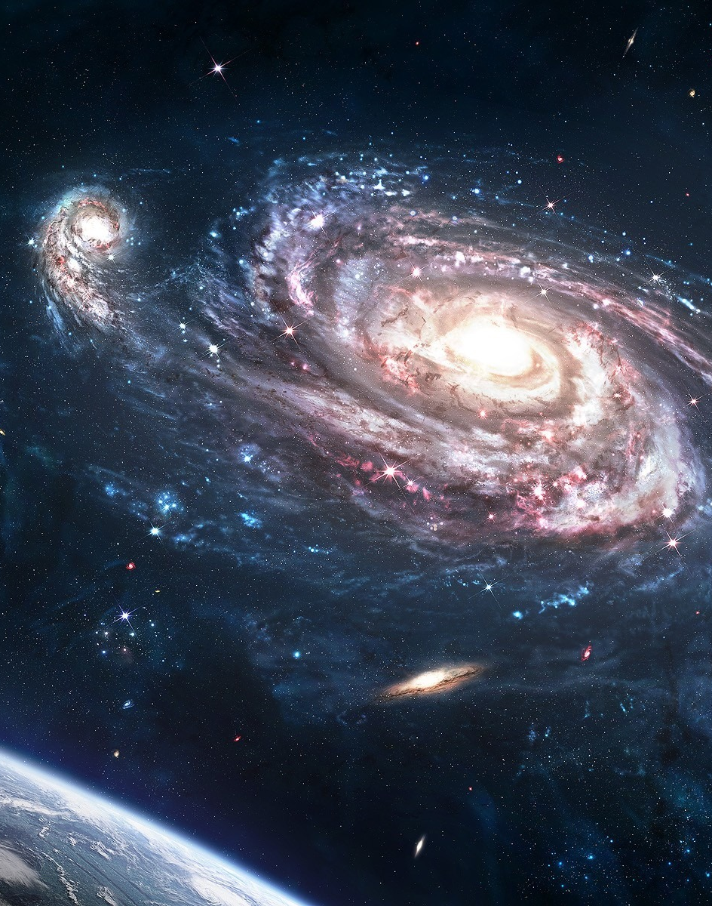
St. Thomas Aquinas: Five Ways
Introduction
  Introduction
    Aristotle
  General Form
    Premise 1: If the world has X, then God exists.
    Premise 2: The world has X.
    Conclusion: God exists.
  Cosmological argument
    Assumption: infinite regress of causes is not possible
This Photo by Unknown Author is licensed under CC BY-NC
Notes:
The Five Ways
I Introduction
A. Introduction
1. Aquinas makes use of arguments developed by Aristotle and some of his Muslim and Jewish commentators.
2. His Five ways are so well presented they have become a model for theistic argumentation.
B. General Form
1. If the world has quality X, then God exists.
2. The world has X.
3. Therefore God exists.
C. Cosmological Argument
1. Aquinas’s first three ways rest on the assumption that an infinite regress of causes is not possible.
2. These three arguments are three versions of what is known as the cosmological argument.

Slide 133



St. Thomas Aquinas: Five Ways
The First Way (the Way of Motion)
  Some things are in motion
  Whatever is moved is moved by another
  Potentiality
  A thing moves
  Reduction from potentiality to actuality
    Fire
This Photo by Unknown Author is licensed under CC BY-NC-ND
Notes:
A. The First Way (The Way of Motion)
1. It is certain and evident to our senses, that some things are in motion.
2. Whatever is moved is moved by another.
3. Nothing can be moved except it is in potentiality to that towards which it is moved.
4. A thing moves inasmuch as it is in act.
5. Motion is the reduction of something from potentiality to actuality.
6. Nothing can be reduced from potentiality to actuality, except by something in a state of actuality.
a. That which is actually hot, fire, makes wood, which is potentially hot, to be actually hot, and thus moves and changes it.

Slide 134

St. Thomas Aquinas: Five Ways
The First Way (the Way of Motion)
  Actuality & potentiality in different respects
    Hot
    Cold
  Impossible to be both moved and mover.
  Whatever is moved is moved by another
  Moved by another
This Photo by Unknown Author is licensed under CC BY
Notes:
7. It is not possible for the same thing to be at once in actuality and potentiality in the same respect, but only in different respects.
a. What is actually hot cannot simultaneously be potentially hot.
b. It is simultaneously potentially cold.
8. It is impossible that in the same respect and in the same way a thing should be both mover and moved (it should move itself).
9. So, whatever is moved must be moved by another.

Slide 135

St. Thomas Aquinas: Five Ways
  This cannot go on to infinity
    No first mover
    No other mover
    Moved by first mover
      Staff
  First mover
  This everyone understands to be God
This Photo by Unknown Author is licensed under CC BY-NC
Notes:
10. If that by which it is moved is itself moved, then this must be moved by another, and that by another.
11. This cannot go on to infinity,
a. Because then there would be no first mover,
b. And consequently no other mover,
c. Because subsequent movers move only inasmuch as they are moved by the first mover.
1. As the staff moves only because it is moved by the hand.

Slide 136

St. Thomas Aquinas: Five Ways
The Second Way ( Efficient Cause)
  Order of efficient causes
  Nothing can be the efficient cause of itself
  Not possible to go on to infinity
  Efficient causes following an order
    First
    Intermediate
This Photo by Unknown Author is licensed under CC BY-NC
Notes:
B. The Second Way (Efficient cause)
1. In the world of sensible things we find there is an order of efficient causes.
2. A thing cannot be the efficient cause of itself.
a. It would be prior to itself, which is impossible.
3. In efficient causes it is not possible to go on to infinity.
4. Because in all efficient causes following in order,
a. The first is the cause of the intermediate cause,
b. The intermediate is the cause of the ultimate cause,
c. Whether the intermediate cause is several or one.

Slide 137


St. Thomas Aquinas: Five Ways
The Second Way ( Efficient Cause)
  Take away the cause
  If no first cause, then neither intermediate nor ultimate
  If it is possible to go on to infinity
    No first efficient cause
    No ultimate effect
    No immediate efficient causes
    Plainly false
  First efficient cause to which everyone gives the name God.
Notes:
5. To take away the cause is to take away the effect.
6. Therefore, if there is no first cause among efficient causes, there will be neither ultimate nor any intermediate cause.
7. If in efficient causes it is possible to go on to infinity,
a. There will be no first efficient cause
b. Nor ultimate effect.
c. Nor intermediate efficient causes.
d. All of which is plainly false.
8. Therefore it is necessary to admit a first efficient cause, to which everyone gives the name of God.

Slide 138
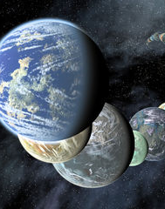
St. Thomas Aquinas: Five Ways
Philosophical Concepts
  Possible: What can be but need not be.
  Necessary: What must be; cannot not be.
  Actual : What is.
This Photo by Unknown Author is licensed under CC BY-SA

Slide 139

St. Thomas Aquinas: Five Ways
The Third Way (Possibility & Necessity)
  Possible to be and not to be
  Impossible for these to always exist
  One time there was nothing
  Nothing would exist now
  Impossible for anything to have begun to exist
  Thus now nothing would be in existence
  There must exist something whose existence is necessary
Notes:
C. The Third Way (Possibility and Necessity)
1. We find in nature things that are possible to be and not to be.
a. They can be generated and corrupted, so it is possible for them to be and not to be.
2. It is impossible for these always to exist, for that which can not-be at some time is not.
3. Therefore, if everything can not-be, then at one time there was nothing in existence.
4. If so, now nothing would exist, because that which does not exist begins to exist only through something already existing.
5. Therefore, if at one time nothing existed, it would have been impossible for anything to have begun to exist.
6. Thus now nothing would be in existence, which is absurd.
7. So, not all beings are merely possible, but there must exist something whose existence is necessary.

Slide 140
St. Thomas Aquinas: Five Ways
The Third Way (Possibility & Necessity)
  Every necessary thing either has its necessity cause by another or not
  Impossible to go on to infinity
    As per efficient causes
  Therefore we must admit the existence of a being
    Having of itself its own necessity
    Not receiving it from another
    Causing necessity in others
  This all men speak of as God
Notes:
8. Every necessary thing either has its necessity caused by another, or not.
9. It is impossible to go on to infinity in necessary things which have their necessity caused by another.
a. As shown in regard to efficient causes.
10. Therefore we must admit the existence of a being
a. Having of itself its own necessity.
b. Not receiving it from another.
c. Causing in others their necessity.
11. This all men speak of as God.

Slide 141

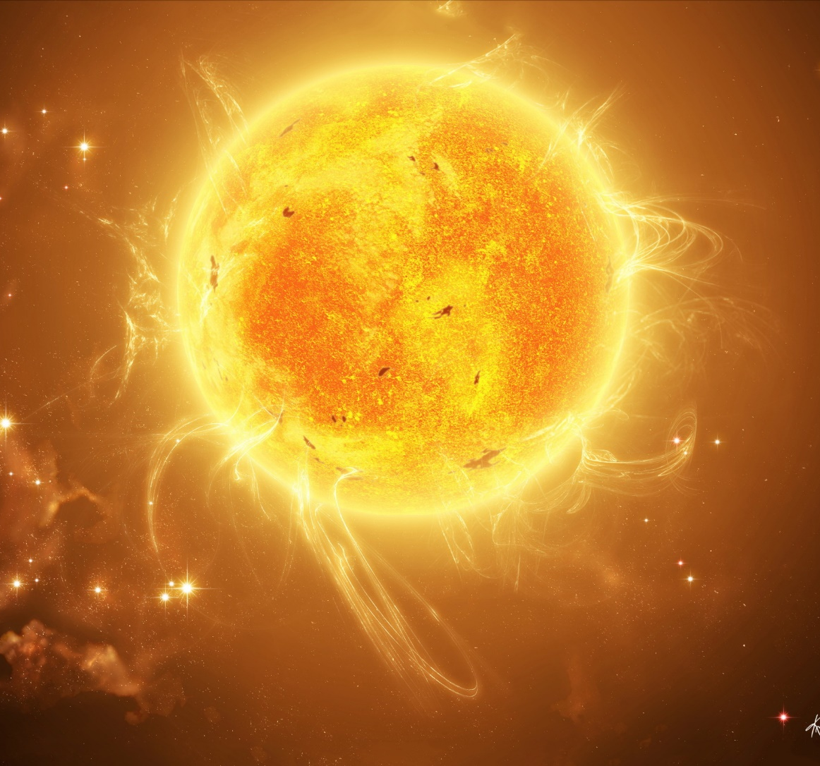
St. Thomas Aquinas: Five Ways
The Fourth Way (Gradation)
  Among beings are some more and some less
  More or less are predicated by resemblance to a maximum
  There is something truest, best, noblest
  There is something most in being
  The maximum in any genus is the cause of all in that genus
    Fire
  There must be something which is the cause of being, goodness, perfection
  This being we call God
This Photo by Unknown Author is licensed under CC BY-NC
Notes:
D. The Fourth Way (Gradation)
1. Among beings there are some more and some less good, true, noble, and the like.
2. More and less are predicated of different things as they resemble in different ways something which is the maximum.
a. A thing is said to be hotter as it more nearly resembles that which is hottest.
3. So, there is something which is truest, something best, something noblest.
4. Consequently, something which is most in being, for those things that are greatest in truth are greatest in being.
5. The maximum in any genus is the cause of all in that genus.
a. As fire, the maximum of heat, is the cause of all hot things.
6. There must be something which is to all the cause of their being, goodness, and every other perfection.
7. This we call God.

Slide 142

St. Thomas Aquinas: Five Ways
The Fifth Way (Governance of the World)
  Things that act from knowledge act for an end
  Evident from acting in the same way
  Whatever lacks knowledge must be directed
  Therefore some intelligent being directs all-natural things
  This being we call God
This Photo by Unknown Author is licensed under CC BY-ND
Notes:
E. The Fifth Way (Governance of the World)
1. Things which lack knowledge, such as natural bodies, act for an end.
2. This is evident from their acting always, or nearly always, in the same way, to obtain the best result.
3. It is plain that they achieve their end, not fortuitously, but designedly.
4. Whatever lacks knowledge cannot move towards an end, unless directed by a being with knowledge and intelligence.
a. As the arrow is directed by the archer.
5. Therefore some intelligent being exists who directs all natural things to their end.
6. This being we call God.

Slide 143

St. Thomas Aquinas: Five Ways
Common Mistakes in Interpreting the 5 Ways
  Everything must have a cause
    Does not assume this
    What is potential must be cause by what is actual
    Created beings
This Photo by Unknown Author is licensed under CC BY-SA
Notes:
III Common Mistakes in Interpreting the Five Ways
A. “Everything must have a cause.”
1. Aquinas does not assume that everything must have a cause.
2. His principle is that what is merely potential (and hence dependent) must be caused by another being that has actuality.
3. All created beings thus require causes, but God does not since He is completely actual.

Slide 144

St. Thomas Aquinas: Five Ways
Common Mistakes in Interpreting the 5 Ways
  The world has a beginning in time
    Does not attempt to prove this
    Does not disprove
    Aristotle’s eternal world and unmoved mover
    Possibility of an eternal universe
This Photo by Unknown Author is licensed under CC BY-NC-ND
Notes:
B. “The world has a beginning in time.”
1. Aquinas does not attempt to prove that the world has a beginning in time.
2. Thus, showing that it is possible that the world always existed does not disprove his arguments.
3. Aristotle held to an eternal world and the Unmoved Mover.
4. Aquinas did not regard Aristotle’s argument as conclusive, but did consider the logical possibility and theistic acceptability of an eternal universe.
5. A universe that always existed would still require a first cause-it would depend on God like an eternal flame would depend on its fuel: there would be no flame without the fuel.
6. Aquinas does not necessarily require God to be the first temporal cause of the world-He could be a continuously sustaining cause.
7. Aquinas does not think it is possible to prove that the world is eternal.
8. St, Bonaventure held we could logically prove the world had a beginning in time, but Aquinas rejects his argument.
9. Aquinas does accept that the world had a beginning in time, but only because the bible states this.
10. Thus this matter is a subject for revelation, not proof.

Slide 145

St. Thomas Aquinas: Five Ways
    First cause
      Eternal flame
    God as a continuously sustaining cause
    Not possible to prove an eternal world
    St. Bonaventure
    Beginning in time
    Revelation, not proof
This Photo by Unknown Author is licensed under CC BY-SA
Notes:
5. A universe that always existed would still require a first cause-it would depend on God like an eternal flame would depend on its fuel: there would be no flame without the fuel.
6. Aquinas does not necessarily require God to be the first temporal cause of the world-He could be a continuously sustaining cause.
7. Aquinas does not think it is possible to prove that the world is eternal.
8. St, Bonaventure held we could logically prove the world had a beginning in time, but Aquinas rejects his argument.
9. Aquinas does accept that the world had a beginning in time, but only because the bible states this.
10. Thus this matter is a subject for revelation, not proof.

Slide 146

St. Thomas Aquinas: Five Ways
Common Criticisms
  Five beings
    Five different beings
    Being distinguished by qualities
    Perfect and unlimited being
    Two perfect beings would be identical
    Cannot be two unlimited beings
Notes:
IV Common Criticisms
A. Five Beings
1. Why not conclude that the five ways each prove the existence of a different being and not God.
2. On his view, beings are distinguished by their qualities.
3. The Five Ways point to a perfect and unlimited being.
4. If two beings were perfect, they would be identical and would be the same.
a. However, it would still seem that they would be distinguished by their matter.
5. There cannot be two unlimited beings-they would limit each other.

Slide 147
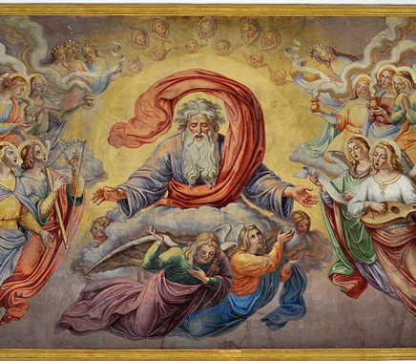
St. Thomas Aquinas: Five Ways
Common Criticisms
  “And this everyone understands to be God”
    Different from the personal God
    Not a complete view of God
    Important qualities
    Way of gradation
This Photo by Unknown Author is licensed under CC BY-SA
Notes:
B. “And this everyone understands to be God.”
1. Critics claim that the abstract, metaphysical cause proven in each Way is quite different from the conception of a personal, loving God.
2. Aquinas never claims the Ways give a complete view of God, which is why revelation is needed.
3. The Ways do provide arguments for His important qualities.
4. It could be argued that the Way of Gradation shows that a perfect being must be perfectly good, then the being would be loving and personal.

Slide 148
St. Thomas Aquinas: Religious Language
Problem
  How can finite and imperfect beings communicate about a perfect and infinite being?
  To say a finite person is X and to say God is X implies God and the person are both X in the same way
    But God’s qualities cannot be equated with the qualities of finite, imperfect beings.
  One approach is using terms equivocally
    X means one thing for finite, imperfect beings
    Another for God.
Notes:
Problem
1. How can finite and imperfect beings communicate about a perfect and infinite being?
2. To say a finite person is X and to say God is X would seem to imply that God and the person are both X in the same way, which seems incorrect because God’s qualities cannot be equated with the qualities of finite, imperfect beings.
3. One approach is to use terms equivocally-X means one thing for finite, imperfect beings, another for God.

Slide 149
St. Thomas Aquinas: Religious Language
Aquinas’s View
  All knowledge comes from experience
    The meanings of all terms must be grounded in experience.
  We lack direct experience of God
    So we cannot use terms that apply to God alone.
  As humans are created in the image of God, there is some degree of similarity.
Notes:
B. Aquinas’s View
1. All knowledge comes from experience so the meanings of all terms must be grounded in experience.
2. We lack direct experience of God, so we cannot use terms that apply to God alone.
3. Since humans are created in the image of God, there is some degree of similarity.

Slide 150
St. Thomas Aquinas: Religious Language
Aquinas’s Negative Solution
  God can be spoken of by negating properties possessed by finite and imperfect beings.
  Examples:
    God is immutable (changeless)
    Eternal (not limited by time)
    Perfect (lacking in defect)
  Not sufficient to define something in terms of what it is not, to adequately speak of God we must be able to say what He is.
Aquinas’s Positive Solution
  Uses the method of analogy, assuming humans are like God.
  One begins with something that one directly knows and then uses an analogy to extend this to God.
  Example: by knowing a wise person, one can extend knowledge of wisdom to an understanding of God’s wisdom.
Notes:
C. Aquinas’s Negative Solution
1. This view was used by earlier thinkers and was favored by the mystics.
2. God can be spoken of by negating properties possessed by finite and imperfect beings.
3. Examples: God is immutable (changeless), eternal (not limited by time), perfect (lacking in defect).
4. He accepted that it was not sufficient to define something in terms of what it is not, thus to adequately speak of God we must be able to say what He is.
D. Aquinas’s Positive Solution
1. He uses the method of analogy and assumes that humans are like God.
2. One begins with something that one directly knows and then uses an analogy to extend this to God.
3. For example, by knowing a wise person, one can extend this knowledge of wisdom to an understanding of God’s wisdom.

Slide 151
St. Thomas Aquinas: Moral Philosophy
Teleological Ethics
  Nicomachean Ethics
    Christian modification
    Each event occurs because of an end towards which it directed.
    Humans have ends and inclinations and are the only earthly beings that can consciously chose to act towards them.
    Ethics: determining which ends are worthy of human pursuit.
    Actions
    All actions are good or bad
    Choice
    Intellectualism
Notes:
A. Nicomachean Ethics
1. His moral theory is a Christian modification of Aristotle’s ethics.
2. Each event occurs because of an end towards which it directed.
3. Humans have ends and inclinations and are the only earthly beings that can consciously chose to act towards these ends and inclinations.
4. Ethics deals with determining which ends are worthy of human pursuit.
5. The moral good is a fulfillment of the natural end of humans.
6. Evil is a lack.

Slide 152
St. Thomas Aquinas: Moral Philosophy
Teleological Ethics
  Nicomachean Ethics
    Christian modification
    Each event occurs because of an end towards which it directed.
    Humans have ends and inclinations and are the only earthly beings that can consciously chose to act towards them.
    Ethics: determining which ends are worthy of human pursuit.
    The moral good is a fulfillment of the natural end of humans.
    Evil is a lack.
Notes:
A. Nicomachean Ethics
1. His moral theory is a Christian modification of Aristotle’s ethics.
2. Each event occurs because of an end towards which it directed.
3. Humans have ends and inclinations and are the only earthly beings that can consciously chose to act towards these ends and inclinations.
4. Ethics deals with determining which ends are worthy of human pursuit.
5. The moral good is a fulfillment of the natural end of humans.
6. Evil is a lack.

Slide 153
St. Thomas Aquinas: Moral Philosophy
Teleological Ethics
  Nicomachean Ethics
    Christian modification
    Each event occurs because of an end towards which it directed.
    Humans have ends and inclinations and are the only earthly beings that can consciously chose to act towards them.
    Ethics: determining which ends are worthy of human pursuit.
    The moral good is a fulfillment of the natural end of humans.
    Evil is a lack.
Notes:
A. Nicomachean Ethics
1. His moral theory is a Christian modification of Aristotle’s ethics.
2. Each event occurs because of an end towards which it directed.
3. Humans have ends and inclinations and are the only earthly beings that can consciously chose to act towards these ends and inclinations.
4. Ethics deals with determining which ends are worthy of human pursuit.
5. The moral good is a fulfillment of the natural end of humans.
6. Evil is a lack.

Slide 154
St. Thomas Aquinas: Moral Philosophy
Actions
  All genuine actions are good or bad
    There are no morally neutral actions.
  All chosen actions always seek an end that will be either good or bad.
  The intellect is primary in ethics:
    Only chosen, deliberate actions have moral qualities.
  The will desires what is good
    Reason is needed to determine what is good and the means for achieving it.
Notes:
B. Actions
1. All genuine actions are good or bad-there are no morally neutral actions.
2. This is because all chosen actions always seek an end that will be either good or bad.
3. The intellect is primary in ethics: Only chosen, deliberate actions have moral qualities.
4. The will desires what is good but reason is needed to determine what is good and the means for achieving it.

Slide 155
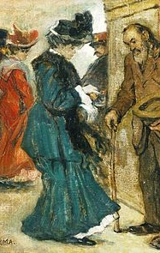
St. Thomas Aquinas: Moral Philosophy
Humans Actions vs. Acts of Humans
  Human actions: voluntary, consciously willed
    Are good or bad
  Acts of humans: unconscious or involuntary
    Morally neutral
Factors of Moral Assessment
  The object of the action.
  The circumstances of the action.
  The end of the action.
  Alms example
This Photo by Unknown Author is licensed under CC BY-SA
Notes:
C. Human Actions vs. Acts of Humans
1. Human actions are voluntary, consciously willed actions chosen because the individual’s reason is seeking a specific end.
2. Human actions are good or bad.
3. Acts of humans are unconscious or involuntary behaviors.
4. Acts of humans are morally neutral.
C. Factors of Moral Assessment
1. The object of the action.
2. The circumstances of the action.
3. The end of the action.
4. Aquinas uses an example of the giving of alms.
a. The object is to give money to one who is in need.
b. The circumstances would include such things as the origin of the money, the needs of the recipient, etc.
c. The end is the goal of the action, such as to help one in need or to be praised for generosity, or to get a tax break.

Slide 156
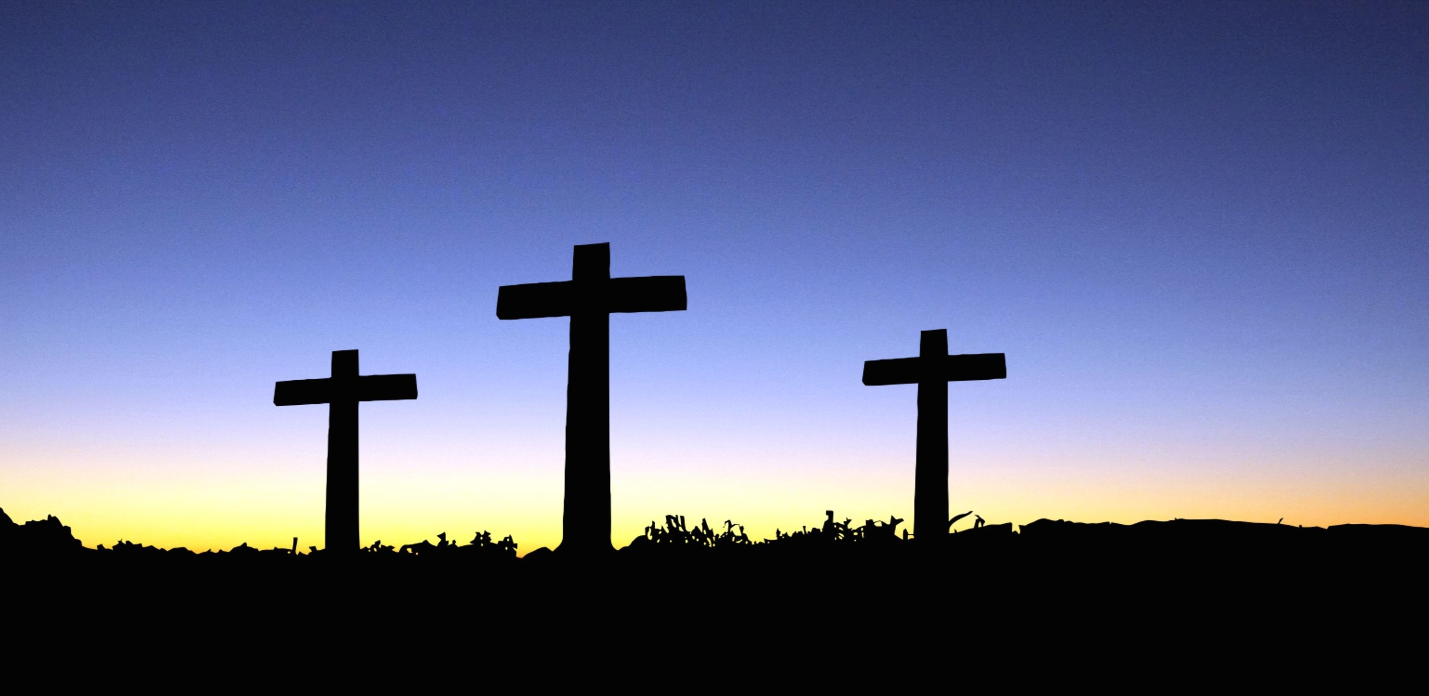
St. Thomas Aquinas: Moral Philosophy
Christian Modification
  Aristotle:
    Humans have a special role as rational beings
    God does not play any role in his theory.
  Aristotle: a natural ethical theory built on achieving imperfect and temporal happiness on earth.
  Humans long for the perfect good, which is not to be found in the imperfect realm of the natural world.
  Aquinas: nature doesn’t provide a means of satisfying one’s spiritual nature.
  The supreme good can only be found in God.
  This supreme good is not acquired by merely having intellectual knowledge of God but by acquaintance with God.
  Acquaintance is not possible in life, so our natural desire for ultimate happiness indicates there must be an afterlife.
Notes:
D. Christian Modification
1. Aristotle’s theory places humans in a special role as rational beings, but God does not play any role in his theory.
2. Aquinas held that Aristotle provided a natural ethical theory built on achieving imperfect and temporal happiness on earth.
3. Aquinas claims that humans long for the perfect good, which is not to be found in the imperfect realm of the natural world.
4. Aquinas claims that nature does not provide us with a means of satisfying one’s spiritual nature.
5. The supreme good can only be found in God.
6. This supreme good is not acquired by merely having intellectual knowledge of God but by acquaintance with God.
7. This acquaintance is not possible in this life, thus our natural desire for ultimate happiness indicates that there must be an afterlife.

Slide 157
St. Thomas Aquinas: Moral Philosophy
Natural Law
  Since humans were created by God to live a certain way, reflection on human nature reveals guidelines for actualizing human potentialities.
  As human nature remains the same across cultures and time, the rules of the natural law are universal and self-evident.
  What is good is what is in accord with reason
    This is conformity to the natural law.
  By reflecting on human nature and natural inclinations, he could infer moral principles.
Natural Morality
  All creatures naturally tend to preserve their own life
    Murder and suicide is wrong because “life is to be preserved.”
  All animals seek to preserve their species and protect their children.
    For humans this includes helping the young develop their full potential.
  Being above animals, humans are inclined to fully develop their rational, human potential.
    This leads to the duty to seek truth and to follow the rules needed to live in society.
Notes:
A. Natural Law
1. Since humans were created by God to live a certain way, reflection on human nature can reveal guidelines for actualizing human potentialities.
2. As human nature remains the same across cultures and time, the rules of the natural law are universal and self-evident.
3. What is good is what is in accord with reason-this is conformity to the natural law.
4. He reasoned that by reflecting on human nature and natural inclinations, he could infer moral principles.
B. Natural Morality
1. All creatures naturally tend to preserve their own life, hence murder and suicide is wrong because “life is to be preserved.”
2. All animals seek to preserve their species and protect their children.
a. For humans this includes helping the young develop their full potential.
3. Being above animals, humans are inclined to fully develop their rational, human potential.
a. This leads to the duty to seek truth and to follow the rules needed to live in society.

Slide 158
St. Thomas Aquinas: Moral Philosophy
Disagreement
  Natural law is universal and self evident, disagreements arise because some are blinded by passions, bad habits, and ignorance.
  People do not see the natural law because of limits and defects.
  Conscience: the rational activity of applying moral knowledge to specific cases.
  “Every will at variance with reason, whether right or erring, is always evil.”
  People are obligated to follow their informed conscience as well as possible.
  If one is mistaken, one is still judged by how well they followed the moral light as they saw it.
Notes:
B. Disagreement
1. Given that natural law is both universal and self evident, disagreements arise because some are blinded by passions, bad habits, and ignorance.
2. People who do not see the natural law fail to do so because of limits and defects.
3. The conscience is the rational activity of applying moral knowledge to specific cases.
4. “Every will at variance with reason, whether right or erring, is always evil.”
5. People are obligated to follow their informed conscience as well as possible.
6. If one is mistaken, one is still judged by how well they followed the moral light as they saw it.

Slide 159
St. Thomas Aquinas: Moral Philosophy
The Four Laws
  Metaphysics
    Moral law is an expression of God’s eternal law
    Not arbitrary
      Result of His reason which is grounded in His nature.
  Eternal Law
    Rational order established by God
    All things follow this law
    Non-rational beings simply obey
    Humans can disobey the moral aspects of the law
Notes:
III The Four Laws
A. Metaphysics
1. The moral law in our nature is an expression of God’s eternal law.
2. The moral law is not an arbitrary creation of God’s will but is the result of His reason which is grounded in His nature.
a. Since God is not arbitrary, neither is the moral law.
3. There are four ways in which God’s law is manifested.
B. Eternal Law
1. The rational order God established for His created world.
2. All things follow this law.
3. Non-rational beings simply follow the law.
4. Humans can choose to obey or disobey the moral aspects of the law.
C. Natural Law
1. Law available to reason that regulates human moral behavior.
2. This law guides humans insofar as they are natural and social beings.
3. It leads humans to develop the Aristotelian model of virtue by developing the classic virtues of temperance, courage, and justice.
D. Divine Law
1. Known by revelation.
2. Goes beyond the natural law and guides humans towards eternal happiness.
3. In following this law, the natural virtues are exceeded by the theological virtues of faith, hope and love.
4. These virtues are only attained by God’s grace.
E. Human Law
1. Laws created by humans.
2. “In temporal law there is nothing just and lawful but what man has drawn from the eternal law.”

Slide 160

St. Thomas Aquinas: Moral Philosophy
  Natural Law
    Law available to reason that regulates human moral behavior
    Guides humans insofar as they are natural and social beings.
    Leads humans to develop the Aristotelian model of virtue by developing the classic virtues
      Temperance
      Courage
      Justice.
This Photo by Unknown Author is licensed under CC BY-NC-ND
Notes:
C. Natural Law
1. Law available to reason that regulates human moral behavior.
2. This law guides humans insofar as they are natural and social beings.
3. It leads humans to develop the Aristotelian model of virtue by developing the classic virtues of temperance, courage, and justice.
D. Divine Law
1. Known by revelation.
2. Goes beyond the natural law and guides humans towards eternal happiness.
3. In following this law, the natural virtues are exceeded by the theological virtues of faith, hope and love.
4. These virtues are only attained by God’s grace.
E. Human Law
1. Laws created by humans.
2. “In temporal law there is nothing just and lawful but what man has drawn from the eternal law.”

Slide 161
St. Thomas Aquinas: Moral Philosophy
Divine Law
  Known by revelation.
  Goes beyond natural law, guides humans towards eternal happiness.
  In following this law, natural virtues are exceeded by theological virtues:
    Faith
    Hope
    Love.
  These virtues are only attained by God’s grace.
Human Law
  Laws created by humans.
  “In temporal law there is nothing just and lawful but what man has drawn from the eternal law.”

Slide 162
St. Thomas Aquinas: Political Philosophy
Background
1. Between Augustine and Aquinas there was little work done in political philosophy.
2. Neo-Platonism’s dominance led thinkers to focus mainly on metaphysics and logic.
3. The availability of Aristotle’s works renewed interest in political philosophy.
4. Political systems were more stable and civilization flourished, making political philosophy of greater concern.
Notes:
A. Background
1. Between Augustine and Aquinas there was little work done in political philosophy.
2. Neo-Platonism’s dominance led thinkers to focus mainly on metaphysics and logic.
3. The availability of Aristotle’s works renewed interest in political philosophy.
4. Political systems were more stable and civilization flourished, making political philosophy of greater concern.

Slide 163
St. Thomas Aquinas: Political Philosophy
B. Law
1. His focus is on the nature of political laws.
2. Law: “an ordinance of reason for the common good, promulgated by him who has care of the community.”
3. Some laws aim at enforcing and elaborating the natural laws and should be the same everywhere.
4. Other laws are created to fill in details left open by the natural law.
5. All human laws draw their validity from the natural law.
6. A human law that violates the natural law is not a genuine law and does not command obedience.
7. In some cases it is the lesser evil to obey an invalid law, while in other cases civil disobedience against an invalid law is necessary.
Notes:
B. Law
1. His focus is on the nature of political laws.
2. Law: “an ordinance of reason for the common good, promulgated by him who has care of the community.”
3. Some laws aim at enforcing and elaborating the natural laws and should be the same everywhere.
4. Other laws are created to fill in details left open by the natural law.
5. All human laws draw their validity from the natural law.
6. A human law that violates the natural law is not a genuine law and does not command obedience.
7. In some cases it is the lesser evil to obey an invalid law, while in other cases civil disobedience against an invalid law is necessary.

Slide 164
St. Thomas Aquinas: Political Philosophy
C. Extent of the Law
1. Attempts to make all immorality illegal would fail because human nature would make this impossible.
2. Law should be concerned mainly with major evils, such as those that inflict harm and undermine an ordered society.
3. Human laws should thus focus on justice as it relates to relations between people.
4. Human laws should not regulate the spiritual community and private morality.
Notes:
C. Extent of the Law
1. Attempts to make all immorality illegal would fail because human nature would make this impossible.
2. Law should be concerned mainly with major evils, such as those that inflict harm and undermine an ordered society.
3. Human laws should thus focus on justice as it relates to relations between people.
4. Human laws should not regulate the spiritual community and private morality.

Slide 165
St. Thomas Aquinas: Political Philosophy
D. Civil Law
1. Civil society is natural and does not require any justification.
2. His view matches that of the Greeks but disagrees with Augustine who regarded society as a necessary evil.
3. His view also disagrees with the common view in the Enlightenment, namely that society is artificial.
4. “In the state of innocence humans would have led a social life.”
5. Any society requires some sort of governance and someone to look out for the common good, so human nature makes government a necessity.
6. Any specific government or leader does need to be justified.
Notes:
D. Civil Law
1. Civil society is natural and does not require any justification.
2. His view matches that of the Greeks but disagrees with Augustine who regarded society as a necessary evil.
3. His view also disagrees with the common view in the Enlightenment, namely that society is artificial.
4. “In the state of innocence humans would have led a social life.”
5. Any society requires some sort of governance and someone to look out for the common good, so human nature makes government a necessity.
6. Any specific government or leader does need to be justified.

Slide 166
St. Thomas Aquinas: Political Philosophy
E. Ideal State
1. A combination of different elements.
2. Has one ruler, whose power is balanced by other governing bodies, all selected by the will of the will of the people.
Notes:
E. Ideal State
1. A combination of different elements.
2. Has one ruler, whose power is balanced by other governing bodies, all selected by the will of the will of the people.

Slide 167
Aquinas, Platonism & Science
Rejection of Platonic Dualism
  The World.
  Like Neo-Platonists: nature is a continuous spectrum from the lowest to the highest.
  Rejects the Platonist view that the physical world is an inferior shadow of the true reality.
  The physical world is linked to the spiritual because the chain of being leads down from God.
    Supports the biblical notion that creation is good.
The Body
  In contrast to the Platonist Christianity, he did not regard the body as a prison for the soul.
  The body is important to knowledge.
  The body is what makes individuals unique.
  Humans are spiritual beings with an eternal fate and natural beings.
Impact
  By making the physical world important he provided a foundation for human culture in a way that Augustine did not.
Notes:
I Rejection of Platonic Dualism
A. The World.
1. Like the Neo-Platonists he took nature to be a continuous spectrum from the lowest to the highest.
2. He rejects the Platonist view that the physical world is an inferior shadow of the true reality.
3. The physical world is linked to the spiritual because the chain of being leads down from God.
a. This supports the biblical notion that creation is good.
B. The Body
1. In contrast to the Platonist Christianity, he did not regard the body as a prison for the soul.
2. The body is important to knowledge.
3. The body is what makes individuals unique.
4. Humans are both spiritual beings with an eternal fate as well as natural beings.
C. Impact
1. By making the physical world important he provided a foundation for human culture in a way that the Augustinian view did not.

Slide 168
Aquinas, Platonism & Science
Science & Theology
  Problem
    Science explains events in terms of physical causes.
    Nature is governed by God, as per his fifth way.
  Dual Causality
    Uses Aristotle’s conception of different types of causes.
  The same effect is ascribed to a natural cause and God not as if each were partial causes but as each producing the entire effect.
  Uses the analogy to an effect ascribed to an instrument and the “principal agent.”
  Natural events can be explained in terms of natural causes without abandoning the view that God governs the world.
  The properties and laws of the natural world are the immediate causes of natural events
    But God created them to implement His will.
  This reconciliation was important for thinkers of the modern era who were Christians and scientists.
Notes:
II Science & Theology
A. Problem
1. Science explains events in terms of physical causes.
2. Nature is governed by God, as per the fifth way.
B. Dual Causality
1. He makes use of Aristotle’s conception of different types of causes.
2. The same effect is ascribed to a natural cause and God not as each were partial causes but as each producing the entire effect.
3. He uses the analogy to an effect ascribed to an instrument and the “principal agent.”
4. Natural events can be explained in terms of natural causes without abandoning the view that God governs the world.
5. The properties and laws of the natural world are the immediate causes of natural events, but it is God who created them to implement His will.
6. This reconciliation proved to be very important for the thinkers of the modern era who were Christians and scientists.

Slide 169
Aquinas, Platonism & Science
Aristotelian Science
  Explained things in teleological terms.
  All of nature aims at ends ordained by God.
  Provides inadequate explanations.
  Emphasis on essences entailed nature is explained in terms of logical and eternal relationships rather than temporal and causal ones.
  Development of science required moving away from determining how the purposes and ends of natural beings worked in God’s plan.
Notes:
C. Aristotelian Science
1. Explained things in teleological terms.
2. All parts of nature aimed at ends ordained by God.
3. This is regarded as providing inadequate explanations.
4. The emphasis on essences entailed that nature was explained in terms of logical and eternal relationships rather than temporal and causal ones.
5. The development of science required moving away from the focus on determining how the purposes and ends of natural beings worked in God’s plan.

Slide 170
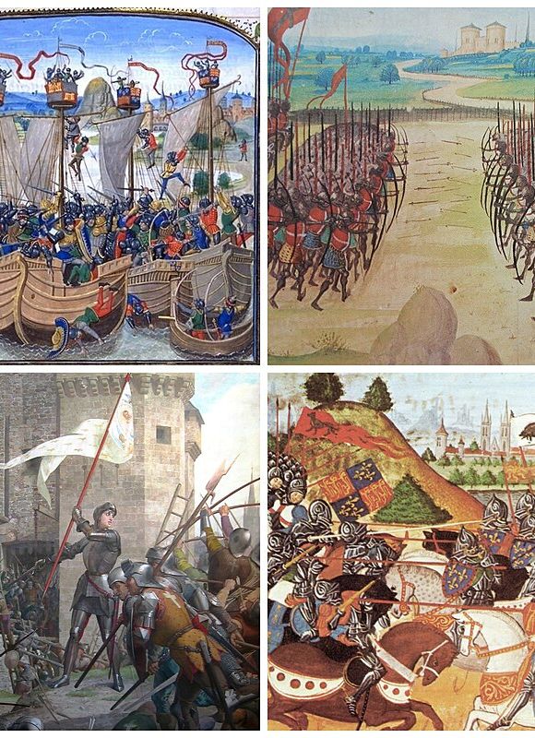
End of the Middle Ages: Background
Social and Political Situation
  Problems within the church
  The papacy declined due to tarnishing of the church by popes and cardinals.
Excesses in wealth and privilege of the church lead to
  Calls for reform
  Some turned from the Church towards individual piety.
Criticisms byJohn Wyclif in England and John Huss in Bohemia revealed the unrest leading to the Reformation.
The Great Schism of 1378-1415:
  Two popes
  A French Pope in Avignon
  An Italian pope in Rome.
Notes:
Social and Political Situation
A. Problems within the church
1. The spiritual prestige and political power of the papacy had declined due to tarnishing of the church by popes and cardinals.
2. The excesses in wealth and privilege of the church lead many to call for reform and others to turn from the Church towards individual piety.
3. Criticisms put forth by John Wyclif in England and John Huss in Bohemia showed the beginnings of the unrest that would result in the Reformation.
4. The Great Schism of 1378-1415: there were two popes, a French one in Avignon and an Italian pope in Rome.

Slide 171
End of the Middle Ages: Background
Church and State
  The Church thrived for centuries as an organized power amidst relatively weak states.
  As secular states grew stronger, they became more autonomous from the Church.
  Aristotle’s view the state is a natural entity justified on moral and rational grounds rather than receiving its authority from God weakened the theoretical underpinnings of the Church’s power.
States
  The Hundred Years War between England and France contributed to nationalism.
  Economic unrest and social upheaval were common
    Peasant revolts of France and England.
  Emphasis on royal sovereignty resulted in strong monarchies in France, England and Spain.
  As state sovereignty increased, the power of the Church diminished.

Slide 172
End of the Middle Ages: Background
Three Pillars
Medieval life was built on three pillars
  Hierarchy
  Authority
  Unity
These pillars were crumbling.
Notes:
D. The Three Pillars
1. Medieval life was built on the pillars of hierarchy, authority and unity.
2. These pillars were crumbling.

Slide 173
End of the Middle Ages: Philosophy
A. The move from Scholasticism
1. Many influential thinkers of the 14th century began to move away from Scholasticism.
2. Their criticisms were presented from within their Christian faith.
3. They were convinced that faith would be best served by freeing it from the influence of philosophy.
4. These thinkers placed a significant emphasis on the omnipotence of God.
5. God was regarded as being free and beyond the ken of reason.
6. This movement resulted in antirationalism, nominalism, a loss of confidence in natural theology, voluntarism, and a new method of science.
Notes:
A. The move from Scholasticism
1. Many influential thinkers of the 14th century began to move away from Scholasticism.
2. Their criticisms were presented from within their Christian faith.
3. They were convinced that faith would be best served by freeing it from the influence of philosophy.
4. These thinkers placed a significant emphasis on the omnipotence of God.
5. God was regarded as being free and beyond the ken of reason.
6. This movement resulted in antirationalism, nominalism, a loss of confidence in natural theology, voluntarism, and a new method of science.

Slide 174
End of the Middle Ages: Background
B. Antirationalism
1. Aquinas took God to be all powerful but defined this as His ability to do anything logically possible.
2. His critics claimed that the realm of possibility is far larger than Aquinas imagined.
3. They claimed reason is not capable of discerning how the world is or must be.
4. Some became empiricists and others became mystics because of their view of the limits of reason.
Notes:
B. Antirationalism
1. Aquinas took God to be all powerful but defined this as His ability to do anything logically possible.
2. His critics claimed that the realm of possibility is far larger than Aquinas imagined.
3. They claimed reason is not capable of discerning how the world is or must be.
4. Some became empiricists and others became mystics because of their view of the limits of reason.

Slide 175
End of the Middle Ages: Background
C. Nominalism
1. Universals were looked on with suspicion.
2. The reality of concrete individuals was accepted.
D. Confidence in natural theology declined
1. The existence of God and the immortality of the soul cannot be definitively proven via reason.
2. Such matters can only be known via revelation and faith.
Notes:
C. Nominalism
1. Universals were looked on with suspicion.
2. The reality of concrete individuals was accepted.
D. Confidence in natural theology declined
1. The existence of God and the immortality of the soul cannot be definitively proven via reason.
2. Such matters can only be known via revelation and faith.

Slide 176
End of the Middle Ages: Background
E. Voluntarism
1. Became the standard for ethics.
2. The will has priority over the intellect.
3. If God’s intellect does not restrict his will, then he is free to choose what is and is not morally good.
4. Human reason cannot determine what is or is not good since God could make anything good or evil.
5. Moral obligation is not based on following the directions of reason but simply obeying God without question.
Notes:
E. Voluntarism
1. Became the standard for ethics.
2. The will has priority over the intellect.
3. If God’s intellect does not restrict his will, then he is free to choose what is and is not morally good.
4. Human reason cannot determine what is or is not good since God could make anything good or evil.
5. Moral obligation is not based on following the directions of reason but simply obeying God without question.

Slide 177
End of the Middle Ages: Background
F. New approach to science
1. God was not guided by any forms in His creation-it resulted from his will.
2. Thus, the world is contingent-there is no necessity in things.
3. Metaphysical speculation cannot reveal what God decided to create.
4. Only empirical observations can reveal what God has decided to create.
Notes:
F. New approach to science
1. God was not guided by any forms in His creation-it resulted from his will.
2. Thus, the world is contingent-there is no necessity in things.
3. Metaphysical speculation cannot reveal what God decided to create.
4. Only empirical observations can reveal what God has decided to create.

Slide 178
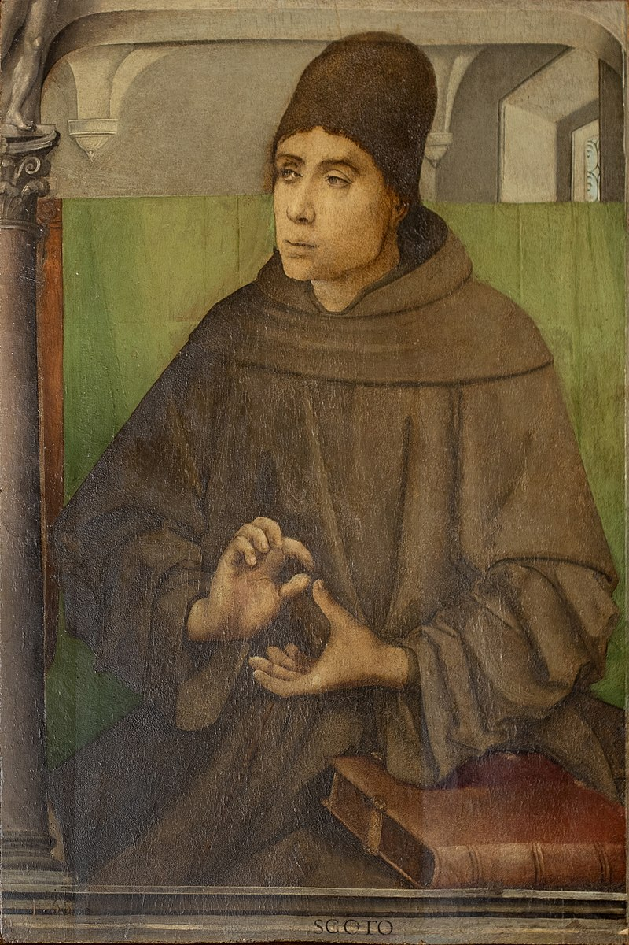
John Dun Scotus: Background
Life
  1266-1308
  “Scotus” means “the Scot.”
  Only those in Scotland were called “Scots.”
    The Irish were no longer known as “Scots.”
  In the Franciscan order.
  Studied at Oxford and Paris.
  Lectured and wrote at Oxford, Paris and Cologne.
Notes:
I Background
A. Life
1. Born around 1266 in Scotland and died in 1308.
a. “Scotus” means “the Scot.”
b. During this time only those in Scotland were called “Scots.”
c. The Irish were no longer known as “Scots.”
2. Was in the Franciscan order.
3. Studied at Oxford and Paris.
4. Lectured and wrote at Oxford, Paris and Cologne.

Slide 179
John Dun Scotus: Background
Works
  Some works have been established as his
  Others attributed to him have been shown to not be his.
  Others are still in dispute.
His works are difficult to read
  Poor writing skills
  Challenging and subtle arguments.
  Known as Doctor Subtilis (“The Subtle Doctor”)
Dunsmen
  He had many followers called “Dunsmen” or “dunces.”
  They and their Scholasticism were seen as barriers to intellectual enlightenment and progress by the Renaissance humanists.
  “Dunce” means “a dull, ignorant person.”

Slide 180
John Dun Scotus: Epistemology
Scotus and Aquinas
  Agrees with Aquinas there can be no conflict between truths of faith and truths of reason.
  Uses philosophical reasoning to defend his view.
  His sphere of reason is more restricted than that of Aquinas.
  His studies in mathematics lead him to a strict view of what counts as a proof
    Many of Aquinas’ arguments did not meet this standard.
  Agreed with Aquinas the Trinity is not subject to rational proof.
  Went beyond Aquinas: only faith can yield certainty in many matters relating to:
    God’s nature
    Divine providence
    Immortality of the soul.
Notes:
A. Scotus and Aquinas
1. He agrees with Aquinas that there can be no conflict between truths of faith and truths of reason.
2. He also uses philosophical reasoning to defend his view.
3. His sphere of reason is significantly more restricted than that of Aquinas.
4. His studies in mathematics lead him to adopt a strict view of what counts as a proof and many of Aquinas’ arguments did not meet this standard.
5. He agreed with Aquinas that the Trinity is not subject to rational proof.
6. He went beyond Aquinas by claiming that only faith can yield certainty in many matters relating to God’s nature, divine providence and the immortality of the soul.

Slide 181
John Dun Scotus: Epistemology
Philosophy & Theology
  Are completely different fields.
  Philosophy is a theoretical discipline.
  The knowledge sought in theology is practical.
  Placing such limits on reason was the first step in unraveling the Scholastic synthesis of faith and reason.
Notes:
B. Philosophy & Theology
1. Are completely different fields.
2. Philosophy is a theoretical discipline.
3. The knowledge sought in theology is practical.
4. His placing such limits on reason was the first step in the unraveling of the Scholastic synthesis of faith and reason.

Slide 182
John Dun Scotus: Metaphysics
Universals
  Contrary to the realists, he claims that only individuals exist.
  Contrary to nominalists, he claims universals have some objective existence.
  Similar to Aquinas.
Notes:
A. Universals
1. Contrary to the realists, he claims that only individuals exist.
2. Contrary to the nominalists, he claims that universals have some objective existence.
3. On these points he is similar to Aquinas.

Slide 183
John Dun Scotus: Metaphysics
Individuals
  Aquinas: matter served to individuate things.
  Scotus: Since matter is indefinite potentiality, it cannot individuate concrete particulars.
  Scotus: Since matter was so indefinite, it could not be an object of knowledge.
  Scotus holds to Aristotle’s assumption that one can only know forms.
  If we can know a particular, then a form must constitute it.
  Inherent in universal nature (essence/whatness) is the individual nature (thisness).
    Haecceitas-Latin term for this individuating difference.
  For an X thing, a, there is the universal form of X that makes all Xs X and there is also a form a that makes a an individual.
  The form X does not exist apart from the form a, but they can be distinguished in a formal way by reason.
  This combination of the Greek conception of universals with an emphasis on individuality was a step away from the Medieval metaphysics.
Notes:
B. Individuals
1. Aquinas held that matter served to individuate things.
2. Scotus argued that since matter is indefinite potentiality, it cannot serve as the basis for individuating concrete particulars.
3. Scotus argued that since matter was so indefinite, it could not be an object of knowledge.
4. Scotus holds to Aristotle’s assumption that one can only know forms.
5. So if we can know a concrete particular, then a form must constitute it.
6. Inherent in the universal nature (essence or whatness) is the individual nature (thisness).
a. Haecceitas-Latin term for this individuating difference.
7. For an X thing, say a, there is the universal form of X that makes all Xs X and there is also a form a that makes a an individual.
8. The form X does not exist apart from the form a, but they can be distinguished in a formal way by reason.
9. This combination of the Greek conception of universals with an emphasis on individuality was an early step away from the Medieval metaphysics.

Slide 184
John Dun Scotus: Natural Theology
Aquinas & Scotus
  Accepts Aquinas’ view that proofs must be based on empirical evidence.
  Quetsions the certainty of most Thomistic proofs.
  Example: Agrees that the Way of Motion proves the existence of a first mover, but
    Claims any proof based in the physical world cannot go beyond that world.
    The Way limits us to the world of motion and does not prove there is a necessary divine being who causes all other beings.
  He reconstructs the arguments based on efficient causes and contingency.
Aquinas & Anselm
  Thinks Anselm’s argument is useful, but it needs a premise stating a necessary being is possible.
  Only some “persuasive considerations” can be given as evidence for the possibility of a necessary being.
  This makes it an empirical and probabilistic argument rather than an a priori argument.
  He saw the theistic arguments as weaker than Aquinas and Anselm believed since they were probabilistic.
Notes:
A. Aquinas & Scotus
1. He seems to accept Aquinas’ view that such proofs must be based on empirical evidence.
2. He does question the certainty of most Thomistic proofs.
3. Example: He agrees that the Way of Motion proves the existence of a first mover, but
a. He claims that any proof based in the physical world cannot go beyond that world.
b. The Way limits us to the world of motion and does not prove there is a necessary divine being who causes all other beings.
4. He does reconstruct the arguments based on efficient causes and contingency.
B. Aquinas & Anselm
1. He thinks Anselm’s argument is useful, but that it needs a further premise that states that a necessary being is possible.
2. But, only some “persuasive considerations” can be given as evidence for the possibility of a necessary being.
3. This makes it an empirical and probabilistic argument rather than an a priori argument that is certain.
4. He thus regards theistic arguments to be weaker than Aquinas and Anselm believed since they were probabilistic.

Slide 185
John Dun Scotus: Metaphysics
Immortality
  Aquinas: the soul necessarily survived bodily death.
  Scotus: this is a matter of probability and not certainty.
  God could have created the soul so that it would perish with the body.
  It is reasonable, but cannot be proved with certainty, that the soul is immortal.
  The immortality of the soul can be known with certainty via faith.
Notes:
C. Immortality
1. Aquinas held that the soul necessarily survived bodily death.
2. Scotus argues that this is a matter of probability and not certainty.
3. God could have created the soul so that it would perish with the body.
4. It is reasonable, but cannot be proved with certainty, that the soul is immortal.
5. However, the immortality of the soul can be known with certainty via faith.

Slide 186
John Dun Scotus: Moral Philosophy
The Will & Intellect
  Aquinas saw the intellect as the higher and nobler aspect of the soul.
  Scotus saw the will as the higher and nobler aspect of the soul.
Scotus’ Arguments for the will
  Knowledge is an instrument of the will.
    The intellect provides the will with information and alternatives.
    The will chooses between them.
  The will can move the intellect: we can choose what we will think about.
  The will is free and cannot be determined by anything, even the intellect.
    Aquinas held the Greek view that we necessarily will what we regard as the highest good.
    Scotus: the will is not determined by knowledge of the good but chooses the good only as the result of a free decision.
  The intellect is determined by the object of knowledge
  The will can accept or reject what is before it.
  “The total cause of willing is in the will itself.”
Notes:
A. The Will & Intellect
1. Aquinas regarded the intellect as the higher and nobler aspect of the soul.
2. Scotus regarded the will as the higher and nobler aspect of the soul.
B. Scotus’ Arguments for the will
1. Knowledge is an instrument of the will.
a. The intellect provides the will with information and alternatives.
b. The will chooses between them.
2. The will can move the intellect: we can choose what we will think about.
3. The will is free and cannot be determined by anything, even the intellect.
a. Aquinas held the Greek view that we necessarily will what we regard as the highest good.
b. Scotus claims the will is not determined by knowledge of the good, but chooses the good only as the result of a free decision.
4. The intellect is determined by the object of knowledge while the will can accept or reject what is before it.
5. “The total cause of willing is in the will itself.”

Slide 187
John Dun Scotus: Moral Philosophy
Voluntarism
  Aquinas: eternal blessedness is found in contemplating God.
    Intellectualism.
  Scotus’s: eternal blessedness is found in the love of God, an act of will uniting one with God.
Voluntarism & Morality
  Aquinas: morality is based on a natural inclination to seek happiness.
  Scotus: morality might require actions that interfere with one’s own happiness.
  Moral obligations depend only on God’s commands and not on human happiness.
  Aquinas: the moral law could be found by the study of human nature.
  Scotus: there was no natural way to determine the moral truths.
Notes:
C. Voluntarism
1. Aquinas held eternal blessedness is found in contemplating God because of his intellectualism.
2. Scotus’s held that eternal blessedness is found in the love of God, an act of will uniting one with God.
D. Voluntarism & Morality
1. Aquinas held that morality was based on a natural inclination to seek happiness.
2. Scotus held that morality might require actions that interfere with one’s own happiness.
3. Moral obligations depend only on God’s commands and not on human happiness.
4. Aquinas held that the moral law could be found by the study of human nature.
5. Scotus held that there was no natural way to determine the moral truths.

Slide 188
John Dun Scotus: Moral Philosophy
Voluntarism & God
  Gods actions are determined by His will and not His reason.
  He is free and omnipotent.
  Reason cannot know His purposes or infer His actions via a priori means.
  As everything is contingent on God’s will there is no rational necessity to the world and it could have been otherwise.
Argument
  If God’s choices were logically necessary, the details of the world could be determined by reason along the lines of a geometric proof.
  We cannot do this.
  Therefore, God was free in His act of creation and the created world is contingent.
Notes:
E. Voluntarism & God
1. Gods actions are determined by His will and not His reason.
2. This is because He is free and omnipotent.
3. Reason cannot know His purposes or infer His actions via a priori means.
4. As everything is contingent on God’s will there is no rational necessity to the world and it could have been otherwise.
5. Argument
a. If His choices were logically necessary, the details of the world could be determined by reason along the lines of a geometric proof.
b. We cannot do this.
c. Therefore, God was free in His act of creation and the created world is contingent.

Slide 189
John Dun Scotus: Moral Philosophy
Love of God
  The command to love God is the only moral law concerned with intrinsic good.
  All other actions are good because they are commanded by God.
Notes:
F. Love of God
1. The command to love God is the only moral law concerned with intrinsic good.
2. All other actions are good because they are commanded by God.

Slide 190
John Dun Scotus: Moral Philosophy
The Ten Commandments
  Scotus: the first set of commands in the Ten Commandments are rationally necessary moral truths.
  These commands include:
    Have no other gods than the one true God.
    Not make any graven images.
    Not take the Lord’s name in vain.
    Keep the Sabbath holy.
Scotus:
  These commands follow from God’s love of Himself
  It would be self-contradictory for Him to not make these commands.
  If there is a natural law, it is in those four commandments.
  The other six commandments are the result of His will and are not rationally necessary.
  They are to be obeyed because God commands them.
  God could have commanded their opposite.
Notes:
G. The Ten Commandments
1. Scotus claims that the first set of commands in the Ten Commandments are rationally necessary moral truths.
2. These commands include those to
a. Have no other gods than the one true God.
b. Not make any graven images.
c. Not take the Lord’s name in vain.
d. Keep the Sabbath holy.
3. Scotus argues that these commands follow from God’s love of Himself and it would be self-contradictory for him to not make these commands.
4. If there is a natural law, it is found in those four commandments.
5. The other six commandments are the result of His will and are not rationally necessary.
6. They are to be obeyed because God commands them and God could have commanded their opposite.

Slide 191
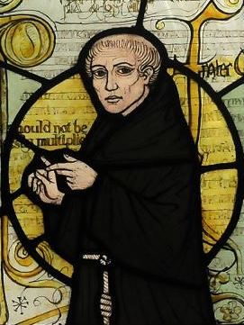
William of Ockham: Background
Born between 1280 and 1290 in the village of Ockham near London.
Joined the Franciscan order and studied at Oxford.
Never earned his master’s degree
  It was suspected he had accepted heretical doctrines.
1324-1328 : investigated by the papal court in Avignon, France.
While waiting, he wrote works on theology, philosophy and physics.
1327: involved in a controversy over St. Francis’s vow of poverty.
  Sided with the head of the Franciscan order who condemned the excesses of the papacy and who desired to return the Church to the simple lifestyle of St. Francis.
  b. 1328 : Pope John XXII was about to condemn their position, they fled and sought protection from Emperor Louis of Bavaria.
  Ockham: “Protect me with your sword and I will defend you with my pen.”
  Ockham and the others were excommunicated.
  Ockham moved to Munich and became more extreme, writing tracts against the Pope’s claim to temporal power.
Notes:
1280-1249
Born between 1280 and 1290 in the village of Ockham near London.
Joined the Franciscan order and studied at Oxford.
Never earned his master’s degree because it was suspected he had accepted heretical doctrines.
3. From 1324-1328 he was investigated by the papal court in Avignon, France.
a. While waiting, he wrote works on theology, philosophy and physics.
4. In 1327 he was involved in a controversy over the interpretation of St. Francis’s vow of poverty.
a. He sided with the head of the Franciscan order who condemned the excesses of the papacy and who desired to return the Church to the simple lifestyle practiced by St. Francis.
b. In 1328 it was evident that Pope John XXII was about to condemn their position, so they fled and sought protection from Emperor Louis of Bavaria.
c. Supposed Ockham said “Protect me with your sword and I will defend you with my pen.”
d. Ockham and the others were excommunicated.
e. Ockham moved to Munich and became more extreme, writing tracts against the Pope’s claim to temporal power.
5. He developed a political theory that pointed the way towards the secularization of politics.
6. After Louis died in 1347, there is some evidence Ockham sought reconciliation with Pope Clement VI.
7. It is believed he died of the black plague in 1349.
80-1349
Image: By self-created (Moscarlop) - Own work, CC BY-SA 3.0, https://commons.wikimedia.org/w/index.php?curid=5523066

Slide 192
William of Ockham: Background
He developed a political theory that pointed the way towards the secularization of politics.
After Louis died in 1347, there is some evidence Ockham sought reconciliation with Pope Clement VI.
It is believed he died of the black plague in 1349.
Notes:
1280-1249
Born between 1280 and 1290 in the village of Ockham near London.
Joined the Franciscan order and studied at Oxford.
Never earned his master’s degree because it was suspected he had accepted heretical doctrines.
3. From 1324-1328 he was investigated by the papal court in Avignon, France.
a. While waiting, he wrote works on theology, philosophy and physics.
4. In 1327 he was involved in a controversy over the interpretation of St. Francis’s vow of poverty.
a. He sided with the head of the Franciscan order who condemned the excesses of the papacy and who desired to return the Church to the simple lifestyle practiced by St. Francis.
b. In 1328 it was evident that Pope John XXII was about to condemn their position, so they fled and sought protection from Emperor Louis of Bavaria.
c. Supposed Ockham said “Protect me with your sword and I will defend you with my pen.”
d. Ockham and the others were excommunicated.
e. Ockham moved to Munich and became more extreme, writing tracts against the Pope’s claim to temporal power.
5. He developed a political theory that pointed the way towards the secularization of politics.
6. After Louis died in 1347, there is some evidence Ockham sought reconciliation with Pope Clement VI.
7. It is believed he died of the black plague in 1349.
80-1349
By self-created (Moscarlop) - Own work, CC BY-SA 3.0, https://commons.wikimedia.org/w/index.php?curid=5523066

Slide 193
William of Ockham: Themes
God’s Omnipotence
  He has a very rigorous concept of God’s omnipotence.
  He sees this as the supreme principle that must guide all thinking about the world.
  “I believe in God, father almighty; which I understand thus, that everything which does not involve a manifest contradiction is to be attributed to the divine power.”
  If God is omnipotent, then His act of creation was not guided by rational necessity and the world is contingent.
  On his view, X is contingent means that there is no logical contradiction in supposing either that X exists or X does not exist.
  Only experience can inform humans about the contents of the world and their qualities.
Notes:
I Guiding Themes
A. God’s Omnipotence
1. He has a very rigorous concept of God’s omnipotence.
2. He regards this as the supreme principle that must guide all thinking about the world.
3. “I believe in God, father almighty; which I understand thus, that everything which does not involve a manifest contradiction is to be attributed to the divine power.”
4. If God is omnipotent, then his act of creation was not guided by rational necessity and thus the world is contingent.
a. On his view, X is contingent means that there is no logical contradiction in supposing either that X exists or X does not exist.
5. So, only experience can inform humans about the contents of the world and their qualities.

Slide 194
William of Ockham: Themes
Empiricism
  Has a rigorous empiricism and rejecs going beyond experience by appealing to unnecessary hypothetical or speculative explanations.
  Ockham’s Razor: “What can be explained on fewer principles is explained needlessly by more.”
    It works as a razor by shaving away unnecessary principles and entities.
  Also known as the principle of parsimony or the principle of economy.
  Utilized the principle to argue the world can be explained without universals.
  Though the principle dates back to Aristotle, it followed from his austere view of what is necessary to explain the world.
  This principle played a role in the replacement of Aristotelian science by modern science.
Notes:
B. Empiricism
1. He has a very rigorous sort of empiricism and rejected going beyond experience by appealing to unnecessary hypothetical or speculative explanations.
2. Ockham’s Razor: “What can be explained on fewer principles is explained needlessly by more.”
a. It works as a razor by shaving away unnecessary principles and entities.
b. It is also known as the principle of parsimony or the principle of economy.
3. He utilized the principle to argue that the world can be explained without universals.
4. Though the principle dates back to Aristotle, it followed from his rather austere view of what is necessary to explain the world.
5. This principle played an important role in the replacement of Aristotelian science by the theories of modern science.

Slide 195
William of Ockham: Epistemology
Intuitive knowledge/Experimental knowledge
“Nothing can be naturally known in itself, unless it is known intuitively.”
  Intuition is whatever is directly evident to the mind.
  Intuitive knowledge includes
    The perception of external things
    The immediate awareness of one’s own inner states.
  Under normal conditions intuitive knowledge is directly related to its object and can indicate what does and does not exist.
Notes:
A. Intuitive knowledge/Experimental knowledge
1. “Nothing can be naturally known in itself, unless it is known intuitively.”
a. Intuition is whatever is directly evident to the mind.
2. Intuitive knowledge includes the perception of external things and the immediate awareness of one’s own inner states.
3. Under normal conditions intuitive knowledge is directly related to its object and can thus indicate what does and does not exist.

Slide 196
William of Ockham: Epistemology
Abstractive Knowledge
  Knowledge not related to an object of immediate experience and is derivative knowledge.
  Objects of immediate experience are retained in the mind as concepts/mental signs.
  Concepts can not prove existence since what formed a concept might no longer exist.
  Abstractive knowledge consists of memory of the object with the concrete details of its existence subtracted.
  Abstractive knowledge includes abstract ideas
    Ideas that refer to a class of individuals such as cats.
  Abstract ideas appear to be universals because they are vague representations that blur the details of specific individuals that caused the ideas.
  Abstract ideas lack metaphysical status and are not universals.
Notes:
B. Abstractive Knowledge
1. Knowledge not related to an object of immediate experience and hence is derivative knowledge.
2. The objects of immediate experience are retained in the mind as concepts/mental signs.
3. The concepts can not provide evidence of existence since what formed a concept might no longer exist.
4. Abstractive knowledge consists of the image/memory of the object with the concrete details of its existence subtracted.
5. Abstractive knowledge also includes abstract ideas-ideas that refer to a class of individuals such as cats.
6. Abstract ideas appear to be universals because they are vague representations that blur the details of the various specific individuals that caused the ideas.
7. Abstract ideas do not have their own metaphysical status and hence are not universals.

Slide 197
William of Ockham: Epistemology
Theory of Signs
Signs
  Sign: something that represents something else.
  Natural sign: a sign that occurs when an object signifies its cause.
    Smoke is a sign of fire.
  Natural signs include those produced via perception when a specific object creates a mental image.
    This kind has a degree of universality since the image will be the same for all who have the same experience.
  Conventional sign: signs created when words are invented to signify mental images.
Notes:
A. Signs
1. Sign: something that represents something else.
2. Natural sign: a sign that occurs when an object signifies its cause.
a. Smoke is a sign of fire.
3. Natural signs also include those produced via perception when a specific object creates a mental image.
a. This type of natural sign has a degree of universality since the image will be the same for all who have the same experience.
4. Conventional sign: signs created when words are invented to signify the mental images.

Slide 198
William of Ockham: Epistemology
Theory of Signs
Individuals & Universals
  Some terms are signs for specific individuals
  Some are signs for many individuals that are a kind or type.
  Claims universal statements are a summary about specific judgments regarding specific individuals.
    Saying all As are X is saying a is X, b is X, c is X, etc.
  There is no universal X over and above the X things.
  The verbal sign X is a sign for mental images formed from experiences with specific beings with similar qualities.
  Mental images and verbal terms are sufficient to explain human thinking.
  Thus, by Ockham’s Razor, there are no universals in the world or in the mind.
  Thought is about particulars and is done with mental signs.
Notes:
B. Individuals & Universals
1. Some terms are signs for specific individuals and some are signs for many individuals that are a kind or type.
2. He claims that universal statements are a summary about specific judgments regarding specific individuals.
a. All As are X is actually saying a is X, b is X, c is X, etc.
3. There is no universal X over and above the X things.
4. The verbal sign X is a sign for the mental images formed from experiences with specific beings with similar qualities.
5. The mental images and verbal terms are sufficient to explain human thinking.
6. Thus, by Ockham’s Razor, there are no universals in the world or in the mind.
7. Thought is about particulars and is done with mental signs.

Slide 199
William of Ockham: Epistemology
Theory of Signs
Logic & Nominalism
The problem of universals is reduced to a problem of logic:
  How can proper names and general terms be used to refer to individuals?
  His nominalism is not as extreme as Roscelin’s
  Roscelin accepted only conventional signs in thought.
  Ockham: Concepts act as natural signs, making him a conceptualist or termist.
Notes:
C. Logic & Nominalism
1. The problem of universals has been reduced to a problem of logic: how can proper names and general terms be used to refer to individuals?
2. His nominalism is not as extreme as that of Roscelin-he accepted only conventional signs in thought.
3. Ockham takes concepts to act as natural signs, thus making him a conceptualist or termist.

Slide 200
William of Ockham: Epistemology
Theory of Signs
God & Universals
  Since universals are not real entities, God cannot conceive of them.
  When God has an idea of what He will create, it is the idea of a specific individual.
  So, when God created humans, He had in mind distinct humans who resemble each other.
Notes:
D. God & Universals
1. Since universals are not real entities, God cannot conceive of them.
2. When God has an idea of what He will create, it is the idea of a specific individual.
3. So, when God created humans He had in mind distinct humans who resemble each other.

Slide 201
William of Ockham: Metaphysics
Individuals
  Only individuals are real and the object of science.
  Individuals have the qualities they do because God chose to create them that way.
  Eternal essences would limit God, so there are none.
That God created the world entails nothing about the world
  He is free to do as he wills.
Since everything in the world is contingent, there are no necessary connections allowing one to draw logical inferences from one thing to the existence or nature of another.
  Including God.
Notes:
. Individuals
1. Only individuals are real and the object of science.
2. Individuals have the qualities they do because God chose to create them that way.
3. Eternal essences would limit God, so there are none.
4. The fact that God created the world entails nothing about the world-He is free to do as he wills.
5. Since everything in the world is contingent, there are no necessary connections allowing one to draw logical inferences from one thing to the existence or nature of another-including God.

Slide 202
William of Ockham: Metaphysics
Causality
  We can know every event has some cause.
  Experience only yields probability to the connection between a specific type of cause and a specific type of effect.
  When we say X causes Y we experience a regularity in experiences such that when X is present Y is also present and when X is absent, so is Y.
  Never experience a causal power in X or any necessity in its alleged effect.
  There may be a causal relation between X and Y, but this cannot be known.
Notes:
A. Causality
1. We can know that every event has some cause.
2. Experience only yields probability in regards to the connection between a specific type of cause and a specific type of effect.
3. He argues that when we say X causes Y we just experience a regularity with our experiences such that when X is present Y is also present and when X is absent, so is Y.
4. We never experience a causal power in X or any necessity in its alleged effect.
5. There may be a causal relation between X and Y, but this cannot be known.

Slide 203
William of Ockham: Metaphysics
Knowledge of X does not yield knowledge of its effects as a cause
Only experience enables us to make a probable connection between X and Y.
If there is no logical necessity between X and Y, God can produce Y without X or X without Y, making miracles possible.
God keeps nature uniform and science studies the normal sequences of things.
If the world is contingent, then God can change the normal sequence
  This creates doubt about the ability of theories to capture the structure of reality.
  What happens at one time between X and Y might not happen the next time
  There is no necessity that it do so.
Notes:
6. Knowledge of X does not yield knowledge of its effects as a cause-only experience enables us to make a probable connection between X and Y.
7. If there is no logical necessity between X and Y, God can produce Y without X or X without Y, thus making miracles possible.
8. God generally keeps nature uniform and science studies the normal sequences of things.
9. If the world is contingent, then God can change the normal sequence-this creates doubt in regards to the ability of theories to capture the structure of reality.
a. This is because what happens at one time between X and Y might not happen the next time-there is no necessity that it do so.

Slide 204
William of Ockham: Decline of Metaphysics
Metaphysics & Logic
  Metaphysics is significantly less important.
  Logic informs us of the relation between mental signs and propositions
  It does not provide information about the world.
    Contrasts Aristotle’s view.
  Ockham’s Razor entails one should not attempt to explain something in the world by speculating about what might be beyond it.
  He rejected final causes as metaphors.
  Using his standard of evidence, he concluded many of Aristotle’s principles of physics and astronomy were neither necessary nor self-evident.
Asserted any phenomena could be explained by different theories.
Notes:
A. Metaphysics & Logic
1. Metaphysics is significantly less important.
2. Logic informs us of the relation between mental signs and propositions-it does not provide information about the world.
a. This is in stark contrast to Aristotle’s view.
3. Ockham’s Razor leads to the view that one should not attempt to explain something in the world by speculating about what might be beyond it.
4. He rejected final causes as mere metaphors.
5. Using his standard of evidence, he concluded that many of Aristotle’s principles of physics and astronomy were neither necessary nor self-evident.
6. He asserted that any phenomena could be explained by different theories.

Slide 205
William of Ockham: Decline of Metaphysics
Effects on Science
  Science
    Does not aim at finding the logical necessities between things
    Aims at observing and cataloging empirical facts and their regular sequences.
  This view changed the tendency to reason about what must be the case instead of seeing what is the case.
  Science involves
    Speculation and theory forming
    Acceptance of entities that cannot be observed
    The existence of logical necessities in nature (mathematics).
Notes:
B. Effects on Science
1. Science does not aim at finding the logical necessities between things, it aims at observing and cataloging empirical facts and their regular sequences.
2. This view helped correct the tendency to reason about what must be the case instead of seeing what is the case.
3. However, current science involves speculation and theory forming, the acceptance of entities that cannot be observed and the existence of logical necessities in nature (mainly in mathematics).

Slide 206
William of Ockham: Rejection of Natural Theology
Rejection
  All knowledge of what exists comes from experience.
  We do not have direct experience of God.
  Neither God’s existence nor attributes can be proven.
  Only faith and revelation provide such knowledge.
Notes:
A. Rejection
1. All knowledge of what exists comes from experience.
2. We do not have direct experience of God.
3. Neither God’s existence nor attributes can be proven.
4. Only faith and revelation provide such knowledge.

Slide 207
William of Ockham: Rejection of Natural Theology
Rejection of Aquinas
  If an effect is known, it can be known it has a cause.
  Aside from experience with similar situations one cannot reason from effect to cause.
  We cannot reason from what we know about the world to the nature of the world’s cause.
  Hence, Aquinas’s arguments are rejected.
  Ockham thought the Way of Efficient cause can show the world needs a sustaining cause.
  Ockham argues it cannot be proven there is but one such cause that has the attributes of God.
  There is no possibility of certainty in such proofs, only probability.
Notes:
B. Aquinas
1. Ockham’s view that if an effect is known, it can be known it has a cause.
2. Aside from experience with similar situations one cannot reason from effect to cause.
3. We cannot reason from what we know about the world to the nature of the world’s cause.
4. Hence, Aquinas’s arguments are rejected.
5. Ockham does claim that the Way of Efficient cause has some promise-it can be shown the world needs a sustaining cause.
6. Ockham argues that it cannot be proven that there is but one such cause that has the attributes of God.
7. There is no possibility of certainty in such proofs-only probability.

Slide 208
William of Ockham: Rejection of Natural Theology
The Soul
  The existence and immortality of the soul can only be known by revelation.
  Experience only yields experience of internal states and activities.
  We do not experience an underlying spiritual substance.
  Hence, the existence of the soul cannot be proven empirically nor can its immortality.
Notes:
C. The Soul
1. The existence and immortality of the soul can only be known by revelation.
2. Experience only yields experience of internal states and activities.
3. We do not experience an underlying spiritual substance.
4. Hence, the existence of the soul cannot be proven empirically nor can its immortality.

Slide 209
William of Ockham: Moral Philosophy
Voluntarism
  Free Will
  Free will is the basis for moral agency.
  An action determined by natural causes is neither good nor evil.
  The will makes and action good or bad: an otherwise good act done from evil intent is not good.
God
  God is omnipotent and limited only by contradictions, so the created world is contingent and chosen by His will.
  The moral law is also contingent-God could make anything good and anything evil.
  There is no universal human essence to base a natural moral law
    God could have made humans other than they are.
  Thus, the existing moral order is entirely contingent.
  Reason is useless in determining what is right
    Anything could be right or wrong.
  The only source of moral knowledge is divine revelation
    One must know what God happened to will.
Notes:
I Voluntarism
A. Free Will
1. Free will is the basis for moral agency.
2. An action determined by natural causes is neither good nor evil.
3. The will makes and action good or bad: an otherwise good act done from evil intent is not good.
B. God
1. God is omnipotent and limited only by contradictions, so the created world is contingent and chose by His will.
2. The moral law is also contingent-God could make anything good and anything evil.
3. There is no universal human essence on which to base a natural moral law-God could have made humans other than they are.
4. Thus, the existing moral order is entirely contingent.
5. Reason is useless in determining what is right-anything could be right or wrong.
6. The only source of moral knowledge is divine revelation-one must know what God happened to will.

Slide 210
William of Ockham: Impact
Faith and Reason
  For Aquinas the spheres of faith and reason overlapped.
    Propositions of faith are known via revelation and Church authority.
    Reason includes all that can be known via logic and experience.
    Some spiritual truths can be proven by reason and experience.
    Natural truths are acquired by reason and experience.
  Ockham
    Spiritual truths are distinct from reason.
    Revelation can yield knowledge about God and the spiritual realm.
    Revelation cannot yield knowledge about the world-since God is omnipotent there is no way the world must be.
    Experience yields knowledge of the created world, but cannot yield knowledge of God or the spiritual realm.
    Logic informs us merely of the relations between propositions
    It cannot yield knowledge of God, the spiritual realm or the created world.
    Thus, reason, experience and faith have utterly distinct spheres.
Notes:
B. Faith and Reason
1. For Aquinas the spheres of faith and reason overlapped.
a. Propositions of faith are known via revelation and Church authority.
c. Reason includes all that can be known via logic and experience.
d. Some spiritual truths can be proven by reason and experience.
e. Natural truths are acquired by reason and experience.
2. Ockham
a. Spiritual truths are distinct from reason.
b. Revelation can yield knowledge about God and the spiritual realm.
c. Revelation cannot yield knowledge about the world-since God is omnipotent there is no way the world must be.
d. Experience yields knowledge of the created world, but cannot yield knowledge of God or the spiritual realm.
e. Logic informs us merely of the relations between propositions-it cannot yield knowledge of God, the spiritual realm or the created world.
f. Thus, reason, experience and faith have utterly distinct spheres.

Slide 211
William of Ockham: Impact
Dispute
  Set off a bitter feud between realists and nominalists.
  University of Paris
    Banned Ockham’s books in 1339.
    Officially rejected nominalism in 1340.
    Required all faculty to take and oath to teach realism in 1473.
  Other Universities permitted nominalism because of a broader view of intellectual freedom.
    1348 Prague.
    1365 Vienna.
    1386 Heidelberg
    1388 Cologne
Notes:
. Dispute
1. He set off a bitter feud between realists and nominalists.
2. University of Paris
a. Banned Ockham’s books in 1339.
b. Officially rejected nominalism in 1340.
c. Required all faculty to take and oath to teach realism in 1473.
3. Other Universities permitted nominalism because they had a broader view of intellectual freedom.
a. 1348 Prague.
b. 1365 Vienna.
c. 1386 Heidelberg
d. 1388 Cologne

Slide 212
William of Ockham: Impact
Effects of Separating faith, reason and experience.
  Philosophy used to clarify boundaries, but is left with little else to do.
  His goal is to protect faith from philosophy and science.
  Results in philosophy or science cannot count for or against faith.
  Freed philosophy and science: on his view they did not need to make their results consistent with theology.
  Science could focus on the natural world and philosophy could begin reclaiming independence from religion.
  Though accused of skepticism and undercutting the intellectual foundations of religion, he had genuine faith.
Reformation
  His emphasis on faith and revelation helped lead to the Reformation.
  Protestants were inspired to return to simpler doctrines free of the accumulation of theological baggage.
Notes:
C. Effects of Separating faith, reason and experience.
1. Philosophy was used to clarify the boundaries, but is left with little else to do after that.
2. His goal was to protect faith from philosophy and science.
3. Results in philosophy or science cannot count for or against faith.
4. One side effect is that he freed philosophy and science: on his view they did not need to make their results consistent with theology.
5. Science could now focus on the natural world and philosophy could begin its return to an independence from religion.
6. Though accused of skepticism and undercutting the intellectual foundations of religion, he seemed to have a genuine faith.
D. Reformation
1. His emphasis on faith and revelation helped lead to the Reformation.
2. Protestant informers were inspired to return to simpler doctrines that were free of the accumulation of theological baggage.

Slide 213
Changes in Science
Changes
  His empiricism emphasized the primary role of experience in understanding the natural world.
  His razor recommended scientists should do away with metaphysical speculation and focus on facts.
    This helped escape the tendency of medieval scientists to make their findings match Aristotelian assumptions.
  This fear of speculation had to be overcome to make way for theory.
  His emphasis on God’s freedom, though motivated by theology, favored science.
    If reason cannot tell us how the world must be, we must look to see how God made it.
  By freeing science from theology and philosophy, he created a surge in interest in math, astronomy, and physics.
Notes:
A. Changes
1. His empiricism emphasized the primary role of experience in understanding the natural world.
2. His razor recommended that scientists should do away with metaphysical speculation and focus on facts.
a. This helped escape the tendency of medieval scientists to squeeze their findings to match the boxes of Aristotelian assumptions.
b. This fear of speculation eventually had to be overcome to make way for theory.
3. His emphasis on God’s freedom, though motivated by theology, favored science.
a. If reason cannot tell us how the world must be, we have to look to see how God made it.
4. By freeing science from theology and philosophy, he created a surge in interest in math, astronomy, and physics.

Slide 214
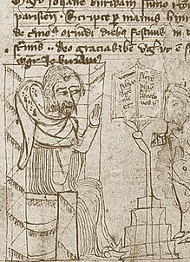
Changes in Science: John Buridan
John Buridan (1320-1382)
  Medieval view of falling objects
  Following Aristotle, most medieval scientists saw the earth as the natural resting place of earthly objects.
  It is in the essence of natural objects to desire their natural resting place.
  An example of their use of final causes.
  Bodies accelerate as they fall
  Explained in terms of an increase in an object’s natural desire as it gets closer to its goal.
John Buridan
  Student of Ockham.
  Reasoned that if velocity was a function of proximity, then a stone dropped from a tower should have the same velocity at a certain distance from the earth as one dropped from a much lesser height.
  Empirical testing showed that velocity increase with the height of the fall.
  He developed a new physics of acceleration that did not involve final causes.
Notes:
II. John Buridan (1320-1382)
A. Medieval view of falling objects
1. Following Aristotle, most medieval scientists regarded the earth as the natural resting place of earthly objects.
2. It is in the essence of natural objects to desire their natural resting place.
3. This is an example of their use of final causes.
4. Bodies accelerate as they fall and this was explained in terms of an increase in an object’s natural desire as it gets closer to its goal.
B. John Buridan
1. Student of Ockham.
2. Reasoned that if velocity was a function of proximity, then a stone dropped from a tower should have the same velocity at a certain distance from the earth as one dropped from a much lesser height.
3. Empirical testing showed that velocity increase with the height of the fall.
4. He developed a new physics of acceleration that did not involve final causes.

Slide 215
Mysticism
Ockham
  Ockham’s nominalism and empiricism helped support a growing mystic movement.
  If logic cannot provide knowledge of God and knowledge only comes from direct experience, then one should strive to experience rather than understand God.
Mysticism
  God can only be known via a special sort of religious experience.
  Language and reason are too limited and abstract to comprehend an infinite and transcendent God.
  The mystic seeks to rise above the normal modes of thought and encounter God in a powerful religious experience.
  The experience involves an immediate feeling of oneness with God.
  A version of intuitive knowledge.
  Mysticism was present throughout the middle ages, and surged at the end of the 13th.
  By downplaying the importance of reason, it helped undermine Scholastic rationalism.
Notes:
A. Ockham
1. Ockham’s nominalism and empiricism helped support a growing mystic movement.
2. If logic cannot provide knowledge of God and knowledge only comes from direct experience, then one should strive to experience rather than understand God.
B. Mysticism
1. God can only be known via a special sort of religious experience.
2. Language and reason are too limited and abstract to comprehend an infinite and transcendent God.
3. The mystic seeks to rise above the normal modes of thought and encounter God in a powerful religious experience.
4. The experience involves an immediate feeling of oneness with God.
5. This is a version of intuitive knowledge.
6. Mysticism was present throughout the middle ages, but surged at the end of the 13th century.
7. By downplaying the importance of reason it helped undermine Scholastic rationalism.

Slide 216
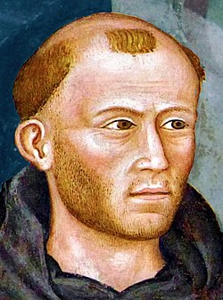
Mysticism: Meister Eckhart
Meister Eckhart (1260-1327)
Background
  A German Dominican.
  His writings were condemned in 1329.
  Operated within the Thomistic framework.
  His metaphysical investigations aimed at charting the soul’s journey towards oneness with God.
God
  Influenced by Neo-Platonism, he saw God as the One-a transcendent unity.
  Definitions and concepts are used to limit and grasp what one tries to understand, so they cannot adequately serve to apprehend God.
  Often put forth a thesis and then defended its antithesis.
    This makes it seem like he was contradicting himself.
    He might have been trying to show that the divine nature cannot fit into limited, human categories.
Notes:
II. Meister Eckhart (1260-1327)
A. Background
1. A German Dominican.
2. His writings were condemned in 1329.
3. He operated within the Thomistic framework.
4. His metaphysical investigations aimed at charting the soul’s journey towards oneness with God.
B. God
1. Influenced by Neo-Platonism, he saw God as the One-a transcendent unity.
2. Definitions and concepts are used to limit and grasp what one tries to understand, so they cannot adequately serve to apprehend God.
3. He often put forth a thesis and then defended its antithesis.
a. This makes it seem like he was contradicting himself.
b. He might have been trying to show that the divine nature cannot fit into limited, human categories.

Slide 217
Mysticism: Meister Eckhart
Examples:
  God is above existence since He is the source of existence.
    God is existence itself.
    God is not like a craftsman whose work exists outside himself.
    God is distinct from an above his Creation.
  Theological categories are necessarily inadequate for the task of describing God.
Notes:
4. Examples:
a. God is above existence since He is the source of existence.
b. God is existence itself.
c. God is not like a craftsman whose work exists outside himself.
d. God is distinct from an above his Creation.
5. His ultimate view seems to be that theological categories are necessarily inadequate for the task of describing God.

Slide 218
Mysticism: Meister Eckhart
The Soul
  His goal was to lead the soul to a union with God.
  Below the intellect, in the innermost recess of the soul is the human essence
    A spark that is the divine image.
  The divine spark is the part that can join with God in a mystical union.
  “God and I, we are one” and just as fire changes wood to fire, “so are we changed into God.”
  Achieving this unity requires emptying the soul until one knows, desires, and has nothing.
    The soul must be empty before it can be filled with God.
Heretic?
  Church authorities though he was engaged in heresy.
  This likely stemmed from taking his claims out of context.
Notes:
C. The Soul
1. His goal was to lead the soul to a union with God.
2. Below the intellect, in the innermost recess of the soul is the human essence-a spark that is the divine image.
3. The divine spark is the part that can join with God in a mystical union.
4. “God and I, we are one” and just as fire changes wood to fire, “so are we changed into God.”
5. Achieving this unity requires emptying the soul until one knows, desires, and has nothing.
a. The soul must be empty before it can be filled with God.
D. Heretic?
1. Church authorities though he was engaged in heresy.
2. This likely stemmed from taking his claims out of context.

Slide 219
Mysticism: Meister Eckhart
Impact
  He had many followers who focused mainly on the religiously practical and experimental aspects of his thought.
  His views had an influenced that lasted for centuries.
  Martin Luther published one of his works under the title A German Theology.
Notes:
E. Impact
1. He had many followers who focused mainly on the religiously practical and experimental aspects of his thought.
2. His views had an influenced that lasted for centuries.
3. Martin Luther published one of his works under the title A German Theology.

Slide 220
The End of Medieval Philosophy
Architectural Metaphor
  The French Beauvais Cathedral was begun in 1247.
  It collapsed in 1284 due to the failure of its supporting arches.
  Architects became more conservative and their work more modest as they recognized their limits.
  Nominalism, voluntarism, the distinction of faith and reason, Ockham’s empiricism and mysticism all added to the collapse of the cathedral of reason built by thinkers like Aquinas.
Reformation
  From Ockham’s view that theology should be based on revelation not philosophy the next step was to reduce revelation to scripture.
    John Wyclif and other Protestant reformers took that step.
    Martin Luther was directly influenced by Ockham.
Notes:
A. Architectural Metaphor
1. The French Beauvais Cathedral was begun in 1247 and had a 157 foot high ceiling.
2. It collapsed from its soaring height in 1284 do to the failure of its supporting arches.
3. Architects became more conservative and their work more modest as they recognized their limits.
4. Nominalism, voluntarism, the distinction of faith and reason, Ockham’s empiricism and mysticism all added to the collapse of the metaphorical cathedral of reason built by such thinkers as Aquinas.
B. Reformation
1. From Ockham’s view that theology should be based on revelation not philosophy the next step was to reduce revelation to scripture.
a. John Wyclif and other Protestant reformers took that step.
b. Martin Luther was directly influenced by Ockham.

Slide 221

The End of Medieval Philosophy
Philosophy
  Ockham was credited with replacing the old ways of thinking with the new way (via moderna).
  Scholasticism continued to have influence.
  The Thomistic tradition continues.
  The 17th century philosophers depended on the terms and concepts developed by the scholastics.
Notes:
C. Philosophy
1. Ockham was credited with replacing the old ways of thinking with the new way (via moderna).
2. Scholasticism continued to have influence.
3. The Thomistic tradition continues.
4. the 17th century philosophers depended on the terms and concepts developed by the scholastics.

