Slide 1

Course Paper
Ancient & Medieval Philosophy

Slide 2
Paper Options: Pick One
The Meno: A summary and argument style paper.
1
Aristotle’s Moral Education: A summary and argument style paper.
2
Case Paper: An argument and objection-reply paper. You can create your own case
3

Slide 3
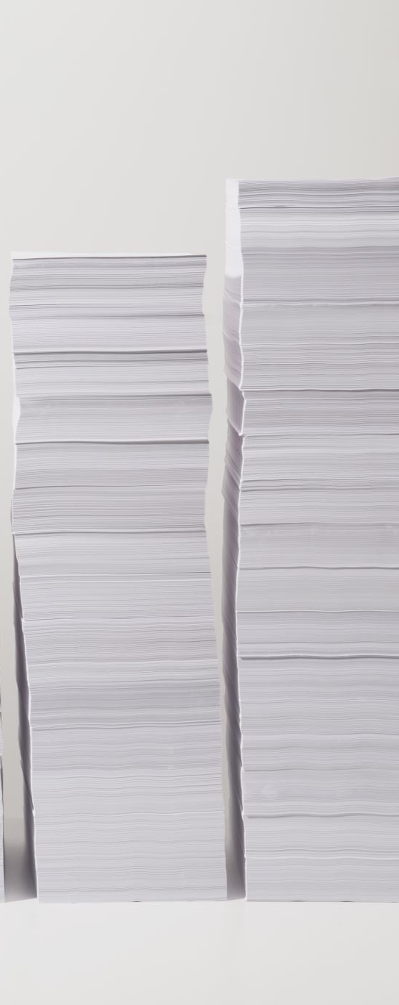
The Draft
Draft Due:
Submit via Canvas assignment
Can submit early or multiple drafts
Drafts are scored and commented on, but not graded
Does not count toward final grade
Draft Available Until:
Final opportunity to submit a draft
Same rules as above (Canvas only, multiple drafts allowed)

Slide 4
Paper Deadlines
“On Time” / +5 Bonus Deadline:
Submit via Canvas as a readable Word or PDF file
No printed or emailed copies accepted
Earn +5 bonus points if submitted by this date
No extensions allowed
“Emergency” Deadline:
Full credit deadline for unexpected issues
No documentation or permission required
Extensions possible via formal request
Canvas submission only (Word or PDF format)

Slide 5
Paper Deadlines
50% Deadline
Final chance to submit the paper for partial credit (50%)
Submissions after this date receive a 0
Must be submitted via Canvas assignment
File must be readable Word or PDF
The Paper Only Needs to Be Turned in Once!

